Slide 1
Aggression & Invasion
Appeasement and the Rise of Hitler

Slide 2
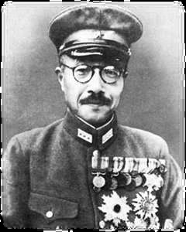
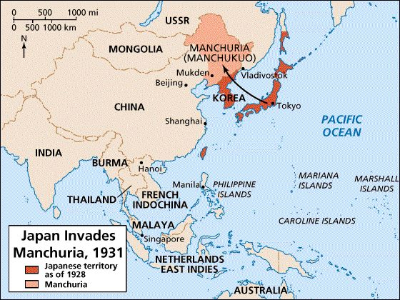
1931 Japan invaded Manchuria, China 1937 Nanking Massacre
WHY:
Scarce Natural Resources - (oil, rubber, lumber, land for growing population / cultivate food)
LEAGUE OF NATIONS: Verbal Warning Economic sanctions ineffective
Nations did not want to give up trade as economies were depressed & trade was too valuable
Timeline of WWII:
http://www.learnnc.org/lp/table.php?id=5975
Army Minister Hideki Tojo appointed by Emperor Hirohito

Slide 3
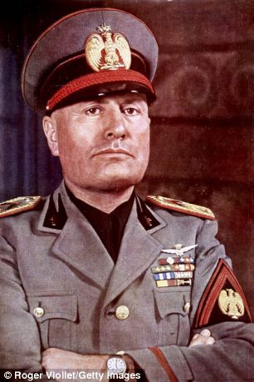
1935 Italy invaded Ethiopia
WHY:
Land for unemployed Italians, Minerals, Revenge against Ethiopia for Italy’s defeat in war in 1896, Empire
Benito Mussolini – Fascist Leader of Italy
Fascism: http://www.crf-usa.org/bill-of-rights-in-action/bria-25-4-mussolini-and-the-rise-of-fascism.html
Absolute power of a Dictator
Extreme Nationalism
Militarism and Imperialism: Use Violence to gain influence and power
Superiority of Nation’s People

Slide 4
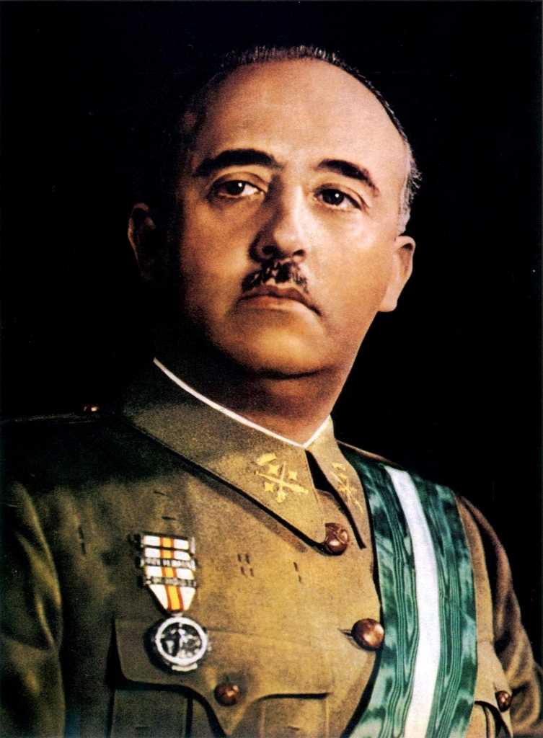
1936-1939 Spanish Civil War
Rise of Franco and Fascism:
Francisco Franco overthrew the democratically elected government of Spain
Hitler provided aid (weapons) to Franco’s war
US did not assist the Democratic government of Spain due to US Isolationist Policy and its Neutrality Acts (ban the sale of arms to countries at war)

Slide 5
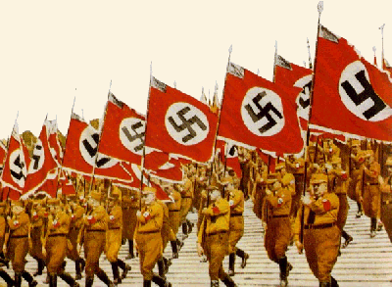
Rise of Nazi Germany & Policy of Appeasement

Slide 6
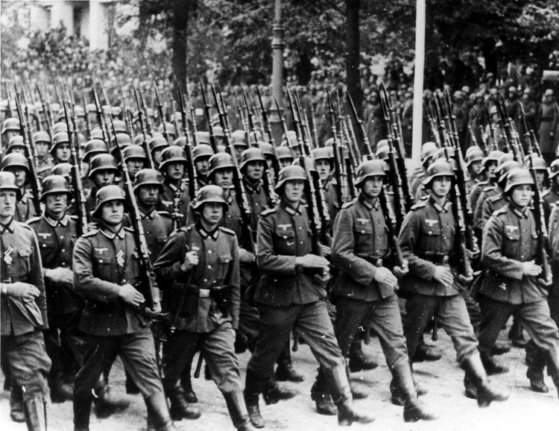
German Rearmament – 1935
By 1938, Germany had rebuilt its military under Hitler in violation of the Treaty of Versailles which limited them to 100,000 men and no air force.
Hitler was looking to expand Germany’s borders, claiming that he was attempting to unite ethnic Germans in Europe.
Recent memories of the First World War left European countries reluctant to prepare for war.
Video (4:07) https://www.youtube.com/watch?v=sGZueuWeUdc
Review of German Troops, 1939
Notes:
Image credit: Warschau, Parade vor Adolf Hitler [Photograph]. (1939). Retrieved September 25, 2012 from: http://en.wikipedia.org/wiki/File:Bundesarchiv_Bild_146-1989-034-21,_Warschau,_Parade_vor_Adolf_Hitler.jpg

Slide 7
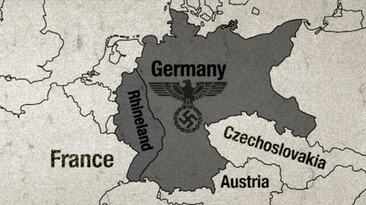
German Aggression: 1936 - 1938
1936: Hitler Re-militarized Rhineland and begins to rebuild the industry there.
Violation of the Versailles Treaty.
The Rhineland was a demilitarized zone – meant to buffer France from Germany. It is also a heavily industrialized area…good for military hardware production.

Slide 8
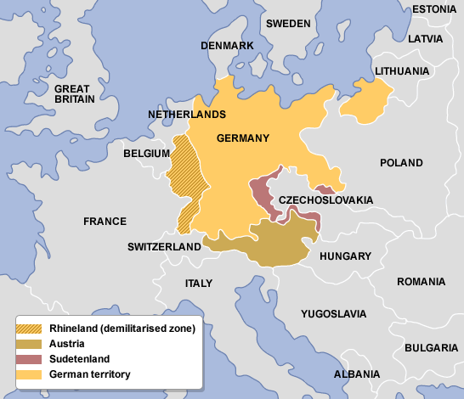
German Aggression: 1936 - 1938
1938 Germany invades
Austria
1938 Demanded that Czechoslovakia give
Germany the Sudetenland,
a region with a heavy ethnic-German population
http://www.bbc.co.uk/bitesize/higher/history/roadwar/rhine/revision/1/
Notes:
Image from: http://users.humboldt.edu/ogayle/hist111/unit2WWII.html

Slide 9
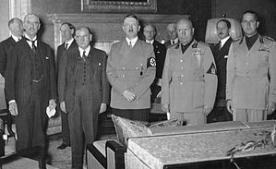
The Munich Agreement - 1938
The British government took the role of negotiating with Germany.
British Prime Minister Neville Chamberlain met with Hitler in Munich to find a compromise over the Sudetenland.
The “Munich Agreement” stated that Germany would receive the Sudetenland, along with a promise not to take further land from Czechoslovakia and stop aggressive behavior.
Munich became synonymous with
“appeasement.”
Signing of the Munich Agreement
Notes:
Image from: http://users.humboldt.edu/ogayle/hist111/unit2WWII.html

Slide 10
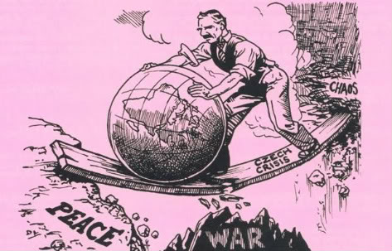
Policy of Appeasement
France and Britain's policy toward Germany of giving concessions in hopes of avoiding war

Slide 11
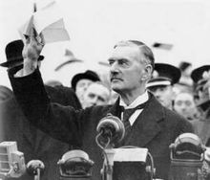
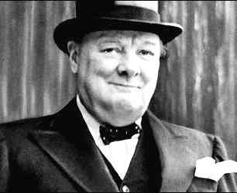
Reactions to the Munich Conference
Neville Chamberlain, the British Prime Minister who came up with the agreement, said that he had achieved “peace in our time”
Winston Churchill, the future Prime Minister, said: “Britain and France had to choose between war and shame. They chose shame. They will get war, too.”
“An appeaser is one who feeds a crocodile, hoping it will eat him last.”

Slide 12
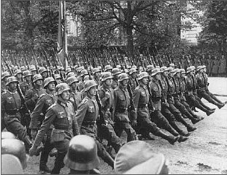
Further German Aggression
March 13-14, 1939, Germany violated the Munich Agreement by occupying Czechoslovakia.
September 1, 1939, Germany invaded Poland, which initiated World War II in Europe.
September 3, 1939
Great Britain and France Declared War on Germany.
German Troops Entering Poland, 1939
Notes:
Image from: http://users.humboldt.edu/ogayle/hist111/unit2WWII.html

Slide 13
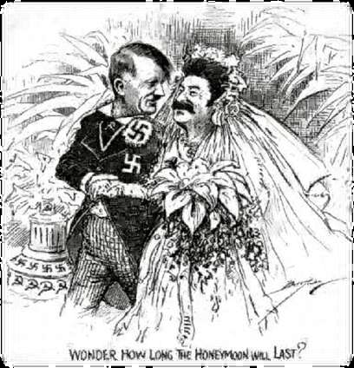
Nazi - Soviet Pact 1939 Nonaggression Pact
Agreement under which Germany and USSR pledged to not attack on another
Germany’s eastern border was now secure from Soviet attack
Stalin signs and agreement with his sworn enemy Hitler
WHY: Stalin knew disagreed with the Munich agreement; he knew Hitler would continue his invasions
Choices: http://www.johndclare.net/RoadtoWWII8.htm
1- Agree to Munich Agreement and fight a war over Poland; doesn’t trust Britain
2- Prepare for coming war with Germany and get half of Poland
NonAggression Pact broken in 1940 with Operation Barbarossa (German invasion of Soviet Union)

Slide 14
Holocaust
Nuremburg Laws – 1935, excluded Jews from citizenship and banned intermarriage
Kristallnacht - 1938 organized violence or pogroms against Jews
Genocide - Mass extermination of about 6 million Jews and others in Nazi death camps
The "final solution" was Adolf Hitler's plan to mass-exterminate "undesirable" peoples
United States Holocaust Memorial Museum
https://www.ushmm.org/wlc/en/article.php?ModuleId=10005143

Slide 15
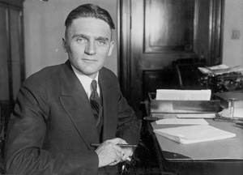
United States Isolationism
Nye Committee: Senator Gerald Nye's Report 1934 - 1935
Senate hearings headed by Nye (ND) reveal that lucrative profit and support for WWI came from international bankers and arms exporters. Felt that the US had been duped into entering WWI. “Merchants of War” mad profited
Businessmen like Henry Ford didn’t want to give up the market of Nazi Germany (slave labor used in Ford Plants located in Germany)
Trade with Japan continue – trucks, aircraft, oil (80% from US until 1941)
Senator Gerald P. Nye [R-ND]

Slide 16
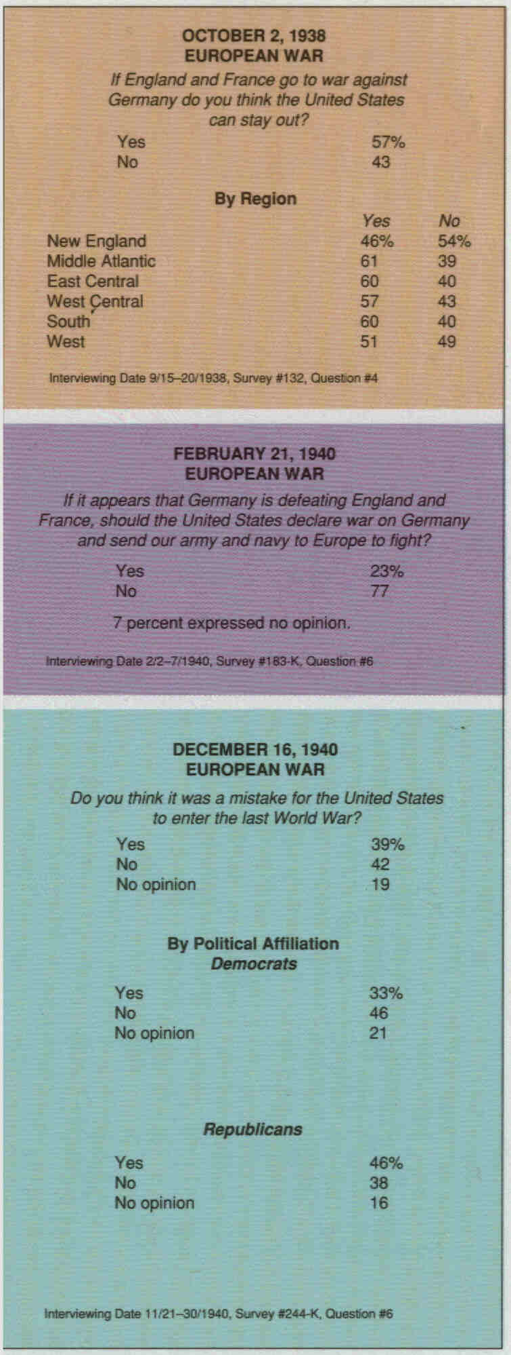
United States Isolationism
Gallup Poll – 1937, 2/3 of Americans felt that US involvement in WWI had been a mistake and most Americans supported Neutrality
Ethnic Diversity - German and Italian Americans supported nationalism and expansion of mother countries, while Irish remained anti-British
Neutrality Acts – (1935 - 1937)
Congress wanted to avoid foreign entanglements: Ban travel on belligerent ships & arms sales to nations at war
Non-Military goods must be purchased on a “cash-and-carry” basis (pay when you pick up goods)
Ban involvement in Spanish American War
1939 – amendments allow sale of arms to belligerents
"Cash and Carry" Plan 1940
Allowed Great Britain to purchase U.S. arms on a restricted basis

Slide 17
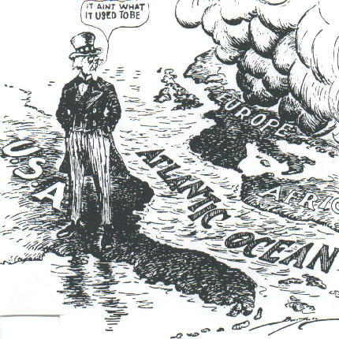

Slide 18
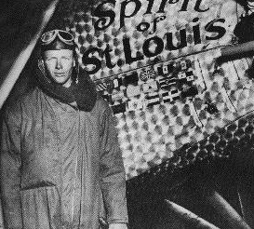
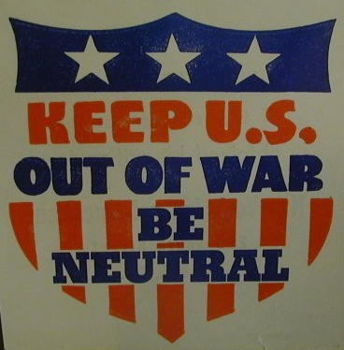
America First Committee
Charles Lindbergh

Slide 19
The Arsenal of Democracy
Destroyer-Base Deal (1940) traded 50 “old” destroyers for 8 military bases with Great Britain
Selective Service Act (1940)– 1st peacetime draft, required men ages 21-35 to registers; men ages 18 – 45 were subject to the draft when WWII started
Lend-Lease Act (1941) allowed Britain (and later USSR) to “borrow” $50 billion worth of supplies
Continued German expansion and aggression. The fall of France and the Battle of Britain convinced FDR and Congress that they must provide Britain aid before she falls. America would become a "great arsenal of democracy" by providing military aid to Britain, China, and the Soviets with a promise that they would return it all after the war.

Slide 20
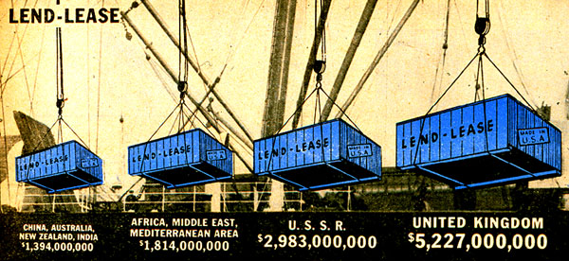
Lend-Lease Act 1941
Great Britain.........................$31 billion Soviet Union...........................$11 billion France......................................$ 3 billion China.......................................$1.5 billion Other European.................$500 million South America...................$400 million The amount totaled: $48,601,365,000

Slide 21
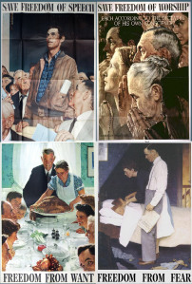
The Four Freedoms:
What are we fighting for?
Freedom of Speech
Freedom of Worship
Freedom From Want
Freedom From Fear
Norman Rockwell
http://www.americainwwii.com/articles/norman-rockwell-and-the-four-freedoms/

Slide 22
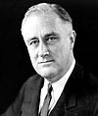
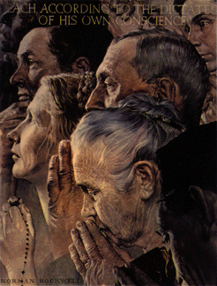
The Four Freedoms: State of the Union Address (January 6, 1941)
 | State of the Union (Four Freedoms) (January 6, 1941) MENU 0:00 Franklin Delano Roosevelt's January 6, 1941 State of the Union addressintroducing the theme of the Four Freedoms (starting at 32:02)
Problems playing this file? See media help.
FDR won his 3rd term in 1940 and worked to win over America’s aid to Britain and expand production of war industries at home
Norman Rockwell’s paintings 1st appeared in the Saturday Evening Post, then toured the country to persuade Americans to buy war bonds
Four Freedoms came to embody the essence of American’s war goals
Norman Rockwell,
“Freedom of Worship”

Slide 23
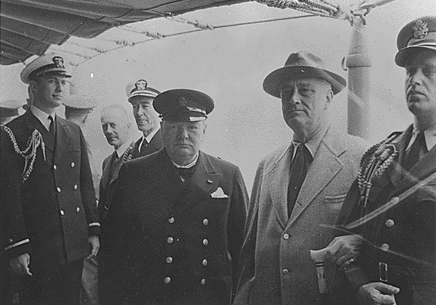
Atlantic Charter: Declaring War Aims
Freedoms from Want & Fear
Atlantic Charter:
FDR & Churchill:
Collective security
Disarmament
Self-determination
Economic cooperation
Freedom of the seas
Churchill & Roosevelt, Aug. 1941

Slide 24
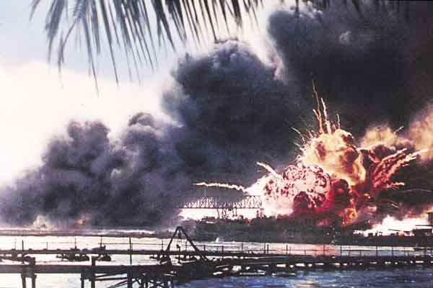
Pearl Harbor - Dec. 7, 1941 A date which will live in infamy! - FDR

Slide 25
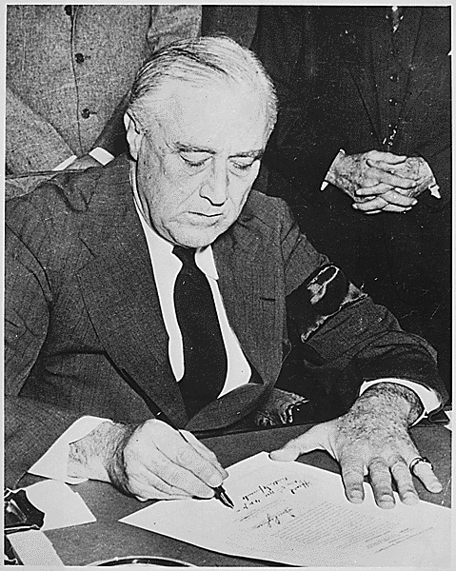
United States declares War

Slide 26
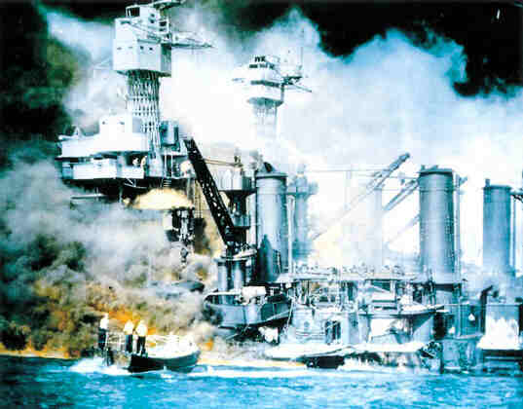
Pearl Harbor - Dec. 7, 1941

Slide 27
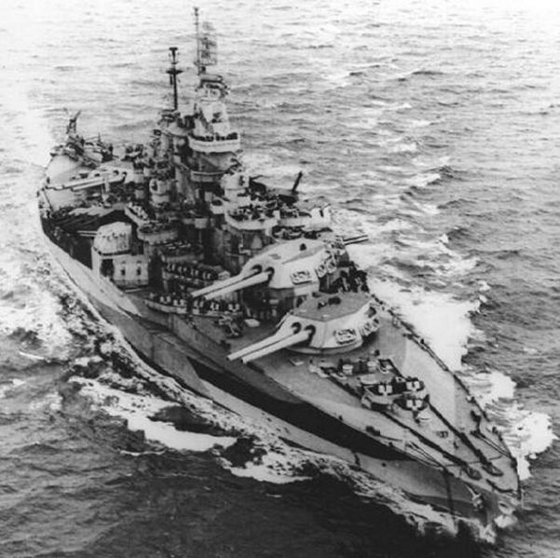
USS West Virginia
USS West Virginia

