Slide 1
World War II
Homefront – African Americans

Slide 2
NOTES GUIDE QUESTION
Double V
Origin -
Goals of the Campaign –
Racism at Home
Examples –
Racism Abroad
Example -
Military Service
Discrimination
Service
GI Bill
Benefits
Limits
March on Washington / Executive Order 8802
Who/What -
Bargain -
What was the Double V Campaign and what are some examples of this movement?

Slide 3
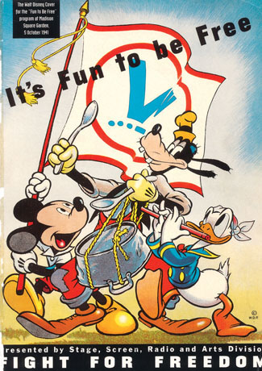
Walt Disney’s program cover
for the October 1941
Give Me Liberty!: An American history, 3rd Edition
Copyright © 2011 W.W. Norton & Company

Slide 4
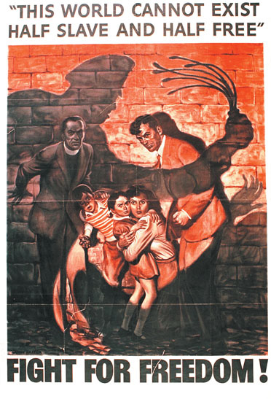
In this patriotic war poster issued
by the Office of War Information
Give Me Liberty!: An American history, 3rd Edition
Copyright © 2011 W.W. Norton & Company

Slide 5
“Democracy: Victory at Home, Victory Abroad”
Fighting Racism at Home
Fighting Fascism and Nazism abroad
Pittsburgh Courier (black newspaper, largest circulation)
Public relations campaign that urged African Americans to promote civil rights and support the war effort
Deserve full citizenship rights / Risking lives abroad
Double V Campaign: Interlocking Vs with the theme “Democracy: Victory at Home, Victory Abroad”

Slide 6
Letter to Pittsburgh Courier – Jan. 31, 1942
Published a letter to the editor from James G. Thompson of Wichita, Kan.
It was titled “Should I Sacrifice to Live ‘Half American?‘ ” In it, Thompson wrote: “Being an American of dark complexion and some 26 years, these questions flash through my mind: ‘Should I sacrifice my life to live half American?’ ‘Will things be better for the next generation in the peace to follow?’ ‘Would it be demanding too much to demand full citizenship rights in exchange for the sacrificing of my life?’ ‘Is the kind of America I know worth defending?’ ‘Will America be a true and pure democracy after this war?’ ‘Will colored Americans suffer still the indignities that have been heaped upon them in the past?’ These and other questions need answering.”

Slide 7
Letter to Pittsburgh Courier – Jan. 31, 1942
Then he proposed what he called “the double V V for a double victory … The V for victory sign is being displayed prominently in all so-called democratic countries which are fighting for victory over aggression, slavery, and tyranny. If this V sign means that to those now engaged in this great conflict, then let we colored Americans adopt the double V V for a double victory. The first V for victory over our enemies from without, the second V for victory for our enemies from within. For surely those who perpetuate these ugly prejudices here are seeking to destroy our democratic form of government just as surely as the Axis forces.”

Slide 8
Double V Campaign – Pittsburgh Courier
American flag with every subscription
Encouraged its readers to buy war bonds
Double V clubs spread around the country
Published a weekly photo of a new “Double V Girl” frequently lifting two fingers in a “v” sign
Celebrity and political endorsements
A Double V hairstyle called “the Doubler” also became popular, historian Patrick Washburn recalls, as did Double V gardens and Double V baseball games
Other black newspapers joined the Courier’s campaign

Slide 9
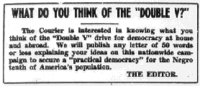
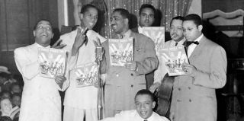
The Inkspots promote the Double V Campaign

Slide 10
RACISM at HOME
Nazis used American prejudices as proof of its own racial policies
“Last Hired, First Fired” was the reality before the war
Hired for low wages / low skill jobs during the war
Washington DC remained segregated
Lynching continued
Race Riots
(1943) 274 race related incidents in about 50 cities
Detroit – federal troops intervene in a 2 day race riot Dead: 25 black, 9 white, Injured: 700+
Time Magazine slide show: http://time.com/3880177/detroit-race-riots-1943-photos-from-a-city-in-turmoil-during-wwii/

Slide 11
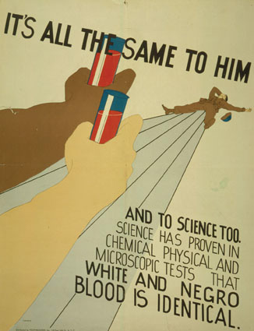
World War II Poster
Red Cross –
wouldn’t initially take blood donated by black people
would not mix blood of whites and blacks
black scientist Charles Drew's insisted that it was an unfounded/unscientific policy
Jan. 3, 1942, the Pittsburgh Courier denounced the American Red Cross’ refusal to accept black blood in donor drives, under the title “The Red Blood Myth.”
Give Me Liberty!: An American history, 3rd Edition
Copyright © 2011 W.W. Norton & Company

Slide 12
Military Service
Segregation: Military segregated during the war
Segregated units until 1948
Service:
1.2 million African Americans served by 1945
Navy - waiters, cooks
Excluded from combat units initially
Transportation:
Train in South (northern blacks experienced Jim Crow south)
Forced to give up seats on train to Nazi POW's

Slide 13
Military Service
Joe Louis (African American – World Heavyweight Boxing Champion)
“Lots of things are wrong with America, but Hitler ain’t going to fix them.”
Henry L. Stimson (Secretary of War)
“leadership is not embedded in the negro race”
(Black officer prohibited black officers from commanding white soldiers/sailors)

Slide 14
Tuskegee Airmen
Background: http://www.nationalww2museum.org/learn/education/for-students/ww2-history/at-a-glance/tuskegee-airmen.html
600 pilots trained in Tuskegee, Alabama
1st time African Americans served as pilots in the military due to racist views
Flew over 15,000 missions
Excellence of Service helped to integrate the military and dispel stereotypes
Video (2:37) https://www.youtube.com/watch?v=qMPLpExgkGg
Video (7:17) https://www.youtube.com/watch?v=7Su0JjIYTZY

Slide 15
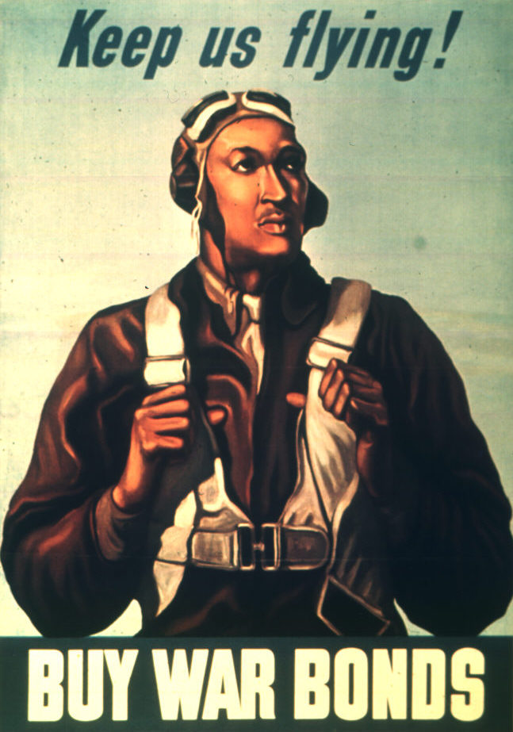

Slide 16
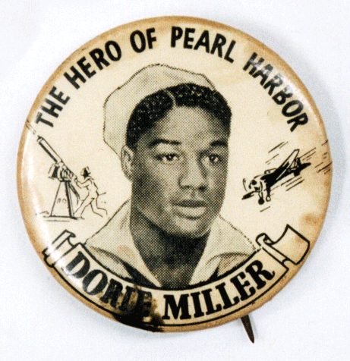
Dorie Miller
Dorie Miller - a messman on the USS West Virginia when it was bombed by the Japanese in Pearl Harbor.
Bravery –
Dorie ran up on deck, found his wounded commander and carried him to safety.
He returned to the deck, picked up an antiaircraft weapon he had never been trained to use and managed to shoot down four enemy aircraft.
Credit for Bravery almost missed
When the Courier tracked down the identity of the “Negro messman,” as he was called in all the newspaper articles, and printed his name, Dorie was finally awarded his well deserved Navy Cross for heroism. But if the Courier hadn’t printed his name, Dorie’s brave actions and quick thinking would have gone into obscurity, but now his heroic legacy lives o.

Slide 17
GI Bill
Servicemen’s Readjustment Act (1944):
aka: GI Bill of Rights (GI = Government Issue, slang for “serviceman”)
Benefits for Veterans:
Healthcare for veterans
Education (college tuition assistance)
Job Training
Preference given to veterans in government jobs
Home Loans (low interest)
Limits to African American Veterans:
education benefits only good at segregated colleges
job training only for unskilled/low wage jobs

Slide 18
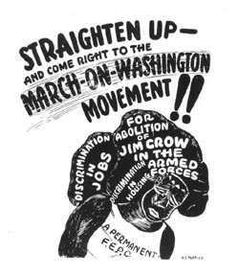
March on Washington & A Philip Randolph: 1941
A. Philip Randolph head of the Brotherhood of Sleeping Car Porters planned a march on Washington D.C.
March on Washington - 1941
Demand end of racial discrimination in defense industries
Bargain: Threat that thousands would descent on Washington led to Executive Order 8802 and the march was called off
urge 10,000 blacks to “march on Washington for jobs in national defense and equal integration in the fighting forces.”

Slide 19
March on Washington & Executive Order 8802
Executive Order 8802 – June 25, 1941
forbade discrimination in defense industry
Creating the Fair Employment Practices Committee to enforce a new rule — that “there shall be no discrimination in the employment of workers in defense industries or government because of race, creed, color, or national origin.”
FEPC - Fair Employment Practices Commission: its investigations exposed the deep racial divide (want ads specified "colored" for porters and janitors, "white" for skilled jobs)

Slide 20
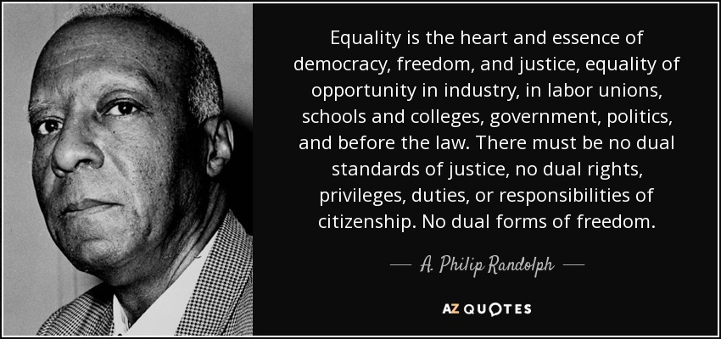
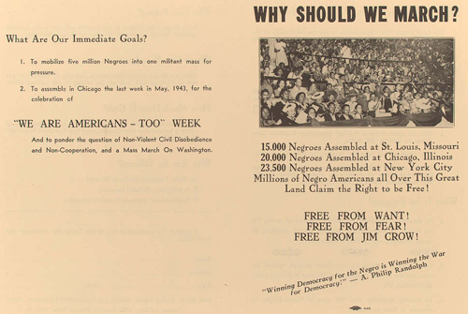

Slide 21
March on Washington & A Philip Randolph: 1941
Philip Randolph http://www.biography.com/people/a-philip-randolph-9451623
Video: https://www.youtube.com/watch?v=zrTd_bXsZVM
PBS, March on Washington http://www.pbs.org/wnet/jimcrow/stories_events_march.html
Background: http://www.blackpast.org/aah/march-washington-movement-1941-1947

Slide 22
Black Organizations that Advocated for Equality
NAACP -( National Association for the Advancement for Colored People, 1909) membership skyrocketed (50,000 to 500,000)
CORE - (Congress of Racial Equality) founded 1942, interracial, sit-ins in urban north

Slide 23
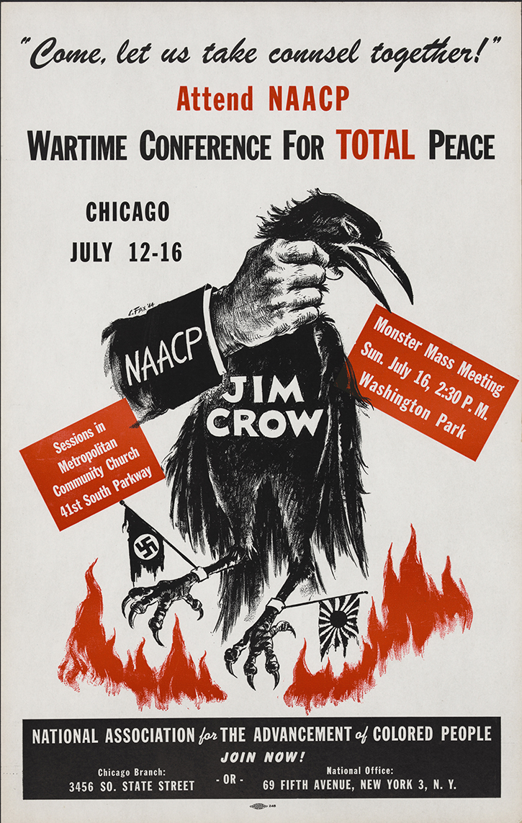
NAACP Poster

Slide 24
Double V Campaign
Background
campaign for Victory at Home and Abroad (win the war for freedom)
Four Freedoms : Freedom of Speech, Religion Freedom from fear - end lynching
Freedom from want - end job discrimination
Cool Story
Bessie Coleman - 1st female pilot (3:06)

Slide 25
World War II
Homefront – Mexican Americans

Slide 26
Bracero Program: 1942-1964
A work program between the US and Mexico.
Mexican laborers work in the US in domestic and agricultural jobs
Helped fulfill the wartime labor shortage.
4.5 million Mexicans worked in this program over time
Braceros could be deported at will; work conditions were unsafe and there were no unions for them.
2nd generation Mexicans found work in the defense industries & served in the army (along w/ whites).
A half million Latinos served in the armed forces.
Bracero’s in Oregon: http://www.opb.org/programs/oregonexperiencearchive/braceros/about.php
Photos: http://amhistory.si.edu/onthemove/themes/story_51_5.html

Slide 27
Zoot Suit Riots 1943
Zoot Suits were suits that were oversized and had a style characteristic of their long coats, large shoulders and excess of material.
Originated from Jazz and African American culture
Chicanos, Filipino and Italian American men were sometimes known to sport this style.
Conflict between US Sailors and Mexicans on the West Coast led to large street fights.
Discrimination led to violence from sailors and policemen against Mexican youth.
FEPC (Fair Employment Practices Commission) received many complaints of Mexican workers being restricted to the lowest paid jobs.

Slide 28
"Zoot-suiters" were criticized both by their parents, who saw their clothing styles and use of English as signs that they were rejecting the parents' culture, and by some non-Mexican Americans, who regarded them as alien and dangerous.
Zoot Suit Riots in Los Angeles https://www.mtholyoke.edu/~campo22k/classweb/Zoot%20Suits/Zoot%20Suit%20Riots%20in%201943.html
Zoot Suit Riots (Experiences) http://www.pbs.org/wgbh/amex/zoot/

