Slide 1
The Texas Revolution
Who and why did the Spanish government permit to live in Texas?
In 1821, Mexico won independence from Spain and required settlers to follow what rules?
Who led American settlement in the 1820 – 30’s into Texas?
What led to the conflict in Texas?
What happened at the Alamo and the Battle of San Jacinto?
When Texas gained independence in 1836, why didn’t the Lone Star Republic get annexed by the United States?

Slide 2
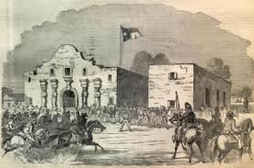
TEXAS REVOLT 1835 - 1836
Texas Revolution
Map & Video
https://www.thinglink.com/scene/477480368174268416

Slide 4
Spanish Texas
The Spanish had been in the Americas since Columbus in 1492.
Spain owned a large part of North America, including Texas.

Slide 5
Tejanos
Mexico Independence 1821.
The Spanish government failed to attract Spanish setters to Texas
In 1821, only about 4,000 Tejanos lived in Texas.
Tejanos are people of Spanish heritage who consider Texas their home.

Slide 6
Moses Austin
An American, Moses Austin was given permission by the Mexican government to start a colony in Texas.
Americans had to do was follow Mexican laws.
Moses died in 1821, so his son Stephen tried to start the colony.

Slide 7
In 1821, Mexico won independence from Spain

Slide 8
Mexican Independence Changes Texas
The Mexican government told Stephen Austin his settlers would have to: 1. become Mexican citizens
2. join Roman Catholic Church 3. Learn Spanish.
Between 1821 and 1827, Austin attracted 297 families to his new settlement.

Slide 9
American Settlement in Texas
1820’s – 1830’s
America settlement led Stephen Austin to demand more autonomy from Mexican officials.
Americans dominate Texas:
1830, American population swelled to 16,000
Americans formed a 4 :1 majority in the northern region.
The success of Austin’s colony attracted more land speculators & settlers to Texas from the US.
Purpose: Some were looking for a new life, some were escaping from the law, and others were looking for a chance to grow rich.
Notes:
Stephen Austin lobbied the Mexican Government in 1827 successfully against the banning of slavery in Texas, even though it had been illegal in Mexico since 1824.
1830, Mexican officials banned further immigration by Americans into Texas, but he found a loophole that allowed him to continue to expand his colony. 35,000 Americans by 1836
http://www.pbs.org/weta/thewest/people/a_c/austin.htm

Slide 10
Rising Tensions in Texas
1829 - Mexican government outlawed slavery
1830 – Mexican government bans immigration
1833 – MX government rejects TX Constitution
Mexican authorities concerned that American settlers didn’t assimilate or follow Mexican laws.
Settlers kept slaves to grow cotton
Did not learn Spanish
Few converted to Catholicism
Built separate schools
Immigrants continued into Texas
Mexican President, General Antonio Lopez de Santa Anna sent Mexican troops to Texas.

Slide 11
TEXAS REVOLT - WAR 1835-1836
http://www.digitalhistory.uh.edu/disp_textbook.cfm?smtID=2&psid=3260
Oct. 1835 – Texas Revolution – http://www.softschools.com/timelines/texas_revolution_timeline/64/
Mexican soldiers are fired upon in Gonzales, TX
Battle of Goliad – Texans win
Battle of Concepcion (San Antonio)– Texans win
Seige of Bexar / Capture of San Antonio – Texans win and dominate Texas
March 1836 – Republic of Texas Texans (American settlers) declare independence and write a Constitution
Battle of the Alamo – Texans lose
Goliad Massacre – 400 Texans surrender, General Santa Anna executes over 300 prisoners
Battle fo San Jacinto – Texans win Independence

Slide 12
The Alamo
Alamo Mission, near San Antonio
The Mexican Army, under General Santa Anna attacked and slaughtered rebels at the Alamo
13 day attack on the Alamo mission near San Antonio
189 Texans died

Slide 13
The Fight for the Alamo -1836
VIDEO: (2:38) https://www.youtube.com/watch?v=OjWZFMnA8Qw
183+ Texans guarding the Alamo
Mexican army had 1,800 men
Texans held the Alamo for twelve days.
13th day – (March 6, 1836) Santa Anna ordered his men to storm the fortress.
Most Americans died, 600 Mexicans killed + wounded
Survivors were were executed by Santa Anna.
Texans were shocked by the slaughter at the Alamo and vowed to fight for their freedom
Remember the Alamo
became the battle cry for Texas Independence

Slide 16
Battle at San Jacinto April 21, 1836
Led by Sam Houston, Texan Army defeated Santa Anna’s troops and gained independence for Texas
800 Texas Troops: included Tejanos, American settlers, volunteers from the United States, and many free and enslaved African Americans.
Their battle cry was, “Remember the Alamo!”
It was over in 18 minutes. More than half the Mexican army was killed.
Treaties of Velasco - Santa Anna was forced to sign a treaty giving Texas its freedom – Republic of Texas
Mexican government does not recognize treaty. General Santa Anna not authorized to sign.
General Santa Anna Biography: http://www.pbs.org/weta/thewest/people/s_z/santaanna.htm

Slide 17
General Santa Anna surrenders to General Houston

Slide 18
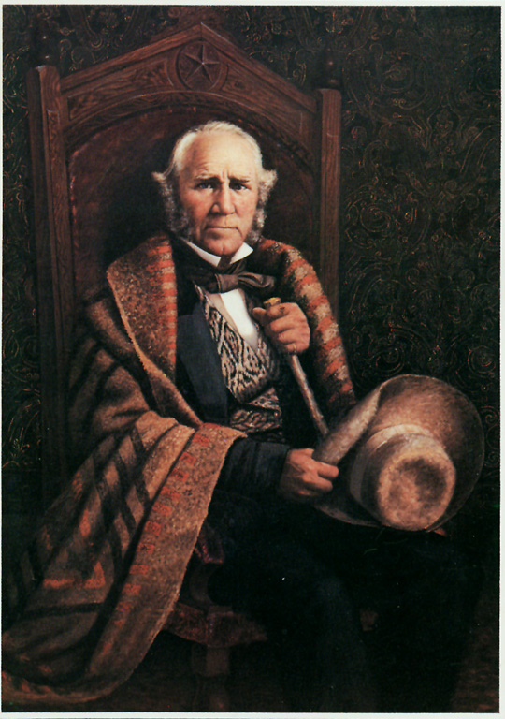
Lone Star Republic of Texas (1836-1845)
In 1836, Texas declared itself The Lone Star Republic.
Sam Houston elected President
Some Americans wanted Texas to be part of the U.S.
Presidents Andrew Jackson and Martin Van Buren rejected adding Texas because they wanted to avoid igniting the slave issue, others wanted to avoid war with Mexico.
(Both would eventually happen)

