Slide 1
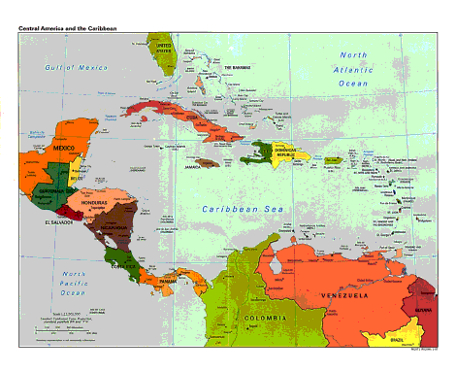
Spanish American War 1898

Slide 2
Spanish American War Questions
What led to war? http://www.ushistory.org/us/44c.asp
Spanish treatment of Cubans Harsh:
Yellow Journalists
Economic interests – markets for American goods
Spanish Ambassador Enrique Dupuy de Lome’s Letter:
Explosion of the USS Maine:
2. What is yellow journalism and its impact on the Spanish-American war?
What is the Teller Amendment?
What territories did the US gain control of following the Spanish-American War?
What is the Platt Amendment?
What did the Supreme Court decide in the “Insular Cases”?
Why did America promote expansionism?

Slide 3
Spanish American War Resources
Overview of War: http://www.ushistory.org/us/44c.asp
VIDEOS
APUSH Lecture on You Tube:
http://www.youtube.com/watch?v=iv10oYoZiMQ
Start of Spanish American War – Explosion of the USS Maine:
https://www.schooltube.com/video/102a16609608689b8bcc/The%20Spanish%20American%20War
Overview of Expansionist US in the Spanish American War:
http://www.youtube.com/watch?v=IU5l4yQCpMM

Slide 4
Crisis over Cuba
Spain v Cuba
1895 Cubans revolted against Spanish rule in Cuba
Spanish authorities brutally attempted to suppress the rebellion
Cuban Leader of revolt was Jose Marti
1896, Spain sent "The Butcher“(General Weyler) to Cuba to prevent the insurrections
Weyler built concentration camps - imprisoned a large portion of the population

Slide 5
Yellow Journalism http://www.pbs.org/crucible/frames/_journalism.html
Yellow Journalism: sensationalist newspapers
Public opinion in the U.S. turned against the Spanish because of yellow-journalism and many Americans supported war:
William Randolph Hearst: New York Journal
Joseph Pulitzer: New York World
Both turned Jose Marti into a martyr
Both featured daily accounts of Spanish atrocities
Americans sympathized with Cuban struggle against Spanish colonizers

Slide 6
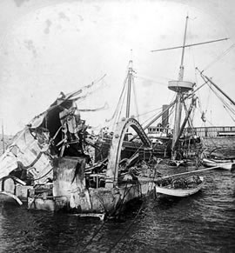
Causes of Spanish American War
American Sympathy towards Cuban Fight for Freedom against Spanish Rule
“Butcher” Weyler forced 300,000 Cuban Rebels into concentration camps
Monroe Doctrine (1823) – chance to get Spain out of Western Hemisphere
Economic Interests – sugar plantations, markets for economic exports
Yellow Journalism – American Press got American’s behind going to war
Spark: Sinking of the USS Maine Feb. 15, 1898

Slide 7
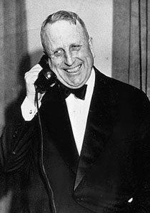
William Randolph Hearst
Newspaper publisher and leading example of yellow journalism
New York Journal started a public hysteria for war with Spain by publishing incendiary articles and illustrations
Hearst once said "You provide the pictures and I'll provide the war."

Slide 8
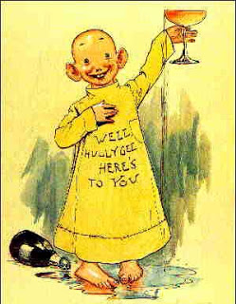
Yellow Journalism http://iml.jou.ufl.edu/projects/spring04/vance/yellowjournalism.html
A type of journalism that distorts and exaggerates the news to create sensations and attract readers
William Randolph Hearst vs Joseph Pulitzer.
New York Journal New York World

Slide 9
Characteristics of Yellow Journalism
Characteristics of Yellow Journalism:
Headlines in huge print, often of minor news
Many pictures, or imaginary drawings
use of faked interviews, misleading headlines, and false information from so-called experts
dramatic sympathy with the "underdog" against the system.
Emotional words and symbols; scare tactics

Slide 10
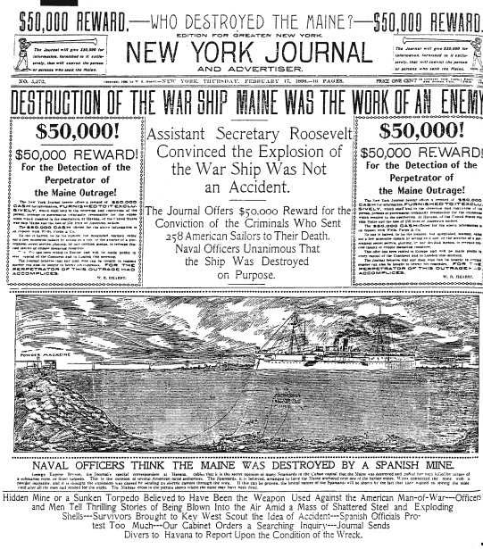
1.What is most noticeable about the example?
2. How is this media making people feel?
3. How would this influence or change peoples mind?

Slide 11
Crisis in Cuba US Entangled in War
Pres. McKinley didn’t want to intervene in Cuba
He sent the US battleship Maine to Havana to protect the lives and property of Americans in Cuba
On Feb. 15, 1898, an explosion on the Maine killed about 266 of its crewmen
US Public and Newspapers demanded revenge
Giving in to popular pressure, McKinley asked Congress to declare war on Spain
Congress declared war on April 1898

Slide 12
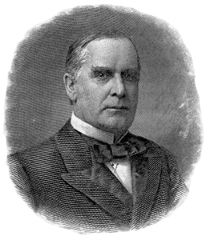
William McKinley, Jr. (1896-1901) http://www.whitehouse.gov/1600/presidents/williammckinley
25th President
Won Elections of 1896 & 1900
Assassinated in 1901
Wanted to avoid war in Cuba
Yellow journalism and public supported war
Embraced expansionist policies post-war http://www.loc.gov/rr/hispanic/1898/mckinley.html

Slide 13
Events-Timeline
1895: Cuban nationalists revolt against Spanish rule
1896: Spanish General Weyler (the "Butcher") comes to Cuba.
1897: Spain recalls Weyler
Early 1898: USS Maine sent to Cuba
February 9, 1898: Hearst publishes Spanish Ambassador, Dupuy du Lome's letter insulting McKinley. http://www.pbs.org/crucible/tl9.html

Slide 14
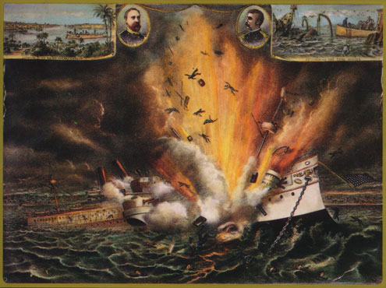
Remember the Maine, To Hell with Spain
At 9:40pm on February 15, 1898, the battleship U.S.S. Maine exploded in Havana Harbor
268 men were killed, shocking the American population
What or who caused this explosion?
http://www.homeofheroes.com/wallofhonor/spanish_am/02_maine.html

Slide 15
Important Events
Feb. 18, 1898: Sinking of the USS Maine -Cuba
266 US Servicemen are killed
Blamed on a Spanish mine
April 1898: Teller Amendment – stated that the U.S. would not annex Cuba; this was to show that the US was interested in Cuban Independence and not colonization http://www.historyofcuba.com/history/teller.htm
May 1, 1898: Admiral Dewey – Surprise attack on the Spanish Fleet in Manila Harbor (Philippines) http://www.nps.gov/goga/historyculture/spanish-american-war.htm
All Spanish Ships are Sunk
Spanish Defeated in Battle of San Juan Hill
T. Roosevelt led the “Rough Riders” to victory
http://www.spanamwar.com/tr2.htm
Dec. 10, 1898: Spain signs Treaty of Paris Ending the War http://www.pbs.org/wgbh/amex/macarthur/peopleevents/pandeAMEX87.html

Slide 16
The Spanish-American War, 1898
“Splendid Little War”
http://amhistory.si.edu/militaryhistory/exhibition/flash.html
The fighting against Spain lasted less than 4 months
Spain fled Cuba in defeat
Teddy Roosevelt’s Rough Riders were famous for their charge of San Juan Hill (national hero) Video: https://www.youtube.com/watch?v=eQlCbeNwKzg&safe=active
Video Clip – Background on Teddy Roosevelt and the Rough Riders: http://classroomclips.org/video/673
Admiral George Dewey attacked the Spanish fleet in the Philippines
American troops took Manila Bay in August
By July, the Spanish were driven from Cuba
The defeated Spanish:
Recognized Cuba’s independence
Ceded to the United States:
Philippines
Puerto Rico
Guam

Slide 17
Effects of the Spanish American War
US becomes an Imperialist Power
Treaty of Paris signed on December 10, 1898 ended the Spanish- American War
Cuba went free, Guam, Puerto Rico, and the Philippines were ceded to the US, and the US agreed to pay Spain an indemnity of $20 million
Guam, Puerto Rico, and the Philippines become colonies of the US
Cuba gains its independence from Spain, but becomes a US Protectorate
US will “protect” and partially control Cuba

Slide 18
The Spanish-American War, 1898
Contrary to the Teller Amendment, the U.S. occupied Cuba from 1898 to 1902
The U.S. withdrew its forces only after Cuba agreed to the conditions set forth in the 1901 Platt Amendment
Authorized the US to intervene militarily in Cuba
It limited Cuba’s sovereignty by:
Reserving to the U.S. the right to intervene in Cuba
The U.S. could maintain a naval base on Cuba (Guantanamo)
Insular Cases - held that the Constitution did not fully apply to the territories acquired by the US during the Spanish American War http://www.law.virginia.edu/html/news/2007_spr/insular.htm

Slide 19
Critics of Empire
Some Americans were horrified by their nation’s actions in the Spanish-American War
They founded the Anti-Imperialist League
Pointed out that imposing U.S. rule on other peoples by military force violated the principles of human equality and liberty championed in our own Declaration of Independence

Slide 20
Guerrilla War in the Philippines, a continuation of war 1898-1902
Pres. McKinley was persuaded that the U.S. should keep the Philippines by the arguments of:
the expansionists
businessmen to use the islands as a way of penetrating nearby Chinese markets
He wanted to help civilize them
This U.S. decision to dominate and withhold independence from the Philippines, led to a war against Filipino independence fighters led by Emilio Aquinaldo

Slide 21
Guerrilla War in the Philippines, 1898-1902
To crush the guerrilla resistance of the Filipinos, the U.S. used brutal tactics
The U.S. lost many more soldiers than it had in the Spanish-American War
In 1946, the U.S. granted the Philippines their independence

