Slide 1
Urbanization, consumerism & Immigration
PROGRESSIVE ERA
1890 - 1920

Slide 2
Urbanization – cities: Economic Inequality
Economic Growth:
Industrial Production increased
Population Increase
Consumer Markets Expand
Farms and Cities: grew together
Agriculture entered its “golden age”
Commercial Farming – meet growing demand of cities
Gap between Rich & Poor:
Immigrants live in slums
Wealthy live in isolated neighborhoods & mansions
J. P. Morgan’s financial firm directly or indirectly controlled 40 percent of all financial and industrial capital in the nation, while more than a third of mining and factory workers lived in poverty.

Slide 3
City of Ambition, 1910, by photographer Alfred Stieglitz, captures the start beauty of NYC’s new skyscrapers

Slide 4
Table 18.1 Rise Of The City, 1880–1920

Slide 5
The mansion of Cornelius Vanderbilt II on New York City’s Fifth Avenue, in a 1920 photograph.

Slide 6
A rare color photograph from around 1900, Mulberry St. NYC’s Lower East Side

Slide 7
Art & Literature:
Cities attracted writers and artists who captured its dynamism & modernity.
ASHCAN School was not an established school, but a style of art that focused on city life http://www.kettererkunst.com/dict/ashcan-school-the-eight.shtml
Although the Ashcan artists were not an organized “school” and espoused somewhat varied styles and subjects, they were all urban Realists who supported Henri’s credo—”art for life’s sake,” rather than “art for art’s sake.” http://www.metmuseum.org/toah/hd/ashc/hd_ashc.htm

Slide 8
In Hester Street, painted in 1905, George Luks, a member of the Ashcan School of urban artists, captures the colorful street life of an immigrant neighborhood in NYC

Slide 9
Six O’Clock, Winter, a 1912 painting by John Sloan, depicts a busy city street with an elevated railroad overhead. Sloan was on of a group of painters dubbed the Ashcan School because of their focus on everyday city life.

Slide 10
Mass Consumption
Cities were the birthplace of a mass-consumption society that gave new meaning to American freedom.
Freedom and Goods - The promise of American life had always in part resided in the enjoyment of goods that in other nations were available only to the wealthy.
Low wages, unequal income distribution, and southern poverty limited the extent of the consumer economy before World War I, in the Progressive Era mass consumption became a cornerstone of American freedom, understood as the abundance of goods offered by modern capitalism.

Slide 11
Mass Consumption
Access to Goods
Urban dwellers purchased goods in large downtown department stores and chain stores in cities (Macy’s)
Rural Residents used mail-order catalogs to access the goods produced in America’s factories
National Brands: Quaker Oats, Ivory Soap
National Chains: A&P grocery stores
Montgomery Ward / Sears, Roebuck & Co. Catalogs
Advertising linked goods with the idea of freedom
increase sales by linking goods with the idea of freedom.
“Liberty” was used as a brand name or used images of liberty as a sales device.
Statue of Liberty image used

Slide 12
One of the numerous advertisements of the early 20th century that invoked the Statue of Liberty to market consumer goods, in this case a brand of crackers.

Slide 13
the Promise of Abundance –Consumerism Grows
Production shifted from capital goods (steel, railroad equipment) to consumer products
Edward Filene, a department store magnate, called consumerism a “school of freedom,” as consumers made individual choices on basic questions of living.
Abundance came to define the “American way of life,” in which personal fulfillment was attained through acquiring material goods.
Consumerism - Desire for consumer goods led many workers to join unions and demand higher wages, and the claim that monopolistic corporations artificially raised prices at the expense of consumers became a weapon against the trusts.

Slide 14
An American Standard of Living
Standard of Living included material goods, competitive pay, opportunity
It became a “right” for being an American citizen
Consumer economy birthed ideas that offered a new language for criticizing inequalities of wealth & power.
A Living Wage (1906), Father John A. Ryan suggested that a decent standard of living was a “natural and absolute” right of citizenship. Ryan attempted to translate into American terms Pope Leo XIII’s declaration of 1894, Rerum Novarum, which endorsed social justice over competitive and individualistic competition.
Demands for a living wage and a decent standard of living were part of the promise of the Progressive Era, in which some predicted that want and scarcity were disappearing, with capitalism providing abundance and leisure for all.

Slide 15
Women
Traditional gender roles changed dramatically, as women were newly visible in public places such as workplaces, stores, and sites of entertainment.
More women worked at wages, and although black and immigrant women were still confined to low-paid, low-skilled jobs, native-born white women found expanding opportunities in white-collar work (telephone operator)
Women workers were no longer only young, unmarried white women and adult black women.
Working women became symbols of female emancipation (economic independence from men and moving beyond their traditional roles as wives and mothers)
Their desire to participate in the new mass consumer society caused many women, both native and immigrant, to earn money independently of their families, sometimes causing great friction, especially in immigrant families.
Young working women desired clothes, make-up and entertainment , while parents were worried about their youth embracing “American” freedom

Slide 17
The Return from Toil, a drawing by John Sloan for the radical magazine, The Masses, pictures working women not as downtrodden but as independent-minded, stylish, and self-confident.

Slide 18
Entertainment
Leisure activities were part of mass consumption, with mass entertainment in amusement parks, dance halls, and theaters attracting large crowds.
“Nickelodeons” - motion-picture theaters with a 5 cent admission charge
Vaudeville– live theatrical entertainment consisting of numerous short acts (song, dance, comedy, acrobats, magicians, trained animals) VIDEO: Historic Footage – Vaudeville Acts 1898 – 1910 (9:54) https://www.youtube.com/watch?v=vZo4imTt4Og

Slide 19
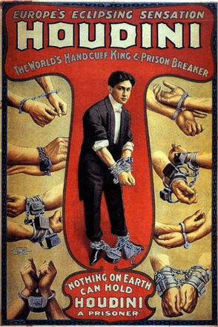
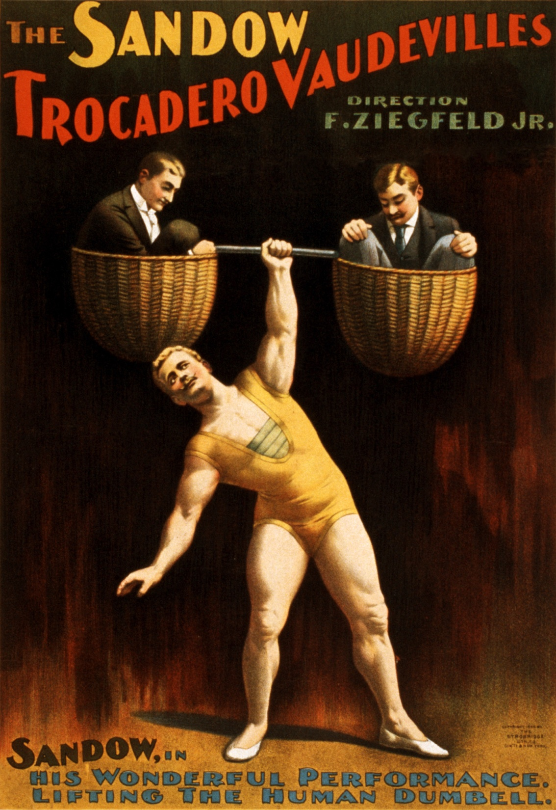

Slide 20
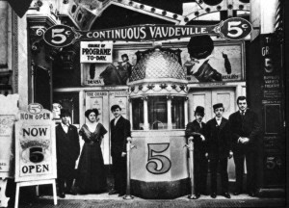
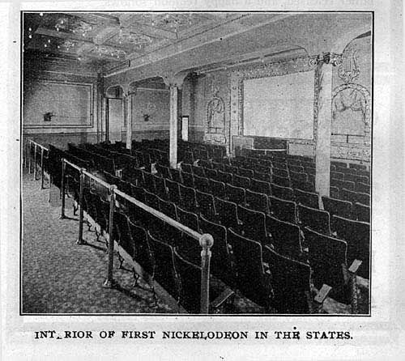
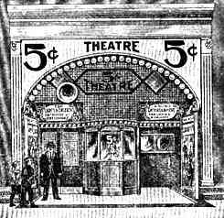
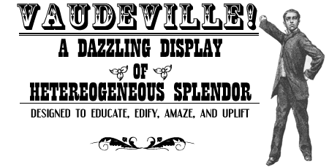
Grand theater in buffalo ny, around 1900 nickelodeons

Slide 21
Movie, 5 Cents. - Nickelodeons

Slide 22
The Rise of Fordism Henry Ford – Assembly Line
Fordism – an economic system based on mass production and mass consumption
Ford did not invent the automobile, he created production and marketing techniques that brought it within the reach of ordinary Americans.
1905, he founded the Ford Motor Company (only one of many small automobile manufacturers at the time)
1908, he introduced the Model T (a simple and light vehicle that could stand the country’s poor road)
Ford focused on standardizing output and lowering prices in order to bring a luxury good to the masses of consumers.
1913, Ford’s Highland Park, Michigan factory adopted the moving assembly line, in which car frames were brought to workers on a continuously moving conveyor belt. This process allowed Ford to vastly reduce the time it took to produce an auto, and thus greatly expand his output.

Slide 23
The Rise of Fordism – HENRY FORD: LAOBR AND CONSUMERISM
1914, Ford raised his wages to an unheard $5 per day, allowing him to attract skilled workers.
Assembly-line work was monotonous and Ford used spies and armed detectives to prevent his employees from unionizing.
Ford justified the high wages by arguing that workers needed to be able to afford the goods being produced by America’s factories.
1916 Ford’s Model T’s were affordable for many workers

Slide 24
The assembly line at the Ford Motor Company factory in Highland Park, Michigan, around 1915

Slide 25
One day’s output of Model T Fords, in a 1913 photograph. The assembly line made mass production like this possible.

Slide 27
Scientific management
1909, Taylor published "The Principles of Scientific Management"
Frederick W. Taylor’s’ method of “scientific management”—a way of increasing production and profits by scientifically studying and controlling costs and work practices.
Many skilled workers saw “Taylorism” as an assault on their traditional control over work processes, and thus, a loss of freedom.

Slide 28
Immigration – “Old Immigrants” v “new immigrants”
Old Immigrants:
Settled in the US in the early 1800’s (19th Century)
From Northern and Central Europe
England, Ireland

Slide 29
Immigration – “Old Immigrants” v “new immigrants”
New Immigrants: 1890-1924
Settled in the US in the late1800’s (19th Century)
From Eastern and Southern Europe
13 million immigrants
Italy, Poland, Greece, Russia, Romania
Assimilation more difficult, often inspired Nativism
Language Barrier –
did not learn English as quickly as old immigrants
Old Immigrants who spoke German, Dutch or English learned more quickly due to similarities in language
Close-Knit Communities –
like Little Italy where immigrants stuck together and lived in a microcosms of their country of origin
Had their own businesses and community organizations
spoke their own language and published foreign-language newspapers
Churches were central in these communities.
Unskilled Labor – compared to old immigrants who often were skilled (blacksmith)
CHART: Old Immigrants vs New Immigrants http://historyrfd.net/isern/104/new.htm
BACKGROUND: Immigration during the Progressive Era http://www.ushistory.org/us/38c.asp

Slide 30
A community settlement map for Chicago in 1900, illustrates the immigration and racial neighborhoods in the nation’s 2nd largest city.

Slide 31
new immigrants – reasons for settlement
This wave of immigration was part of a global process of immigration caused by industrial growth and agricultural decline. Many left behind extremes of poverty, taxation, bad economies, lack of liberty
1840-1914, when World War I halted migration from Europe, nearly 40 million people emigrated to the United States and another 20 million moved to other parts of the Western Hemisphere.
Millions migrated to Southeast Asian and South Pacific from India and China, while even more moved to Manchuria, Siberia, and Central Asia from Russia and northern Asia
While many of these immigrants, pushed and pulled by a variety of factors, moved to America freely, not all emigrated as “free labor.”
Large numbers of Chinese, Mexican, and Italian migrants were bound to long-term labor contracts, signed with labor agents who provided the contract workers to American employers.

Slide 34
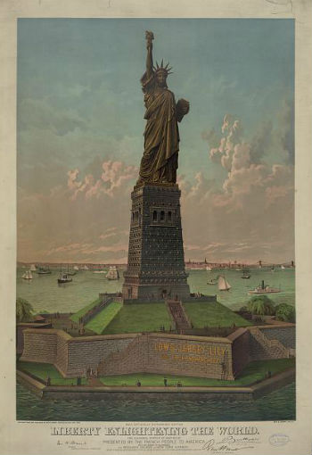
Statue of Liberty
Facts: http://www.factmonster.com/ipka/A0874962.html
http://www.libertyellisfoundation.org/statue-facts
The New Colossus
Not like the brazen giant of Greek fame, With conquering limbs astride from land to land; Here at our sea-washed, sunset gates shall stand A mighty woman with a torch, whose flame Is the imprisoned lightning, and her name Mother of Exiles. From her beacon-hand Glows world-wide welcome; her mild eyes command The air-bridged harbor that twin cities frame. "Keep ancient lands, your storied pomp!" cries she With silent lips. "Give me your tired, your poor, Your huddled masses yearning to breathe free, The wretched refuse of your teeming shore. Send these, the homeless, tempest-tost to me, I lift my lamp beside the golden door!" Emma Lazarus (November 2, 1883)

Slide 35
Ellis Island
Most European immigrants entered through Ellis Island in New York Harbor, which 1892 became the main facility for processing immigrants.
Those who failed a medical examination or were judged to be anarchists, prostitutes, or otherwise undesirable, were sent home.
Background http://www.nps.gov/elis/historyculture/places_immigration.htm
History & Culture http://www.nps.gov/elis/historyculture/index.htm
Immigrant Registry http://www.castlegarden.org/

Slide 36
Italian Family on Ferry Boat, Leaving Ellis Island, a 1905 photograph by Lewis Hine. The family of immigrants has just passed through the inspection process at the gateway to the U.S.

Slide 37
Angel Island “Ellis Island of the west”
Due to the Chinese Exclusion Act (1882), Japanese laborers arrived to work as agricultural laborers in California (fruit and vegetable) and Hawaii (sugar)
Populations of Japanese origin grew to 72,000 by 1910

Slide 38
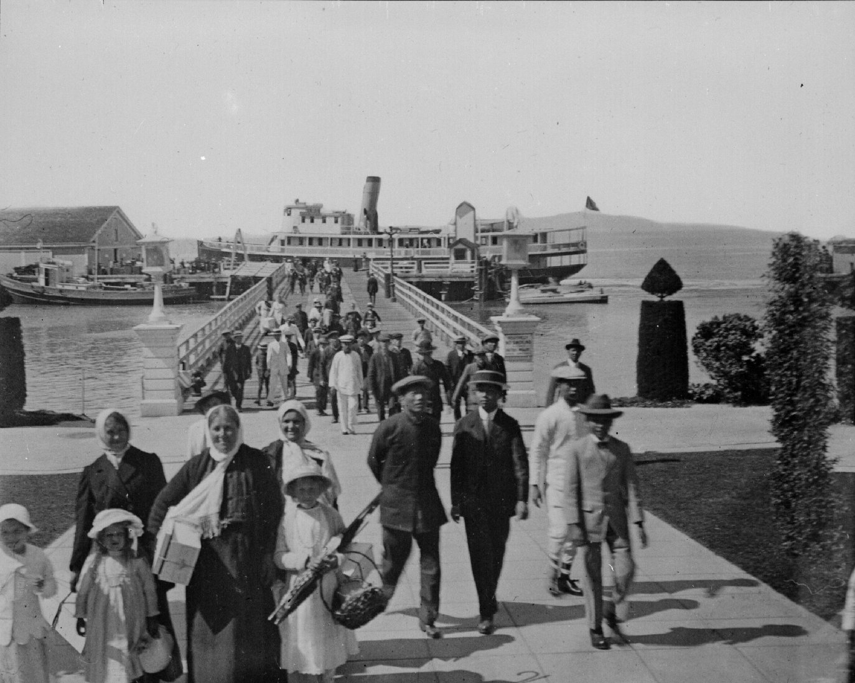
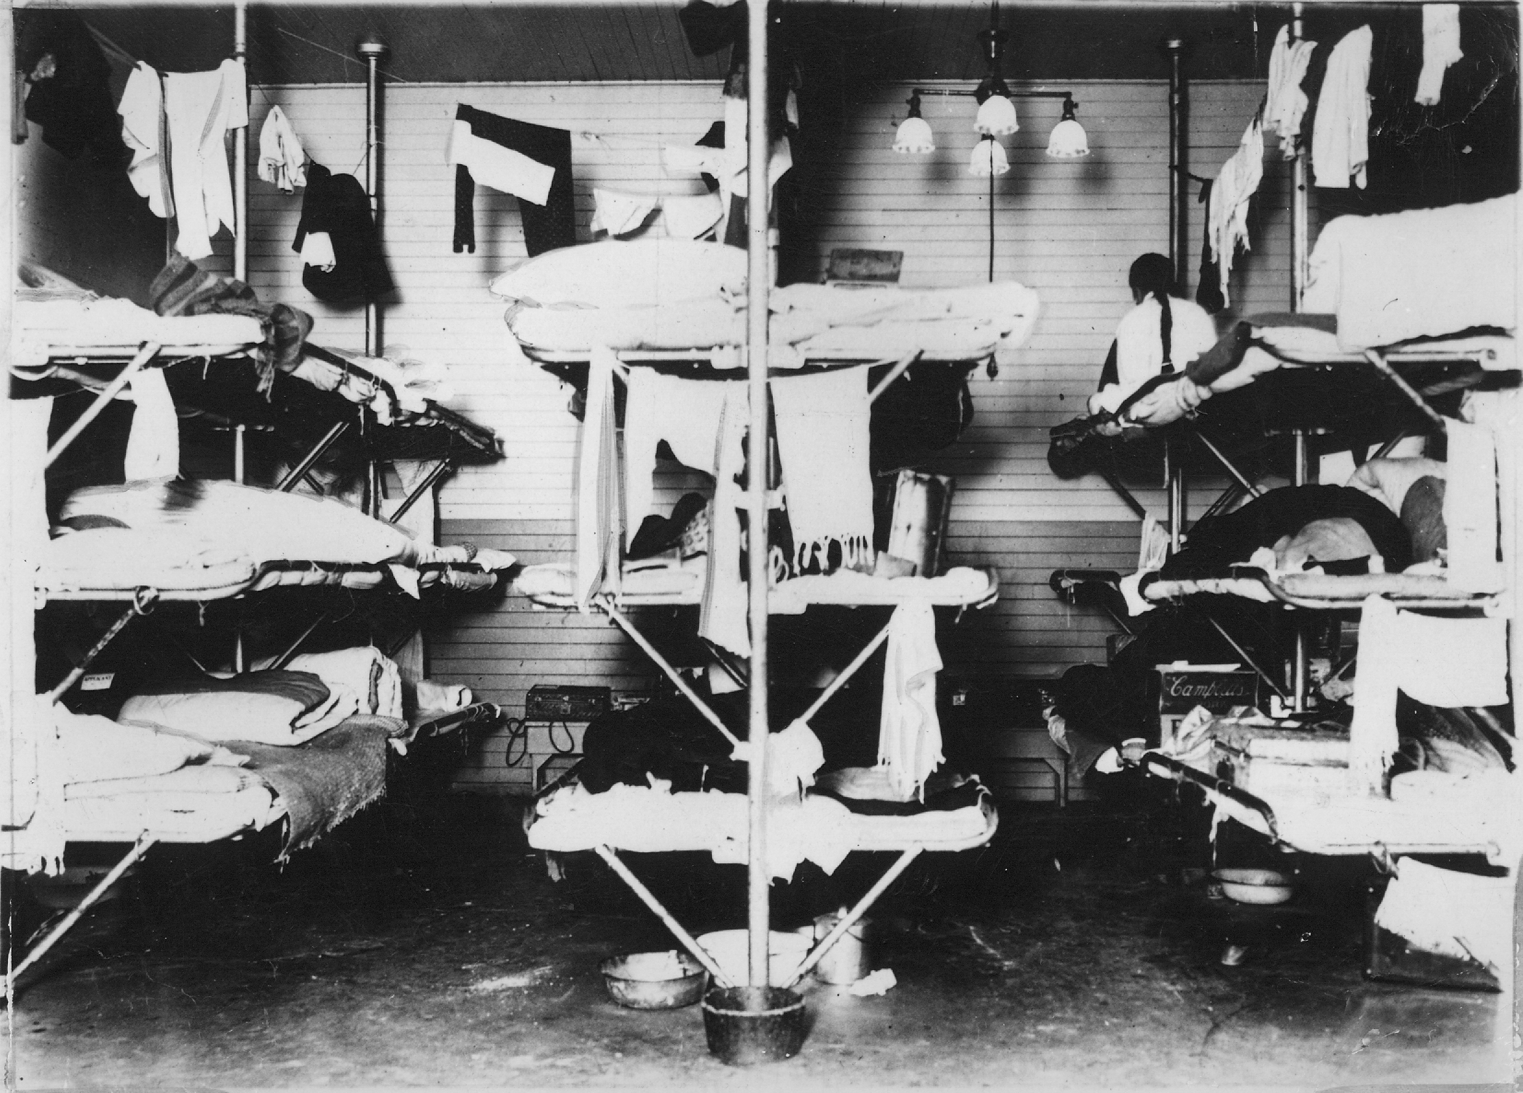
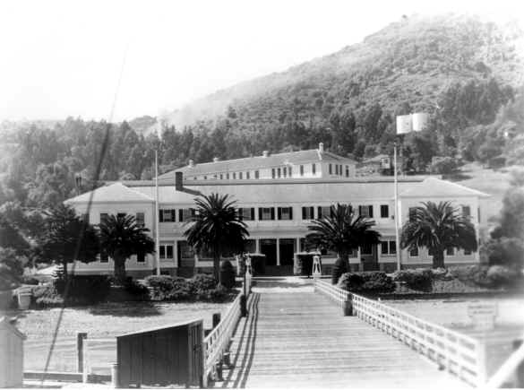

Slide 39
Immigration - El Paso,texas
Asian and Mexican migrants came to the American West, mostly through San Francisco.
Mexican migration was much larger than Japanese migration.
1900 and 1930, nearly 1 million Mexicans came to the United States, mostly through El Paso, Texas, and many became cheap agricultural labor.

Slide 40
An immigrant from Mexico, arriving around 1912 in a cart drawn by a donkey

Slide 41
Birds of Passage
Birds of Passage – immigrants who planned on returning to their homeland
While some, such as Jews fleeing religious persecution in Russia, intended to settle permanently, most planned to earn money to return home and buy land.
Groups such as the Irish and Mexicans had many such “birds of passage,” who stayed only briefly in the United States.

Slide 42
Immigrant Populations
1910 one of every seven people in America was foreign-born highest percentage in American history
More than 40 % of New York’s population was born abroad
More than 30 % in other major cities like Chicago and Milwaukee.
While many immigrants moved west, most settled in industrial centers.
Although most immigrants earned more in the United States than they could have at home, they faced long hours, low wages, and dangerous working conditions in the mines, factories, and fields.

Slide 43
An illustration in the 1912 publication. The New Immigration depicts the various “types” entering the United States.

Slide 44
Progressives: Social Reforms
WHEN: 1890 – 1920
WHO: Movement drew its strength from middle-class reformers
WHAT: Many diverse groups in American society launched efforts to reform or eliminate the many social problems resulting from rapid industrialization, urbanization, and immigration.

Slide 45
Progressive ideals
Fix a society fragmented by labor conflict, mass migration, social inequality
Some desired a return to a competitive marketplace of small producers
Others accepted the large corporation and looked to the government to combat a growing concentration of wealth and ensure social justice.
Nearly all Progressives felt that freedom had to take on a new meaning to confront early twentieth-century social and economic realities.

Slide 46
ISSUES – Work Safety TRIANGLE SHIRTWASTE FACTORY
When: March 25, 1911
WHERE: Manhattan (Greenwich village), NY
What:
A factory caught fire by a match or cigarette
Cloth quickly ignighted
Workers were in the 8 – 10 floors
Safety Issues: exit doors were chained shut, elevators couldn’t accommodate the number of workers, fire ladders didn’t reach the top floors, fire escapes were inadequate
Tragedy: Some women jumped out the window, 146 workers died
Who:
Workers - Women (mostly), Jewish/Italian Made ready-to-wear clothing; Shirtwaists (women's blouses).
Owners - Max Blanck and Isaac Harris

Slide 47
Policemen stare up as the Triangle fire of 1911 rages

Slide 48
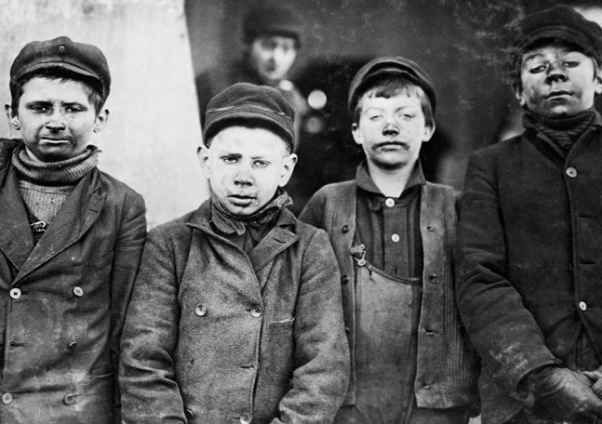
ISSUES – Child Labor
1890 – over one million children, 10 – 15 years old work for wages
1910 - 2 million children under the age of 15 years old worked for wages
Children as young as 5 or 6 years old would work 18 – 20 hour days
Glassworks: extreme heat, fumes
Miners: cramped, breath coal dust
Oyster: cut hands when shuck
Injuries on the Job: http://mentalfloss.com/article/30248/depressing-stories-behind-20-vintage-child-labor-pictures

Slide 49
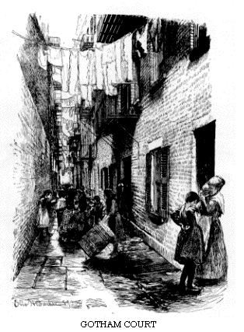
ISSUES – Housing
Tenement Housing – urban apartments that were divided up into small units to accommodate the growing population
Renters were often poor immigrants
Unsanitary Conditions: lack proper ventilation, minimal to no running water, chamber pots tossed out windows until landlords had to put in some toilets

Slide 50
muckrakers
Journalists and writers who exposed the ills of industrial and urban life to induce reform (poverty, greed, corruption)
Theodore Roosevelt criticized this kind of journalism, calling it “muckraking.”
A new generation of journalists writing for mass-circulation national magazines exposed the problems of industrial and urban existence

Slide 51
muckrakers
Lewis Hines photograph child laborers to bring attention to social inequality
http://www.icp.org/museum/exhibitions/lewis-hine
http://www.historyplace.com/unitedstates/childlabor/
Lincoln Steffens’series for McClure’s, published as The Shame of the Cities, showed how party bosses and businessmen profited from political corruption.
Ida Tarbell pointed to the arrogance & economic machinations of Rockefeller’s Standard Oil Company
Novelists produced similarly critical works of fiction, such as The Jungle, by Upton Sinclair, whose descriptions of unsanitary slaughterhouses and rotten meat led directly to the passage of the Pure Food and Drug and Meat Inspection Acts.
Chapter 14 (spoiled meat): http://xroads.virginia.edu/~hyper/SINCLAIR/ch14.html

Slide 52
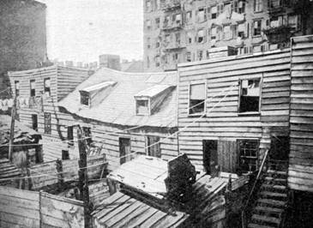
Jacob a Riis – how the other half lives
A muckraker, Jacob Riis exposed the living conditions in New York tenements in, How the Other Half Lives
Housing Reforms:
Council of Hygiene and the first Tenement House Law of 1867
Tenement House Act of 1901

Slide 53
Politics of progressivism
GOAL: Progressives wanted to restore democracy by returning political power to citizens and civic harmony to a divided America.
State & Local Government Progressive Reforms:
Reduce political corruption (political bosses)
“natural monopolies” (utilities: gas, water) become publically controlled
Improve public transportation, schools, parks…

Slide 54
Politics of progressivism – Urban progressive reforms
Hazen Pingree – Mayor of Detroit, MI 1889-1897
Gas & Telephone companies forced to lower rates
Municipal Power Plant
Samuel “Golden Rule” Jones –Mayor of Toledo,OH 1897-1905
8 hr. work day, paid vacation (at his factory, oil drilling equipment)
Night Schools, Fee Kindergartens, Parks, support Unions
Hiram Johnson – Governor of California 1910
Public Utilities Act –railroad regulation
Child Labor laws
Limit the work hours of women

Slide 55
Politics of progressivism – Urban progressive reforms
Robert La Follette – “Fighting Bob”, Governor 1900 - 1906
Wisconsin Idea – reforms that would be a model for others to create more democratic and fair governments
Faculty at the University of Wisconsin were used as experts to help pass legislation
Primary Elections replace Political Bosses to nominate candidates for office
Tax Corporate Wealth
Railroads & Utilities regulated
Workers Compensatation (1st in nation)

Slide 56
Politics of progressivism - Urban progressive reforms
17th Amendment: made U.S. senators elected by popular vote rather than by state legislatures
Several states adopted:
Initiative (voters propose legislation)
Referendum (voters directly vote on a proposal)
Recall (voters remove officials)

Slide 57
Government by Expert
Most Progressives were leery of the real world of politics, in which people pursued narrow class, ethnic, or regional interests.
Many Progressives thus turned to college professors and other professional “experts,” believing government could ensure intelligent rule over society through a democracy run by impartial experts unaccountable to citizens. This was part of Progressives’ impulse toward order, efficiency, and centralized management as a means of ensuring social justice.
In Drift and Mastery (1914), Walter Lippman argued the nation could either continue to “drift,” operating according to a dated belief in individual autonomy, or embrace “mastery,” using scientific inquiry to address modern social problems. For Lippman and others, political freedom rested not in direct political participation but in the formation of public policy by the most qualified.
Walter Lippman - http://www.britannica.com/EBchecked/topic/342965/Walter-Lippmann

Slide 58
Children at play at the Hudson-Bank Gymnasium, built in 1898 in a New York immigrant neighborhood by the Outdoor Recreation League, one of many Progressive era groups that sought to improve life in urban centers.

Slide 59
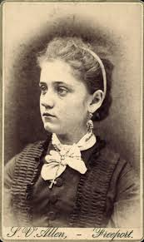
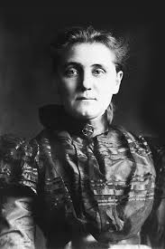
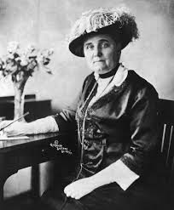
Jane Addams and Hull House
Jane Addams:
Advocated for the working poor
Addams never married and resisted expectations to become tied to a family as a mother and wife
Hull House (1889) founded in Chicago, a “settlement house” dedicated to improving the lives of the immigrant poor
Settlement house workers moved into poor neighborhoods, built and ran schools, employment bureaus, and health clinics, and helped women victims of domestic abuse.
1910, more than 400 settlement houses had been established in cities around the nation
VIDEO: http://www.youtube.com/watch?v=Tw4GZeABlNI

Slide 60
A staff member greets an immigrant family at Hull House, the settlement house established in Chicago by Jane Addams.

Slide 61
Visiting nurse on a New York City rooftop, 1908. Efforts to uplift the immigrant poor offered new opportunities for professional employment to many women during the Progressive Era.

Slide 62
Progressive reforms: women
Still unable to vote and hold office in most states, women were central to Progressive politics. They challenged barriers to political participation and elaborated a democratic, grassroots vision of government. They were moved to act most often by the conditions faced by poor immigrant communities and women and child workers.
Addams typified the era’s “new woman,” as more and more women went to college and entered professions such as social services, nursing, and education.
Middle-class women’s efforts to help the poor, working women, and children helped expand government’s role in society.
Through settlement and other social work, these women learned that legislation was necessary for dealing with housing, income, and health inequalities.
Hull House led a number of campaigns for legislation in Illinois, around shorter working hours, workplace safety, and union organizing rights, which inspired others to do likewise.
In the South, however, race affected reform, as ending child labor was justified as necessary for giving white children the education they would need as members of the South’s ruling race.
The settlement houses have been called “spearheads of reform,” as they produced prominent Progressive leaders, such as Julia Lathrop, the first women to head a federal agency (the Children’s Bureau, founded in 1912 to investigation conditions of mothers and children and advocate for them), and Florence Kelley, who organized the National Consumers League to use purchasing power as a way to force manufacturers to improve working conditions.

Slide 63
The Campaign for Woman Suffrage
After 1900, the campaign for women’s suffrage became a mass movement for the first time.
National American Women Suffrage Association’s membership grew enormously, and its campaigns had some success in states, half of which allowed women to vote in local elections regarding schools.
Women’s Suffrage
won in Wyoming, Colorado, Idaho, and Utah.
1910 - 1914, seven more western states gave women the vote.
Campaigns were conducted with a new spirit of militancy, used modern methods of advertising, publicity, and entertainment characteristic of a mass consumer society. State campaigns were costly, and increasingly efforts focused on gaining suffrage at the national level.
Background: http://ocp.hul.harvard.edu/ww/nawsa.html
Images: http://www.loc.gov/rr/print/list/076_vfw.html

Slide 64
In this 1912 woman suffrage parade in New York City, a mother wheels a baby carriage to counteract the charge that allowing women to vote would undermine the family.

Slide 65
Maternalist Reform
The celebration of women’s domestic role actually inspired the suffrage movement.
Many Progressive proposals emerged from the idea that the state should protect women and children, and female reformers formed a movement for improving the lives of poor mothers and children.
Many states enacted pensions for mothers to enable them to care for children.
Such “maternalist” reforms were based on the assumption that government should encourage women’s ability to bear and raise children and allow them to be economically independent.
Other Progressive laws recognized that many women worked outside the home, but defined them as a dependent group (like children) that needed state protection in ways male workers were not.

Slide 66
Maternalist Reform
Muller v Oregon - http://www.oyez.org/cases/1901-1939/1907/1907_107
In the landmark case, Muller v. Oregon (1908), the U.S. Supreme Court accepted the arguments of Louis D. Brandeis that long hours of labor were dangerous for women, whose child-bearing abilities required government protection. (women were too weak to work long hours)
Louis D. Brandeis: http://www.biography.com/people/louis-brandeis-39048
This was the first major breach of “liberty of contract” doctrine, just three years after the Lochner decision. http://www.pbs.org/wnet/supremecourt/capitalism/landmark_lochner.html
Costs of Muller were high, as while even more states passed protective laws for women workers, these laws both benefited women and tied them to their family roles, and kept reinforced gender discrimination and exclusion in labor markets.
Though the use of government to regulate working conditions raised questions about liberty of contract, maternalist policies built gender inequality into the early foundations of the welfare state.

Slide 67
The Idea of Economic Citizenship
Brandeis imagined a different kind of welfare state from that of maternalists, one rooted less in healthy motherhood than in ideas of universal economic entitlements, such as a right to a decent income and protection against unemployment and work-related accidents.
The right to assistance for Brandeis derived from citizenship, not some special service to the nation, as in the case of mothers.
Some states supported the kind of welfare Brandeis envisioned, as they passed workmen’s compensation laws that drew upon workers’ own wages to create a fund for workers injured on the job.
The idea of universal entitlements and protections for all workers, including male workers, would be expressed in policy in the New Deal Era.

Slide 68
Louis D. Brandeis, Progressive reformer and advocate of the labor movement, was appointed to the Supreme Court in 1916 by President Woodrow Wilson.

Slide 69
The New Feminism
Feminism first became a widely used word in the Progressive Era.
In 1914, a mass meeting in New York that debated the question, “What Is Feminism?” was organized by Heterodoxy, a women’s club in Greenwich Village.
Bohemia:
The club was part of a new radical “bohemia” (a social circle of artists, writers, and others who reject conventional rules and practices), and its definition of feminism merged calls for the vote and greater economic opportunity with open discussions of sexuality.
Before World War I, in Greenwich Village and equivalent neighborhoods in Chicago, San Francisco, and other cities, a “lyrical left” took shape that included discussion clubs, experimental theaters, and magazines, and which anticipated the emancipation of the human spirit from nineteenth-century prejudices.
Isadora Duncan’s new expressive dance was one symbol of the era, as was New York’s Armory Show in 1913, showing cubist paintings by European artists like Pablo Picasso in America for the first time.

Slide 70
The Rise of Personal Freedom
Freedom was central to the lyrical left’s vision of society, but their individualist notion of freedom was quite different from other Progressives’ interest in order and efficiency. Yet sexual freedom came alive in this period. Sigmund Freud lectured in America in 1909 and found that Americans were familiar with his theories of infantile sexuality, repression, and the irrational.
Free sexual expression and reproductive choice became critical elements of women’s liberation
New sexual attitudes spread beyond bohemia to many young, unmarried, and independent women, and the new tolerance for sexual freedom drew gay people to Greenwich Village for the first time.

Slide 71
A sheet music cover, with a modern woman erasing the word “obey” from marriage vows.

Slide 72
Isadora Duncan brought a new freedom to an old art form. Expressive dance based on free movement of a body liberated from the constrants of traditional technique and costume. This became a symbol of women breaking from tradition.

Slide 73
The Birth-Control Movement
Women’s growing presence in the labor market strengthened demands for birth control, giving political expression to changes in sexual behavior.
In the nineteenth century, the right to “control one’s body” meant the ability to refuse sexual advances, including those of a husband, but now it meant enjoying an active sexual life without necessarily bearing children.
Emma Goldman, an anarchist, regularly wrote and lectured about the right to birth control and various contraceptive devices, and was arrested often.
Margaret Sanger placed birth control at the center of the new feminism.
http://www.pbs.org/wgbh/amex/pill/peopleevents/p_sanger.html
By 1914, after facing censorship from the U.S. Post Office for writing about how to use birth control, she openly advertised birth-control devices in her journal, The Woman Rebel.
She argued no woman could be free who did not control her own body and decisions about whether to become a mother.
In 1916, when Sanger opened a clinic in a working-class area of Brooklyn and started giving contraceptive devices to poor Jewish and Italian women, she was jailed for a month.
Labor radicals and cultural modernists, not just feminists, promoted Sanger and birth control.

Slide 74
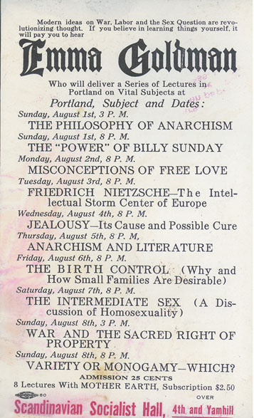
The much-beloved and much-feared Emma Goldman, with a poster advertising a series of her lectures, illustrating the remarkable variety of topics on which she spoke. - Goldman emigrated from Lithuania at 16 and toured the country lecturing on subjects from anarchism, homosexuality, and birth control.

Slide 75
Mothers with baby carriages wait outside Margaret Sanger’s birth control clinic in Brownsville, Brooklyn, 1916

Slide 76
Society of American Indians
Even Native Americans shared the Progressive impulse.
Society of American Indians, founded in 1911 by Carlos Montezuma, was a typical reform organization.
It united Indian intellectuals around discussion of Native Americans’ problems and sought to arouse public awareness. It brought together Indians from many different backgrounds and created a pan-Indian public space free from white influence.
Many in the Society shared the basic goals of federal Indian policy, including transforming communal lands on the reservations into family farms.
Carlos Montezuma, became an avowed critic who condemned government paternalism and demanded the abolition of the Bureau of Indian Affairs.
He called for self-determination and for Indians to be granted full citizenship – sought independence

Slide 77
nationalism
The most significant political development of early twentieth-century America was the rise of the national state.
Nationalization was occurring everywhere: national corporations dominated the economy; national organizations like the American Medical Association began to raise the incomes and respect of professions. Even sports developed national leagues in this period.
Stronger National Government:
Progressives believed that only an energetic national government could establish the social conditions of freedom.
Poverty, economic insecurity, and an absence of industrial democracy were national problems that could only be solved nationally.
Herbert Croly, editor of the New Republic, argued that the democratic national state was an alternative to the forces that controlled Americans’ lives, whether the narrow interests that manipulated politics or corporations. Croly suggested that “Jeffersonian ends” of democratic self-determination and individual freedom could be secured only through the “Hamiltonian means” of government intervention in the economy. - bigger and more involved government could benefit the people by regulating forces that cause social ills
Theodore Roosevelt was the first of the Progressive-Era presidents to address this question.

Slide 78
Labor unions & strikes
PROGRESSIVE ERA
1890 - 1920

Slide 79
Labor unions - socialism
The Socialist Presence
Economic freedom was also the cry of American socialism, which reached its greatest influence in the Progressive era.
The Socialist Party, founded in 1901, united late nineteenth-century radicals such as Populists and followers of Edward Bellamy with parts of the labor movement.
http://www.britannica.com/EBchecked/topic/59737/Edward-Bellamy
GOALS: The party called for immediate reforms like free college, laws to improve working conditions, and it ultimately proposed democratic control over the economy through public ownership of railroads and factories.
GROWTH: By 1912, the Socialist Party had 150,000 dues-paying members, published hundreds of newspapers, had significant support in the American Federation of Labor, and elected dozens of local officials.
MEMBERS: Socialism flourished in immigrant communities, such as among Jews in the Lower East Side in New York City and Germans in Milwaukee, and also gained support among farmers in old Populists states like Oklahoma and mining regions in Idaho and Montana.

Slide 80
Socialism – Eugene V Debs
The Gospel of Debs
http://www.pbs.org/wgbh/amex/wilson/peopleevents/p_debs.html
He was the president and the organizer of the American Railway Union. He organized the Pullman Strike and helped organized the Social Democratic party.
Most important in spreading socialist ideas and linking socialism to American ideals of equality, self-government, and freedom was Eugene V. Debs, the former union leader jailed during the Pullman Strike of 1894.
For two decades, Debs toured the nation, preaching that “political equality and economic freedom” could be won only by socialism’s democratic control of the economy.
Debs united the disparate and often dueling factions of the party.
As socialism gained in strength in Europe, particularly in Germany, France, and Scandinavia, Debs led socialism forward in America, too.
In 1912, he received 900,000 votes for president, nearly 6 percent of the total, and the socialist newspaper, Appeal To Reason, had the largest weekly circulation in the nation.

Slide 81
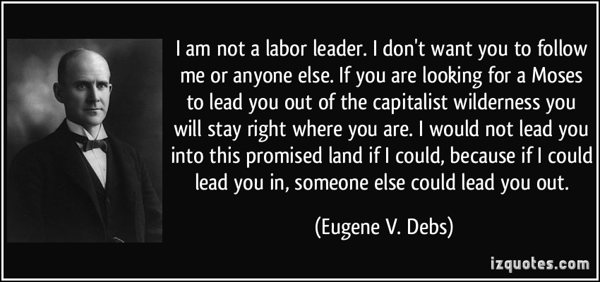
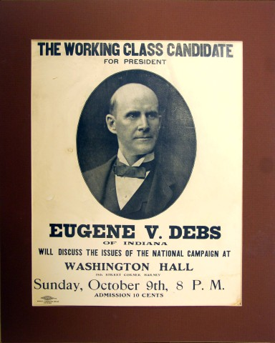

Slide 82
Map 18.2 Socialist Town and Cities, 1900-1920 – Although the Socialist Party never won more than 6% of the vote nationally, it gained control of numerous small and medium-sized cities.

Slide 83
Roller skaters with socialist leaflets during a New York City strike in 1916. A “scab” is a worker who crosses the picket line during a strike.

Slide 84
One Big Union, the emblem of the Industrial Workers of the World.

Slide 85
American Federation of Labor (AFL)
http://railroadswag.weebly.com/american-federation-of-labor.html
Founded1886, made up of 25 craft unions (skilled labor)
Membership tripled to 1.6 million between 1900 and 1904
Leaders forged closer ties with corporate leaders willing to deal with unions as a means to stabilizing labor relations.
AFL President Samuel Gompers joined with large capitalists in the National Civic Federation, which accepted workers’ right to collective bargaining in “responsible” unions. (bridge between union and corporations)
National Civic Federation (NCF) helped settle hundreds of industrial disputes, improved safety and created pensions plans for long-term workers; but most employers still adamantly opposed unions.
Membership: The AFL mostly represented America’s most privileged workers—skilled industrial and craft labor, mostly all white, male, and native-born.

Slide 86
Industrial Workers of the World (IWW)
http://www.britannica.com/EBchecked/topic/287195/Industrial-Workers-of-the-World-IWW
1905, unionists rejecting the AFL’s exclusionist approach formed the Industrial Workers of the World (IWW)
The IWW was both a union and a revolutionary organization dedicated to seizing the means of production and abolishing the state
Solidarity their guiding principle – printed leaflets, banners, and posters in multiple languages and persuaded local religious leaders, shopkeepers, and officeholders to support strikes
Inclusive Membership: It sought to organize all workers excluded from the AFL: immigrant factory workers, migrant timber and agricultural workers, women, blacks, and even the Chinese.
Leaders: Bill Haywood , Eugene V. Debs

Slide 87
The New Immigrants on Strike
Mass strikes by immigrant workers placed workers’ demand to bargain collectively with employers at the front of Progressive reform.
The strikes showed that ethnic divisions might impede labor solidarity, but that ethnic cohesiveness could be a basis of unity, if strikes were organized democratically.
The IWW was often called to run these strikes, which started spontaneously, and it insisted that each ethnic group have representation on strike committees.

Slide 88
strikes
1912 in Lawrence, Massachusetts - Bread and Roses Strike:
Issue: men, women, and child workers went on strike against pay cuts
IWW forged the strikers into a united group, survived militia and police attacks, and won the strike on the unions’ terms.
Woolen mills, 32,000 employees, 25 nationalities
IWW help organize diverse workers → “Big Bill” Haywood (leader) sent strikers’ children to Socialist families in NYC
Lawrence children were a sad sight to New Yorkers → pale, malnourished
“We want bread and roses too” – demand for better pay and a better standard of living
http://libcom.org/history/articles/lawrence-textile-strike-1912 http://dp.la/exhibitions/exhibits/show/breadandroses

Slide 89
strikes
1907 New Orleans dockworkers strike
black and white workers made an uncommon cross-racial alliance to resist pay cuts and attacks on their unions.
1914 Ludlow, Massacre (Colorado Mine workers vs. militia)
the strike by the United Mine Workers against the Rockefeller-owned Colorado Fuel and Iron Company
Strike for union recognition, wage increases, an eight-hour day, and the right to live and shop in places not owned by the company.
The owners responded to the strike by evicting strikers from their houses, and after armed militias surrounded a tent colony erected by the strikers, they attacked the tent city in April 1914, killing up to thirty men, women, and children in what became known as the Ludlow Massacre.
http://www.pbs.org/wgbh/americanexperience/features/primary-resources/rockefellers-ludlow/
Video: http://www.youtube.com/watch?v=6qIHN68YNXw

Slide 90
Labor and Civil Liberties - Free Speech
Union struggles put free speech at the center of Progressive reform.
Even while courts rejected union’s claims to be exercising First Amendment rights, labor struggles created the modern demands of civil liberties so critical in the twentieth century.
In many areas, especially “company towns” dominated by an employer, workers were not free to speak out without being fired, or worse.
IWW – Free Speech movement
The IWW in particular waged a series of “free speech” fights as a means for organizing unions in the West.
When IWW members were arrested and jailed for speaking in public, the union would send hundreds and thousands more members to speak, forcing local governments to arrest them all.
Eventually, local officials would become overwhelmed and would allow IWW members to speak.

Slide 91
Striking New York City garment workers carrying signs in multiple languages, 1913

Slide 92
The New York shirtwaist strike of 1909 inspired workers in other cities. Here women in Rochester, NY, boldly hold aloft a strike banner.

Slide 93
Progressive presidents: Theodore Roosevelt william Howard Taft Woodrow wilson
PROGRESSIVE ERA
1890 – 1920
1901 – 1909
1909 – 1913
1913 - 1921

Slide 94
Theodore Roosevelt
1897 – 1901 McKinley served a full term and started a second before Teddy Roosevelt resumed the Presidency due to his death
Presidential Succession:
As vice-president, he became the youngest president ever to hold office after an anarchist assassinated William McKinley in 1901. http://www.eyewitnesstohistory.com/mckinley.htm
http://www.history.com/this-day-in-history/president-william-mckinley-is-shot
Background:
He was an impetuous and energetic man who celebrated the “strenuous life” of manly adventure and daring, and he became the model for the twentieth-century president, actively and continuously involved in domestic and foreign policy and setting the political agenda.

Slide 95
Square deal – teddy Roosevelt
http://millercenter.org/president/roosevelt/essays/biography/4
VIDEO - http://www.youtube.com/watch?v=_Bu2a3nYTmc
Addressed problems of economic consolidation by distinguishing between “good” and “bad” corporations. - Consumer Protection, Regulate Big Business
Soon after taking office, Roosevelt shocked the business world by prosecuting the Northern Securities Company, a “holding” company created by financier J.P. Morgan to run three western railroads that monopolized rail transport between the Great Lakes and the Pacific.
In 1904, the Supreme Court handed the anti-trust movement a significant victory by ordering Northern Securities dissolved.

Slide 96
Roosevelt and Economic Regulation
Labor Dispute Moderator:
Roosevelt also believed the president should help settle labor disputes as a neutral third-party, and not simply act in favor of business, as had previous presidents.
In 1902, when a strike paralyzed the coal industry, he brought union leaders and managers to the White House and settled the strike by appointing a commission.
Regulating Industry:
Re-elected in 1904, Roosevelt advocated more direct economic regulations, including reinforcing the Interstate Commerce Commission, whose powers had been restricted by the Supreme Court.
In 1906, public opinion had shifted in support of Roosevelt, and Congress passed the
Hepburn Act - giving the Interstate Commerce Commission (ICC) power to set railroad rates, an important step in giving the federal government regulatory power.
While many businessmen supported the creation of new federal agencies to improve consumer product safety, they were alarmed by Roosevelt’s calls for federal inheritance and income taxes and interstate business regulation.

Slide 97
The conservation movement
http://www.nps.gov/thro/historyculture/theodore-roosevelt-and-conservation.htm
Roosevelt was also an avid outdoorsman. While the United States led the world in conserving wilderness areas, having established the first national park at Yellowstone in 1872, it had no national conservation policy until Roosevelt’s administration.
He ordered that millions of acres be set aside as wildlife preserves and urged creation of new national parks. Conservation was typically Progressive in some ways. Experts would help the government serve the public good while preventing “special interests” from damaging the environment. But conservation also served efficiency and control, as conservation aimed to control the exploitation of minerals and forests on national lands, not prevent it. In the West, water was especially scarce and required regulation in order to conserve and distribute it fairly.

Slide 98
How was T. Roosevelt a Progressive President?
The Square Deal
T. Roosevelt promised a “square deal” between business and labor
Government as tool to protect people from big business
Coal strike of 1902
A coal strike threatened to leave Americans without coal to heat there homes in the winter
T. Roosevelt called union leaders and mine owners to the White House for mediation
When mine owners refused to attend, T. Roosevelt threatened to take over the mines with federal troops
Owners agreed to meet and accepted term of mediation
10% wage increase
Nine hour workday

Slide 99
How was T. Roosevelt a Progressive President?
Trust-busting
T. Roosevelt was the first president to enforce the Sherman Anti-Trust Act
In 1904 the Supreme court upheld T. Roosevelt’s use of the act to break up the Northern Securities Company, a railroad monopoly
Made a distinction between “good trusts” and “bad trusts”
Bad trusts: harmed consumers by raising prices and stifling competition
Good trusts: dominated the market through efficiency and low prices
Railroad regulation
Convinced Congress to pass two laws that strengthened the Interstate Commerce Commission (ICC)
The Elkins Act (1903): strengthened the regulatory power of the ICC
The Hepburn Act (1906): allowed the ICC to fix “just and reasonable” railroad rates

Slide 100
How was T. Roosevelt a Progressive President?
Consumer protection
Upton Sinclair’s novel The Jungle motivated Roosevelt and congress to enact two regulatory laws
Pure Food and Drug Act: prohibited the manufacture, sale, and transportation of contaminated or mislabeled foods and drugs
The Meat Inspection Act: provided federal inspection of meatpacking plants to ensure sanitation standards
Conservatism
Protection of natural resources
Set aside 150 million acres of federal land as national reserve
Newlands Reclamation Act (1902): provided money from the sale of public land for irrigation projects in western states

Slide 101
President Theodore Roosevelt addressing a crowd in Evanston, Illinois, in 1902.

Slide 102
Putting the Screws on Him, a 1904 cartoon, depicts President Theodore Roosevelt squeezing ill-gotten gains out of the trusts.

Slide 103
Theodore Roosevelt and the conservationist John Muir at Glacier Point, Yosemite Valley, California, in 1906. Yosemite was set aside as a national park in 1890.

Slide 104
Taft in office
Background: http://www.pbs.org/wgbh/americanexperience/features/biography/presidents-taft/
Roosevelt’s successor to run for president in 1908 was William Howard Taft, a federal judge from Ohio and former governor of the Philippines.
Taft defeated William Jennings Bryan in his third unsuccessful run for the presidency.
Trust Buster:
Taft was Progressive in that he believed government should go beyond laissez-faire principles of the 19th century, and he pursued anti-trust more aggressively than had Roosevelt.
In 1911, he convinced the Supreme Court to declare John D. Rockefeller’s Standard Oil Company in violation of the Sherman Anti-Trust Act and order its breakup into separate companies.
This case, along with a similar prosecution of the American Tobacco corporation, birthed a “rule of reason” in anti-trust policy, allowing the government to distinguish between “good” companies and the “bad” companies that stifled competition.
Taft also supported the 16th Amendment, which allowed Congress to establish a graduated national income tax, thus giving the national government a more reliable and flexible revenue source than the tariff.
Politics:
But Taft, despite his Progressive policies, tended to ally with the more conservative wing of the Republican Party, and a dispute in 1910 with reform-minded officials within his administration alienated Progressives.
In 1912, when Roosevelt failed in challenging Taft for the Republican nomination, he launched a new and independent Progressive Party.

Slide 105
The Election of 1912
The different tendencies in Progressive thought were expressed in the 1912 presidential campaign, which saw a four-way contest between Taft, Roosevelt, Democrat Woodrow Wilson, and Socialist Eugene V. Debs.
They all took a different position in what became a national debate on the relationship between political and economic freedom in the age of big business.
Taft, the most conservative, argued that economic individualism could still be the basis of society if business and government worked together to solve social ills.
Debs stood at the opposite end of the political spectrum from Taft, and although most Americans did not support the Socialists’ revolutionary goals, their proposals for public ownership of railroads and banks, unemployment assistance, and laws limiting working hours and setting a minimum wage were typically Progressive.
But the fight between Roosevelt and Wilson over the federal government’s role in the economy captivated most voters in 1912.
While they both believed government was necessary to preserve individual freedom, they disagreed about the dangers of increasing government power.
Wilson, believing in states’ rights and laissez-faire, was Progressive in his policies as New Jersey’s governor, where he helped create workmen’s compensation and state regulation of utilities and railroads.

Slide 106
How were political parties crazy in the election of 1912?
Splitting the Republican Party
Roosevelt decided to make a comeback and challenged Taft for the Republican nomination
Taft received the Republican nomination
Roosevelt left the Republican Party
The Progressive Party / Bull Moose Party
Progressives formed their own party
Nominated Roosevelt
Democrats: nominated Woodrow Wilson
The Socialist Party of America
Labor party
Favored more radical reforms than Progressives
Public ownership of railroads, utilities, and major industries
Socialists nominated Eugene V. Debs for President in 1912

Slide 107
How did Wilson & Roosevelt differ as candidates?
Taft was unpopular and Debs was too radical
The election came down to competition between Roosevelt and Wilson
New Nationalism – Teddy Roosevelt’s Platform
Advocated a strong central government as a tool to protect citizens
Advocated increased government regulation of business, woman’s suffrage, and social welfare programs
Elimination of “bad trusts”, like Northern Securities
New Freedom – Wilson’s Platform
Limit big business and big government
End corruption in government
Restore competition in business by eliminating all trusts

Slide 108
New freedom and new nationalism Wilson - Roosevelt
Influenced by Louis D. Brandeis, Wilson argued that government had to be independent of big business and restore market competition without creating “big” government.
Question – Protect consumers and workers with Regulation or Trust-busting
New Freedom, (Wilson) involved strengthening anti-trust, protecting workers rights to organize unions, and encouraging small business.
Wilson thus hoped to create the conditions for real economic competition without increasing government regulation of the economy.
To Roosevelt and his supporters, Wilson’ program was outdated, as it focused on small business but ignored inevitable economic concentration and the interests of professionals, consumers, and labor.
New Nationalism -
Roosevelt’s program, the New Nationalism, accepted bigness and the need for strong government regulation to check its abuses.
Roosevelt proposed heavy personal and corporate taxes and federal regulation of industries such as rail, mining, and oil.
His Progressive Party adopted a platform with many other Progressive reforms, such as woman’s suffrage, an eight-hour day and living wage for workers, and a national system of social insurance covering medical care, unemployment, and old age. This program contained much of the agenda that came to define liberalism in the twentieth century.

Slide 109
What was the outcome of the election of 1912?
Taft (23%) and Roosevelt (27%) split the Republican Party
Debs and the Socialists received 900,000 votes (6%) but no electoral votes
Wilson won the election with 45% of the popular vote and a majority of the electoral vote (435)
Wilson was the second Democrat elected President since the Civil War

Slide 110
Philadelphia inquirer, oct. 31, 1912

Slide 111
Eugene V. Debs, the Socialist Party candidate, speaking in Chicago during the 1912 presidential campaign.

Slide 112
Wilson’s First Term
The split in the Republican Party gave Wilson a resounding victory, although Roosevelt came in second, embarrassing Taft.
Wilson:
Wilson became a strong president.
He regularly dealt with Congress regarding legislation
First president to hold regular press conferences
First president to deliver messages personally to Congress.
With Democrats controlling congress, Wilson pushed to implement his particular Progressive vision.
Underwood Tariff, which reduced duties on imports but made up for them with a graduated income tax on the wealthy.
Clayton Act of 1914 exempted unions from anti-trust laws and barred courts from issuing injunctions that limited workers’ right to strike.
Other laws outlawed child labor, limiting work in railroads to eight hours per day, and gave credit to farmers who stored their crops in government warehouses.

Slide 113
The Expanding Role of Government
Some of Wilson’s policies seemed more in line with Roosevelt’s New Nationalism than his own New Freedom agenda of 1912, and he abandoned anti-trust for more government economic regulation.
Wilson pushed Congress to create the Federal Reserve System in 1913, which gave government-regulated banks the ability to issue currency, help failing banks, and influence interest rates.
In 1914, Congress, at Wilson’s urging, also created the Federal Trade Commission, tasked with investigating and prosecuting “unfair” business activity such as price-fixing and monopoly.
By 1916, Progressive-Era efforts had vastly increased the powers of the national state.

Slide 114
Map 18.3 The Presidential Election of 1912

