Slide 1
Chapter 25 The Sixties, 1960–1968
Notes:
On February 1, 1960, four black students in Greensboro, North Carolina, entered the local Woolworth’s department store and sat down at a lunch counter reserved for whites. Told they couldn’t be served, they stayed seated until the store closed. They returned every day. Other students joined them, and soon protests spread around the country. After five months, Woolworth’s agreed to serve black customers at its lunch counters.
The sit-in reflected blacks’ growing frustrations at the slow pace of civil rights progress, and it marked the beginning of the 1960s, a decade of political activism and social change. Similar protests flared throughout the South, demanding the integration of parks, pools, restaurants, bowling allies, libraries, and other facilities. By the end of 1960, as many as 70,000 people had participated in sit-ins. Though angry whites often attacked them, these civil rights activists were trained in non-violent resistance and did not retaliate.
The sit-ins forced Americans to rethink the meaning of freedom. Civil rights activists, with their freedom rides, freedom schools, freedom marches, and calls for “Freedom now!” made freedom their rallying cry. Thousands of ordinary men and women risked physical and economic safety to claim their freedom, and their acts inspired other challenges to the status quo, such as a student movement called the New Left, the “second wave” of feminism, and activism by other minorities. At the end of the 1960s, these movements had challenged the 1950s definition of freedom as shaped by the Cold War and consumerism. They changed perceptions about U.S. foreign policy and introduced notions of freedom in personal life. They made other Americans aware that many groups, such as students, women, racial minorities, and homosexuals, felt excluded from the enjoyment of freedom.

Slide 2
The Freedom Movement
Through the sit-ins, college students became the leading force for social change. In 1960, young black and a few white activists in Raleigh, North Carolina formed the Student Non-Violent Coordinating Committee (SNCC), which would work to replace segregation with a “beloved community” of racial justice and give blacks control over the decisions that affected their lives. Direct actions of many sorts followed the sit-ins. Blacks demanded access to segregated beaches and pools. In 1961, the Congress of Racial Equality (CORE) launched the Freedom Rides. Integrated groups traveled on buses into the Deep South to force compliance with court orders banning segregation in interstate transportation. Violent mobs attacked them and burned the buses while police stood by. The Freedom Rides forced the federal desegregation of interstate transportation.
Escalating protests saw the growing resistance by local authorities. Late in 1961, SNCC and other groups began a nonviolent campaign against racial discrimination in Albany, Georgia. The protests lasted a year, and demonstrators’ filling of jails failed to win national sympathy. In late 1962, a court ordered the University of Mississippi to admit James Meredith, a black student. State police did nothing as a mob encouraged by the state’s governor rioted. Two were killed, and President Kennedy dispatched army troops to restore order.
Notes:
Through the sit-ins, college students became the leading force for social change. In 1960, young black and a few white activists in Raleigh, North Carolina formed the Student Non-Violent Coordinating Committee (SNCC), which would work to replace segregation with a “beloved community” of racial justice and give blacks control over the decisions that affected their lives. Direct actions of many sorts followed the sit-ins. Blacks demanded access to segregated beaches and pools. In 1961, the Congress of Racial Equality (CORE) launched the Freedom Rides. Integrated groups traveled on buses into the Deep South to force compliance with court orders banning segregation in interstate transportation. Violent mobs attacked them and burned the buses while police stood by. The Freedom Rides forced the federal desegregation of interstate transportation.
Escalating protests saw the growing resistance by local authorities. Late in 1961, SNCC and other groups began a nonviolent campaign against racial discrimination in Albany, Georgia. The protests lasted a year, and demonstrators’ filling of jails failed to win national sympathy. In late 1962, a court ordered the University of Mississippi to admit James Meredith, a black student. State police did nothing as a mob encouraged by the state’s governor rioted. Two were killed, and President Kennedy dispatched army troops to restore order.

Slide 3
The Freedom Movement
The crest of protest was 1963, as demonstrations against inequalities in education, employment, and housing spread throughout the South. In one week in June, more than 15,000 were arrested in 186 cities. This wave of discontent culminated in Birmingham, Alabama, a Deep South city with a history of violence against blacks since World War II. When local blacks protesting for more economic opportunity and the desegregation of local business had little success, Martin Luther King, Jr., came to the city. While in jail for violating a ban on demonstrations, King wrote his eloquent, “Letter from a Birmingham Jail.” King excoriated local clergy who asked for patience, and recounted the daily abuses black southerners faced. King asked white moderates to abandon fears of disorder and commit themselves to racial justice. When King decided to have black schoolchildren join the protests, the city’s police chief, Eugene “Bull” Connor, ordered brutal attacks with nightsticks, fire hoses, and attack dogs. Televised images of the repression outraged national and world opinion, and led Kennedy to begin to embrace the civil rights movement’s goals. Leading businessmen, fearing damage to the city’s reputation, ended the protests by desegregating stores and restaurants and by promising to hire blacks.
Birmingham forced white Americans to decide whether they had more in common with citizens demanding basic rights or with violent segregationists. The assassination of Medgar Evers, an NAACP official in Mississippi, and the bombing of a black church in Birmingham that killed four young girls later in 1963, made the question more pointed.
On August 28, 1963, 250,000 black and white Americans participated in the March on Washington, considered by many the high point of the civil rights movement. Organized by a coalition of civil rights, labor, and church groups, it was the largest protest in American history up to that time. Crying for “Jobs and Freedom,” the marchers called for passage of a civil rights bill in Congress, a public works program to fight unemployment, a minimum wage increase, and a law barring discrimination in unemployment. On the Lincoln Memorial steps, King said his most famous words, in what is now known as his “I Have a Dream” speech. While the march showed the movement’s potential, including unity between blacks and whites, it also showed the movement’s limits. All the speakers were male, despite the critical role of women in the movement. Organizers also pressed SNCC leader John Lewis to remove militant messages from his speech.
Notes:
The crest of protest was 1963, as demonstrations against inequalities in education, employment, and housing spread throughout the South. In one week in June, more than 15,000 were arrested in 186 cities. This wave of discontent culminated in Birmingham, Alabama, a Deep South city with a history of violence against blacks since World War II. When local blacks protesting for more economic opportunity and the desegregation of local business had little success, Martin Luther King, Jr., came to the city. While in jail for violating a ban on demonstrations, King wrote his eloquent, “Letter from a Birmingham Jail.” King excoriated local clergy who asked for patience, and recounted the daily abuses black southerners faced. King asked white moderates to abandon fears of disorder and commit themselves to racial justice. When King decided to have black schoolchildren join the protests, the city’s police chief, Eugene “Bull” Connor, ordered brutal attacks with nightsticks, fire hoses, and attack dogs. Televised images of the repression outraged national and world opinion, and led Kennedy to begin to embrace the civil rights movement’s goals. Leading businessmen, fearing damage to the city’s reputation, ended the protests by desegregating stores and restaurants and by promising to hire blacks.
Birmingham forced white Americans to decide whether they had more in common with citizens demanding basic rights or with violent segregationists. The assassination of Medgar Evers, an NAACP official in Mississippi, and the bombing of a black church in Birmingham that killed four young girls later in 1963, made the question more pointed.
On August 28, 1963, 250,000 black and white Americans participated in the March on Washington, considered by many the high point of the civil rights movement. Organized by a coalition of civil rights, labor, and church groups, it was the largest protest in American history up to that time. Crying for “Jobs and Freedom,” the marchers called for passage of a civil rights bill in Congress, a public works program to fight unemployment, a minimum wage increase, and a law barring discrimination in unemployment. On the Lincoln Memorial steps, King said his most famous words, in what is now known as his “I Have a Dream” speech. While the march showed the movement’s potential, including unity between blacks and whites, it also showed the movement’s limits. All the speakers were male, despite the critical role of women in the movement. Organizers also pressed SNCC leader John Lewis to remove militant messages from his speech.

Slide 4
The Kennedy Years
Though John F. Kennedy was president for only three years and accomplished little in domestic affairs, his administration is now seen as a time of high hopes and U.S. world leadership. In his inaugural address in 1961, Kennedy promised that a “new generation of Americans” would “pay any price, bear any burden” to “assure the survival and success of liberty,” seeming to ask Americans to transcend 1950s consumerism and sacrifice for the common good. But Kennedy ignored the growing civil rights movement, and focused on his main interest: vigorously fighting the Cold War.
Kennedy tried to increase U.S. influence and check communist power in the world with several programs, including the Peace Corps, which sent young Americans to assist economic and educational work in developing nations, and a space program that would send Americans to the moon (after the Soviets first launched a satellite carrying the first man into orbit around the earth), which happened in 1969. Kennedy also formed a new Latin America policy, the Alliance for Progress, a smaller Marshall Plan for the region that would fight poverty and challenge communism. But military regimes and local elites controlled and took most Alliance funds, and few of Latin America’s poor benefited.
Like Truman and Eisenhower, Kennedy saw the world through a Cold War lens, including events in Cuba. In 1959, Fidel Castro successfully led forces that overthrew the regime of Cuban dictator Fulgencio Batista. Under Batista, Cuba had been an economic dependency of the United States, and when Castro’s government started to nationalize Americans’ lands and investments and sell sugar to the Soviet Union, Eisenhower stopped trade with the island and the Central Intelligence Agency (CIA) began to train anti-Castro exiles for an invasion. In April, 1961, Kennedy let the CIA invade at the Bay of Pigs. The invasion was a colossal failure., and pushed Cuba closer to the Soviet Union. Kennedy’s administration tried assassinations and other tactics to get rid of Castro but failed.
Notes:
Though John F. Kennedy was president for only three years and accomplished little in domestic affairs, his administration is now seen as a time of high hopes and U.S. world leadership. In his inaugural address in 1961, Kennedy promised that a “new generation of Americans” would “pay any price, bear any burden” to “assure the survival and success of liberty,” seeming to ask Americans to transcend 1950s consumerism and sacrifice for the common good. But Kennedy ignored the growing civil rights movement, and focused on his main interest: vigorously fighting the Cold War.
Kennedy tried to increase U.S. influence and check communist power in the world with several programs, including the Peace Corps, which sent young Americans to assist economic and educational work in developing nations, and a space program that would send Americans to the moon (after the Soviets first launched a satellite carrying the first man into orbit around the earth), which happened in 1969. Kennedy also formed a new Latin America policy, the Alliance for Progress, a smaller Marshall Plan for the region that would fight poverty and challenge communism. But military regimes and local elites controlled and took most Alliance funds, and few of Latin America’s poor benefited.
Like Truman and Eisenhower, Kennedy saw the world through a Cold War lens, including events in Cuba. In 1959, Fidel Castro successfully led forces that overthrew the regime of Cuban dictator Fulgencio Batista. Under Batista, Cuba had been an economic dependency of the United States, and when Castro’s government started to nationalize Americans’ lands and investments and sell sugar to the Soviet Union, Eisenhower stopped trade with the island and the Central Intelligence Agency (CIA) began to train anti-Castro exiles for an invasion. In April, 1961, Kennedy let the CIA invade at the Bay of Pigs. The invasion was a colossal failure., and pushed Cuba closer to the Soviet Union. Kennedy’s administration tried assassinations and other tactics to get rid of Castro but failed.

Slide 5
The Kennedy Years
Relations between the United States and the USSR worsened. In August 1961, to deter emigrants fleeing from East to West Berlin, the Soviets built a wall separating the two parts of the city. Until its 1989 demolition, the Berlin Wall symbolized the Cold War and the division of Europe. But a far more dangerous crisis developed in Cuba in October 1962, where U.S. spy planes discovered that the Soviets were installing missiles capable of delivering nuclear warheads to U.S. targets. The Russians’ motives are still unclear, but the Kennedy administration refused to accept the missiles’ presence.
Kennedy rejected military advice to invade Cuba, which would have very likely triggered a Soviet attack in Berlin and perhaps nuclear war, and instead imposed a blockade or “quarantine” of the island, demanding the missiles’ removal. Tense behind-the-scenes negotiations led Soviet premier Nikita Khrushchev to withdraw the missiles in exchange for U.S. promises not to invade Cuba and secretly remove U.S. missiles from Turkey that could reach the Soviet Union. For thirteen days, the world was on the brink of total nuclear war, and the crisis diminished Kennedy’s Cold War enthusiasm. The next year, Kennedy tried to reduce tensions by appealing for more cooperation, and that year the United States and USSR agreed to a treaty banning nuclear weapons tests in the atmosphere and space.
In 1963, civil rights began to distract Kennedy from the Cold War. Kennedy had been reluctant to support black demands, and he seemed to share the fears of Federal Bureau of Investigation (FBI) director J. Edgar Hoover that the movement was inspired by communism. Kennedy waited until 1962 to ban discrimination in federal housing, a 1960 campaign promise. He used force only when federal law was blatantly violated, but would not protect civil rights workers from violence, insisting that law enforcement was a local responsibility. The Birmingham protests convinced Kennedy that the United States could not portray itself as the champion of freedom in the world while it maintained a system of racial inequality. In June, he called for a law banning discrimination in all public accommodations, a major goal of the civil rights struggle. But Kennedy died before the civil rights bill was enacted. On November 22, 1963, while riding in a motorcade through Dallas, Texas, he was shot and killed, most likely by Lee Harvey Oswald, a troubled former marine. Oswald’s assassination two days later by a local businessmen has fostered speculation about conspiracies to this day. Kennedy’s death shocked the nation, and his late-coming commitment to civil rights fell to the vice-president who assumed his office, Lyndon B. Johnson.
Notes:
Relations between the United States and the USSR worsened. In August 1961, to deter emigrants fleeing from East to West Berlin, the Soviets built a wall separating the two parts of the city. Until its 1989 demolition, the Berlin Wall symbolized the Cold War and the division of Europe. But a far more dangerous crisis developed in Cuba in October 1962, where U.S. spy planes discovered that the Soviets were installing missiles capable of delivering nuclear warheads to U.S. targets. The Russians’ motives are still unclear, but the Kennedy administration refused to accept the missiles’ presence.
Kennedy rejected military advice to invade Cuba, which would have very likely triggered a Soviet attack in Berlin and perhaps nuclear war, and instead imposed a blockade or “quarantine” of the island, demanding the missiles’ removal. Tense behind-the-scenes negotiations led Soviet premier Nikita Khrushchev to withdraw the missiles in exchange for U.S. promises not to invade Cuba and secretly remove U.S. missiles from Turkey that could reach the Soviet Union. For thirteen days, the world was on the brink of total nuclear war, and the crisis diminished Kennedy’s Cold War enthusiasm. The next year, Kennedy tried to reduce tensions by appealing for more cooperation, and that year the United States and USSR agreed to a treaty banning nuclear weapons tests in the atmosphere and space.
In 1963, civil rights began to distract Kennedy from the Cold War. Kennedy had been reluctant to support black demands, and he seemed to share the fears of Federal Bureau of Investigation (FBI) director J. Edgar Hoover that the movement was inspired by communism. Kennedy waited until 1962 to ban discrimination in federal housing, a 1960 campaign promise. He used force only when federal law was blatantly violated, but would not protect civil rights workers from violence, insisting that law enforcement was a local responsibility. The Birmingham protests convinced Kennedy that the United States could not portray itself as the champion of freedom in the world while it maintained a system of racial inequality. In June, he called for a law banning discrimination in all public accommodations, a major goal of the civil rights struggle. But Kennedy died before the civil rights bill was enacted. On November 22, 1963, while riding in a motorcade through Dallas, Texas, he was shot and killed, most likely by Lee Harvey Oswald, a troubled former marine. Oswald’s assassination two days later by a local businessmen has fostered speculation about conspiracies to this day. Kennedy’s death shocked the nation, and his late-coming commitment to civil rights fell to the vice-president who assumed his office, Lyndon B. Johnson.

Slide 6
Lyndon Johnson’s Presidency
Unlike Kennedy, who came from a wealthy and powerful family and seemed to view success as a birthright, Lyndon B. Johnson grew up poor in the impoverished Texas hill country and struggled to achieve wealth and power. By the 1950s, he was majority leader of the U.S. Senate, but he never forgot the poor white and Mexican children he had taught in the 1930s. More than Kennedy, he was committed to New Deal social programs that assisted the less fortunate.
Immediately upon taking office, Johnson called on Congress to enact the civil rights bill that Kennedy had championed. In 1964, Congress passed the Civil Rights Act, which barred racial discrimination in employment, institutions like hospitals and schools, and privately owned public accommodations like restaurants, hotels, and theater. It also banned discrimination on grounds of sex, although this provision was added to by opponents of civil rights who hoped to derail the bill, and embraced by liberal and female members of Congress. Johnson knew that many whites opposed the law, and he feared the South would turn Republican.
But the 1964 law did not address blacks’ right to vote in the South. That summer, a coalition of civil rights groups started a voter registration drive in Mississippi. Hundreds of white college students form the North traveled to take part in the campaign, called Freedom Summer. Violence was quick and deadly, including bombings, beatings, and the murder of three civil rights workers—two white, one black—near Philadelphia, Mississippi. Though many black civil rights workers had been killed, the deaths of the two white youths grabbed national attention and revealed federal indifference to violence against citizens claiming their rights. Freedom Summer also led to the dramatic campaign by the Mississippi Freedom Democratic Party (MFDP) to take the seats of the state’s all-white official party at the 1964 Democratic national convention. As blacks were barred from Democratic activities or registering to vote, civil rights activists created the MFDP, open to all citizens. Fannie Lou Hamer of the MFDP captivated the country in televised hearings, in which she recounted her history of poverty and beatings by police for civil rights work. Johnson feared that southern Democrats would abandon the party if the MFDP delegates were seated, and the MFDP rejected a compromise to seat only two black delegates.
Notes:
Unlike Kennedy, who came from a wealthy and powerful family and seemed to view success as a birthright, Lyndon B. Johnson grew up poor in the impoverished Texas hill country and struggled to achieve wealth and power. By the 1950s, he was majority leader of the U.S. Senate, but he never forgot the poor white and Mexican children he had taught in the 1930s. More than Kennedy, he was committed to New Deal social programs that assisted the less fortunate.
Immediately upon taking office, Johnson called on Congress to enact the civil rights bill that Kennedy had championed. In 1964, Congress passed the Civil Rights Act, which barred racial discrimination in employment, institutions like hospitals and schools, and privately owned public accommodations like restaurants, hotels, and theater. It also banned discrimination on grounds of sex, although this provision was added to by opponents of civil rights who hoped to derail the bill, and embraced by liberal and female members of Congress. Johnson knew that many whites opposed the law, and he feared the South would turn Republican.
But the 1964 law did not address blacks’ right to vote in the South. That summer, a coalition of civil rights groups started a voter registration drive in Mississippi. Hundreds of white college students form the North traveled to take part in the campaign, called Freedom Summer. Violence was quick and deadly, including bombings, beatings, and the murder of three civil rights workers—two white, one black—near Philadelphia, Mississippi. Though many black civil rights workers had been killed, the deaths of the two white youths grabbed national attention and revealed federal indifference to violence against citizens claiming their rights. Freedom Summer also led to the dramatic campaign by the Mississippi Freedom Democratic Party (MFDP) to take the seats of the state’s all-white official party at the 1964 Democratic national convention. As blacks were barred from Democratic activities or registering to vote, civil rights activists created the MFDP, open to all citizens. Fannie Lou Hamer of the MFDP captivated the country in televised hearings, in which she recounted her history of poverty and beatings by police for civil rights work. Johnson feared that southern Democrats would abandon the party if the MFDP delegates were seated, and the MFDP rejected a compromise to seat only two black delegates.

Slide 7
Lyndon Johnson’s Presidency
The 1964 Democratic convention weakened blacks’ faith that they could use the political system and foretold the break between Democratic liberals and the civil rights movement. But the civil rights movement rallied behind Johnson’s campaign for re-election. Johnson faced Republican candidate and Senator Barry Goldwater of Arizona, whose 1960 book, The Conscience of a Conservative, had sold more than 3 million copies. Goldwater demanded a more aggressive Cold War stance, but mostly criticized “internal” threats to freedom, especially the New Deal welfare state. He called for private charity to replace public welfare and Social Security and the abolition of the graduated income tax. Goldwater also voted against the 1964 Civil Rights Act. But Democrats’ portrayal of Goldwater as an extremist who would abolish Social Security and risk nuclear war won Johnson an overwhelming victory. Democrats also took two-to-one majorities in both houses of Congress.
But the 1964 campaign also launched the modern conservative movement. Goldwater carried five Deep South states, and the segregationist Democratic governor of Alabama, George Wallace, had done well in primaries in northern states such as Indiana and Wisconsin. Also, in 1964, California voters approved Proposition 14, which repealed a 1963 law that banned racial discrimination in real estate sales, celebrated by conservatives as a move that would give white homeowners freedom against government interference.
The Goldwater campaign and other stirrings showed that the 1960s had a conservative side. In 1960, students inspired by conservative intellectual William F. Buckley gathered at his home in Sharon, Connecticut, and formed the Young Americans for Freedom (YAF). The YAF’s Sharon Statement advocated the free market as the basis of personal freedom, limited government, and the destruction of global communism in the Cold War. YAF members became Goldwater’s shock troops in his campaign. Goldwater also found support in the suburbs of California and the Southwest, where immigrants from elsewhere in the US had come to work in defense-related industries. These suburbanites were the base for later conservative insurgencies. Goldwater’s winning of five Deep South states also showed that Republicans might take advantage of white resentments against civil rights and move the South away from the Democrats. Although conservatives in the 1960s would abandon blatant language of racial superiority and inferiority, their calls for law and order and their stigmatization of welfare had strong racial overtones.
Notes:
The 1964 Democratic convention weakened blacks’ faith that they could use the political system and foretold the break between Democratic liberals and the civil rights movement. But the civil rights movement rallied behind Johnson’s campaign for re-election. Johnson faced Republican candidate and Senator Barry Goldwater of Arizona, whose 1960 book, The Conscience of a Conservative, had sold more than 3 million copies. Goldwater demanded a more aggressive Cold War stance, but mostly criticized “internal” threats to freedom, especially the New Deal welfare state. He called for private charity to replace public welfare and Social Security and the abolition of the graduated income tax. Goldwater also voted against the 1964 Civil Rights Act. But Democrats’ portrayal of Goldwater as an extremist who would abolish Social Security and risk nuclear war won Johnson an overwhelming victory. Democrats also took two-to-one majorities in both houses of Congress.
But the 1964 campaign also launched the modern conservative movement. Goldwater carried five Deep South states, and the segregationist Democratic governor of Alabama, George Wallace, had done well in primaries in northern states such as Indiana and Wisconsin. Also, in 1964, California voters approved Proposition 14, which repealed a 1963 law that banned racial discrimination in real estate sales, celebrated by conservatives as a move that would give white homeowners freedom against government interference.
The Goldwater campaign and other stirrings showed that the 1960s had a conservative side. In 1960, students inspired by conservative intellectual William F. Buckley gathered at his home in Sharon, Connecticut, and formed the Young Americans for Freedom (YAF). The YAF’s Sharon Statement advocated the free market as the basis of personal freedom, limited government, and the destruction of global communism in the Cold War. YAF members became Goldwater’s shock troops in his campaign. Goldwater also found support in the suburbs of California and the Southwest, where immigrants from elsewhere in the US had come to work in defense-related industries. These suburbanites were the base for later conservative insurgencies. Goldwater’s winning of five Deep South states also showed that Republicans might take advantage of white resentments against civil rights and move the South away from the Democrats. Although conservatives in the 1960s would abandon blatant language of racial superiority and inferiority, their calls for law and order and their stigmatization of welfare had strong racial overtones.

Slide 8
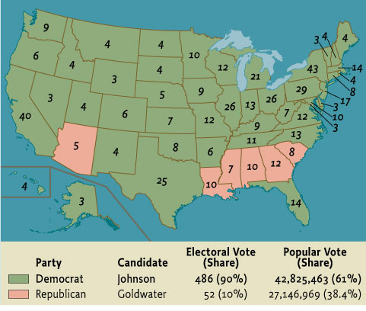
Map 25.1 The Residential Election of 1964
Give Me Liberty!: An American history, 3rd Edition
Copyright © 2011 W.W. Norton & Company

Slide 9
Lyndon Johnson’s Presidency
In early 1965, Martin Luther King, Jr., launched a voting rights drive in Selma, Alabama. Defying a ban by Governor Wallace, King tried to lead a march from Selma to the state capital, Montgomery. State police met the marches with cattle prods, whips, and tear gas. Once more, images of brutal police attacks on non-violent demonstrators flashed on televisions worldwide. The government was forced to take action, and Johnson quickly asked Congress to pass a law securing the right to vote. Congress soon enacted the Voting Rights Acts of 1965, which allowed federal officials to register voters. Black southerners finally regained the suffrage that had been denied them since the end of the nineteenth century. The twenty-fourth Amendment to the Constitution also outlawed the poll tax, which had prevented poor blacks and some whites from voting in the South.
By 1965, the belief spread by the civil rights movement that racism could no longer create second-class citizens affected other policy debates. In 1965, the Hart-Celler Act ended the national-origins quota system of immigration that had excluded Asians and restricted immigration from southern and eastern Europe. The law established new, racially neutral criteria for immigration, including family reunification and the demand for skills needed in America. Yet, because of growing hostility in the Southwest to Mexican immigration, the law for the first time sharply limited immigration from the Western Hemisphere to 120,000 per year. This provision created the category of “illegal aliens” for migrants from elsewhere in the Americas. The law set the quota for the rest of the world at 170,000 per year. Exceptions for refugees from communist countries soon let immigration exceed the limits. Although immigrants were only 5 percent of the nation’s population at the time, the reform caused a dramatic shift in the sources of immigration to Latin America, the Caribbean, and Asia.
Notes:
In early 1965, Martin Luther King, Jr., launched a voting rights drive in Selma, Alabama. Defying a ban by Governor Wallace, King tried to lead a march from Selma to the state capital, Montgomery. State police met the marches with cattle prods, whips, and tear gas. Once more, images of brutal police attacks on non-violent demonstrators flashed on televisions worldwide. The government was forced to take action, and Johnson quickly asked Congress to pass a law securing the right to vote. Congress soon enacted the Voting Rights Acts of 1965, which allowed federal officials to register voters. Black southerners finally regained the suffrage that had been denied them since the end of the nineteenth century. The twenty-fourth Amendment to the Constitution also outlawed the poll tax, which had prevented poor blacks and some whites from voting in the South.
By 1965, the belief spread by the civil rights movement that racism could no longer create second-class citizens affected other policy debates. In 1965, the Hart-Celler Act ended the national-origins quota system of immigration that had excluded Asians and restricted immigration from southern and eastern Europe. The law established new, racially neutral criteria for immigration, including family reunification and the demand for skills needed in America. Yet, because of growing hostility in the Southwest to Mexican immigration, the law for the first time sharply limited immigration from the Western Hemisphere to 120,000 per year. This provision created the category of “illegal aliens” for migrants from elsewhere in the Americas. The law set the quota for the rest of the world at 170,000 per year. Exceptions for refugees from communist countries soon let immigration exceed the limits. Although immigrants were only 5 percent of the nation’s population at the time, the reform caused a dramatic shift in the sources of immigration to Latin America, the Caribbean, and Asia.

Slide 10
Lyndon Johnson’s Presidency
After his 1964 election victory, Johnson outlined the greatest plan for government action to promote the general welfare since the New Deal. Johnson’s programs of 1965–1967, known as the Great Society, provided health services to the poor and elderly in the new Medicaid and Medicare programs and poured federal funds into education and urban development. New cabinet-level offices, such as the Departments of Transportation and Housing and Urban Development, and new agencies, such as the Equal Employment Opportunities Commission and a national public broadcasting network, were established. These measures greatly expanded the federal government’s powers, and completed and extended the social agenda (except national health insurance) that had stalled in Congress since 1938. Yet the Great Society was a response to prosperity, not depression. In the mid-1960s, the economy was expanding, fueled by higher government spending and a tax cut for individuals and businesses passed in 1964. Johnson and Democratic liberals believed economic growth would fund more government programs and improve Americans’ quality of life.
Notes:
After his 1964 election victory, Johnson outlined the greatest plan for government action to promote the general welfare since the New Deal. Johnson’s programs of 1965–1967, known as the Great Society, provided health services to the poor and elderly in the new Medicaid and Medicare programs and poured federal funds into education and urban development. New cabinet-level offices, such as the Departments of Transportation and Housing and Urban Development, and new agencies, such as the Equal Employment Opportunities Commission and a national public broadcasting network, were established. These measures greatly expanded the federal government’s powers, and completed and extended the social agenda (except national health insurance) that had stalled in Congress since 1938. Yet the Great Society was a response to prosperity, not depression. In the mid-1960s, the economy was expanding, fueled by higher government spending and a tax cut for individuals and businesses passed in 1964. Johnson and Democratic liberals believed economic growth would fund more government programs and improve Americans’ quality of life.

Slide 11
Lyndon Johnson’s Presidency
The War on Poverty was the centerpiece of the Great Society. Launched in 1964, this effort was inspired in part by politicians’ rediscovery of poverty amid 1950s affluence. In 1962, Michael Harrington’s book, The Other America, showed that 40–50 million Americans still lived in poverty in urban and rural areas removed from middle-class life and consciousness. Harrington showed that the mechanization of agriculture and automation of industry had cut jobs for the unskilled. The civil rights movement highlighted the problem of poverty for blacks, but Harrington showed the majority of the poor were white.
While Democrats during the New Deal had attributed poverty to an imbalance of economic power and flawed economic institutions, the Johnson administration believed poverty was caused by a lack of skills and proper attitudes and work habits. The War on Poverty did not directly fight poverty, through efforts like works programs, spreading unions, or preventing businesses from moving production to the low-wage South or overseas. It did not address economic changes that reduced well-paid factory jobs and left poor rural and urban families with few opportunities. Perhaps the most successful and popular program was food stamps, a form of direct aid. But the War on Poverty sought to equip the poor with skills and motivate them. A new Office of Economic Opportunity created Head Start (early childhood education), job training, legal services, college scholarships, and Volunteers in Service to America (VISTA), a domestic version of the Peace Corps. It also created Community Action Programs that required that poor people participate in forming local policies—which fostered resentment among local officials used to controlling federal funds.
Notes:
The War on Poverty was the centerpiece of the Great Society. Launched in 1964, this effort was inspired in part by politicians’ rediscovery of poverty amid 1950s affluence. In 1962, Michael Harrington’s book, The Other America, showed that 40–50 million Americans still lived in poverty in urban and rural areas removed from middle-class life and consciousness. Harrington showed that the mechanization of agriculture and automation of industry had cut jobs for the unskilled. The civil rights movement highlighted the problem of poverty for blacks, but Harrington showed the majority of the poor were white.
While Democrats during the New Deal had attributed poverty to an imbalance of economic power and flawed economic institutions, the Johnson administration believed poverty was caused by a lack of skills and proper attitudes and work habits. The War on Poverty did not directly fight poverty, through efforts like works programs, spreading unions, or preventing businesses from moving production to the low-wage South or overseas. It did not address economic changes that reduced well-paid factory jobs and left poor rural and urban families with few opportunities. Perhaps the most successful and popular program was food stamps, a form of direct aid. But the War on Poverty sought to equip the poor with skills and motivate them. A new Office of Economic Opportunity created Head Start (early childhood education), job training, legal services, college scholarships, and Volunteers in Service to America (VISTA), a domestic version of the Peace Corps. It also created Community Action Programs that required that poor people participate in forming local policies—which fostered resentment among local officials used to controlling federal funds.

Slide 12
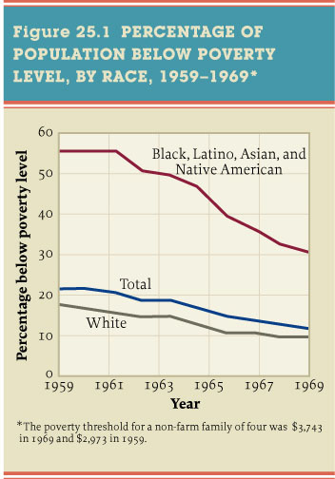
Figure 25.1 Percentage of Population Below
Poverty Level, by Race, 1959–1969*
Give Me Liberty!: An American history, 3rd Edition
Copyright © 2011 W.W. Norton & Company

Slide 13
Lyndon Johnson’s Presidency
Johnson defended the Great Society in a New Deal language of freedom reinforced by the civil rights movement. Recognizing that black poverty, caused by past and present racism, was different from white poverty, he tried to redefine the relationship between freedom and equality. He argued that economic liberty was more than equal opportunity. But while Johnson’s Great Society may not have achieved equality, it did reaffirm the idea of social citizenship. It was the greatest effort in American history to mobilize the powers of the federal government to aid the less fortunate Americans, especially those, like blacks, who had been excluded by original New Deal entitlements like Social Security.
Combined with incredible economic growth, the War on Poverty reduced poverty rates from 22 to 13 percent of American families during the 1960s. But the amount spent on the programs was too low to end poverty or transform life in poor urban areas. By the 1990s, the historic gap between whites and blacks in education, income, and access to skilled jobs had greatly narrowed. But deindustrialization and urban decay, combined with residential segregation, kept the wealth of white households ten times as great as that of blacks and left nearly a quarter of all black children in poverty.
Notes:
Johnson defended the Great Society in a New Deal language of freedom reinforced by the civil rights movement. Recognizing that black poverty, caused by past and present racism, was different from white poverty, he tried to redefine the relationship between freedom and equality. He argued that economic liberty was more than equal opportunity. But while Johnson’s Great Society may not have achieved equality, it did reaffirm the idea of social citizenship. It was the greatest effort in American history to mobilize the powers of the federal government to aid the less fortunate Americans, especially those, like blacks, who had been excluded by original New Deal entitlements like Social Security.
Combined with incredible economic growth, the War on Poverty reduced poverty rates from 22 to 13 percent of American families during the 1960s. But the amount spent on the programs was too low to end poverty or transform life in poor urban areas. By the 1990s, the historic gap between whites and blacks in education, income, and access to skilled jobs had greatly narrowed. But deindustrialization and urban decay, combined with residential segregation, kept the wealth of white households ten times as great as that of blacks and left nearly a quarter of all black children in poverty.

Slide 14
The Changing Black Movement
The civil rights movement entered a crisis when it moved from demanding access to schools, public facilities, and voting booths to economic disparities between blacks and whites. In the mid-1960s, economic problems became a civil rights priority. Violence in northern ghettos brought attention to racial injustice and inequalities in jobs, education, and housing, which the end of legal segregation didn’t solve. The hostility of later race relations emerged from many whites’ belief that blacks had won equality in civil rights and voting rights laws and needed no further assistance, while blacks, aware of discrimination in jobs, education, housing, and the criminal justice system, called for more government action.
The first riots—actually battles between blacks and mostly white police—erupted in Harlem in 1964. The larger uprising of 1965 in Watts, the black ghetto of Los Angeles, saw 50,000 rioters attack police and firemen, loot white-owned businesses, and burn buildings. After the National Guard restored order, 35 had been killed, 900 injured, and $20 million in property destroyed. By the summer of 1967, urban riots seemed everywhere. Some feared racial war. Urban rebellions left 23 dead in Newark and 43 in Detroit, huge parts of which were devastated. Johnson appointed a commission to study the causes of urban disorder, whose report blamed them on “segregation and poverty,” indicted “white racism,” and claimed that the society was becoming harshly divided on racial lines.
The civil rights movement, knowing black unemployment was twice that of whites and that the average black family had little more than half the income of white families, moved to address economic freedom for black Americans. In 1964, King called for a bill of rights that would offer positive economic rights to African-Americans—what would become affirmative action. In 1966, he launched the Chicago Freedom Movement, demanding an end to discrimination by employers and unions, equal access to mortgages, the integration of public housing, and decentralized low-income housing. But King’s movement was no match for the political machine of Chicago’s major, Richard J. Daley, and white homeowners who fiercely opposed him. King’s non-violent attacks failed in the North. King became more radical, and started to call for a “better distribution of wealth” for “all God’s children.”
Notes:
The civil rights movement entered a crisis when it moved from demanding access to schools, public facilities, and voting booths to economic disparities between blacks and whites. In the mid-1960s, economic problems became a civil rights priority. Violence in northern ghettos brought attention to racial injustice and inequalities in jobs, education, and housing, which the end of legal segregation didn’t solve. The hostility of later race relations emerged from many whites’ belief that blacks had won equality in civil rights and voting rights laws and needed no further assistance, while blacks, aware of discrimination in jobs, education, housing, and the criminal justice system, called for more government action.
The first riots—actually battles between blacks and mostly white police—erupted in Harlem in 1964. The larger uprising of 1965 in Watts, the black ghetto of Los Angeles, saw 50,000 rioters attack police and firemen, loot white-owned businesses, and burn buildings. After the National Guard restored order, 35 had been killed, 900 injured, and $20 million in property destroyed. By the summer of 1967, urban riots seemed everywhere. Some feared racial war. Urban rebellions left 23 dead in Newark and 43 in Detroit, huge parts of which were devastated. Johnson appointed a commission to study the causes of urban disorder, whose report blamed them on “segregation and poverty,” indicted “white racism,” and claimed that the society was becoming harshly divided on racial lines.
The civil rights movement, knowing black unemployment was twice that of whites and that the average black family had little more than half the income of white families, moved to address economic freedom for black Americans. In 1964, King called for a bill of rights that would offer positive economic rights to African-Americans—what would become affirmative action. In 1966, he launched the Chicago Freedom Movement, demanding an end to discrimination by employers and unions, equal access to mortgages, the integration of public housing, and decentralized low-income housing. But King’s movement was no match for the political machine of Chicago’s major, Richard J. Daley, and white homeowners who fiercely opposed him. King’s non-violent attacks failed in the North. King became more radical, and started to call for a “better distribution of wealth” for “all God’s children.”

Slide 15
The Changing Black Movement
If the early civil rights movement had clear objectives and profound accomplishments, the later movement saw political fragmentation and few victories. Even during the height of integration struggles, the incendiary orator Malcolm X insisted that blacks must control the political and economic resources of their own communities and avoid working with whites. Named Malcolm Little when as a youth he committed several crimes, Malcolm X converted in jail to the Nation of Islam, or Black Muslims, who preached a message of white evil and black discipline. Malcolm dropped his “slave surname” in favor of “X,” symbolizing blacks’ separation from African ancestry. Released from prison, Malcolm X became a spokesman for the Muslims and a vehement critic of the integrationism and non-violence of King and the civil rights movement. Unlike King, Malcolm X saw nothing redemptive in American values. On a 1964 trip to Mecca, Islam’s spiritual center, Malcolm X saw inter-racial harmony between Muslims and moderated his message, embracing the possibility of interracial cooperation for radical change in America. But his assassination in early 1965 left no consistent ideology or organization behind. His calls for black independence inspired the urban poor and younger civil rights activists, and his 1966 autobiography became a bestseller.
Malcolm X was the father of “Black Power,” a slogan popularized by SNCC leader Stokely Carmichael in 1966 during a march in Mississippi. Black Power rallied those angry with the federal government’s failure to stop violence against civil rights activists, white attempts to dominate the movement, and the movement’s inability to influence the economic plight of urban blacks. Black Power suggested everything from electing more blacks to political office to the belief that blacks were a colonized people whose freedom could be won only through revolutionary struggles for self-determination. The idea reflected the radicalization of young civil rights activists and inspired cultural pride. The word “Negro” was abandoned for “Afro-American,” and African dress and hairstyles were celebrated. Previously interracial civil rights groups like SNCC and CORE also repudiated their inclusion of whites, and they soon disintegrated. New groups sprang up, however, most prominently the Black Panther Party, formed in Oakland, California, in 1966 to protest policy brutality. The Black Panthers won notoriety for advocating armed self-defense, and their militant stance and actions alarmed moderate blacks and many whites. Troubled by internal disputes and police and FBI repression, the Black Panthers disintegrated by the early 1970s.
Notes:
If the early civil rights movement had clear objectives and profound accomplishments, the later movement saw political fragmentation and few victories. Even during the height of integration struggles, the incendiary orator Malcolm X insisted that blacks must control the political and economic resources of their own communities and avoid working with whites. Named Malcolm Little when as a youth he committed several crimes, Malcolm X converted in jail to the Nation of Islam, or Black Muslims, who preached a message of white evil and black discipline. Malcolm dropped his “slave surname” in favor of “X,” symbolizing blacks’ separation from African ancestry. Released from prison, Malcolm X became a spokesman for the Muslims and a vehement critic of the integrationism and non-violence of King and the civil rights movement. Unlike King, Malcolm X saw nothing redemptive in American values. On a 1964 trip to Mecca, Islam’s spiritual center, Malcolm X saw inter-racial harmony between Muslims and moderated his message, embracing the possibility of interracial cooperation for radical change in America. But his assassination in early 1965 left no consistent ideology or organization behind. His calls for black independence inspired the urban poor and younger civil rights activists, and his 1966 autobiography became a bestseller.
Malcolm X was the father of “Black Power,” a slogan popularized by SNCC leader Stokely Carmichael in 1966 during a march in Mississippi. Black Power rallied those angry with the federal government’s failure to stop violence against civil rights activists, white attempts to dominate the movement, and the movement’s inability to influence the economic plight of urban blacks. Black Power suggested everything from electing more blacks to political office to the belief that blacks were a colonized people whose freedom could be won only through revolutionary struggles for self-determination. The idea reflected the radicalization of young civil rights activists and inspired cultural pride. The word “Negro” was abandoned for “Afro-American,” and African dress and hairstyles were celebrated. Previously interracial civil rights groups like SNCC and CORE also repudiated their inclusion of whites, and they soon disintegrated. New groups sprang up, however, most prominently the Black Panther Party, formed in Oakland, California, in 1966 to protest policy brutality. The Black Panthers won notoriety for advocating armed self-defense, and their militant stance and actions alarmed moderate blacks and many whites. Troubled by internal disputes and police and FBI repression, the Black Panthers disintegrated by the early 1970s.

Slide 16
Vietnam and the New Left
The rise of a white youth student movement was a surprise to many. Colleges had long been conservative institutions that drew their students from the privileged strata in American society, and few thought college students in the 1960s had anything to complain about. But student definitions of freedom, as they took form in a critique of mainstream values and institutions, birthed a protest movement that came to be called the New Left.
What made the New Left new was its rejection of the political and intellectual categories that had shaped radicalism and liberalism for most of the twentieth century. It challenged mainstream America and the Old Left of the 1930s and 1940s. Unlike the Communist Party, it did not see the Soviet Union as a model society or view the working class as the main agent of social change. Not language of economic equality and social citizenship, but the language of loneliness, isolation, alienation, and powerlessness in a bureaucratic society whose affluence denied authenticity characterized New Left expression. The baby boom produced a mass generation influenced by these ideas, as more than 7 million attended college by 1968.
The New Left ultimately had roots in the American Revolution and the critique made by the abolitionists of the gap between American values and realities. It was inspired by the cultural radicalisms of the 1910s and 1950s. But its most immediate inspiration was the black freedom movement. “The Sixties”—a decade of political, racial, and cultural turmoil—was born of claims made by those who felt excluded from society, from southern and urban blacks to middle-class students. Both the black movement and the white New Left shared the belief that evils were deeply embedded in America’s institutions and could only be resolved through direct confrontation.
Notes:
The rise of a white youth student movement was a surprise to many. Colleges had long been conservative institutions that drew their students from the privileged strata in American society, and few thought college students in the 1960s had anything to complain about. But student definitions of freedom, as they took form in a critique of mainstream values and institutions, birthed a protest movement that came to be called the New Left.
What made the New Left new was its rejection of the political and intellectual categories that had shaped radicalism and liberalism for most of the twentieth century. It challenged mainstream America and the Old Left of the 1930s and 1940s. Unlike the Communist Party, it did not see the Soviet Union as a model society or view the working class as the main agent of social change. Not language of economic equality and social citizenship, but the language of loneliness, isolation, alienation, and powerlessness in a bureaucratic society whose affluence denied authenticity characterized New Left expression. The baby boom produced a mass generation influenced by these ideas, as more than 7 million attended college by 1968.
The New Left ultimately had roots in the American Revolution and the critique made by the abolitionists of the gap between American values and realities. It was inspired by the cultural radicalisms of the 1910s and 1950s. But its most immediate inspiration was the black freedom movement. “The Sixties”—a decade of political, racial, and cultural turmoil—was born of claims made by those who felt excluded from society, from southern and urban blacks to middle-class students. Both the black movement and the white New Left shared the belief that evils were deeply embedded in America’s institutions and could only be resolved through direct confrontation.

Slide 17
Vietnam and the New Left
In 1962 and 1963, books appeared that challenged the 1950s consensus. James Baldwin’s The Fire Next Time captured the anger of blacks; Rachel Carson’s The Silent Spring showed the environmental costs of economic growth; and Jane Jacobs’ The Death and Life of Great American Cities criticized the urban renewal and highway construction that made cities larger and less diverse, and thus less livable and socially interactive. But in some ways the most influential critique came in 1962 from a small group of liberal and radical college students, Students for a Democratic Society (SDS). Their Port Huron statement, composed at Port Huron, Michigan, criticized American institutions, including political parties, corporations, unions, and the military-industrial complex. But the document inspired new student radicalism with its vision of social change. The statements’ authors called for the creation of a democracy of individual participation, where the “individual shares in those social decisions determining the quality and direction of his life.” Freedom, for the New Left, meant “participatory democracy.” This rather vague standard was used to judge existing social arrangements, and workplaces, schools, and government were found to be deeply flawed and undemocratic. The New Left rejected a society run by experts, the dream of the Progressive generation.
SDS grew quickly, and in 1964, events at the University of California at Berkeley revealed the power of the student movement. This university, an immense and bureaucratic Cold War institution, imposed a new rule that banned political groups from using a central area of the campus to distribute ideas and literature. It sparked massive protests. Students, including conservatives, created a movement for free expression. Protest leaders likened the university to a knowledge factory, and encouraged students to break the machines. Massive protests for months caused the university to rescind its ban on free expression.
Notes:
In 1962 and 1963, books appeared that challenged the 1950s consensus. James Baldwin’s The Fire Next Time captured the anger of blacks; Rachel Carson’s The Silent Spring showed the environmental costs of economic growth; and Jane Jacobs’ The Death and Life of Great American Cities criticized the urban renewal and highway construction that made cities larger and less diverse, and thus less livable and socially interactive. But in some ways the most influential critique came in 1962 from a small group of liberal and radical college students, Students for a Democratic Society (SDS). Their Port Huron statement, composed at Port Huron, Michigan, criticized American institutions, including political parties, corporations, unions, and the military-industrial complex. But the document inspired new student radicalism with its vision of social change. The statements’ authors called for the creation of a democracy of individual participation, where the “individual shares in those social decisions determining the quality and direction of his life.” Freedom, for the New Left, meant “participatory democracy.” This rather vague standard was used to judge existing social arrangements, and workplaces, schools, and government were found to be deeply flawed and undemocratic. The New Left rejected a society run by experts, the dream of the Progressive generation.
SDS grew quickly, and in 1964, events at the University of California at Berkeley revealed the power of the student movement. This university, an immense and bureaucratic Cold War institution, imposed a new rule that banned political groups from using a central area of the campus to distribute ideas and literature. It sparked massive protests. Students, including conservatives, created a movement for free expression. Protest leaders likened the university to a knowledge factory, and encouraged students to break the machines. Massive protests for months caused the university to rescind its ban on free expression.

Slide 18
Vietnam and the New Left
The Vietnam War transformed black and New Left protest into a generational rebellion. The war, a logical extension of Cold War assumptions and policies, demonstrated the danger of treating the world and every local situation through a simple anti-communist lens. Few Americans, even policymakers deciding to go to war, knew much at all about Vietnam’s history or culture. Cold War administrations viewed a complex national liberation struggle, led by homegrown communists who had broad popular support and Soviet backing, as a test of “containment.” The Truman and Eisenhower administration had supported France’s failed efforts to retain Vietnam as a colony, but then cast their lot with the South Vietnamese government, in violation of Geneva accords that had promised elections to unify North and South Vietnam. By the 1960s, the United States supported Ngo Dinh Diem’s brutal and corrupt regime in the South.
Fears that voters would not forgive them if they “lost” Vietnam made Kennedy and Johnson reluctant to remove U.S. aid and forces from Vietnam. Kennedy’s advisors saw Vietnam as a test of whether the US could successfully conduct counterinsurgencies—interventions against internal uprisings in non-communist countries—in order to stop Third World revolutions. But U.S. advisors in Vietnam aiding Diem’s government could not check the progress of the communist-led Viet Cong insurgency, and in October 1963, after large Buddhist protests against Diem’s regime, the United States approved a military coup that led to Diem’s death.
Notes:
The Vietnam War transformed black and New Left protest into a generational rebellion. The war, a logical extension of Cold War assumptions and policies, demonstrated the danger of treating the world and every local situation through a simple anti-communist lens. Few Americans, even policymakers deciding to go to war, knew much at all about Vietnam’s history or culture. Cold War administrations viewed a complex national liberation struggle, led by homegrown communists who had broad popular support and Soviet backing, as a test of “containment.” The Truman and Eisenhower administration had supported France’s failed efforts to retain Vietnam as a colony, but then cast their lot with the South Vietnamese government, in violation of Geneva accords that had promised elections to unify North and South Vietnam. By the 1960s, the United States supported Ngo Dinh Diem’s brutal and corrupt regime in the South.
Fears that voters would not forgive them if they “lost” Vietnam made Kennedy and Johnson reluctant to remove U.S. aid and forces from Vietnam. Kennedy’s advisors saw Vietnam as a test of whether the US could successfully conduct counterinsurgencies—interventions against internal uprisings in non-communist countries—in order to stop Third World revolutions. But U.S. advisors in Vietnam aiding Diem’s government could not check the progress of the communist-led Viet Cong insurgency, and in October 1963, after large Buddhist protests against Diem’s regime, the United States approved a military coup that led to Diem’s death.

Slide 19
Vietnam and the New Left
Lyndon Johnson took office with little experience in foreign relations. While reluctant to send US troops to South Vietnam and fearing interminable involvement, he felt that “losing” Vietnam would deliver electoral advantages to Republicans. In August 1964, North Vietnamese boats encountered an American ship on a spy mission off of North Vietnam’s coast. When the boats fired on the U.S .vessel, Johnson claimed the United States was a victim of aggression. Congress passed the Gulf of Tonkin resolution, authorizing the president to take measures to defend U.S. forces in Vietnam. Only two senators voted against the resolution, the nearest the United States came to declaring war in this conflict, and it passed without any discussion of U.S. goals or strategy. (In 2005, the National Security Agency released secret documents which made clear that no North Vietnamese attack ever occurred.)
Notes:
Lyndon Johnson took office with little experience in foreign relations. While reluctant to send US troops to South Vietnam and fearing interminable involvement, he felt that “losing” Vietnam would deliver electoral advantages to Republicans. In August 1964, North Vietnamese boats encountered an American ship on a spy mission off of North Vietnam’s coast. When the boats fired on the U.S .vessel, Johnson claimed the United States was a victim of aggression. Congress passed the Gulf of Tonkin resolution, authorizing the president to take measures to defend U.S. forces in Vietnam. Only two senators voted against the resolution, the nearest the United States came to declaring war in this conflict, and it passed without any discussion of U.S. goals or strategy. (In 2005, the National Security Agency released secret documents which made clear that no North Vietnamese attack ever occurred.)
In the 1964 election campaign, Johnson said he did not intend to send U.S. troops to Vietnam. Advised to do so after the proper provocation, he launched air strikes against North Vietnam and sent U.S. ground troops to the South when the Viet Cong, in early 1965, attacked a U.S .air base. By 1968, more than half a million U.S. troops were at war in South Vietnam. US forces bombed North and South Vietnam with more tonnage than was used by all sides in World War II. U.S. ground forces ruthlessly hunted the Viet Cong in “search and destroy” operations that left villages burned and many civilians killed. But the might of the U.S. military did not break the Viet Cong insurgency or its North Vietnamese support.
Simultaneously, Johnson sent U.S. troops to the Dominican Republic, where military leaders tried to restore the rule of Juan Bosch, the left-wing but non-communist president who in 1963 had been removed from power by a military coup. Johnson dispatched troops to quell unrest and ensure that Bosch would not return.

Slide 20
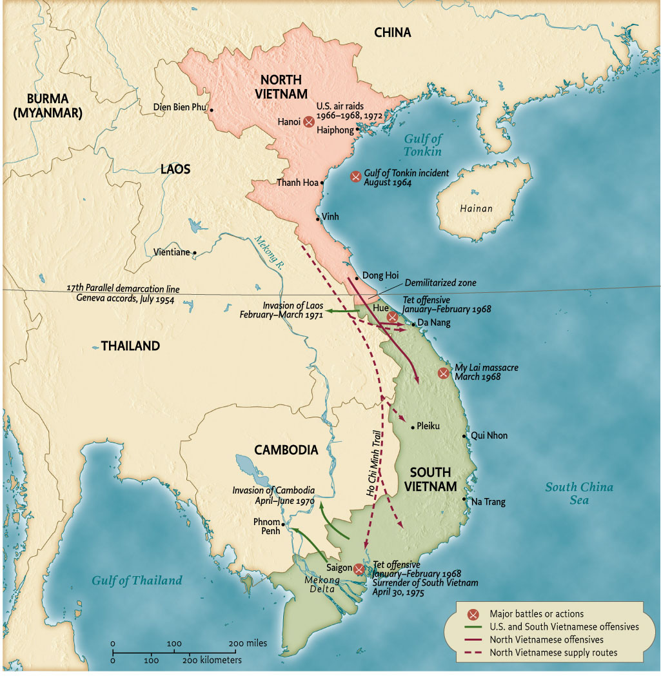
Map 25.2 The Vietnam War, 1964-1975
Give Me Liberty!: An American history, 3rd Edition
Copyright © 2011 W.W. Norton & Company

Slide 21
Vietnam and the New Left
With rising casualties and the massive bombing of North and South Vietnam, the Cold War consensus began to disintegrate. By 1968, the war had sidetracked much of the Great Society and divided families, universities, and the Democratic Party. With both liberal and conservative political leaders committed to the war, young activists lost all confidence in the political system. Opposition to the war united all kinds of grievances and discontent with American society. With college students exempted from the draft, the fighting of the war fell to working class and poor draftees. In 1967, even Martin Luther King, Jr., a onetime ally of President Johnson, condemned the war for its violence and its diversion of resources from America. To SDS, the war seemed to epitomize the antithesis of participatory democracy, since U.S. intervention has risen from secret commitments and decisions made by political elites, with no real debate. SDS organized the first major anti-war demonstration, which occurred in Washington, D.C., in April 1965, and from there protests spread across the country. By 1967, young men were burning their draft cards and fleeing to Canada to avoid fighting what they believed to be an unjust war. In October 1967, as many as 100,000 antiwar protesters converged on the Pentagon.
Notes:
With rising casualties and the massive bombing of North and South Vietnam, the Cold War consensus began to disintegrate. By 1968, the war had sidetracked much of the Great Society and divided families, universities, and the Democratic Party. With both liberal and conservative political leaders committed to the war, young activists lost all confidence in the political system. Opposition to the war united all kinds of grievances and discontent with American society. With college students exempted from the draft, the fighting of the war fell to working class and poor draftees. In 1967, even Martin Luther King, Jr., a onetime ally of President Johnson, condemned the war for its violence and its diversion of resources from America. To SDS, the war seemed to epitomize the antithesis of participatory democracy, since U.S. intervention has risen from secret commitments and decisions made by political elites, with no real debate. SDS organized the first major anti-war demonstration, which occurred in Washington, D.C., in April 1965, and from there protests spread across the country. By 1967, young men were burning their draft cards and fleeing to Canada to avoid fighting what they believed to be an unjust war. In October 1967, as many as 100,000 antiwar protesters converged on the Pentagon.
During the 1960s, Americans’ definition of freedom grew to include cultural freedom. The war was a central cause of the generational rebellion called the counterculture. By the late 1960s, millions of young people rejected their elders’ values and behavior. Their ranks included not just college student, but young workers, even though most unions strongly condemned anti-war protests and the counterculture. For the first time in American history, the repudiation of respectable norms in clothing, language, sexual behavior, and drug use became the foundations of a mass movement. Much of the counterculture, such as colorful clothes, rock music, and images of sexual freedom, were easily turned into mass-marketed goods, even though ostensibly they represented a rejection of mass consumer culture. But self-indulgence and self-destruction were built into the counterculture. Countercultural icons like Timothy Leary urged young people to take hallucinogenic drugs like LSD and “turn on, tune in, drop out.”
Yet the counterculture was more than just sex, drugs, and rock and roll. Personal liberation represented a rebellion against and release from bureaucratized education and work, repressive behavioral norms, and a militarized state that wreaked destruction on distant lands. It encouraged new forms of radical action. “Underground” newspapers pioneered a highly personal and political journalism. The Youth International Party, or “Yippies,” injected human and spectacle into protest, in one instance throwing dollar bills from the visitors’ gallery onto the floor of the New York Stock Exchange, halting trading as brokers scrambled to grab the money. The counterculture established havens in cities like New York, in the East Village, and San Francisco’s Haight-Ashbury. 2,000 communes were established in rural areas throughout the nation. The Woodstock music festival in upstate New York in 1969 brought hundreds of thousands of young people together, who were welcomed with the first song, by Richie Havens, who began it by repeating a single word, “Freedom.” Above all, the counterculture centered on the free individual, nowhere more so than in sexual freedom. The birth-control pill had separated sex from reproduction and allowed “free love” to flourish.

Slide 22
The New Movements and the Rights Revolution
The sexual revolution also contributed to the birth of the “second wave” of feminism in the late 1960s. The civil rights movement had inspired other Americans to express their grievances and claim rights. Many borrowed the militant tactics of blacks and students, and adopted their language of “power” and “liberation,” rejecting traditional organizations and approaches.
Women’s suffrage had not ended women’s lack of power and opportunity. When the 1960s began, only a few women held political office, women were still restricted to traditionally female occupations, and major universities limited the number of women admitted. But a new feminist consciousness began to emerge in 1963, with the publication of Betty Friedan’s The Feminine Mystique. Friedan criticized the emptiness of consumer culture and emphasized middle class discontent. Her book portrayed talented and educated women trapped in world in which they believed marriage and motherhood were their primary ambitions. Women’s lives still revolved around the home, now a suburban home, which Friedan called a “comfortable concentration camp.” The book focused attention on feminist concerns. In 1963, Congress passed the Equal Pay Act, barring sex discrimination among those holding the same job. The Civil Rights Act prohibited inequalities base on sex as well as race. The Equal Employment Opportunity Commission challenged barriers to women’s employment. In 1966, the National Organization of Women was formed, with Friedan the president, as a civil rights organization to press for equal opportunity in jobs, education, and political participation.
A more militant feminist movement emerged from the civil rights and student movements. Young women who embraced ideologies of equality and freedom and learned political organizing skills, once facing inequality and sexual exploitation within these movements, formed their own. Some white women in civil rights work drew parallels between the treatment of blacks and women. In SDS, women protested their subordination and exploitation by male activists. By 1967, women were forming “consciousness-raising” groups to discuss the cause of their discontent. The movement began sensationally at the Miss America beauty pageant in Atlantic City in 1968, where women threw into a trash can (but did not burn) bras, high-heeled shoes, and copies of Playboy and Cosmopolitan.
Notes:
The sexual revolution also contributed to the birth of the “second wave” of feminism in the late 1960s. The civil rights movement had inspired other Americans to express their grievances and claim rights. Many borrowed the militant tactics of blacks and students, and adopted their language of “power” and “liberation,” rejecting traditional organizations and approaches.
Women’s suffrage had not ended women’s lack of power and opportunity. When the 1960s began, only a few women held political office, women were still restricted to traditionally female occupations, and major universities limited the number of women admitted. But a new feminist consciousness began to emerge in 1963, with the publication of Betty Friedan’s The Feminine Mystique. Friedan criticized the emptiness of consumer culture and emphasized middle class discontent. Her book portrayed talented and educated women trapped in world in which they believed marriage and motherhood were their primary ambitions. Women’s lives still revolved around the home, now a suburban home, which Friedan called a “comfortable concentration camp.” The book focused attention on feminist concerns. In 1963, Congress passed the Equal Pay Act, barring sex discrimination among those holding the same job. The Civil Rights Act prohibited inequalities base on sex as well as race. The Equal Employment Opportunity Commission challenged barriers to women’s employment. In 1966, the National Organization of Women was formed, with Friedan the president, as a civil rights organization to press for equal opportunity in jobs, education, and political participation.
A more militant feminist movement emerged from the civil rights and student movements. Young women who embraced ideologies of equality and freedom and learned political organizing skills, once facing inequality and sexual exploitation within these movements, formed their own. Some white women in civil rights work drew parallels between the treatment of blacks and women. In SDS, women protested their subordination and exploitation by male activists. By 1967, women were forming “consciousness-raising” groups to discuss the cause of their discontent. The movement began sensationally at the Miss America beauty pageant in Atlantic City in 1968, where women threw into a trash can (but did not burn) bras, high-heeled shoes, and copies of Playboy and Cosmopolitan.

Slide 23
The New Movements and the Rights Revolution
Personal Freedom
The women’s liberation movement greatly expanded the idea of freedom by insisting that it should be applied to the most personal and intimate parts of life. These feminists, introducing terms like sexism, sexual politics, and the phrase, the personal is political, argued that sexual relations, marriage, and beauty standards were just as political as war, civil rights, and class tensions. This repudiated the sacred nuclear family of the 1950s and permanently changed Americans’ definition of freedom. Radical feminists first campaigned for the repeal of state laws that denied women the right to terminate a pregnancy. They defined control over reproduction as the most basic of women’s freedoms. But women liberations’ concerns went far beyond sexual freedom. Interests ranged from combating domestic violence, to inequalities in the law, churches, workplaces, and family. By 1970, feminist ideas were penetrating mainstream American life.
Gay Liberation
Perhaps the greatest surprise of the 1960s was the movement for gay liberation. Gays and lesbians had formed societies in the 1950s, but these were not protest groups. Homosexuals faced stigmatization as sinful or mentally ill, most states made homosexual acts illegal, and police harassed gays in major cities like San Francisco and New York. Most gays and lesbians kept their sexuality “in the closet.” The 1960s transformed gay politics. One moment in particular marks the beginning of gay liberation—the 1969 riot caused by a police raid on the Stonewall Bar in New York’s Greenwich Village. Instead of complying with police as usual, gays fought back. In a few years, “gay pride” marches were being held in cities across the country.
Notes:
The women’s liberation movement greatly expanded the idea of freedom by insisting that it should be applied to the most personal and intimate parts of life. These feminists, introducing terms like sexism, sexual politics, and the phrase, the personal is political, argued that sexual relations, marriage, and beauty standards were just as political as war, civil rights, and class tensions. This repudiated the sacred nuclear family of the 1950s and permanently changed Americans’ definition of freedom. Radical feminists first campaigned for the repeal of state laws that denied women the right to terminate a pregnancy. They defined control over reproduction as the most basic of women’s freedoms. But women liberations’ concerns went far beyond sexual freedom. Interests ranged from combating domestic violence, to inequalities in the law, churches, workplaces, and family. By 1970, feminist ideas were penetrating mainstream American life.
Perhaps the greatest surprise of the 1960s was the movement for gay liberation. Gays and lesbians had formed societies in the 1950s, but these were not protest groups. Homosexuals faced stigmatization as sinful or mentally ill, most states made homosexual acts illegal, and police harassed gays in major cities like San Francisco and New York. Most gays and lesbians kept their sexuality “in the closet.” The 1960s transformed gay politics. One moment in particular marks the beginning of gay liberation—the 1969 riot caused by a police raid on the Stonewall Bar in New York’s Greenwich Village. Instead of complying with police as usual, gays fought back. In a few years, “gay pride” marches were being held in cities across the country.

Slide 24
The New Movements and the Rights Revolution
Latino Activism
In the mid-1960s, a new movement emerged among Mexican-Americans that challenged their status as second-class citizens. Like Black Power, this movement emphasized pride in the Mexican past and the Chicano culture born in the United States. But unlike SDS and Black Power, Latino activism was tied to labor struggles. In 1965, César Chavez, the son of migrant farm workers and disciple of Martin Luther King, Jr., led nonviolent protests to force growers to sign labor contracts with the United Farm Workers (UFW) union. The UFW campaign mobilized Latinos for civil and economic rights across the southwest, and by 1970, the major growers had signed contracts with the union. In New York, the Young Lords, modeled on the Black Panthers, held street demonstrations to protest conditions facing Puerto Ricans. Like SDS and SNCC, the Latino movement, with its male leaders and emphasis on machismo, inspired protests by women who called for freedom and equality for all members of la raza (“the race” or “the people”).
Red Power
Indian militancy also emerged in the 1960s. Although the Truman and Eisenhower administrations had tried to dismantle reservations and integrate Indians into mainstream American life, many Indian leaders protested, and these efforts were abandoned by President Kennedy. President Johnson’s programs gave some funds to reservations, but Indian activists compared the reservations to under-developed nations, and they demanded, not just economic aid, but also self-determination. The American Indian Movement, founded in 1968, staged protests demanding greater tribal sovereignty and economic resources guaranteed in treaties. In 1969, Indians seized Alcatraz Island in San Francisco, claiming it had been illegally seized from the original inhabitants. The protest, lasting until 1971, inspired the Red Power movement. In the 1970s and 1980s, many Indian tribes won more control over education and economic development on reservations, and Indian activists brought land claims and other suits demanding compensation for past dispossession.
Notes:
In the mid-1960s, a new movement emerged among Mexican-Americans that challenged their status as second-class citizens. Like Black Power, this movement emphasized pride in the Mexican past and the Chicano culture born in the United States. But unlike SDS and Black Power, Latino activism was tied to labor struggles. In 1965, César Chavez, the son of migrant farm workers and disciple of Martin Luther King, Jr., led nonviolent protests to force growers to sign labor contracts with the United Farm Workers (UFW) union. The UFW campaign mobilized Latinos for civil and economic rights across the southwest, and by 1970, the major growers had signed contracts with the union. In New York, the Young Lords, modeled on the Black Panthers, held street demonstrations to protest conditions facing Puerto Ricans. Like SDS and SNCC, the Latino movement, with its male leaders and emphasis on machismo, inspired protests by women who called for freedom and equality for all members of la raza (“the race” or “the people”).
Indian militancy also emerged in the 1960s. Although the Truman and Eisenhower administrations had tried to dismantle reservations and integrate Indians into mainstream American life, many Indian leaders protested, and these efforts were abandoned by President Kennedy. President Johnson’s programs gave some funds to reservations, but Indian activists compared the reservations to under-developed nations, and they demanded, not just economic aid, but also self-determination. The American Indian Movement, founded in 1968, staged protests demanding greater tribal sovereignty and economic resources guaranteed in treaties. In 1969, Indians seized Alcatraz Island in San Francisco, claiming it had been illegally seized from the original inhabitants. The protest, lasting until 1971, inspired the Red Power movement. In the 1970s and 1980s, many Indian tribes won more control over education and economic development on reservations, and Indian activists brought land claims and other suits demanding compensation for past dispossession.

Slide 25
The New Movements and the Rights Revolution
Silent Spring
The environmental movement challenged foundations of American life, including assumptions that progress meant endless growth in consumption, and the faith that science, technology, and economic growth improved social welfare. The Progressive era saw the beginnings of conservation and public parks, but the new environmental movement was militant, demanding that individuals have control over decisions that affected them. The affluence and mass consumption of the 1950s and early 1960s was now identified as the source of environmental degradation. In 1962, Rachel Carson’s book Silent Spring exposed to millions of Americans the effects of DDT, an insecticide used by homeowners and farmers against mosquitoes and other insects. Carson showed how DDT killed birds and animals and sickened humans. Chemical and pesticide companies tried to discredit her as a communist or “hysterical,” but her work inspired the modern environmental movement.
The New Environmentalism
The membership of the Sierra Club, founded in the 1890s to preserve forests, skyrocketed, and soon groups across the country were exposing the dangers of water contamination, air pollution, and extinct species. Nearly every state quickly banned DDT. In 1969, a major oil spill on the California coast revealed the costs and risks of oil drilling and transportation. Despite opposition from business groups, which saw environmentalism as an infringement on property rights, the movement enjoyed broad support. Under Republican president Richard Nixon, Congress passed a series of measures to protect the environment, including the Clean Air, Clean Water, and Endangered Species Acts. In April 1970, the first Earth Day drew the participation of 20 million people.
The consumer movement, a close cousin to environmentalism, also flourished. It was inspired by Ralph Nader, whose book Unsafe at Any Speed (1965) showed how auto manufacturers produced highly dangerous vehicles. General Motors hired private investigators to try to discredit him, and when their efforts were exposed, GM paid Nader a large settlements, which he used to fund investigations of other dangerous consumer products and false advertising. Nader’s work laid the foundation for numerous state and federal laws for consumer safety, which limited one kind of freedom, especially private property rights, in the name of a greater good.
Notes:
The environmental movement challenged foundations of American life, including assumptions that progress meant endless growth in consumption, and the faith that science, technology, and economic growth improved social welfare. The Progressive era saw the beginnings of conservation and public parks, but the new environmental movement was militant, demanding that individuals have control over decisions that affected them. The affluence and mass consumption of the 1950s and early 1960s was now identified as the source of environmental degradation. In 1962, Rachel Carson’s book Silent Spring exposed to millions of Americans the effects of DDT, an insecticide used by homeowners and farmers against mosquitoes and other insects. Carson showed how DDT killed birds and animals and sickened humans. Chemical and pesticide companies tried to discredit her as a communist or “hysterical,” but her work inspired the modern environmental movement.
The membership of the Sierra Club, founded in the 1890s to preserve forests, skyrocketed, and soon groups across the country were exposing the dangers of water contamination, air pollution, and extinct species. Nearly every state quickly banned DDT. In 1969, a major oil spill on the California coast revealed the costs and risks of oil drilling and transportation. Despite opposition from business groups, which saw environmentalism as an infringement on property rights, the movement enjoyed broad support. Under Republican president Richard Nixon, Congress passed a series of measures to protect the environment, including the Clean Air, Clean Water, and Endangered Species Acts. In April 1970, the first Earth Day drew the participation of 20 million people.
The consumer movement, a close cousin to environmentalism, also flourished. It was inspired by Ralph Nader, whose book Unsafe at Any Speed (1965) showed how auto manufacturers produced highly dangerous vehicles. General Motors hired private investigators to try to discredit him, and when their efforts were exposed, GM paid Nader a large settlements, which he used to fund investigations of other dangerous consumer products and false advertising. Nader’s work laid the foundation for numerous state and federal laws for consumer safety, which limited one kind of freedom, especially private property rights, in the name of a greater good.

Slide 26
The New Movements and the Rights Revolution
The Rights Revolution
Although the “rights revolution” began in the streets, it won constitutional legitimacy in the Supreme Court, traditionally the most conservative government branch. Guided by Chief Justice Earl Warren, the Court greatly expanded the rights of all Americans and placed them beyond the reach of legislative and local majorities.
The Courts’ move towards protecting civil liberties and rights began in the 1930s, but was signaled in 1957, when the Court started to check McCarthyism by overturning the convictions of individuals who had advocated overthrowing the government, not answered questions of the House Un-American Activities Committee, or refused to state their political beliefs to state officials. By 1969, the Court had affirmed the right to hold unpopular views and dismantled the Cold War loyalty security system. In the 1950s and 1960s, civil liberties became integrated with civil rights. The court protected the rights of private organizations to keep secret their membership lists, and secured modern freedom of the press. In the 1960s, the Court continued to strike down numerous state segregation laws. In Loving v. Virginia (1967), the Court declared unconstitutional state laws that prohibited interracial marriage. The Court in 1968 made illegal racial discrimination in the rental or sale of housing.
Policing the States
The Court also pressed states to respect civil liberties enshrined in the Bill of Rights. It required states to abide by protections against illegal search and seizure, honor defendants’ rights to a speedy trial, prohibit cruel and unusual punishments, and secure the right of poor defendants to receive publicly-supported counsel. Miranda v. Arizona (1966) was one of the most important of these decisions, in which individuals were supposed to made aware of their rights on arrest, including their right to remain silent and confer with lawyers before answering any questions.
The Right to Privacy
The Warren Court also outlined entirely new rights in response to changes in American society. Most dramatically, it invented a constitutional right to privacy in Griswold v. Connecticut (1965), overturning a state law banning the use of contraceptives. Although the constitution nowhere articulates a right of privacy, Justice William O. Douglass, the author of the decision, asserted that privacy was the basis of all other freedoms, and that a constitutionally protected area of privacy within marriage could be inferred from the “penumbras” (shadows) of the Bill of Rights. The Court soon made privacy a right of individuals, within or outside marriage, by ensuring access to birth control and, most controversially, by creating a constitutional right to terminate a pregnancy, in Roe v. Wade (1973)—a major victory of feminist movement and the source of major opposition to this day. The rulings that followed Griswold and Roe seemed to accept the view that families were collections of individuals rather than a unit with a single authority. Women gained multiple rights within the family, including protection against rape and assault by husbands.
Notes:
Although the “rights revolution” began in the streets, it won constitutional legitimacy in the Supreme Court, traditionally the most conservative government branch. Guided by Chief Justice Earl Warren, the Court greatly expanded the rights of all Americans and placed them beyond the reach of legislative and local majorities.
The Courts’ move towards protecting civil liberties and rights began in the 1930s, but was signaled in 1957, when the Court started to check McCarthyism by overturning the convictions of individuals who had advocated overthrowing the government, not answered questions of the House Un-American Activities Committee, or refused to state their political beliefs to state officials. By 1969, the Court had affirmed the right to hold unpopular views and dismantled the Cold War loyalty security system. In the 1950s and 1960s, civil liberties became integrated with civil rights. The court protected the rights of private organizations to keep secret their membership lists, and secured modern freedom of the press. In the 1960s, the Court continued to strike down numerous state segregation laws. In Loving v. Virginia (1967), the Court declared unconstitutional state laws that prohibited interracial marriage. The Court in 1968 made illegal racial discrimination in the rental or sale of housing.
The Court also pressed states to respect civil liberties enshrined in the Bill of Rights. It required states to abide by protections against illegal search and seizure, honor defendants’ rights to a speedy trial, prohibit cruel and unusual punishments, and secure the right of poor defendants to receive publicly-supported counsel. Miranda v. Arizona (1966) was one of the most important of these decisions, in which individuals were supposed to made aware of their rights on arrest, including their right to remain silent and confer with lawyers before answering any questions.
The Warren Court also outlined entirely new rights in response to changes in American society. Most dramatically, it invented a constitutional right to privacy in Griswold v. Connecticut (1965), overturning a state law banning the use of contraceptives. Although the constitution nowhere articulates a right of privacy, Justice William O. Douglass, the author of the decision, asserted that privacy was the basis of all other freedoms, and that a constitutionally protected area of privacy within marriage could be inferred from the “penumbras” (shadows) of the Bill of Rights. The Court soon made privacy a right of individuals, within or outside marriage, by ensuring access to birth control and, most controversially, by creating a constitutional right to terminate a pregnancy, in Roe v. Wade (1973)—a major victory of feminist movement and the source of major opposition to this day. The rulings that followed Griswold and Roe seemed to accept the view that families were collections of individuals rather than a unit with a single authority. Women gained multiple rights within the family, including protection against rape and assault by husbands.

Slide 27
1968
A Year of Turmoil
The 1960s climaxed in 1968, when profound events happened so quickly that society seemed to be disintegrating. In January 1968, the Viet Cong launched the Tet offensive, multiple uprisings throughout South Vietnam that took major cities and completely surprised U.S .military leaders. U.S. forces repulsed the attacks and inflicted heavy losses, but the intense fighting, captured on television, eroded the confidence of the public in political and military leaders who repeatedly claimed that victory was not far off. Leading figures in politics and the press now criticized the war. Eugene McCarthy, an antiwar senator from Minnesota, announced he would seek the Democratic presidential nomination, and with the support of thousands of students, won the New Hampshire primary. Lyndon Johnson, stunned, refused to send 200,000 more troops to Vietnam, as the army suggested, and declared he would not seek re-election. Peace talks began in Paris.
Martin Luther King, Jr., at the time was organizing a Poor People’s March on Washington to demand more federal anti-poverty programs. But after traveling to Memphis to support a strike by black sanitation workers there, King was killed by a white assassin. The greatest outbreak of urban violence in American history soon erupted. Washington, D.C., was occupied by soldiers before order was restored. At the end of April, students protesting Columbia University’s participation in defense research and its plan to build a gymnasium in a public park occupied campus buildings and were forcibly removed by police. In June, a young Palestinian nationalist assassinated Robert F. Kennedy, who was seeking the Democratic nomination as an anti-war candidate. In August, tens of thousands of anti-war demonstrators went to the Democratic national convention in Chicago to protest the nomination of Vice President Hubert Humphrey, and Chicago’s police wildly attacked the demonstrators. The government indicted eight radicals for conspiring to incite the violence, and after a tumultuous trial of the Chicago Eight, several were found guilty (their charges were overturned on appeal, given the flagrant bias of the judge).
Notes:
The 1960s climaxed in 1968, when profound events happened so quickly that society seemed to be disintegrating. In January 1968, the Viet Cong launched the Tet offensive, multiple uprisings throughout South Vietnam that took major cities and completely surprised U.S .military leaders. U.S. forces repulsed the attacks and inflicted heavy losses, but the intense fighting, captured on television, eroded the confidence of the public in political and military leaders who repeatedly claimed that victory was not far off. Leading figures in politics and the press now criticized the war. Eugene McCarthy, an antiwar senator from Minnesota, announced he would seek the Democratic presidential nomination, and with the support of thousands of students, won the New Hampshire primary. Lyndon Johnson, stunned, refused to send 200,000 more troops to Vietnam, as the army suggested, and declared he would not seek re-election. Peace talks began in Paris.
Martin Luther King, Jr., at the time was organizing a Poor People’s March on Washington to demand more federal anti-poverty programs. But after traveling to Memphis to support a strike by black sanitation workers there, King was killed by a white assassin. The greatest outbreak of urban violence in American history soon erupted. Washington, D.C., was occupied by soldiers before order was restored. At the end of April, students protesting Columbia University’s participation in defense research and its plan to build a gymnasium in a public park occupied campus buildings and were forcibly removed by police. In June, a young Palestinian nationalist assassinated Robert F. Kennedy, who was seeking the Democratic nomination as an anti-war candidate. In August, tens of thousands of anti-war demonstrators went to the Democratic national convention in Chicago to protest the nomination of Vice President Hubert Humphrey, and Chicago’s police wildly attacked the demonstrators. The government indicted eight radicals for conspiring to incite the violence, and after a tumultuous trial of the Chicago Eight, several were found guilty (their charges were overturned on appeal, given the flagrant bias of the judge).

Slide 28
1968
The Global 1968
The year 1968 was one of worldwide turmoil. In many nations, young radicals confronted power structures, borrowing language and strategies from America’s protest movements and adapting them to their own circumstances. Television carried images of protests to other countries simultaneously. Massive antiwar protests happened in London, Rome, Paris, Munich, and Tokyo, with great violence. In Italy, students occupied universities. In Paris, a nationwide student uprising that began in May 1968 echoed American students’ demands, but in France, millions of French workers went on strike, demanding higher wages and workplace democracy. A general strike resulted which nearly toppled the government. In communist Czechoslovakia, reformist leaders trying to democratize socialism were ousted by a Soviet invasion. Troops fired on students demonstrating for greater democracy at the Olympics in Mexico City, killing more than 500. In Northern Ireland, still part of Great Britain after Ireland achieved independence, the police attacked a non-violent march demanding an end to religious discrimination, initiating an era of violence called The Troubles.
Throughout the world, American second-wave feminism inspired women of other nations to protest for equal rights and citizenship. Women in Catholic nations such as France and Italy won the right to obtain divorce and have abortions. Our Bodies, Ourselves, a book published by Boston women dealing with widely misunderstood women’s health issues, such as pregnancy and childbirth, menopause, and birth control, was translated into twenty languages.
Notes:
The year 1968 was one of worldwide turmoil. In many nations, young radicals confronted power structures, borrowing language and strategies from America’s protest movements and adapting them to their own circumstances. Television carried images of protests to other countries simultaneously. Massive antiwar protests happened in London, Rome, Paris, Munich, and Tokyo, with great violence. In Italy, students occupied universities. In Paris, a nationwide student uprising that began in May 1968 echoed American students’ demands, but in France, millions of French workers went on strike, demanding higher wages and workplace democracy. A general strike resulted which nearly toppled the government. In communist Czechoslovakia, reformist leaders trying to democratize socialism were ousted by a Soviet invasion. Troops fired on students demonstrating for greater democracy at the Olympics in Mexico City, killing more than 500. In Northern Ireland, still part of Great Britain after Ireland achieved independence, the police attacked a non-violent march demanding an end to religious discrimination, initiating an era of violence called The Troubles.
Throughout the world, American second-wave feminism inspired women of other nations to protest for equal rights and citizenship. Women in Catholic nations such as France and Italy won the right to obtain divorce and have abortions. Our Bodies, Ourselves, a book published by Boston women dealing with widely misunderstood women’s health issues, such as pregnancy and childbirth, menopause, and birth control, was translated into twenty languages.

Slide 29
1968
Nixon’s Comeback
Though 1968 was a year of radical protest, the year marked a conservative reaction as well. Social protest sparked calls for law and order. Black militancy provoked white “backlash,” a growing force in politics. The Supreme Court’s invention and protection of rights led to claims that distant federal bureaucrats were meddling with local tradition.
In August, Richard Nixon made a striking political comeback by winning the Republican presidential nomination. He campaigned as champion of the “silent majority”—ordinary Americans who believed change had gone too far—and called for “law and order.” Facing a divided Democratic Party, Nixon barely won a victory over Hubert Humphrey. Yet George Wallace, running as an independent on a platform of resentment against civil rights, the Great Society, and the Warren Court, received 13 percent of the national vote. The Nixon and Wallace totals taken together showed that liberalism was in retreat. But 1968 did not mark the end of the “sixties.” The Great Society actually peaked under Nixon, and second-wave feminism surged in the 1970s. But Nixon’s election initiated a period of conservatism in American politics.
The Legacy of the Sixties
The 1960s did not produce a revolution, but it did revolutionize American life. It produced new rights and understandings of freedom. It allowed racial minorities to enter mainstream American life, although it did not solve urban poverty. It started to transform women’s status. It made Americans expected new things from government, like clean air and old-age medical insurance. But it also undermined public confidence in political leaders. Relations between the generations and between whites and non-whites, along with every institution in society, changed. The debates of the 1960s would live on in later questions and controversies, and as the nation became more conservative, the 1960s became blamed for many social ills. However, the United States became more open, more tolerant, and more free in this decade.
Notes:
Though 1968 was a year of radical protest, the year marked a conservative reaction as well. Social protest sparked calls for law and order. Black militancy provoked white “backlash,” a growing force in politics. The Supreme Court’s invention and protection of rights led to claims that distant federal bureaucrats were meddling with local tradition.
In August, Richard Nixon made a striking political comeback by winning the Republican presidential nomination. He campaigned as champion of the “silent majority”—ordinary Americans who believed change had gone too far—and called for “law and order.” Facing a divided Democratic Party, Nixon barely won a victory over Hubert Humphrey. Yet George Wallace, running as an independent on a platform of resentment against civil rights, the Great Society, and the Warren Court, received 13 percent of the national vote. The Nixon and Wallace totals taken together showed that liberalism was in retreat. But 1968 did not mark the end of the “sixties.” The Great Society actually peaked under Nixon, and second-wave feminism surged in the 1970s. But Nixon’s election initiated a period of conservatism in American politics.
The 1960s did not produce a revolution, but it did revolutionize American life. It produced new rights and understandings of freedom. It allowed racial minorities to enter mainstream American life, although it did not solve urban poverty. It started to transform women’s status. It made Americans expected new things from government, like clean air and old-age medical insurance. But it also undermined public confidence in political leaders. Relations between the generations and between whites and non-whites, along with every institution in society, changed. The debates of the 1960s would live on in later questions and controversies, and as the nation became more conservative, the 1960s became blamed for many social ills. However, the United States became more open, more tolerant, and more free in this decade.

Slide 30
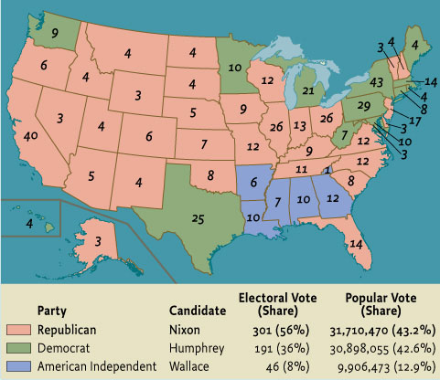
Map 25.3 The Residential Election of 1968
Give Me Liberty!: An American history, 3rd Edition
Copyright © 2011 W.W. Norton & Company

Slide 31
Additional Art for Chapter 25

Slide 32
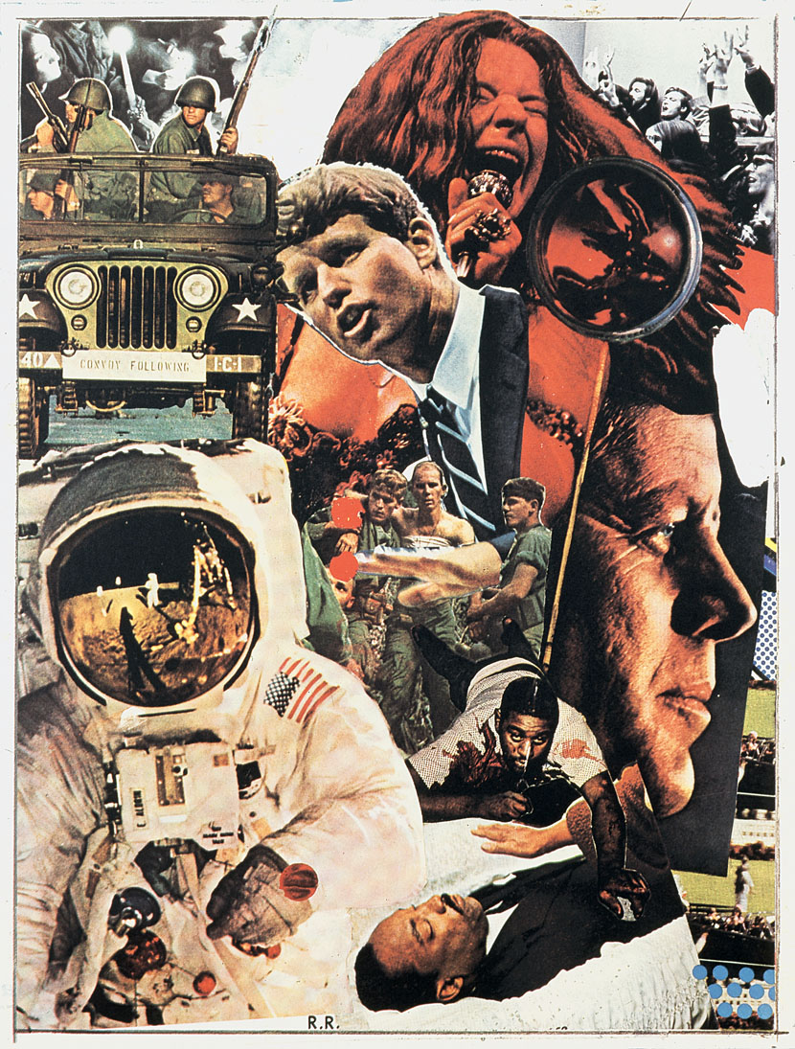
Give Me Liberty!: An American history, 3rd Edition
Copyright © 2011 W.W. Norton & Company
Signs, a 1970 painting by Robert Rauschenberg

Slide 33
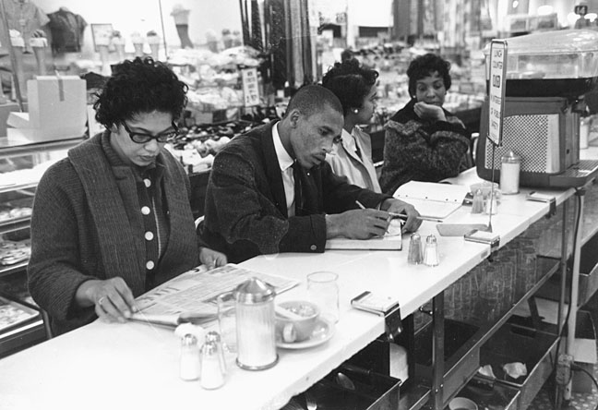
Give Me Liberty!: An American history, 3rd Edition
Copyright © 2011 W.W. Norton & Company
Participants in a sit-in in Raleigh

Slide 34
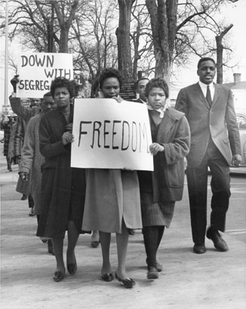
Give Me Liberty!: An American history, 3rd Edition
Copyright © 2011 W.W. Norton & Company
Civil rights demonstrators

Slide 35
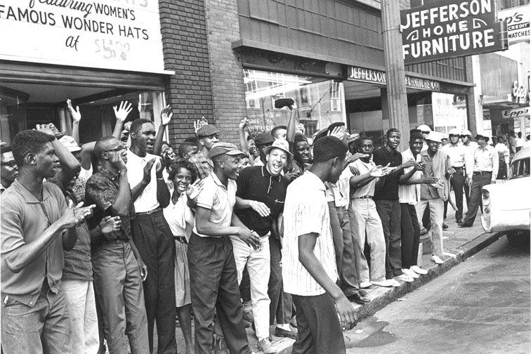
Give Me Liberty!: An American history, 3rd Edition
Copyright © 2011 W.W. Norton & Company
Demonstrators in downtown

Slide 36
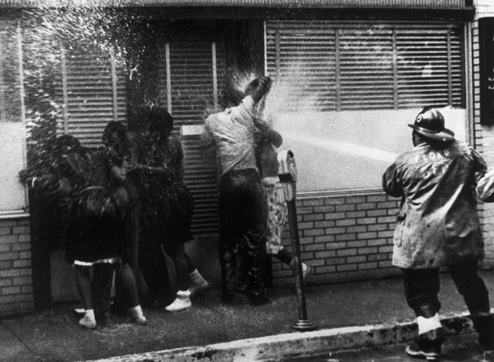
A fireman assaulting young African-
American
Give Me Liberty!: An American history, 3rd Edition
Copyright © 2011 W.W. Norton & Company

Slide 37
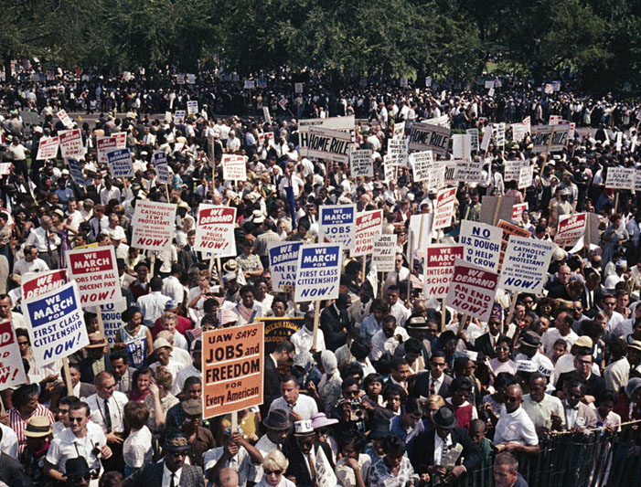
Part of the crowd that gathered at the
Lincoln Memorial
Give Me Liberty!: An American history, 3rd Edition
Copyright © 2011 W.W. Norton & Company

Slide 38
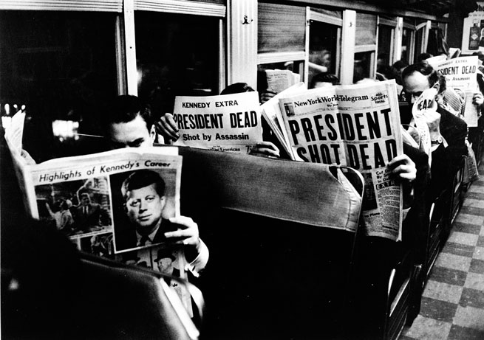
Reading the news of President Kennedy’s
assassination
Give Me Liberty!: An American history, 3rd Edition
Copyright © 2011 W.W. Norton & Company

Slide 39
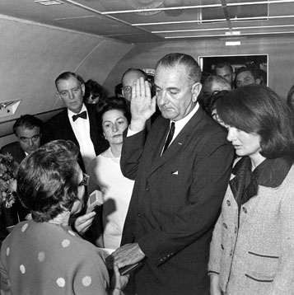
Give Me Liberty!: An American history, 3rd Edition
Copyright © 2011 W.W. Norton & Company
Lyndon B. Johnson being sworn in

Slide 40
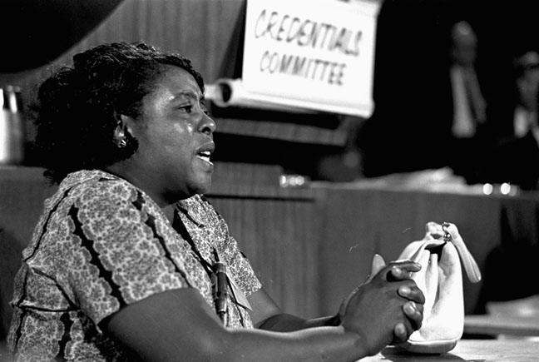
Give Me Liberty!: An American history, 3rd Edition
Copyright © 2011 W.W. Norton & Company
Fannie Lou Hamer testifying

Slide 41
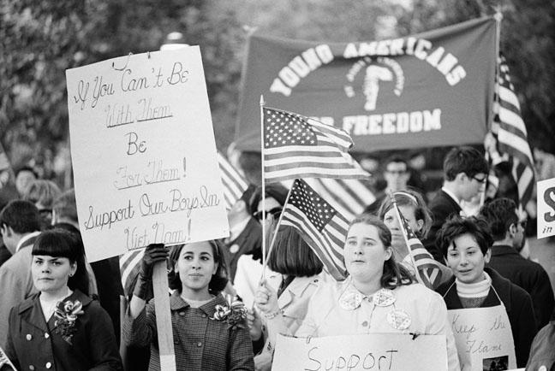
Give Me Liberty!: An American history, 3rd Edition
Copyright © 2011 W.W. Norton & Company
A 1967 rally

Slide 42
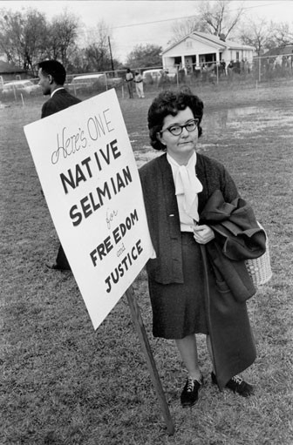
Give Me Liberty!: An American history, 3rd Edition
Copyright © 2011 W.W. Norton & Company
Selma offers her support to civil rights demonstrators

Slide 43
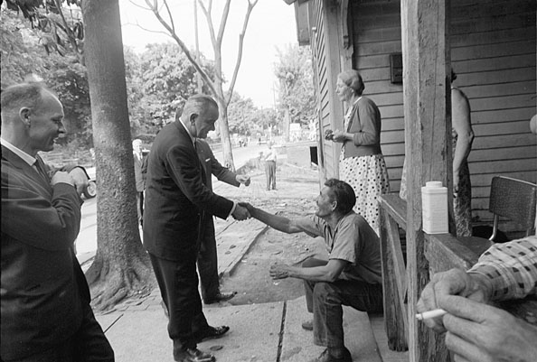
Give Me Liberty!: An American history, 3rd Edition
Copyright © 2011 W.W. Norton & Company
President Lyndon Johnson visited Appalachia

Slide 44
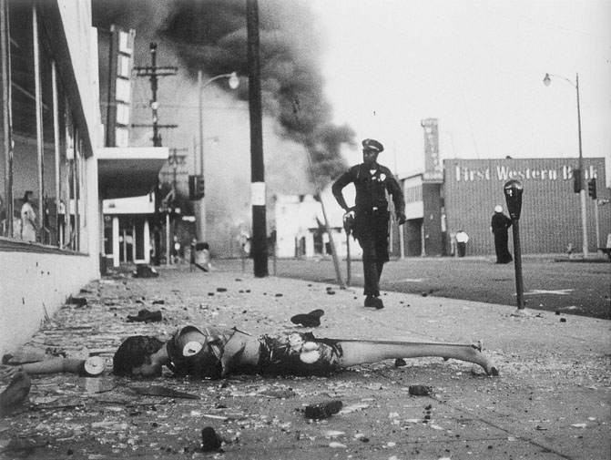
Give Me Liberty!: An American history, 3rd Edition
Copyright © 2011 W.W. Norton & Company
A burned store

Slide 45
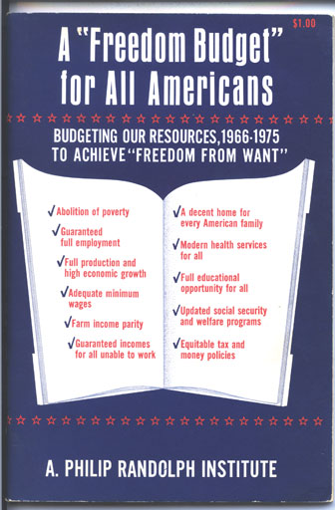
The focus of the civil rights movement was shifting
from desegregation to economic inequality.
Give Me Liberty!: An American history, 3rd Edition
Copyright © 2011 W.W. Norton & Company

Slide 46
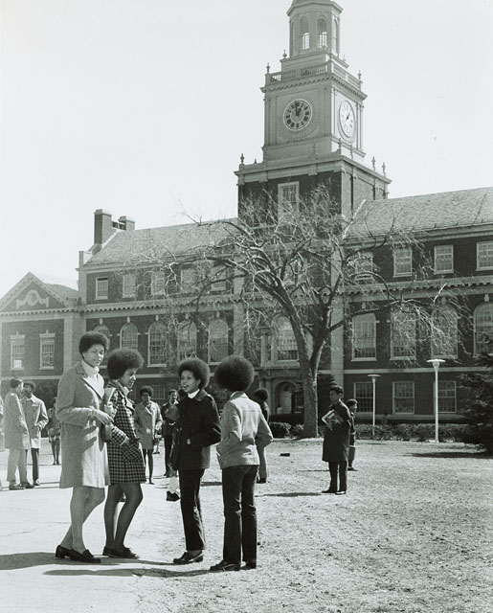
Give Me Liberty!: An American history, 3rd Edition
Copyright © 2011 W.W. Norton & Company
Female students on the campus

Slide 47
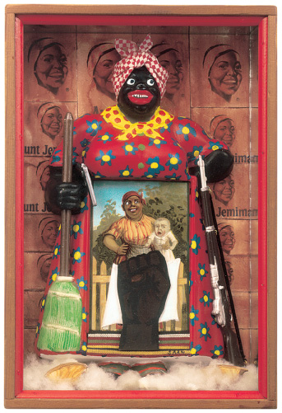
Give Me Liberty!: An American history, 3rd Edition
Copyright © 2011 W.W. Norton & Company
The Liberation of Aunt Jemima

Slide 48
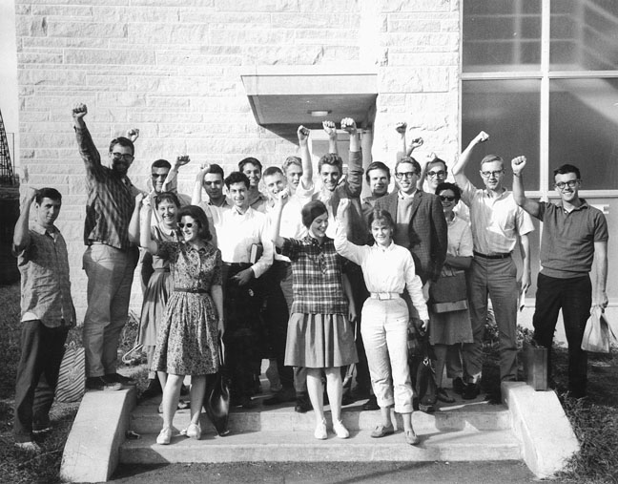
Give Me Liberty!: An American history, 3rd Edition
Copyright © 2011 W.W. Norton & Company
Members of Students for a Democratic Society (SDS)‏

Slide 49
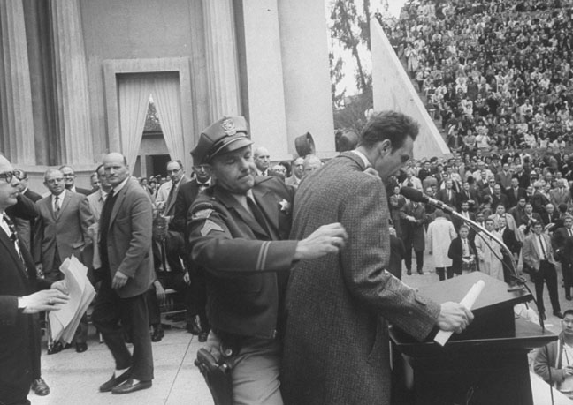
Give Me Liberty!: An American history, 3rd Edition
Copyright © 2011 W.W. Norton & Company
Police arresting Mario Savio

Slide 50
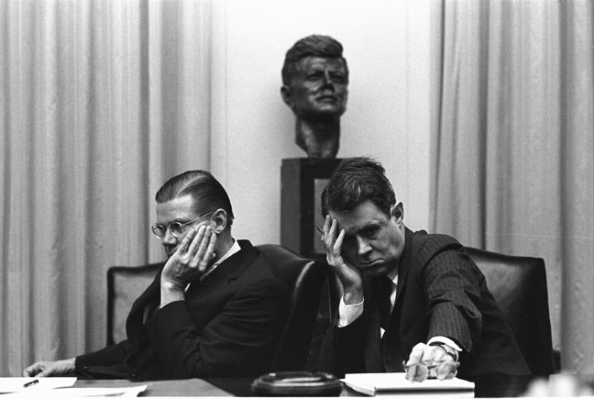
Give Me Liberty!: An American history, 3rd Edition
Copyright © 2011 W.W. Norton & Company
The war in Vietnam was discussed

Slide 51
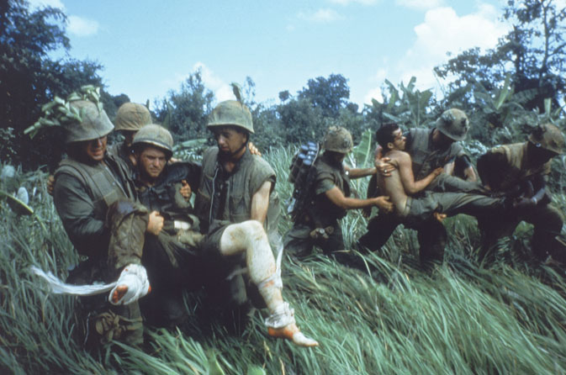
American soldiers in South Vietnam carrying
wounded men
Give Me Liberty!: An American history, 3rd Edition
Copyright © 2011 W.W. Norton & Company

Slide 52
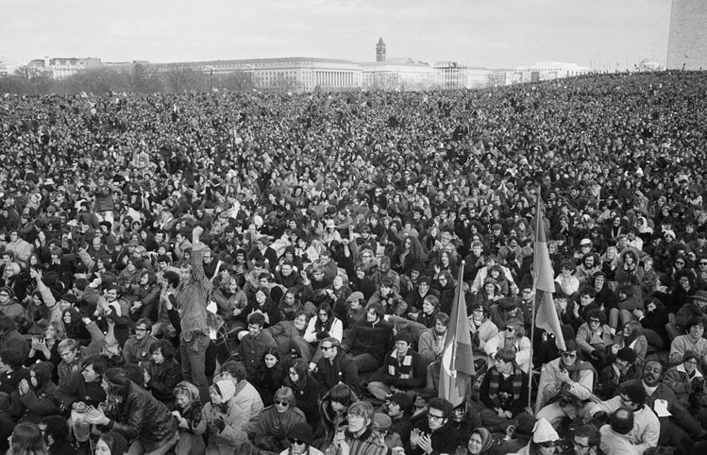
Give Me Liberty!: An American history, 3rd Edition
Copyright © 2011 W.W. Norton & Company
A massive 1969 antiwar demonstration

Slide 53
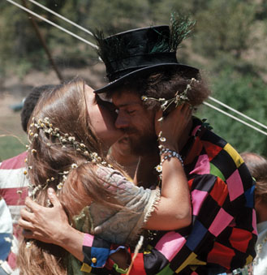
Two young members of the counterculture
at their wedding in NewMexico.
Give Me Liberty!: An American history, 3rd Edition
Copyright © 2011 W.W. Norton & Company

Slide 54
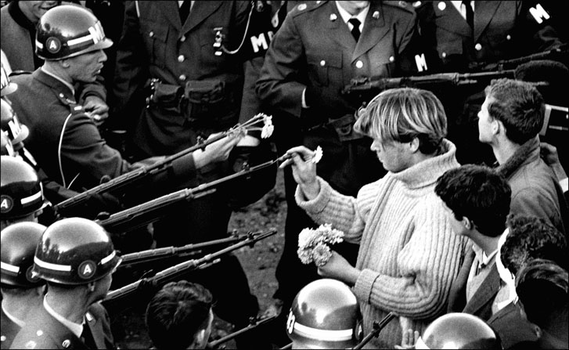
Give Me Liberty!: An American history, 3rd Edition
Copyright © 2011 W.W. Norton & Company
Antiwar Protest

Slide 55
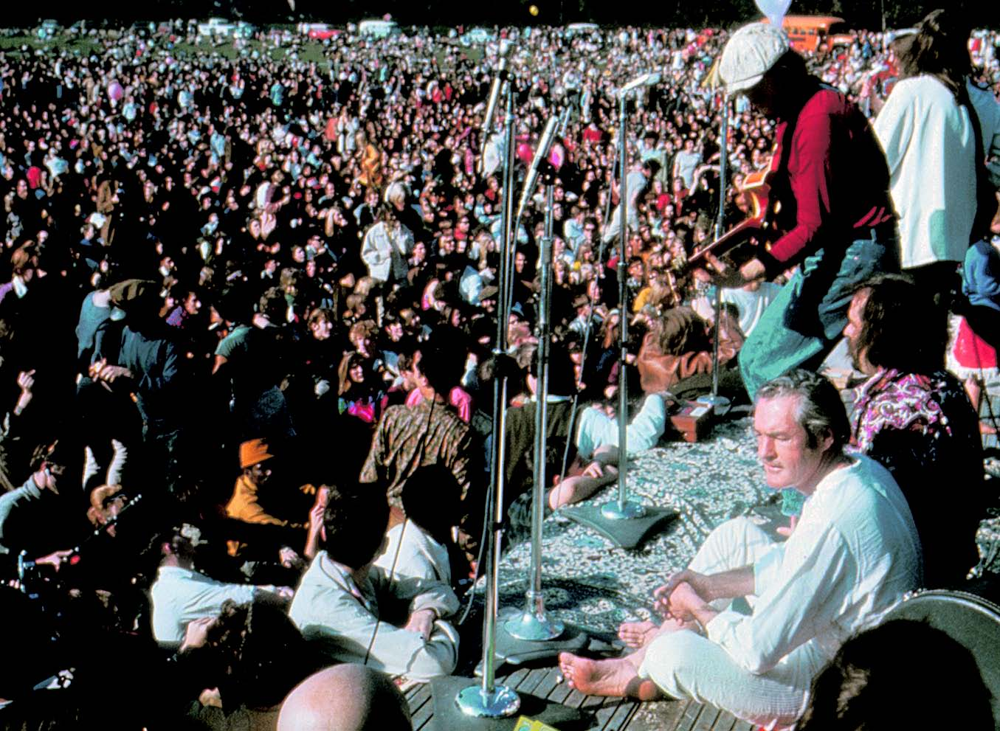
Promoter of the hallucinogenic drug LSD,
listening to the band QuicksilverMessenger Service
Give Me Liberty!: An American history, 3rd Edition
Copyright © 2011 W.W. Norton & Company

Slide 56
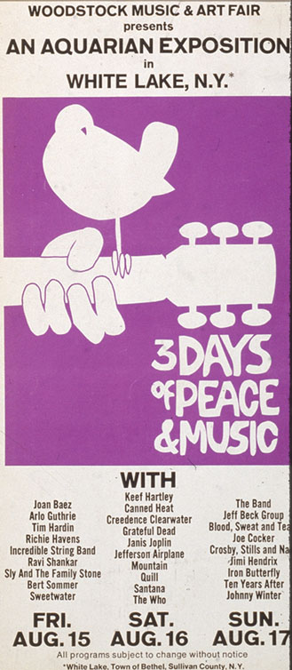
Give Me Liberty!: An American history, 3rd Edition
Copyright © 2011 W.W. Norton & Company
A poster listing some of the performers

Slide 57
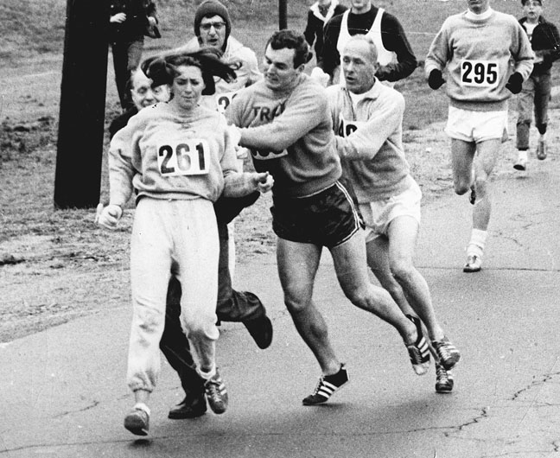
A race official tried to eject Kathrine Switzer from
the Boston Marathon
Give Me Liberty!: An American history, 3rd Edition
Copyright © 2011 W.W. Norton & Company

Slide 58
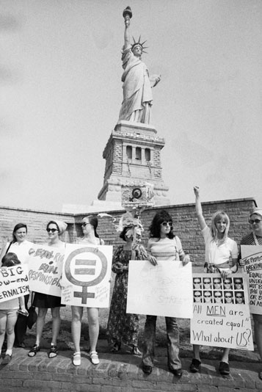
A 1970 women’s liberation demonstration
at the Statue of Liberty
Give Me Liberty!: An American history, 3rd Edition
Copyright © 2011 W.W. Norton & Company

Slide 59
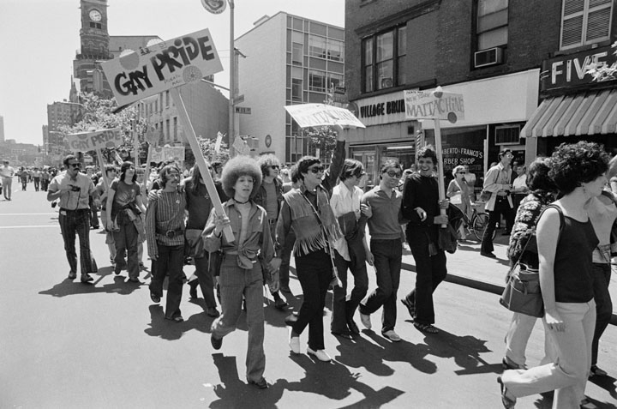
Give Me Liberty!: An American history, 3rd Edition
Copyright © 2011 W.W. Norton & Company
Part of the Gay Liberation Day demonstration

Slide 60
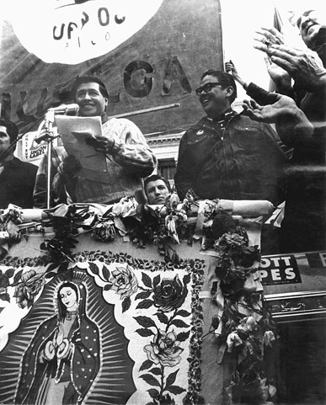
Give Me Liberty!: An American history, 3rd Edition
Copyright © 2011 W.W. Norton & Company
César Chavez speaking

Slide 61
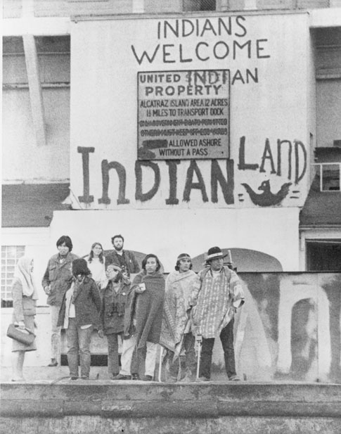
Give Me Liberty!: An American history, 3rd Edition
Copyright © 2011 W.W. Norton & Company
The occupation of Alcatraz Island

Slide 62
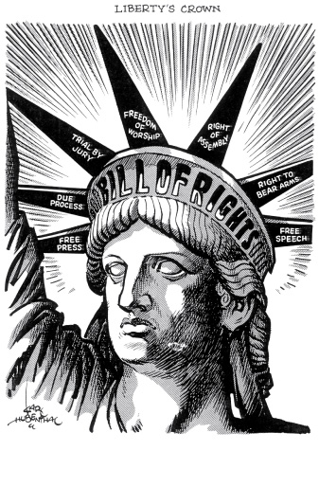
Give Me Liberty!: An American history, 3rd Edition
Copyright © 2011 W.W. Norton & Company
Karl Hubenthal’s December 8, 1976, cartoon

Slide 63
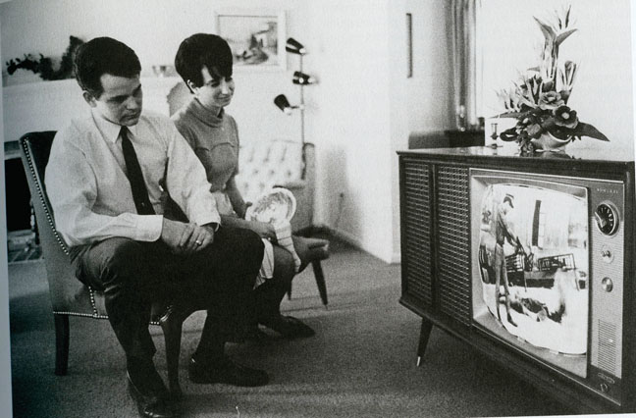
Give Me Liberty!: An American history, 3rd Edition
Copyright © 2011 W.W. Norton & Company
Television brought the VietnamWar

Slide 64
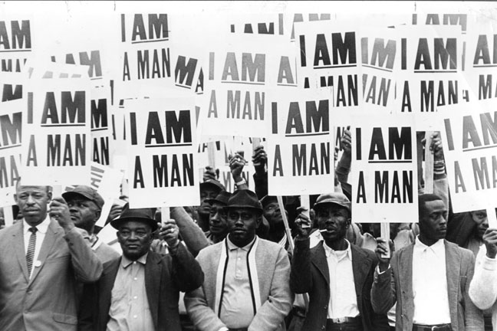
Give Me Liberty!: An American history, 3rd Edition
Copyright © 2011 W.W. Norton & Company
Striking sanitation workers

Slide 65
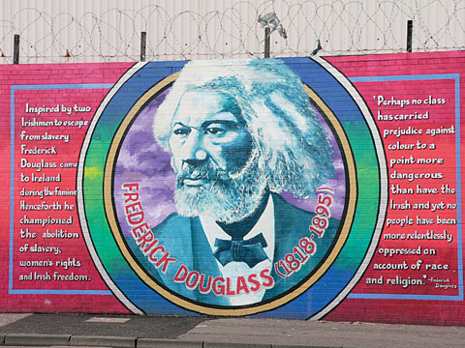
Give Me Liberty!: An American history, 3rd Edition
Copyright © 2011 W.W. Norton & Company
A mural in Belfast, Northern Ireland

Slide 66
Norton Lecture Slides Independent and Employee-Owned
This concludes the Norton Lecture Slides
Slide Set for Chapter 25
Give Me Liberty!
AN AMERICAN HISTORY
THIRD EDITION
by
Eric Foner

