Slide 1
Chapter 5 The American Revolution, 1763–1783

Slide 2
The Crisis Begins
Consolidating the Empire
The experience and costs of the Seven Years’ War led Great Britain, where King George assumed the throne in 1760, to consolidate its growing empire and make the colonists share in its costs.
Before the war, the British had attempted to impose new trading regulations reinforcing the Navigation Acts, which limited and controlled the colonists’ trade.
In the 1740s, the Board of Trade, responsible for colonial affairs, had attempted to expand its influence over colonial governments, trying, for example, to bring colonial laws into conformity with royal instructions. These new regulations failed, in part because colonists ignored them.
Notes:
The experience and costs of the Seven Years’ War led Great Britain, where King George assumed the throne in 1760, to consolidate its growing empire and make the colonists share in its costs.
Before the war, the British had attempted to impose new trading regulations reinforcing the Navigation Acts, which limited and controlled the colonists’ trade. In the 1740s, the Board of Trade, responsible for colonial affairs, had attempted to expand its influence over colonial governments, trying, for example, to bring colonial laws into conformity with royal instructions. These new regulations failed, in part because colonists ignored them.
During the Seven Years’ War, the British had treated colonists as equals, recognizing their contributions to winning the conflict. After the war, in the mid-1760s, the British returned to viewing colonists as subordinates whose role was to enrich the mother country. Without precedent, British rulers sought imperial reforms to make administration of the American colonies more efficient and systematic, and to raise funds, to help pay for the war (which cost Britain far more than its colonies) and finance their empire. To them it seemed fair to force Americans to follow the Navigation Acts, help reduce the war debt, and pay for continued British protection.
Furthermore, almost all Britons believed that Parliament represented the entire empire and rightfully legislated for it. Millions of Britons had no representatives in Parliament. But according to the theory of “virtual representation,” these Britons were constituents of each member of the Parliament, the duty of each was to represent the whole empire, not simply his district. Americans’ argument that they could not be taxed without enjoying direct representation in Parliament did not find much support in Britain.
In the early 1760s, British efforts to combat smuggling by issuing general search warrants, and its Proclamation of 1763 barring further settlement on lands west of the Appalachian Mountains, sparked protest in the colonies. But this response was little compared to the colonists’ outrage in 1764 and 1765 over new laws, including the Sugar, Revenue, and Currency Acts, measures which colonists believed infringed on their liberties and limited the profits they earned from previously less-regulated trade.

Slide 3
The Crisis Begins
Taxing the Colonies
During the Seven Years’ War, the British had treated colonists as equals, recognizing their contributions to winning the conflict. After the war, in the mid-1760s, the British returned to viewing colonists as subordinates whose role was to enrich the mother country. Without precedent, British rulers sought imperial reforms to make administration of the American colonies more efficient and systematic, and to raise funds, to help pay for the war (which cost Britain far more than its colonies) and finance their empire. To them it seemed fair to force Americans to follow the Navigation Acts, help reduce the war debt, and pay for continued British protection.
Furthermore, almost all Britons believed that Parliament represented the entire empire and rightfully legislated for it. Millions of Britons had no representatives in Parliament.
But according to the theory of “virtual representation,” these Britons were constituents of each member of the Parliament, the duty of each was to represent the whole empire, not simply his district. Americans’ argument that they could not be taxed without enjoying direct representation in Parliament did not find much support in Britain.
In the early 1760s, British efforts to combat smuggling by issuing general search warrants, and its Proclamation of 1763 barring further settlement on lands west of the Appalachian Mountains, sparked protest in the colonies. But this response was little compared to the colonists’ outrage in 1764 and 1765 over new laws, including the Sugar, Revenue, and Currency Acts, measures which colonists believed infringed on their liberties and limited the profits they earned from previously less-regulated trade.
http://www.montereyinstitute.org/courses/AP%20US%20History%20I/course%20files/multimedia/lesson10/lessonp.html?showTopic=1

Slide 4
The Crisis Begins
The Stamp Act Crisis
The Stamp Act of 1765 - an unprecedented reform.
Directly taxed activities within the colony, instead of taxing imports and exports.
Parliament tried to raise money by requiring that all kinds of printed matter produced in the colonies, such as newspapers, books, and court documents, carry a stamp issued by authorities.
Purpose: raise funds for the stationing of British troops in the colonies without asking or forcing colonial assemblies to provide money.
Widespread Colonial Outrage: While previous regulations affected mostly those colonists directly involved in trade, the Stamp Act affected virtually every free colonist, many of whom resented a tax that interfered with the flow of information, was imposed without the consent of colonial governments, and paid for British troops whose presence many deemed an unnecessary intrusion. Colonists opposing the tax viewed it as an infringement on their traditional English liberties, taking their property without consent, and they sometimes referred to these as their natural rights.
Taxation and Representation
British imperial rulers and the colonist had different ideas of the British Empire. The British saw the empire as a system of unequal parts, in which different principles governed different areas, and all were subject to Parliament’s’ authority.
Colonists in the Americas and India viewed the empire as an association of equals, in which free colonists had the same rights as Britons at home.
In late 1765, the Stamp Act Congress, with delegates from most North American colonies, affirmed Americans’ loyalty to Great Britain while insisting on their right to consent to taxation. Americans were beginning to see Parliament as no longer the safeguard of English liberty, but its principal enemy.
Notes:
The Stamp Act of 1765, however, was an unprecedented reform. The act did not expand the Navigation Acts but directly taxed activities within the colony, instead of taxing imports and exports. With the act, Parliament tried to raise money by requiring that all kinds of printed matter produced in the colonies, such as newspapers, books, and court documents, carry a stamp issued by authorities. This would raise funds for the stationing of British troops in the colonies without asking or forcing colonial assemblies to provide money.
While previous regulations affected mostly those colonists directly involved in trade, the Stamp Act affected virtually every free colonist, many of whom resented a tax that interfered with the flow of information, was imposed without the consent of colonial governments, and paid for British troops whose presence many deemed an unnecessary intrusion. Colonists opposing the tax viewed it as an infringement on their traditional English liberties, taking their property without consent, and they sometimes referred to these as their natural rights.
British imperial rulers and the colonist had different ideas of the British Empire. The British saw the empire as a system of unequal parts, in which different principles governed different areas, and all were subject to Parliament’s’ authority. Colonists in the Americas and India viewed the empire as an association of equals, in which free colonists had the same rights as Britons at home. In late 1765, the Stamp Act Congress, with delegates from most North American colonies, affirmed Americans’ loyalty to Great Britain while insisting on their right to consent to taxation. Americans were beginning to see Parliament as no longer the safeguard of English liberty, but its principal enemy.

Slide 5
The Crisis Begins
Liberty and Resistance
Symbols of Liberty: liberty trees and liberty poles, reflected resistance to the Stamp Act. Liberty Tree – elm tree in Boston
Liberty Hall –
Liberty Pole -
Politics in the Streets
Committees of Correspondence: Inspired by colonists in Boston who had protested the Sugar and Currency Acts, colonial leaders formed committees that communicated with each other and successfully coordinated efforts to prevent the Stamp Act’s implementation. http://www.ovguide.com/committee-of-correspondence-9202a8c04000641f800000000044c6bb
In cities such as New York and Boston, crowds often organized by the Sons of Liberty destroyed the stamps and forced those administering the law to resign.
Sons of Liberty, supported mostly by urban artisans, labors, and sailors, frightened both imperial officers in the colonies and even colonial elites who opposed the Stamp Act but preferred orderly and peaceful protest.
Though the Americans’ resistance, and pressure from London merchants and manufacturers afraid of losing American markets, led the Parliament to repeal the Stamp Act in 1766, that body simultaneously passed the Declaratory Act, which affirmed that Parliament had the authority and power to pass laws in the future that affected the colonies, including new taxes.
Notes:
Ideas and icons of liberty, such as liberty trees and liberty poles, infused American colonists’ resistance to the Stamp Act. Inspired by colonists in Boston who had protested the Sugar and Currency Acts, colonial leaders formed committees that communicated with each other and successfully coordinated efforts to prevent the Stamp Act’s implementation.
In cities such as New York and Boston, crowds often organized by the Sons of Liberty destroyed the stamps and forced those administering the law to resign. The coercive activities of the Sons of Liberty, supported mostly by urban artisans, labors, and sailors, frightened both imperial officers in the colonies and even colonial elites who opposed the Stamp Act but preferred orderly and peaceful protest. Though the Americans’ resistance, and pressure from London merchants and manufacturers afraid of losing American markets, led the Parliament to repeal the Stamp Act in 1766, that body simultaneously passed the Declaratory Act, which affirmed that Parliament had the authority and power to pass laws in the future that affected the colonies, including new taxes.

Slide 6
The Crisis Begins
The Regulators
The 1760s also saw considerable internal social turmoil within the colonies. In the western back country of many colonies, the conflicting land claims of settlers, speculators, colonial governments and Indians sparked disputes. Rural settlers and farmers had long resented the power and influence of land speculators and large proprietors.
In the mid-1760s, a group of South Carolina settlers calling themselves “Regulators” protested the under-representation of western settlements in the colony’s assembly and the failure to establish local governments that could regularize land titles and impose law and order.
In North Carolina, groups of small farmers taking the same name refused to pay taxes, disrupted courts, and attacked local officials and the property of land speculators, merchants, and lawyers. These armed farmers were suppressed only in 1771 by the colony’s militia.
(Alamance Battle)
The Tenant Uprising
In the mid-1760s, tenants on the large estates of landowners in New York’s Hudson River valley calling themselves the Sons of Liberty stopped paying rent and began to seize land, but they were also suppressed by colonial militia and British troops. Small farmers in Vermont and other parts of New England also took up arms to defend their land claims and resist colonial authorities. Such social turmoil made some colonial elites fear that resistance to British imperial authority threatened their own power and authority over their subordinates within the colonies, and they cautioned against further protests of British rule.
Notes:
The 1760s also saw considerable internal social turmoil within the colonies. In the western back country of many colonies, the conflicting land claims of settlers, speculators, colonial governments and Indians sparked disputes. Rural settlers and farmers had long resented the power and influence of land speculators and large proprietors. In the mid-1760s, a group of South Carolina settlers calling themselves “Regulators” protested the under-representation of western settlements in the colony’s assembly and the failure to establish local governments that could regularize land titles and impose law and order. In North Carolina, groups of small farmers taking the same name refused to pay taxes, disrupted courts, and attacked local officials and the property of land speculators, merchants, and lawyers. These armed farmers were suppressed only in 1771 by the colony’s militia.
In the mid-1760s, tenants on the large estates of landowners in New York’s Hudson River valley calling themselves the Sons of Liberty stopped paying rent and began to seize land, but they were also suppressed by colonial militia and British troops. Small farmers in Vermont and other parts of New England also took up arms to defend their land claims and resist colonial authorities. Such social turmoil made some colonial elites fear that resistance to British imperial authority threatened their own power and authority over their subordinates within the colonies, and they cautioned against further protests of British rule.

Slide 7
The Road to Revolution
The Townshend Crisis
In 1767, the British government imposed a new set of taxes on the American colonies designed by chancellor of the Exchequer Charles Townshend, the government’s chief financial minister. Taking at their word American statements that they did not object to taxes on trade, the Townshend duties taxed goods imported into the colonies and established a new board of customs commissioners to collect the taxes, suppress smuggling, and raise funds to free judges and governors from their financial dependence on colonial assemblies. Although American merchants opposed the duties, the colonial opposition developed more slowly compared to the response to the Stamp Act.
Homespun Virtue
A colonial boycott on imported British goods developed in Boston and spread to the southern colonies, where many southern planters hoped to use the boycott to reduce their debt to British merchants. Boycotters celebrated the virtue of American resistance and denigrated the luxury of British society by producing their own homespun clothing. Although urban artisans welcomed an end to competition from British imports and strongly supported nonimportation, urban merchants were at first reluctant to honor the boycott, and in some cities extralegal committees and crowds attempted to enforce it.
Notes:
In 1767, the British government imposed a new set of taxes on the American colonies designed by chancellor of the Exchequer Charles Townshend, the government’s chief financial minister. Taking at their word American statements that they did not object to taxes on trade, the Townshend duties taxed goods imported into the colonies and established a new board of customs commissioners to collect the taxes, suppress smuggling, and raise funds to free judges and governors from their financial dependence on colonial assemblies. Although American merchants opposed the duties, the colonial opposition developed more slowly compared to the response to the Stamp Act.
A colonial boycott on imported British goods developed in Boston and spread to the southern colonies, where many southern planters hoped to use the boycott to reduce their debt to British merchants. Boycotters celebrated the virtue of American resistance and denigrated the luxury of British society by producing their own homespun clothing. Although urban artisans welcomed an end to competition from British imports and strongly supported nonimportation, urban merchants were at first reluctant to honor the boycott, and in some cities extralegal committees and crowds attempted to enforce it.

Slide 8
The Road to Revolution
The Boston Massacre
Boston was the center of resistance. Royal British troops had been stationed there since a 1768 riot against British attempts to enforce trade regulations, and the unpopular troops had been competing for jobs on the waterfront with the city’s laborers. On March 5, 1770, a fight between Bostonians and British soldiers escalated into an armed confrontation that left five Bostonians dead. The commander and eight soldiers were put on trial and defended by John Adams, who opposed both British policies and lower-class crowd actions against them. Though only two of the British soldiers were convicted of manslaughter, and the rest were found not guilty, Paul Revere and other colonists helped stir up indignation against the British through inaccurate but widely circulated propaganda depicting the incident as a massacre of unarmed Bostonians.
Non-importation temporarily cut British imports by a third, and although the boycott on the Townshend duties faltered by 1770, British merchants’ fear of future trade disruptions led to the repeal of all of the Townshend duties—except for the tax on tea. The British also agreed to remove troops from Boston, and American merchants abandoned the boycott.
Wilkes and Liberty
A controversy within Britain over the treatment of John Wilkes reinforced Americans’ sense that political corruption and other ills were eroding British liberty. A radical journalist who had scandalized authorities with writings on the king and ministry, Wilkes was elected to Parliament from London but expelled. Cries of “Wilkes and Liberty” rallied colonists and Britons in the mother country. British American Protestants were also troubled by rumors that the Anglican Church planned to send bishops to the colonies and, worried that religious courts to punish dissenters would be established, further feared for their liberties.
Notes:
Boston was the center of resistance. Royal British troops had been stationed there since a 1768 riot against British attempts to enforce trade regulations, and the unpopular troops had been competing for jobs on the waterfront with the city’s laborers. On March 5, 1770, a fight between Bostonians and British soldiers escalated into an armed confrontation that left five Bostonians dead. The commander and eight soldiers were put on trial and defended by John Adams, who opposed both British policies and lower-class crowd actions against them. Though only two of the British soldiers were convicted of manslaughter, and the rest were found not guilty, Paul Revere and other colonists helped stir up indignation against the British through inaccurate but widely circulated propaganda depicting the incident as a massacre of unarmed Bostonians.
Non-importation temporarily cut British imports by a third, and although the boycott on the Townshend duties faltered by 1770, British merchants’ fear of future trade disruptions led to the repeal of all of the Townshend duties—except for the tax on tea. The British also agreed to remove troops from Boston, and American merchants abandoned the boycott.
A controversy within Britain over the treatment of John Wilkes reinforced Americans’ sense that political corruption and other ills were eroding British liberty. A radical journalist who had scandalized authorities with writings on the king and ministry, Wilkes was elected to Parliament from London but expelled. Cries of “Wilkes and Liberty” rallied colonists and Britons in the mother country. British American Protestants were also troubled by rumors that the Anglican Church planned to send bishops to the colonies and, worried that religious courts to punish dissenters would be established, further feared for their liberties.

Slide 9
The Road to Revolution
The Tea Act
The next colonial crisis demonstrated how events throughout the British empire reverberated in America. The East India Company was a giant trading monopoly that effectively ruled recently acquired British possessions in India. When a speculative bubble destroyed the company’s stock, in which many British merchants, bankers, and other elites had invested, the British government decided to help rescue the company by marketing its surplus of tea in North America. By this time, tea was no longer a luxury good, but a consumer necessity popular among all social classes in Britain and America. The British government, headed by Lord North, gave the company advantages that allowed it to dump low-priced tea on the America market (which undercut colonial merchants and smugglers), and it wanted to use taxes on imported tea to help pay for the costs of colonial government, another move that threatened the colonial assemblies’ control over finance. Although the tea tax was not new, many colonists argued that a tax on a large new body of tea imports would acknowledge Britain’s right to tax the colonies. Mounting opposition culminated in what much later became known as the Boston Tea Party, in which colonists disguised as Indians dumped tea from British ships into Boston harbor, causing enormous loss to the East India Company.
The Intolerable Acts
North’s government and the Parliament responded with a series of punitive laws the colonies came to call the Intolerable Acts. They closed the port of Boston until all the East India Company had been compensated, altered the Massachusetts charter of 1691 by curtailing town meetings and authorizing the governor to appoint council members previously elected, and allowed British military commanders to house troops in colonists’ private homes. Simultaneously, Parliament passed the Quebec Act, which extended Canada’s boundaries and allowed for legal toleration of the Roman Catholic church in that new British province. Meant to secure the allegiance of Britain’s new subjects, the Quebec Act also caused many colonists, especially New England Protestants, to fear that the British now threatened both their political and religious freedoms.
Notes:
The next colonial crisis demonstrated how events throughout the British empire reverberated in America. The East India Company was a giant trading monopoly that effectively ruled recently acquired British possessions in India. When a speculative bubble destroyed the company’s stock, in which many British merchants, bankers, and other elites had invested, the British government decided to help rescue the company by marketing its surplus of tea in North America. By this time, tea was no longer a luxury good, but a consumer necessity popular among all social classes in Britain and America. The British government, headed by Lord North, gave the company advantages that allowed it to dump low-priced tea on the America market (which undercut colonial merchants and smugglers), and it wanted to use taxes on imported tea to help pay for the costs of colonial government, another move that threatened the colonial assemblies’ control over finance. Although the tea tax was not new, many colonists argued that a tax on a large new body of tea imports would acknowledge Britain’s right to tax the colonies. Mounting opposition culminated in what much later became known as the Boston Tea Party, in which colonists disguised as Indians dumped tea from British ships into Boston harbor, causing enormous loss to the East India Company.
North’s government and the Parliament responded with a series of punitive laws the colonies came to call the Intolerable Acts. They closed the port of Boston until all the East India Company had been compensated, altered the Massachusetts charter of 1691 by curtailing town meetings and authorizing the governor to appoint council members previously elected, and allowed British military commanders to house troops in colonists’ private homes. Simultaneously, Parliament passed the Quebec Act, which extended Canada’s boundaries and allowed for legal toleration of the Roman Catholic church in that new British province. Meant to secure the allegiance of Britain’s new subjects, the Quebec Act also caused many colonists, especially New England Protestants, to fear that the British now threatened both their political and religious freedoms.

Slide 10
The Coming of Independence
The Continental Congress
By 1774, British actions had eroded the imperial government’s legitimacy among many colonists, and opposition to the Intolerable Acts spread to small towns and rural areas that had not yet participated in the resistance. While colonists, particularly in New England, intimidated, harassed, and sometimes assaulted British officials and colonists who supported British policies, a September convention of delegates from towns across Massachusetts issued the Suffolk Resolves, urging Americans to refuse to obey the new laws, withhold taxes, and prepare for war. To coordinate resistance to the Acts, that month a Continental Congress also met in Philadelphia. Composed of political leaders from all the colonies except Georgia, it included men like John Adams and his more radical cousin Samuel Adams of Massachusetts, and from Virginia George Washington and Patrick Henry, the latter of whom famously declared to his fellow Virginians, “Give me liberty, or give me death!”
The Continental Association
The Congress adjourned in October 1774 after it agreed to meet the following May if its demands were not met. It endorsed the Suffolk Resolves and formed the Continental Association to halt virtually all trade with Great Britain and the West Indies. The Congress, through the Association, authorized local Committees of Safety to enforce its policies and act against “enemies of liberty” who violated the boycott or used it as an opportunity to raise prices. This was the beginning of a process that transferred effective political power from colonial governments whose authority derived from Great Britain to extralegal bodies reflecting the popular will. By early 1775, thousands of men, many of whom were without property and who had never before been part of the “political nation,” were serving on these committees, which became laboratories for self-government and soon revolution.
Notes:
By 1774, British actions had eroded the imperial government’s legitimacy among many colonists, and opposition to the Intolerable Acts spread to small towns and rural areas that had not yet participated in the resistance. While colonists, particularly in New England, intimidated, harassed, and sometimes assaulted British officials and colonists who supported British policies, a September convention of delegates from towns across Massachusetts issued the Suffolk Resolves, urging Americans to refuse to obey the new laws, withhold taxes, and prepare for war. To coordinate resistance to the Acts, that month a Continental Congress also met in Philadelphia. Composed of political leaders from all the colonies except Georgia, it included men like John Adams and his more radical cousin Samuel Adams of Massachusetts, and from Virginia George Washington and Patrick Henry, the latter of whom famously declared to his fellow Virginians, “Give me liberty, or give me death!”
The Congress adjourned in October 1774 after it agreed to meet the following May if its demands were not met. It endorsed the Suffolk Resolves and formed the Continental Association to halt virtually all trade with Great Britain and the West Indies. The Congress, through the Association, authorized local Committees of Safety to enforce its policies and act against “enemies of liberty” who violated the boycott or used it as an opportunity to raise prices. This was the beginning of a process that transferred effective political power from colonial governments whose authority derived from Great Britain to extralegal bodies reflecting the popular will. By early 1775, thousands of men, many of whom were without property and who had never before been part of the “political nation,” were serving on these committees, which became laboratories for self-government and soon revolution.

Slide 11
The Coming of Independence
The Sweets of Liberty
By 1774 and 1775, the notions of British liberty that had infused British American political culture were being invoked by indignant colonists of all backgrounds, now against Britain itself. As the crisis intensified, more and more Americans based their claims for liberty not just on the historical rights of Englishmen, but upon more abstract language of natural rights and universal freedom. This language included John Locke’s idea that natural rights existed prior to the establishment of government, which provided a powerful justification for resistance to imperial British rule.
The Outbreak of War
When the Second Continental Congress met in May 1775, war had already begun between British soldiers and armed Massachusetts citizens. The previous month, British forces marching to Concord to seize arms in that town were met in Lexington by militiamen who tried to resist their advance. In Concord, the British were routed and after retreating to Boston, scores of militiamen and British troops had been killed or wounded. These skirmishes initiated the American War of Independence, and inspired colonists in New England and elsewhere to take up arms. New England militia laid siege to Boston and, after failed British attempts to break the siege and the arrival of cannon seized from the British by American militia at Fort Ticonderoga, the British abandoned the city. The Second Continental Congress soon authorized the raising of an army, the printing of money to pay for it, and appointed George Washington as its commander. Britain responded by declaring the colonies to be in a state of rebellion, and it closed all colonial ports and dispatched thousands of troops.
Notes:
By 1774 and 1775, the notions of British liberty that had infused British American political culture were being invoked by indignant colonists of all backgrounds, now against Britain itself. As the crisis intensified, more and more Americans based their claims for liberty not just on the historical rights of Englishmen, but upon more abstract language of natural rights and universal freedom. This language included John Locke’s idea that natural rights existed prior to the establishment of government, which provided a powerful justification for resistance to imperial British rule.
When the Second Continental Congress met in May 1775, war had already begun between British soldiers and armed Massachusetts citizens. The previous month, British forces marching to Concord to seize arms in that town were met in Lexington by militiamen who tried to resist their advance. In Concord, the British were routed and after retreating to Boston, scores of militiamen and British troops had been killed or wounded. These skirmishes initiated the American War of Independence, and inspired colonists in New England and elsewhere to take up arms. New England militia laid siege to Boston and, after failed British attempts to break the siege and the arrival of cannon seized from the British by American militia at Fort Ticonderoga, the British abandoned the city. The Second Continental Congress soon authorized the raising of an army, the printing of money to pay for it, and appointed George Washington as its commander. Britain responded by declaring the colonies to be in a state of rebellion, and it closed all colonial ports and dispatched thousands of troops.
Despite the war’s outbreak, many colonists were reluctant to embrace independence from Great Britain. Many were still proud of British political institutions and culture and the power and glory of the British empire, and more than a few political leaders worried the rebellion might cause internal social conflict, particularly between elites and the disenfranchised and less wealthy Americans. Leaders in Massachusetts and Virginia, incensed by the Intolerable Acts and confident of their ability to retain authority in those colonies, supported independence, as did many southern leaders, who guarded their political liberties and were enraged by a British proclamation in Virginia in late 1775 offering freedom to escaped slaves who enlisted in the royal army. In New York and Pennsylvania, consensus was more difficult to establish. Opposition to British policies had animated small farmers and urban artisans, whose calls for a greater voice in political life prompted many leaders to hesitate to call for independence. Some in these colonies urged for compromise and predicted that a war would unleash fighting between the colonies.

Slide 12
The Coming of Independence
Independence?
Despite the war’s outbreak, many colonists were reluctant to embrace independence from Great Britain. Many were still proud of British political institutions and culture and the power and glory of the British empire, and more than a few political leaders worried the rebellion might cause internal social conflict, particularly between elites and the disenfranchised and less wealthy Americans. Leaders in Massachusetts and Virginia, incensed by the Intolerable Acts and confident of their ability to retain authority in those colonies, supported independence, as did many southern leaders, who guarded their political liberties and were enraged by a British proclamation in Virginia in late 1775 offering freedom to escaped slaves who enlisted in the royal army. In New York and Pennsylvania, consensus was more difficult to establish. Opposition to British policies had animated small farmers and urban artisans, whose calls for a greater voice in political life prompted many leaders to hesitate to call for independence. Some in these colonies urged for compromise and predicted that a war would unleash fighting between the colonies.

Slide 13
The Coming of Independence
Common Sense
In the beginning of 1776, colonists were strangely both engaged in a war against the British empire and calling for rights within it. In July 1775, even as Congress organized a continental military, they sent the Olive Branch Petition to George III, reaffirming their loyalty to the crown and hoping for a “permanent reconciliation.” Ironically, not a colonist but a recent emigrant to Philadelphia from England, Thomas Paine, offered the arguments that catalyzed the final move toward independence. Paine’s pamphlet Common Sense, published in January 1776, caustically criticized the British constitution for its principles of hereditary rule and monarchical government, and argued that the residue of tyranny survived in the form of the monarchy and the aristocratic House of Lords. Paine argued that only a democratic system based on frequent elections, with a single written constitution, could ensure liberty.
Most importantly, Paine argued that America’s future prospects within the British Empire were limited; once America was free of the Navigation Acts and trading freely with the world, its prosperity would be assured. Free from Great Britain, the colonies would also not be entangled in its wars with other European powers, against which the American colonists had never had grievances. Paine argued that the colonies’ membership in the British empire was more burdensome than beneficial. Paine ended the pamphlet by assuring his readers that American independence was linked with the freedom of people everywhere, and argued that the new nation would become a haven for freedom and “an asylum for mankind.”
Paine’s Impact
Although most of Paine’s ideas were not original, he addressed them to all Americans and made it accessible by expressing them in a clear, direct and plain language unusual in most political writing at that time. Common Sense quickly became one of the most successful and influential pamphlets in the history of political writing. The intensification of the war, combined with Paine’s stirring appeal for independence, sparked more calls for independence in many American communities.
Notes:
In the beginning of 1776, colonists were strangely both engaged in a war against the British empire and calling for rights within it. In July 1775, even as Congress organized a continental military, they sent the Olive Branch Petition to George III, reaffirming their loyalty to the crown and hoping for a “permanent reconciliation.” Ironically, not a colonist but a recent emigrant to Philadelphia from England, Thomas Paine, offered the arguments that catalyzed the final move toward independence. Paine’s pamphlet Common Sense, published in January 1776, caustically criticized the British constitution for its principles of hereditary rule and monarchical government, and argued that the residue of tyranny survived in the form of the monarchy and the aristocratic House of Lords. Paine argued that only a democratic system based on frequent elections, with a single written constitution, could ensure liberty.
Most importantly, Paine argued that America’s future prospects within the British Empire were limited; once America was free of the Navigation Acts and trading freely with the world, its prosperity would be assured. Free from Great Britain, the colonies would also not be entangled in its wars with other European powers, against which the American colonists had never had grievances. Paine argued that the colonies’ membership in the British empire was more burdensome than beneficial. Paine ended the pamphlet by assuring his readers that American independence was linked with the freedom of people everywhere, and argued that the new nation would become a haven for freedom and “an asylum for mankind.”
Although most of Paine’s ideas were not original, he addressed them to all Americans and made it accessible by expressing them in a clear, direct and plain language unusual in most political writing at that time. Common Sense quickly became one of the most successful and influential pamphlets in the history of political writing. The intensification of the war, combined with Paine’s stirring appeal for independence, sparked more calls for independence in many American communities.

Slide 14
The Coming of Independence
The Declaration of Independence
On July 2, 1776, Congress formally declared the United States an independent nation, and two days later adopted the Declaration of Independence, authored by Thomas Jefferson and revised by the Congress before its approval. Most of the declaration was a long list of grievances directed against King George III, protesting recent policies that threatened to impose on the colonists “absolute tyranny” (although a clause condemning the slave trade and criticizing the king for overturning laws limiting slave importation was eliminated after protests by delegates from Georgia and South Carolina). The impact and legacy of the Declaration was contained in its preamble, written by Jefferson, and stating that “all men are created equal, that they are endowed with certain unalienable Rights, that among these are Life, Liberty, and the pursuit of Happiness.” Jefferson justified independence by arguing that government derives its powers from “the consent of the governed,” and that when it threatens its subjects’ natural rights, the people have the authority “to alter or abolish it.” The Declaration ultimately asserts the right of revolution.
Notes:
On July 2, 1776, Congress formally declared the United States an independent nation, and two days later adopted the Declaration of Independence, authored by Thomas Jefferson and revised by the Congress before its approval. Most of the declaration was a long list of grievances directed against King George III, protesting recent policies that threatened to impose on the colonists “absolute tyranny” (although a clause condemning the slave trade and criticizing the king for overturning laws limiting slave importation was eliminated after protests by delegates from Georgia and South Carolina). The impact and legacy of the Declaration was contained in its preamble, written by Jefferson, and stating that “all men are created equal, that they are endowed with certain unalienable Rights, that among these are Life, Liberty, and the pursuit of Happiness.” Jefferson justified independence by arguing that government derives its powers from “the consent of the governed,” and that when it threatens its subjects’ natural rights, the people have the authority “to alter or abolish it.” The Declaration ultimately asserts the right of revolution.
The Declaration of Independence forever altered the meaning of American liberty. It completed the transformation of the object of American independence from the rights of Englishmen to the rights of mankind. Jefferson argued that natural laws, not the British constitution or the rights of the freeborn Englishman, justified America’s separation from Britain, and the declaration made freedom a universal entitlement for all people, not a privilege to be enjoyed by a corporate body or people of a certain social class. Jefferson drew upon the theories of John Locke. But by substituting “the pursuit of happiness” for “property” in the Lockean triad that opens the Declaration, Jefferson established in America’s political culture an open-ended, democratic process, in which individuals developed their own potential and sought to realize their own life goals. He made individual self-fulfillment, unimpeded by government, a central element of American freedom, removing tradition as an obstacle to Americans’ desire to shape society as they saw fit.

Slide 15
The Coming of Independence
The Declaration and American Freedom
The Declaration of Independence forever altered the meaning of American liberty. It completed the transformation of the object of American independence from the rights of Englishmen to the rights of mankind. Jefferson argued that natural laws, not the British constitution or the rights of the freeborn Englishman, justified America’s separation from Britain, and the declaration made freedom a universal entitlement for all people, not a privilege to be enjoyed by a corporate body or people of a certain social class. Jefferson drew upon the theories of John Locke. But by substituting “the pursuit of happiness” for “property” in the Lockean triad that opens the Declaration, Jefferson established in America’s political culture an open-ended, democratic process, in which individuals developed their own potential and sought to realize their own life goals. He made individual self-fulfillment, unimpeded by government, a central element of American freedom, removing tradition as an obstacle to Americans’ desire to shape society as they saw fit.

Slide 16
The Coming of Independence
An Asylum for Mankind
The American Revolution created a distinctive definition of national identity resting on freedom. From its beginning, the notion of “American exceptionalism”—the belief that the United States has a special mission to be a refuge from tyranny, a symbol of freedom, and a model for the rest of the world – has been central to American nationality and nationalism. Paine and others believed that the American revolution was an event of global historical importance with the power to reshape the world. Without the burden of monarchy, aristocracy, and hereditary privilege of the Old World of Europe, America would be a new nation governed by principles of universal freedom.
The Global Declaration of Independence
While American colonists were more interested in gaining international recognition and the military aid of other governments than they were in establishing human rights for all people everywhere, the Declaration’s words and ideas have been an inspiration to Americans and colonial peoples throughout the world who have sought independence. Flemish rebels, part of today’s Belgium and then part of the Austrian empire, echoed Jefferson’s words in declaring their rebellion in 1790, and by 1826, the year Jefferson died, twenty other declarations of independence had been issued in Europe, the Caribbean, and Spanish America. Revolutionaries in China in 1911 and in Vietnam in 1945 issued declarations influenced by the American predecessor. Although over time the natural rights that Jefferson asserted became less and less part of the declarations he helped inspire, the idea that legitimate political authority rests on the will of the people and that “the people” have rights has been adopted around the world, inspiring a diverse array of groups including Caribbean slaves, colonial subjects in India, and indigenous peoples of Latin America, to fight for their liberties.
Notes:
The American Revolution created a distinctive definition of national identity resting on freedom. From its beginning, the notion of “American exceptionalism”—the belief that the United States has a special mission to be a refuge from tyranny, a symbol of freedom, and a model for the rest of the world – has been central to American nationality and nationalism. Paine and others believed that the American revolution was an event of global historical importance with the power to reshape the world. Without the burden of monarchy, aristocracy, and hereditary privilege of the Old World of Europe, America would be a new nation governed by principles of universal freedom.
While American colonists were more interested in gaining international recognition and the military aid of other governments than they were in establishing human rights for all people everywhere, the Declaration’s words and ideas have been an inspiration to Americans and colonial peoples throughout the world who have sought independence. Flemish rebels, part of today’s Belgium and then part of the Austrian empire, echoed Jefferson’s words in declaring their rebellion in 1790, and by 1826, the year Jefferson died, twenty other declarations of independence had been issued in Europe, the Caribbean, and Spanish America. Revolutionaries in China in 1911 and in Vietnam in 1945 issued declarations influenced by the American predecessor. Although over time the natural rights that Jefferson asserted became less and less part of the declarations he helped inspire, the idea that legitimate political authority rests on the will of the people and that “the people” have rights has been adopted around the world, inspiring a diverse array of groups including Caribbean slaves, colonial subjects in India, and indigenous peoples of Latin America, to fight for their liberties.

Slide 17
Securing Independence
The Balance of Power
For Americans the challenges to obtaining real independence, as opposed to declaring it, were enormous and Britain, which saw the colonists as rebellious traitors, was determined to crush them. The new American army faced the greatest military power in the world, with a well-trained, professional, disciplined army (augmented by hired soldiers from German states like Hesse), the world’s most powerful navy, and experienced military commanders. The Americans had local militias and a poorly equipped Continental army, many of whom were undisciplined, and no navy to speak of (although it did charter “privateers,” or private ships allowed by the Congress to attack British naval and commercial ships).
Yet many Americans had military experience, particularly those who fought in the Seven Years’ War or had militia training. Americans were fighting on their own soil for a revolutionary cause that inspired sacrifice and devotion. During the war’s eight years, some 200,000 men served in the Continental army as volunteers or in the militia, where service was required of every able-bodied man. By the war’s end, one in twenty of the free white male population in the colonies between the age of 16 to 45 had died, the equivalent of nearly 3 million deaths in today’s population. But the hope for independence survived as long as an American army existed.
The British learned, despite their power, that the conquest of thirteen colonies was an enormous and expensive endeavor, which might require higher taxes which Britons in the mother country would resent. The British made a series of mistakes, misjudging the degree of support for independence among Americans and the capacity of America’s citizen-soldiers. European rivals, particularly France, welcomed British defeat and could equalize the balance of forces in the struggle if they supported America.
Notes:
For Americans the challenges to obtaining real independence, as opposed to declaring it, were enormous and Britain, which saw the colonists as rebellious traitors, was determined to crush them. The new American army faced the greatest military power in the world, with a well-trained, professional, disciplined army (augmented by hired soldiers from German states like Hesse), the world’s most powerful navy, and experienced military commanders. The Americans had local militias and a poorly equipped Continental army, many of whom were undisciplined, and no navy to speak of (although it did charter “privateers,” or private ships allowed by the Congress to attack British naval and commercial ships).
Yet many Americans had military experience, particularly those who fought in the Seven Years’ War or had militia training. Americans were fighting on their own soil for a revolutionary cause that inspired sacrifice and devotion. During the war’s eight years, some 200,000 men served in the Continental army as volunteers or in the militia, where service was required of every able-bodied man. By the war’s end, one in twenty of the free white male population in the colonies between the age of 16 to 45 had died, the equivalent of nearly 3 million deaths in today’s population. But the hope for independence survived as long as an American army existed.
The British learned, despite their power, that the conquest of thirteen colonies was an enormous and expensive endeavor, which might require higher taxes which Britons in the mother country would resent. The British made a series of mistakes, misjudging the degree of support for independence among Americans and the capacity of America’s citizen-soldiers. European rivals, particularly France, welcomed British defeat and could equalize the balance of forces in the struggle if they supported America.

Slide 18
Securing Independence
Blacks in the Revolution
Although George Washington at first would not accept black recruits in the continental army, he reversed this policy after a British proclamation offered freedom to Virginia slaves who escaped and served in the British military. Around 5,000 blacks enlisted in the American army and militia, some of whom were slaves promised their freedom if they served as substitutes for their master or his son. Blacks fighting under George Washington served in racially integrated units, the last black Americans to do so in regular units until the Korean War.
Except for South Carolina and Georgia, the southern colonies also enrolled free blacks and slaves to fight. While these colonies did not explicitly promise the slaves their freedom, many received it individually once the war concluded, at which time Virginia emancipated slaves who had served in the American army.
But many hundreds of blacks, particularly slaves, found freedom and opportunity by enlisting in the British military. Even some of the seventeen of George Washington’s slaves who fled to the British joined the fight against the American colonists.
Notes:
Although George Washington at first would not accept black recruits in the continental army, he reversed this policy after a British proclamation offered freedom to Virginia slaves who escaped and served in the British military. Around 5,000 blacks enlisted in the American army and militia, some of whom were slaves promised their freedom if they served as substitutes for their master or his son. Blacks fighting under George Washington served in racially integrated units, the last black Americans to do so in regular units until the Korean War.
Except for South Carolina and Georgia, the southern colonies also enrolled free blacks and slaves to fight. While these colonies did not explicitly promise the slaves their freedom, many received it individually once the war concluded, at which time Virginia emancipated slaves who had served in the American army.
But many hundreds of blacks, particularly slaves, found freedom and opportunity by enlisting in the British military. Even some of the seventeen of George Washington’s slaves who fled to the British joined the fight against the American colonists.

Slide 19
Securing Independence
The First Years of the War
The sluggish prosecution of the war by British commanders and Washington’s determination to avoid direct confrontation, in order to buy time to gain international support and to prevent the destruction of the American army, made for an inconclusive beginning to the war. Though the British captured New York in 1776 and pushed the Americans back through New Jersey, Washington saved a demoralized and shrinking army in successful surprise attacks in that state, at Trenton in December 1776 and at Princeton in January 1777.
The Battle of Saratoga
In October 1777, a second British army advancing south from Canada into New York, intended to isolate New England from the rest of the colonies, was surrounded, defeated, and forced to surrender at Saratoga. While the British army remained quartered in New York, American troops suffered a punishing winter at Valley Forge, Pennsylvania. But the victory at Saratoga helped persuade the French in 1778 to recognize the United States and supply it with military assistance. Spain soon joined the war on the American side as well. Though these allies first limited their attacks, the entry of France into the war in particular forced Britain to defend not only America but much of its global empire, and significantly weakened its capacity to wage war in North America.
Notes:
The sluggish prosecution of the war by British commanders and Washington’s determination to avoid direct confrontation, in order to buy time to gain international support and to prevent the destruction of the American army, made for an inconclusive beginning to the war. Though the British captured New York in 1776 and pushed the Americans back through New Jersey, Washington saved a demoralized and shrinking army in successful surprise attacks in that state, at Trenton in December 1776 and at Princeton in January 1777.
In October 1777, a second British army advancing south from Canada into New York, intended to isolate New England from the rest of the colonies, was surrounded, defeated, and forced to surrender at Saratoga. While the British army remained quartered in New York, American troops suffered a punishing winter at Valley Forge, Pennsylvania. But the victory at Saratoga helped persuade the French in 1778 to recognize the United States and supply it with military assistance. Spain soon joined the war on the American side as well. Though these allies first limited their attacks, the entry of France into the war in particular forced Britain to defend not only America but much of its global empire, and significantly weakened its capacity to wage war in North America.

Slide 20
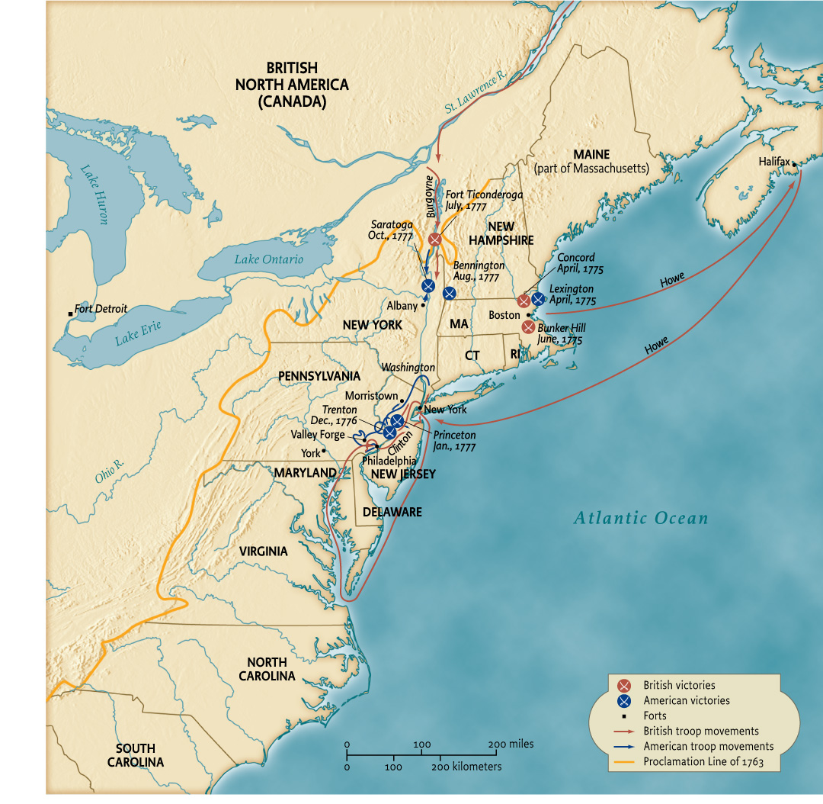
Map 5.1 The Revolutionary war in the North 1775–1781
Give Me Liberty!: An American history, 3rd Edition
Copyright © 2011 W.W. Norton & Company

Slide 21
Securing Independence
The War in the South
In 1778, the center of the war moved to the southern colonies, where the British hoped to take advantage of social tensions between frontier farmers and wealthy planters, enlist the many loyalists in the region, and disrupt the economy by encouraging slaves to escape. By 1780 British forces had occupied Savannah, Georgia and Charleston, South Carolina, and seemed to control much of the south.
This year was perhaps the lowest point of the war for the Americans. Congress was basically bankrupt, and the army, without pay for several months, experienced several mutinies. More and more, loyalists were flocking to British lines along with tens of thousands of slaves. But irregular warfare launched by colonial militia in the south and a brutal civil war in much of North and South Carolina and Georgia between patriot and Loyalist militias, with both sides committing atrocities and destroying property, did not crush the rebellion in the south.
Notes:
In 1778, the center of the war moved to the southern colonies, where the British hoped to take advantage of social tensions between frontier farmers and wealthy planters, enlist the many loyalists in the region, and disrupt the economy by encouraging slaves to escape. By 1780 British forces had occupied Savannah, Georgia and Charleston, South Carolina, and seemed to control much of the south.
This year was perhaps the lowest point of the war for the Americans. Congress was basically bankrupt, and the army, without pay for several months, experienced several mutinies. More and more, loyalists were flocking to British lines along with tens of thousands of slaves. But irregular warfare launched by colonial militia in the south and a brutal civil war in much of North and South Carolina and Georgia between patriot and Loyalist militias, with both sides committing atrocities and destroying property, did not crush the rebellion in the south.
Finally in 1781, defeats and costly campaigns weakened British forces there commanded by Lord Cornwallis, who moved his army to Yorktown, located on a Virginia peninsula. Washington rushed his forces there, and with French troops laid a siege which, when supported by a French naval blockade, forced Cornwallis to surrender his army there in October 1781. Imperial rivalry between Europe’s great colonial powers had helped create the American colonies, and it now secured their independence as a new nation.
Public support for the war collapsed in Great Britain, where many thought the West Indies were more valuable and merchants hoped to renew trade with America. In 1783, Great Britain recognized America’s independence in the Treaty of Paris and ceded the entire area between Canada and Florida east of the Mississippi River. The Americans promised not to persecute Loyalists and to restore to them property seized in the war, but many loyalists left for Great Britain, Canada, or other parts of the empire.
Until independence, the thirteen colonies in North America had been only part of Britain’s empire in the Western Hemisphere. In Canada and the West Indies, where planters feared slave revolts, colonists refused American’s appeal to join the war against the mother country. But with the Treaty of Paris, the United States of America became the first independent nation in the hemisphere, reflecting in its boundaries not the unity of a region, but the circumstances of its birth.

Slide 22
Securing Independence
Victory at Last
Finally in 1781, defeats and costly campaigns weakened British forces there commanded by Lord Cornwallis, who moved his army to Yorktown, located on a Virginia peninsula. Washington rushed his forces there, and with French troops laid a siege which, when supported by a French naval blockade, forced Cornwallis to surrender his army there in October 1781. Imperial rivalry between Europe’s great colonial powers had helped create the American colonies, and it now secured their independence as a new nation.
Public support for the war collapsed in Great Britain, where many thought the West Indies were more valuable and merchants hoped to renew trade with America. In 1783, Great Britain recognized America’s independence in the Treaty of Paris and ceded the entire area between Canada and Florida east of the Mississippi River. The Americans promised not to persecute Loyalists and to restore to them property seized in the war, but many loyalists left for Great Britain, Canada, or other parts of the empire.
Until independence, the thirteen colonies in North America had been only part of Britain’s empire in the Western Hemisphere. In Canada and the West Indies, where planters feared slave revolts, colonists refused American’s appeal to join the war against the mother country. But with the Treaty of Paris, the United States of America became the first independent nation in the hemisphere, reflecting in its boundaries not the unity of a region, but the circumstances of its birth.

Slide 23
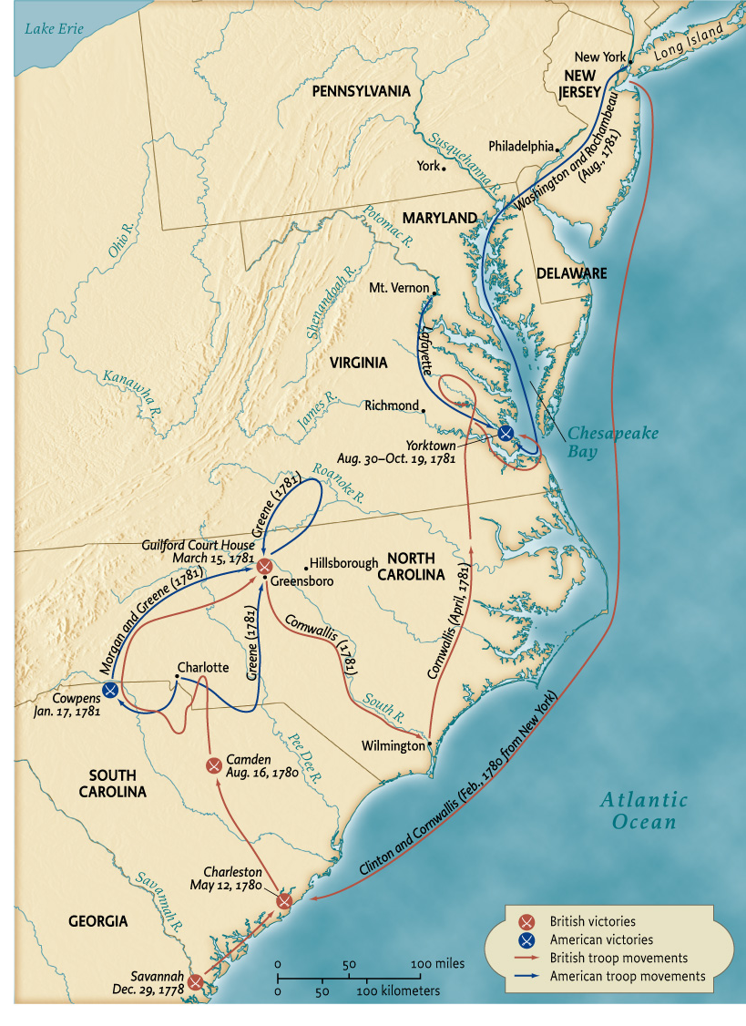
Map 5.2 The Revolutionary war in the South 1775–1781
Give Me Liberty!: An American history, 3rd Edition
Copyright © 2011 W.W. Norton & Company

Slide 24
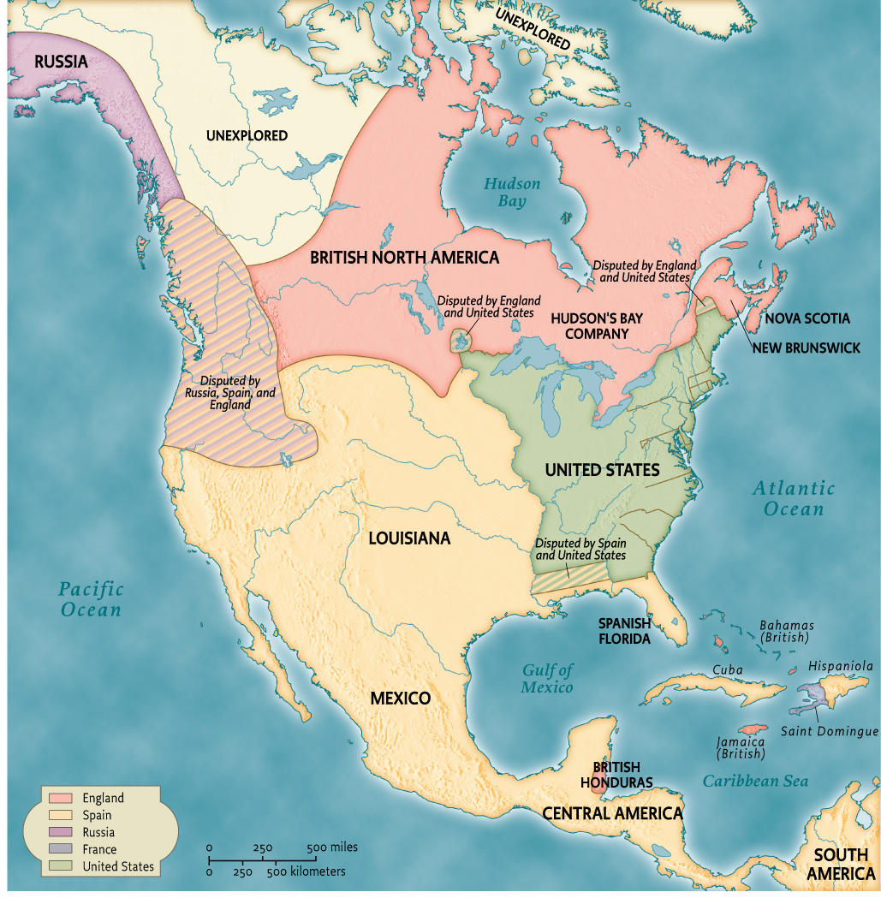
Map 5.3 The North America, 1783
Give Me Liberty!: An American history, 3rd Edition
Copyright © 2011 W.W. Norton & Company

Slide 25
Additional Art for Chapter 5

Slide 26
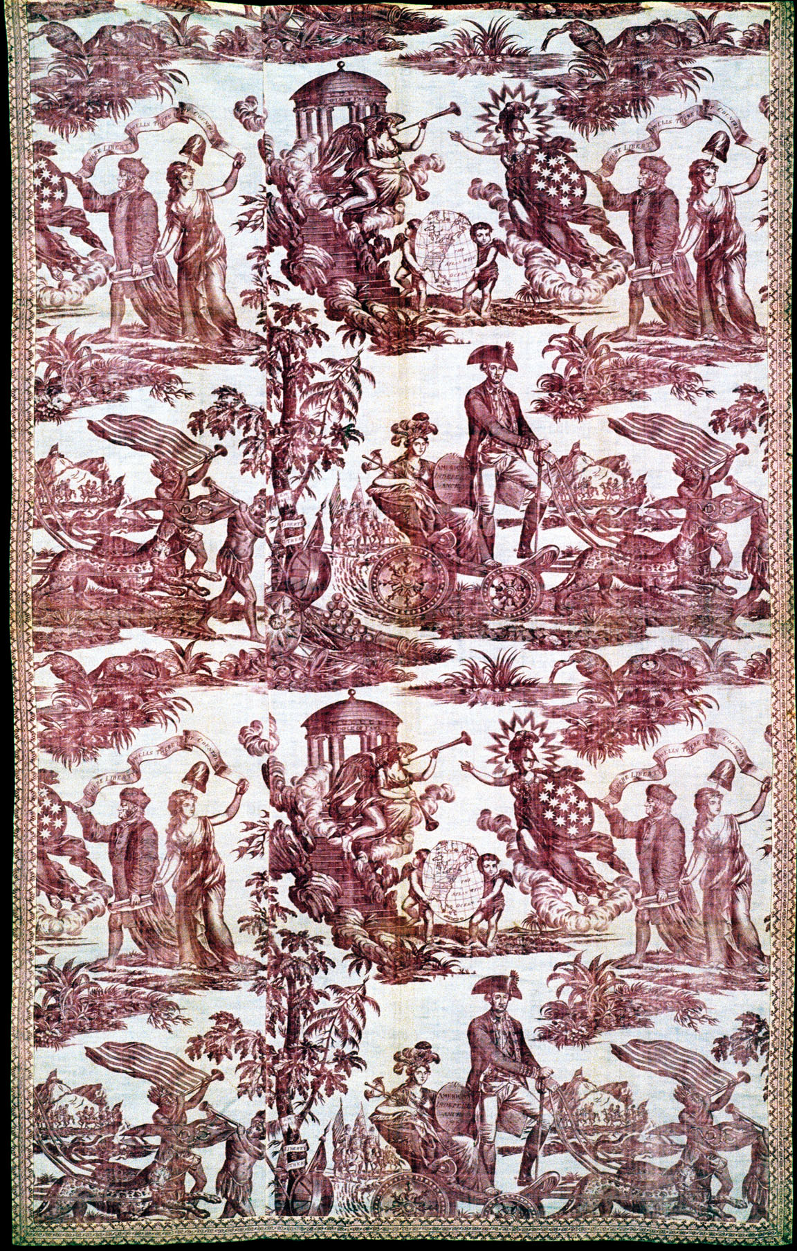
The Apotheosis of Benjamin Franklin and
George Washington
Give Me Liberty!: An American history, 3rd Edition
Copyright © 2011 W.W. Norton & Company

Slide 27
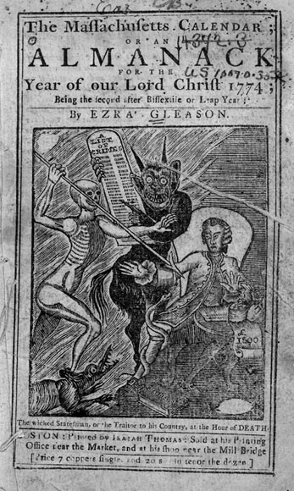
An engraving from a Massachusetts
Give Me Liberty!: An American history, 3rd Edition
Copyright © 2011 W.W. Norton & Company

Slide 28
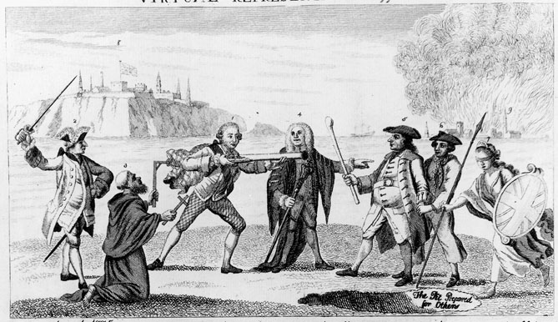
According to the doctrine of “virtual representation,”
the House of Commons
Give Me Liberty!: An American history, 3rd Edition
Copyright © 2011 W.W. Norton & Company

Slide 29
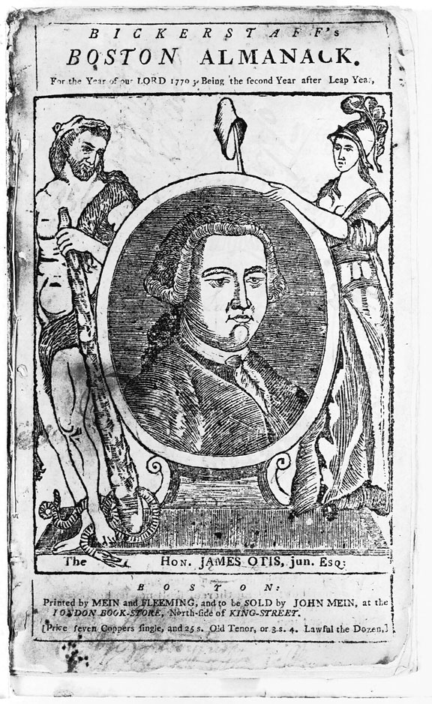
An engraving of James Otis graces the cover of
the Boston Almanack for 1770.
Give Me Liberty!: An American history, 3rd Edition
Copyright © 2011 W.W. Norton & Company

Slide 30
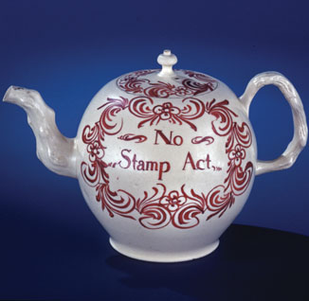
This tea pot protesting the Stamp Act
Give Me Liberty!: An American history, 3rd Edition
Copyright © 2011 W.W. Norton & Company

Slide 31
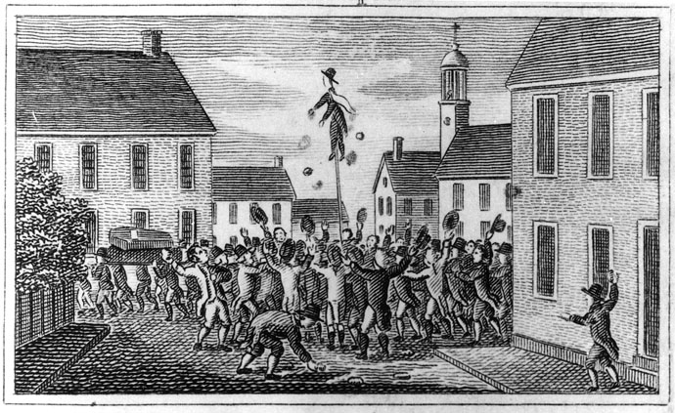
A woodcut depicting a crowd attempting to
intimidate a New Hampshire official charged
Give Me Liberty!: An American history, 3rd Edition
Copyright © 2011 W.W. Norton & Company

Slide 32
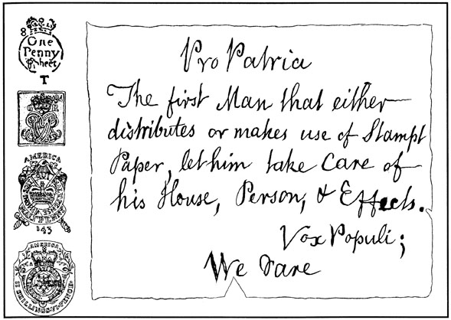
A warning by the Sons of Liberty
Give Me Liberty!: An American history, 3rd Edition
Copyright © 2011 W.W. Norton & Company

Slide 33
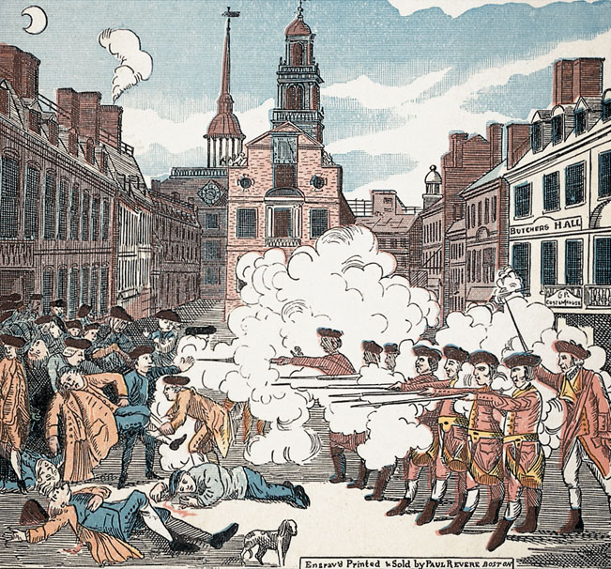
Give Me Liberty!: An American history, 3rd Edition
Copyright © 2011 W.W. Norton & Company
The Boston Massacre

Slide 34
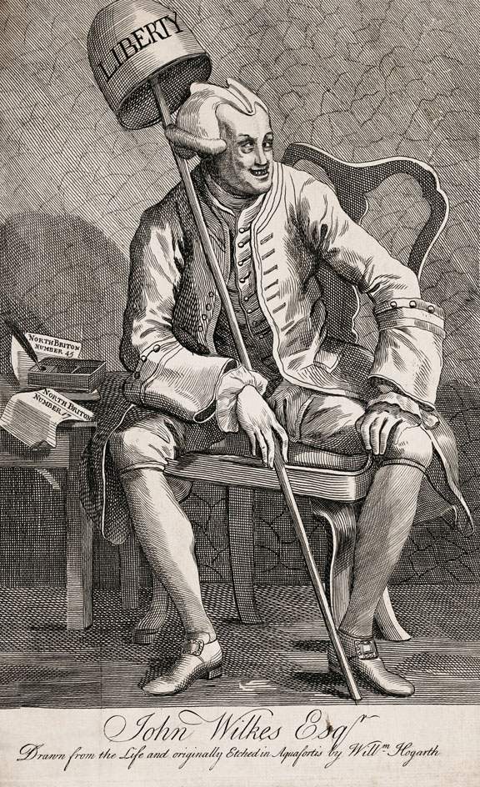
William Hogarth’s
Give Me Liberty!: An American history, 3rd Edition
Copyright © 2011 W.W. Norton & Company

Slide 35
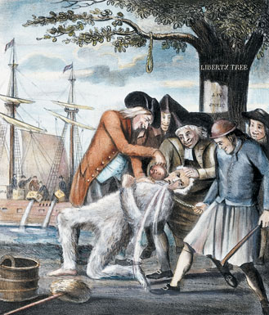
Give Me Liberty!: An American history, 3rd Edition
Copyright © 2011 W.W. Norton & Company
The Bostonians Paying the Excise-Man

Slide 36
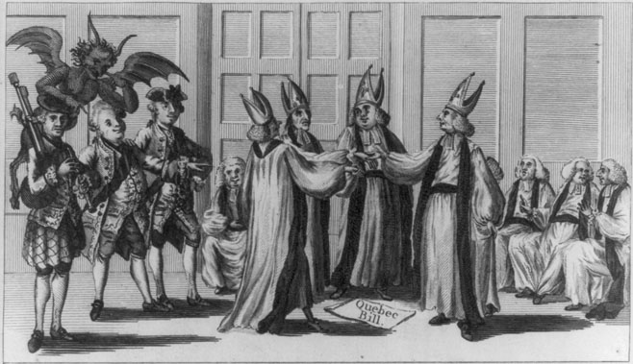
The Mitred Minuet
Give Me Liberty!: An American history, 3rd Edition
Copyright © 2011 W.W. Norton & Company

Slide 37
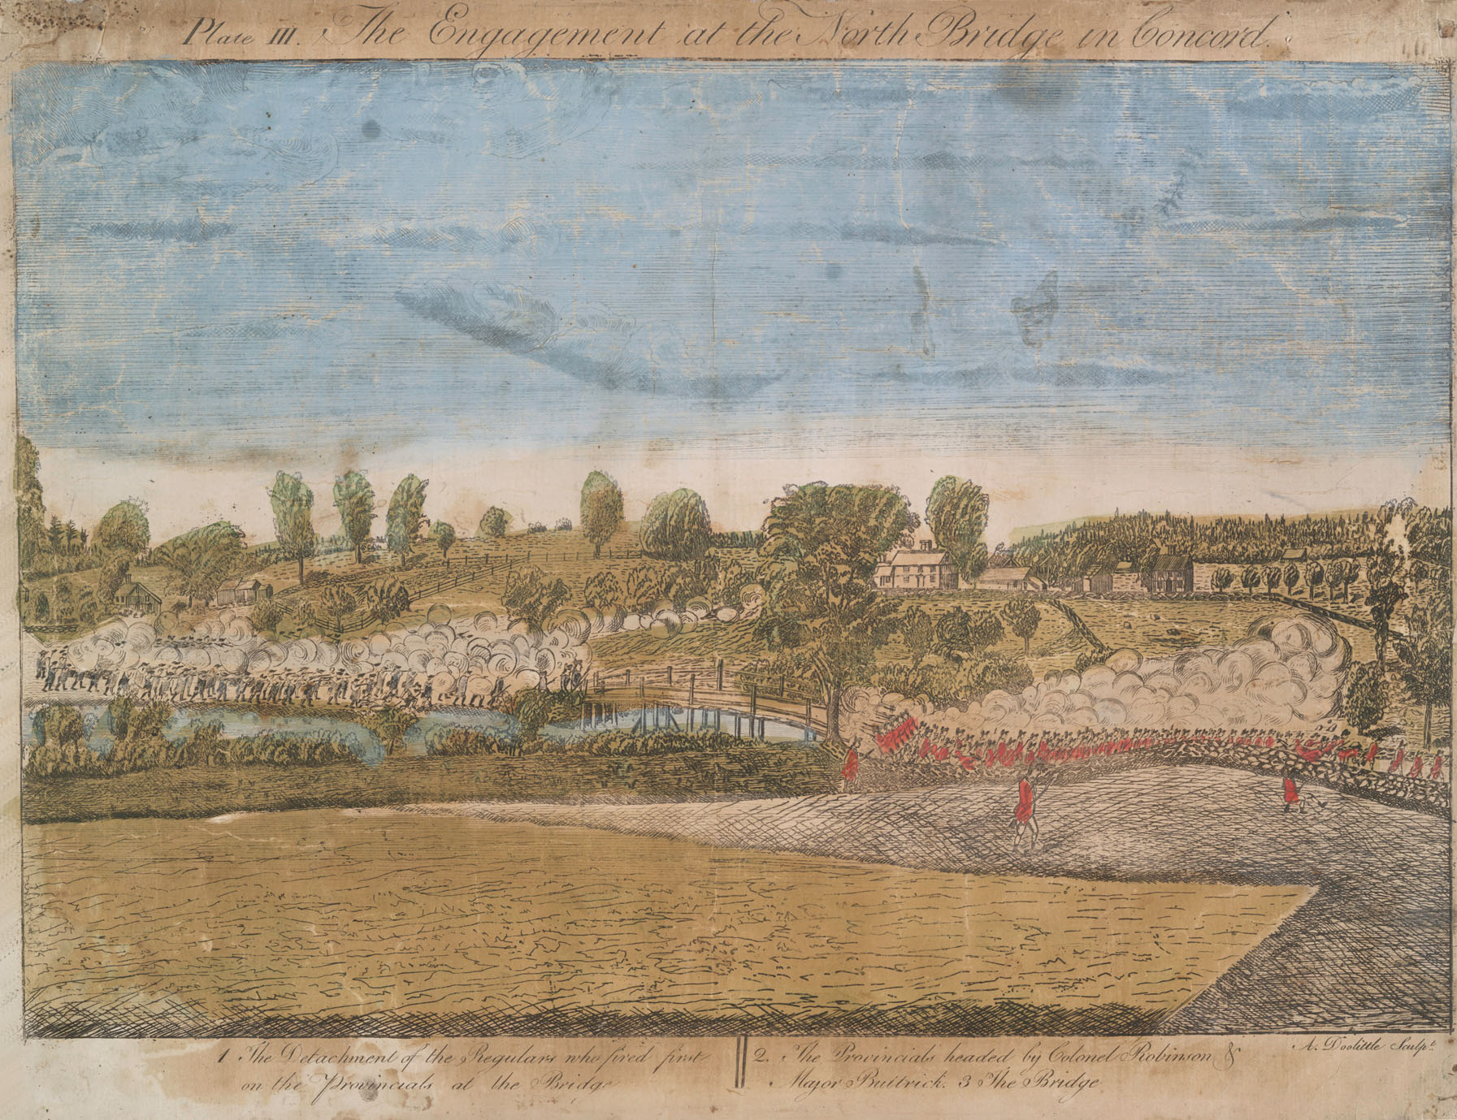
Give Me Liberty!: An American history, 3rd Edition
Copyright © 2011 W.W. Norton & Company
The Battle of Concord

Slide 38
In March 1776, James Pike, a soldier in the
Massachusetts militia
Give Me Liberty!: An American history, 3rd Edition
Copyright © 2011 W.W. Norton & Company

Slide 39
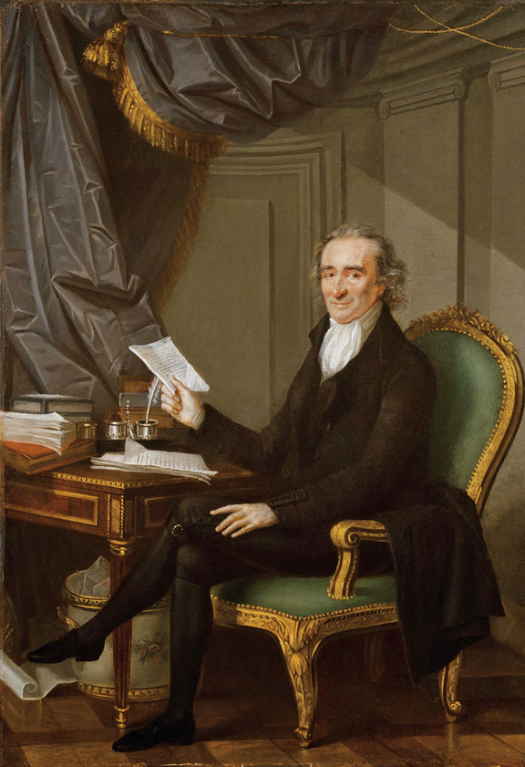
Thomas Paine, advocate of American independence,
in a 1791 portrait.
Give Me Liberty!: An American history, 3rd Edition
Copyright © 2011 W.W. Norton & Company

Slide 40
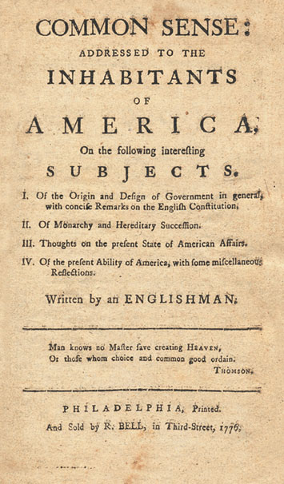
The cover of Common Sense
Give Me Liberty!: An American history, 3rd Edition
Copyright © 2011 W.W. Norton & Company

Slide 41
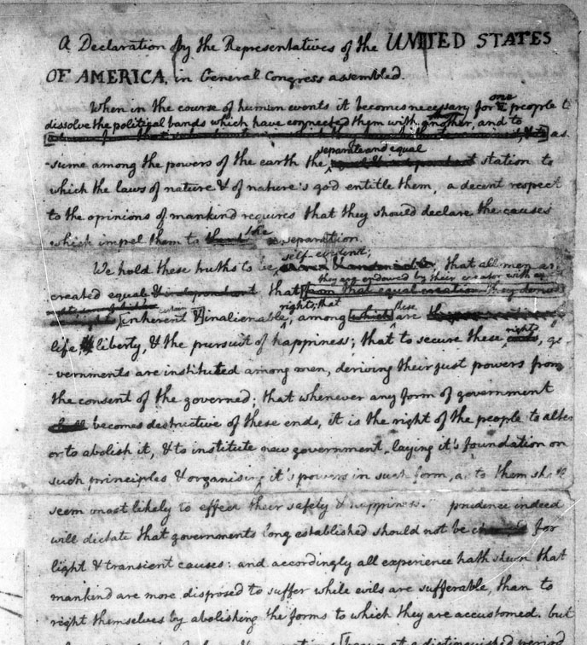
An early draft, with corrections, of the
Declaration of Independence
Give Me Liberty!: An American history, 3rd Edition
Copyright © 2011 W.W. Norton & Company

Slide 42
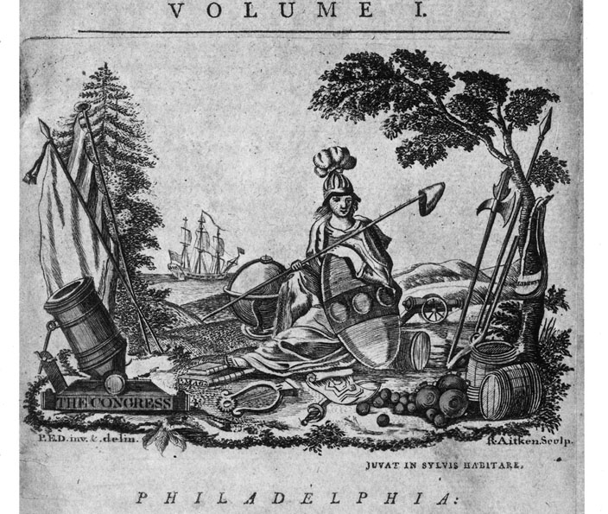
America as a symbol of liberty
Give Me Liberty!: An American history, 3rd Edition
Copyright © 2011 W.W. Norton & Company

Slide 43
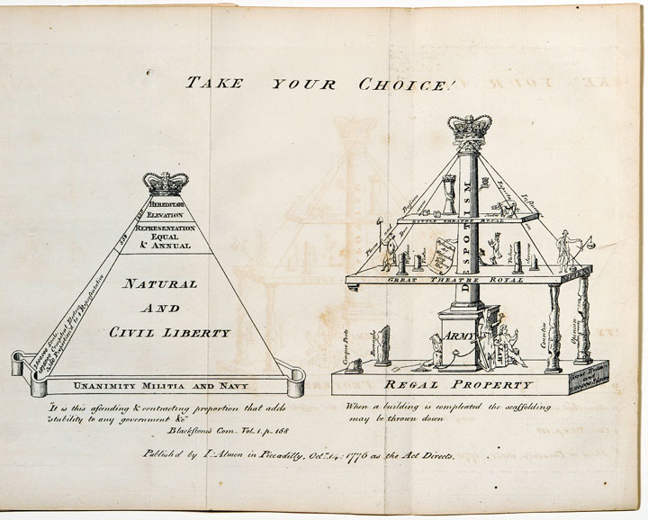
Inspired by the American Revolution
Give Me Liberty!: An American history, 3rd Edition
Copyright © 2011 W.W. Norton & Company

Slide 44
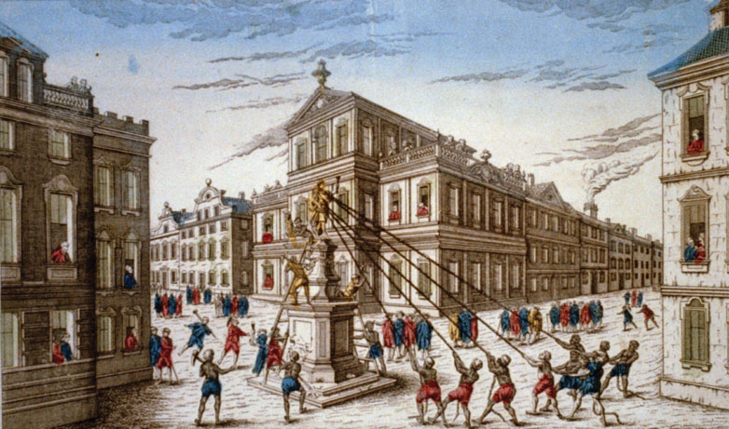
A French engraving depicts New Yorkers
Give Me Liberty!: An American history, 3rd Edition
Copyright © 2011 W.W. Norton & Company

Slide 45
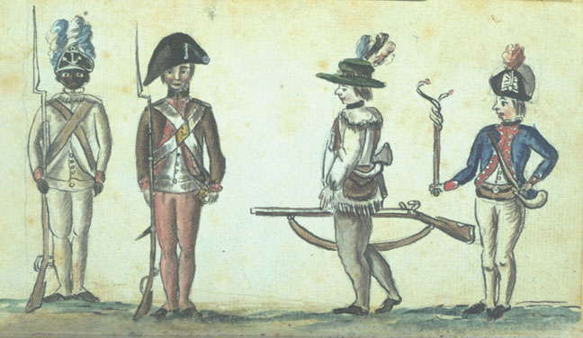
American Foot Soldiers
Give Me Liberty!: An American history, 3rd Edition
Copyright © 2011 W.W. Norton & Company

Slide 46
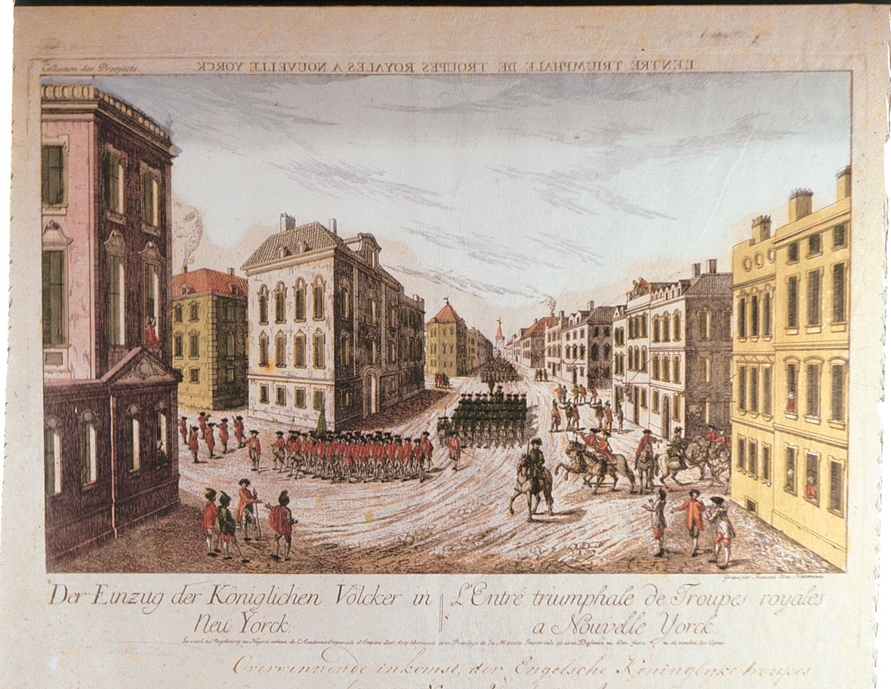
Triumphant Entry of the Royal Troops into New York
Give Me Liberty!: An American history, 3rd Edition
Copyright © 2011 W.W. Norton & Company

Slide 47
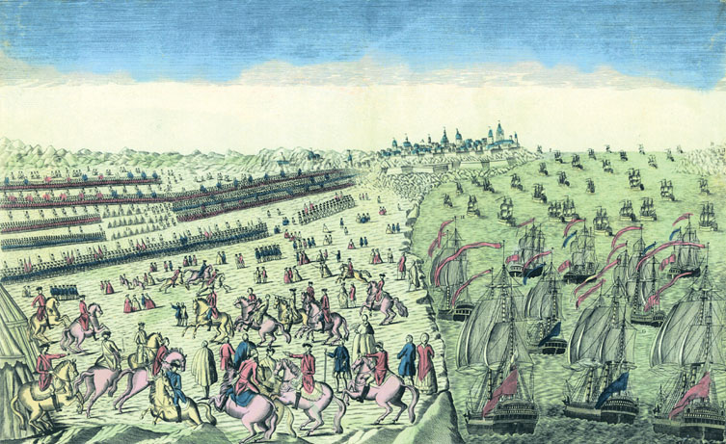
A 1781 French engraving showing the surrender of
Lord Charles Cornwallis’
Give Me Liberty!: An American history, 3rd Edition
Copyright © 2011 W.W. Norton & Company

Slide 48
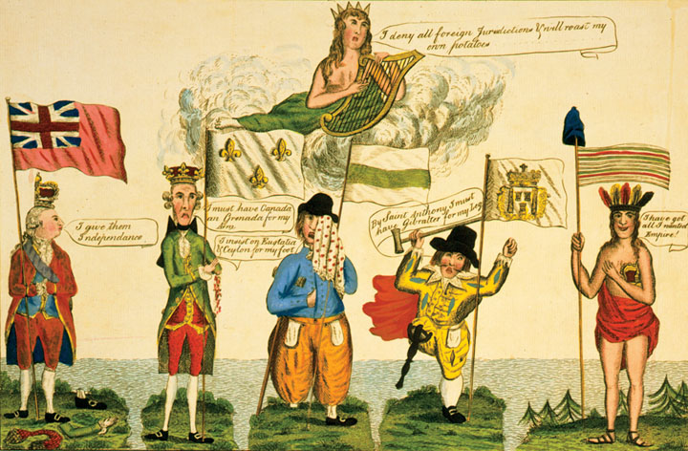
A satirical cartoon depicts America
Give Me Liberty!: An American history, 3rd Edition
Copyright © 2011 W.W. Norton & Company

Slide 49
Norton Lecture Slides Independent and Employee-Owned
This concludes the Norton Lecture Slides
Slide Set for Chapter 5
Give Me Liberty!
AN AMERICAN HISTORY
THIRD EDITION
by
Eric Foner

