Slide 1
Chapter 24 An Affluent Society, 1953–1960
Notes:
In 1959, the United States and the Soviet Union exchanged national exhibitions, giving each nation’s citizens a chance to learn about life in the other. The Soviet Exhibition in New York City displayed factory machines, scientific advances, and other signs of the ways that communism had modernized an undeveloped country. The American Exhibition in Moscow displayed consumer goods, including stereos, a movie theater, home appliances, and twenty-two cars, all to show the superiority of modern capitalism and how it embodied political and economic freedoms. But the exhibition’s most important message was the conflation of consumption and freedom.
At Moscow, vice-president Richard Nixon celebrated America’s high standard of living and its ability to create prosperity for all social classes. The Moscow Exhibition witnessed the “kitchen debate,” unscripted talk between Nixon and Soviet premier Nikita Khrushchev about the relative merits of communism and capitalism that unfolded in a model suburban American kitchen. Nixon claimed the kitchen showed the mass enjoyment of freedom in America—freedom of choice among products, colors, styles, and prices. Nixon understood that “soft power,” or the penetration of American goods and popular culture, was stronger than military might. His celebration of American freedom defined as affluence and consumer choice within a traditional family life captured much about America in the 1950s. Khrushchev mocked American consumer culture and Americans’ obsession with goods. But his prediction that the Soviet Union would soon surpass America in the production of consumer goods conceded the victory of the American way of life in the Cold War.

Slide 2
The Golden Age
A “golden age” of capitalism followed World War II, in which economic expansion, stable prices, low unemployment, and rising living standards characterized American economic life until 1973. In every measurable way, most Americans lived better than had their parents and grandparents. By 1960, a majority of Americans were defined by the government as middle class, and the poverty rate had dropped to one in five families. New innovations like television, air conditioners, dishwashers, cheap long-distance phone calls, and jet air travel came into widespread use and former luxuries like electricity and indoor plumbing became common features for many Americans.
Although the economies of Western Europe and Japan recovered after the war, the United States remained the world’s industrial superpower. Major industries like steel, automobiles, and aircraft dominated the American and world markets, and like other wars, the Cold War increased industrial production and redistributed population and resources. The West became a center of military technology production, and the South housed military bases and shipyards. In New England, new aircraft and submarine production replaced some of the jobs lost by the movement of textiles to the South. But the 1950s were in fact the last years of America’s industrial age. Ever since, the U.S. economy has moved toward services, education, information, finance, and entertainment, while employment in manufacturing has dropped. Union-led wage raises caused many employers to turn to mechanizing production in order to reduce labor costs. The number of farms in America declined as well, even as new technologies and irrigation increased agricultural production. Changes in southern agriculture continued to reduce the number of agricultural laborers, 3 million of whom, both black and white, left the South.
What most spurred economic growth in the 1950s was housing construction and spending on consumer goods. The postwar baby boom and population migration from cities to suburbs created a demand for housing, televisions, home appliances, and cars. By 1960, there were more suburban residents of single-family homes than people living in urban or rural areas. In the 1950s, the number of houses doubled, most of which were built in suburbs. Many Americans now realized dreams of owning their own home by purchasing an inexpensive house in a housing development. But suburbs were often centered around malls, which were accessible by cars and were used only for shopping and other private activities, unlike city centers with multiple uses.
Notes:
A “golden age” of capitalism followed World War II, in which economic expansion, stable prices, low unemployment, and rising living standards characterized American economic life until 1973. In every measurable way, most Americans lived better than had their parents and grandparents. By 1960, a majority of Americans were defined by the government as middle class, and the poverty rate had dropped to one in five families. New innovations like television, air conditioners, dishwashers, cheap long-distance phone calls, and jet air travel came into widespread use and former luxuries like electricity and indoor plumbing became common features for many Americans.
Although the economies of Western Europe and Japan recovered after the war, the United States remained the world’s industrial superpower. Major industries like steel, automobiles, and aircraft dominated the American and world markets, and like other wars, the Cold War increased industrial production and redistributed population and resources. The West became a center of military technology production, and the South housed military bases and shipyards. In New England, new aircraft and submarine production replaced some of the jobs lost by the movement of textiles to the South. But the 1950s were in fact the last years of America’s industrial age. Ever since, the U.S. economy has moved toward services, education, information, finance, and entertainment, while employment in manufacturing has dropped. Union-led wage raises caused many employers to turn to mechanizing production in order to reduce labor costs. The number of farms in America declined as well, even as new technologies and irrigation increased agricultural production. Changes in southern agriculture continued to reduce the number of agricultural laborers, 3 million of whom, both black and white, left the South.
What most spurred economic growth in the 1950s was housing construction and spending on consumer goods. The postwar baby boom and population migration from cities to suburbs created a demand for housing, televisions, home appliances, and cars. By 1960, there were more suburban residents of single-family homes than people living in urban or rural areas. In the 1950s, the number of houses doubled, most of which were built in suburbs. Many Americans now realized dreams of owning their own home by purchasing an inexpensive house in a housing development. But suburbs were often centered around malls, which were accessible by cars and were used only for shopping and other private activities, unlike city centers with multiple uses.

Slide 3
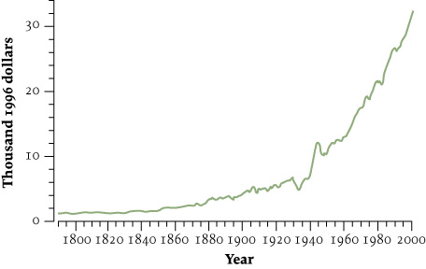
Figure 24.1 Real Gross Domestic Product Per
Capita, 1790–2000
Give Me Liberty!: An American history, 3rd Edition
Copyright © 2011 W.W. Norton & Company

Slide 4
The Golden Age
California best symbolized the postwar suburban boom. Between World War II and 1975, more than 30 million Americans moved west of the Mississippi River. One-fifth of the 1950s population growth happened in California, and in 1963 it surpassed New York as the most populous state. “Centerless” western cities emerged, such as Houston, Phoenix, and Los Angeles. These were decentralized clusters of single-family homes and businesses tied together by highways, unlike eastern cities with central business districts and surrounding residential areas united by public transportation. In the new suburbs, life was revolved around the car; people drove to work and drove to shop, and older city centers stagnated. Suburban homes required lawns, so much so that today more land area in the United States is cultivated in grass than in agricultural crops.
Affluence and consumerism had never before so pervaded American society. In a consumer culture, freedom became the ability to satisfy market desires. The 1950s was the culmination of a long-term trend in which consumerism replaced economic independence and democratic participation as central definitions of American freedom. Americans now happily accumulated debt in order to maintain a consumer lifestyle.
Notes:
California best symbolized the postwar suburban boom. Between World War II and 1975, more than 30 million Americans moved west of the Mississippi River. One-fifth of the 1950s population growth happened in California, and in 1963 it surpassed New York as the most populous state. “Centerless” western cities emerged, such as Houston, Phoenix, and Los Angeles. These were decentralized clusters of single-family homes and businesses tied together by highways, unlike eastern cities with central business districts and surrounding residential areas united by public transportation. In the new suburbs, life was revolved around the car; people drove to work and drove to shop, and older city centers stagnated. Suburban homes required lawns, so much so that today more land area in the United States is cultivated in grass than in agricultural crops.
Affluence and consumerism had never before so pervaded American society. In a consumer culture, freedom became the ability to satisfy market desires. The 1950s was the culmination of a long-term trend in which consumerism replaced economic independence and democratic participation as central definitions of American freedom. Americans now happily accumulated debt in order to maintain a consumer lifestyle.

Slide 5
The Golden Age
Television especially spread the culture of middle-class life and consumerism. By 1960, almost all American families owned a TV set, and television replaced newspapers as the most common information source about public events. TV became the nation’s primary leisure activity. It changed Americans’ habits and offered Americans of all backgrounds a common experience. TV programming almost always avoided controversy and depicted a humdrum middle class existence. Early TV shows that featured urban working-class families fell to later quiz shows, Westerns, and comedies set in suburbia, such as Leave It to Beaver. TV also became the most effective advertising medium ever, selling goods and spreading an image of the good life as one based on consumer goods.
Buying a new car soon seemed essential to freedom and, along with the home and TV, a car became a consumer necessity for each family. By 1960, four of five families in the United States owned at least one car, almost always made in the United States. Auto manufacturers and oil companies became the top companies in America. Detroit became the center of the auto industry, sporting enormous factories with 40,000 or more employees. The car transformed American life. The interstate highway system changed Americans’ traveling habits, enabling long-distance vacations by car. The result was an altered landscape of motels, drive-ins, strip malls, movie theaters, and roadside restaurants, including “fast-food” enterprises like McDonalds. The car was an icon of American freedom, representing individual mobility and private choice.
Notes:
Television especially spread the culture of middle-class life and consumerism. By 1960, almost all American families owned a TV set, and television replaced newspapers as the most common information source about public events. TV became the nation’s primary leisure activity. It changed Americans’ habits and offered Americans of all backgrounds a common experience. TV programming almost always avoided controversy and depicted a humdrum middle class existence. Early TV shows that featured urban working-class families fell to later quiz shows, Westerns, and comedies set in suburbia, such as Leave It to Beaver. TV also became the most effective advertising medium ever, selling goods and spreading an image of the good life as one based on consumer goods.
Buying a new car soon seemed essential to freedom and, along with the home and TV, a car became a consumer necessity for each family. By 1960, four of five families in the United States owned at least one car, almost always made in the United States. Auto manufacturers and oil companies became the top companies in America. Detroit became the center of the auto industry, sporting enormous factories with 40,000 or more employees. The car transformed American life. The interstate highway system changed Americans’ traveling habits, enabling long-distance vacations by car. The result was an altered landscape of motels, drive-ins, strip malls, movie theaters, and roadside restaurants, including “fast-food” enterprises like McDonalds. The car was an icon of American freedom, representing individual mobility and private choice.

Slide 6
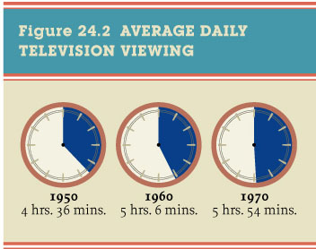
Figure 24.2 Average Daily Television Viewing
Give Me Liberty!: An American history, 3rd Edition
Copyright © 2011 W.W. Norton & Company

Slide 7
The Golden Age
Suburbanization reinforced the family as the center of the “American way of life” and women’s household roles. Most women who had industrial jobs during the war lost them, and most women who worked outside the home remained in low-paying, non-union jobs, rather than better-paid factory jobs. Although the number of women at work slowly rose, more women worked to supplement their family’s consumer lifestyle than for economic independence, and their pay at 1960 was, on average, 60 percent of men’s pay. It was widely assumed that the suburban family’s breadwinner should be male, while the wife stayed at home. Popular culture depicted marriage as the most important life goal of the American woman, and women married younger, divorced less, and had more children. A “baby boom” lasted from the war’s end to the mid-1960s, contributing to a 30 million increase in the nation’s population in the 1950s. And the family became a weapon in the Cold War, as government officials argued that women’s confinement to the home separated the free world from the communist world, where women worked. Feminism seemed to have disappeared from American life and culture.
The suburbs offered the dream of home ownership and security to millions of Americans who had suffered through depression and war. It also promoted Americanization, as ethnic Americans left urban enclaves and joined an America of mass consumption. But the suburbs were racially segregated. Although they differed in many ways, suburbs were almost always white. The racial segregation of suburbanization was the result of decisions by government, real-estate developers, banks, and residents. In the postwar housing boom, government officials ensured mortgages that barred resale to non-whites, and when this was declared unconstitutional, private banks and developers continued the practice.
Notes:
Suburbanization reinforced the family as the center of the “American way of life” and women’s household roles. Most women who had industrial jobs during the war lost them, and most women who worked outside the home remained in low-paying, non-union jobs, rather than better-paid factory jobs. Although the number of women at work slowly rose, more women worked to supplement their family’s consumer lifestyle than for economic independence, and their pay at 1960 was, on average, 60 percent of men’s pay. It was widely assumed that the suburban family’s breadwinner should be male, while the wife stayed at home. Popular culture depicted marriage as the most important life goal of the American woman, and women married younger, divorced less, and had more children. A “baby boom” lasted from the war’s end to the mid-1960s, contributing to a 30 million increase in the nation’s population in the 1950s. And the family became a weapon in the Cold War, as government officials argued that women’s confinement to the home separated the free world from the communist world, where women worked. Feminism seemed to have disappeared from American life and culture.
The suburbs offered the dream of home ownership and security to millions of Americans who had suffered through depression and war. It also promoted Americanization, as ethnic Americans left urban enclaves and joined an America of mass consumption. But the suburbs were racially segregated. Although they differed in many ways, suburbs were almost always white. The racial segregation of suburbanization was the result of decisions by government, real-estate developers, banks, and residents. In the postwar housing boom, government officials ensured mortgages that barred resale to non-whites, and when this was declared unconstitutional, private banks and developers continued the practice.

Slide 8
Figure 24.3 The Baby Boom and its Decline
Give Me Liberty!: An American history, 3rd Edition
Copyright © 2011 W.W. Norton & Company

Slide 9
The Golden Age
Although Congress, in 1949 passed a law to build almost a million units of public housing, the law set a very low ceiling on residents’ income (in order to limit competition for the construction of middle-class housing, on behalf of private contractors). This limited housing projects to the very poor. Along with the fact that white urban and suburban neighborhoods opposed the construction of public housing, this reinforced the poverty of urban non-white areas. “Urban renewal” also demolished poor neighborhoods in city centers in order to develop shopping centers, all-white middle-income residential areas, and state university campuses. Whites displaced by urban renewal often moved to suburbs, while non-whites were unable to leave the inner city.
Suburbanization reinforced racial divisions in America. Between 1950 and 1970, about 7 million whites left cities for suburbs, while 3 million blacks moved from the South to the North, expanding and creating urban ghettos. Half a million Puerto Ricans, many of them small farmers and laborers pushed off the island by sugar companies, moved to the mainland, and many settled in New York City. Racial exclusion reinforced itself. Non-whites facing employment discrimination and exclusion from educational opportunity were confined to unskilled jobs. As whites and industrial jobs moved out of the cities, poor blacks and Latinos stayed in the urban ghettos and became seen as centers of crime, poverty, and welfare. Suburban whites feared that any non-white presence in their neighborhoods would lower their quality of life and property values.
Notes:
Although Congress, in 1949 passed a law to build almost a million units of public housing, the law set a very low ceiling on residents’ income (in order to limit competition for the construction of middle-class housing, on behalf of private contractors). This limited housing projects to the very poor. Along with the fact that white urban and suburban neighborhoods opposed the construction of public housing, this reinforced the poverty of urban non-white areas. “Urban renewal” also demolished poor neighborhoods in city centers in order to develop shopping centers, all-white middle-income residential areas, and state university campuses. Whites displaced by urban renewal often moved to suburbs, while non-whites were unable to leave the inner city.
Suburbanization reinforced racial divisions in America. Between 1950 and 1970, about 7 million whites left cities for suburbs, while 3 million blacks moved from the South to the North, expanding and creating urban ghettos. Half a million Puerto Ricans, many of them small farmers and laborers pushed off the island by sugar companies, moved to the mainland, and many settled in New York City. Racial exclusion reinforced itself. Non-whites facing employment discrimination and exclusion from educational opportunity were confined to unskilled jobs. As whites and industrial jobs moved out of the cities, poor blacks and Latinos stayed in the urban ghettos and became seen as centers of crime, poverty, and welfare. Suburban whites feared that any non-white presence in their neighborhoods would lower their quality of life and property values.

Slide 10
The Golden Age
In the 1950s, to many it seemed that America’s major social problems had been solved. Widespread affluence and narrowed political debate made for a quiescent society. Business booms and busts, mass unemployment, and economic security seemed things of the past. Scholars celebrated the “end of ideology” and the victory of a democratic, capitalist “consensus” in which all Americans except a few fanatics shared the same liberal values of individualism, respect for private property, and belief in equal opportunity. The only problems that might remain required only technical adjustments, not structural change. Religious differences now seemed absorbed into a common “Judeo-Christian” heritage, in which Catholics, Protestants, and Jews all shared history and values and contributed to American society, and freedom of religion was held to differentiate America from the anti-religious Soviet Union. Although the Judeo-Christian concept obscured the long-standing history of religious strife in American life, it reflected the decline of anti-Catholicism and anti-Semitism in the United States and increasing secularization in the nation. Although a majority of Americans were affiliated with a church or synagogue in the 1950s—the highest proportion in American history – religion had more to do with personal identity, group assimilation, and promoting traditional morality than spiritual activity.
Cold War freedom’s economic content became centered on consumer capitalism, or “free enterprise.” An economic system based on private ownership united the nations of the Free World more than political democracy or freedom of speech. Even President Truman dropped freedom from want and fear from his speeches and replaced them with freedom of enterprise. The “selling of free enterprise” became a major industry that involved advertising, school programs, newspaper editorials, and civic activities. Yet talk of the virtue of free markets ignored how government policies like federal tax subsidies, mortgage guarantees, infrastructure construction, military contracts, and GI Bill benefits all spurred postwar economic growth.
Notes:
In the 1950s, to many it seemed that America’s major social problems had been solved. Widespread affluence and narrowed political debate made for a quiescent society. Business booms and busts, mass unemployment, and economic security seemed things of the past. Scholars celebrated the “end of ideology” and the victory of a democratic, capitalist “consensus” in which all Americans except a few fanatics shared the same liberal values of individualism, respect for private property, and belief in equal opportunity. The only problems that might remain required only technical adjustments, not structural change. Religious differences now seemed absorbed into a common “Judeo-Christian” heritage, in which Catholics, Protestants, and Jews all shared history and values and contributed to American society, and freedom of religion was held to differentiate America from the anti-religious Soviet Union. Although the Judeo-Christian concept obscured the long-standing history of religious strife in American life, it reflected the decline of anti-Catholicism and anti-Semitism in the United States and increasing secularization in the nation. Although a majority of Americans were affiliated with a church or synagogue in the 1950s—the highest proportion in American history – religion had more to do with personal identity, group assimilation, and promoting traditional morality than spiritual activity.
Cold War freedom’s economic content became centered on consumer capitalism, or “free enterprise.” An economic system based on private ownership united the nations of the Free World more than political democracy or freedom of speech. Even President Truman dropped freedom from want and fear from his speeches and replaced them with freedom of enterprise. The “selling of free enterprise” became a major industry that involved advertising, school programs, newspaper editorials, and civic activities. Yet talk of the virtue of free markets ignored how government policies like federal tax subsidies, mortgage guarantees, infrastructure construction, military contracts, and GI Bill benefits all spurred postwar economic growth.

Slide 11
The Golden Age
Although Americans had long worried that big business threatened their liberties, they were now told by government officials to embrace large-scale production as a way to fight the Cold War and enhance freedom by spreading consumer goods. Freedom was defined essentially as freedom of choice for the consumer. To many, America seemed to have become a classless society. A steep rise in the number of people investing in Wall Street inspired talk of a “people’s capitalism.” Few could deny that affluence seemed to make poverty a relic of history.
In the 1950s, a few intellectuals began to revive conservatism and reclaim from liberals the idea of freedom. Their ideas eventually defined conservative thought for the rest of the twentieth century. Their opposition to a strong national government was fostered by resentments against the New Deal. These “libertarian” conservatives defined freedom as individual autonomy, limited government, and unregulated capitalism. Their principles appealed to conservative entrepreneurs, especially in the developing South and West. Many businessmen looking to earn profits free of government regulations, high taxes, and unions admired the writings of Milton Friedman. A young economist, Friedman in 1962 published Capitalism and Freedom, which identified the free market as the foundation of individual liberty. Friedman gave this rather popular idea an extreme logic. He called for privatizing almost all government functions and for the repeal of minimum wage laws, the graduated income tax, and Social Security.
Friedman criticized not only liberalism but the “new conservatism,” another growing body of 1950s thought. Believing that the Free World had to be morally and intellectually, and not just militarily, defended against communism, writers like Russell Kirk and Richard Weaver argued that liberals’ toleration of difference was no substitute for the search for absolute truth. They called for a return to a civilization based on Christian values. They understood freedom as a moral condition above all, in which individuals were responsible for their own actions and could be coerced by government if they did not make the right decisions. Although the libertarian conservatives and the new conservatives disagreed about priorities and the definition of freedom, they both united against the Soviet Union and liberalism at home. Conservatism in America was now defined by its opposition to “big government.”
Notes:
Although Americans had long worried that big business threatened their liberties, they were now told by government officials to embrace large-scale production as a way to fight the Cold War and enhance freedom by spreading consumer goods. Freedom was defined essentially as freedom of choice for the consumer. To many, America seemed to have become a classless society. A steep rise in the number of people investing in Wall Street inspired talk of a “people’s capitalism.” Few could deny that affluence seemed to make poverty a relic of history.
In the 1950s, a few intellectuals began to revive conservatism and reclaim from liberals the idea of freedom. Their ideas eventually defined conservative thought for the rest of the twentieth century. Their opposition to a strong national government was fostered by resentments against the New Deal. These “libertarian” conservatives defined freedom as individual autonomy, limited government, and unregulated capitalism. Their principles appealed to conservative entrepreneurs, especially in the developing South and West. Many businessmen looking to earn profits free of government regulations, high taxes, and unions admired the writings of Milton Friedman. A young economist, Friedman in 1962 published Capitalism and Freedom, which identified the free market as the foundation of individual liberty. Friedman gave this rather popular idea an extreme logic. He called for privatizing almost all government functions and for the repeal of minimum wage laws, the graduated income tax, and Social Security.
Friedman criticized not only liberalism but the “new conservatism,” another growing body of 1950s thought. Believing that the Free World had to be morally and intellectually, and not just militarily, defended against communism, writers like Russell Kirk and Richard Weaver argued that liberals’ toleration of difference was no substitute for the search for absolute truth. They called for a return to a civilization based on Christian values. They understood freedom as a moral condition above all, in which individuals were responsible for their own actions and could be coerced by government if they did not make the right decisions. Although the libertarian conservatives and the new conservatives disagreed about priorities and the definition of freedom, they both united against the Soviet Union and liberalism at home. Conservatism in America was now defined by its opposition to “big government.”

Slide 12
The Eisenhower Era
Dwight D. Eisenhower, known as “Ike,” was the most popular military leader to emerge from World War II. Eisenhower supported Truman’s candidacy for president in 1948, and in 1952, both parties wanted Eisenhower as their candidate. But Eisenhower believed that a contender for the Republican nomination, Senator Robert A. Taft of Ohio, would turn American back to isolationism, and Eisenhower gained the Republican nomination. He chose as his running mate Richard Nixon of California, who, as a member of the House Un-American Activities Committee, had achieved notoriety through his anti-communist activism, particularly against Alger Hiss. Nixon won a senate seat in 1950 by suggesting that his Democratic opponent sympathized with communism. Though Nixon thus gained a reputation for opportunism and dishonesty, he also was a skillful politician who led efforts to change the Republican Party’s image from defender of business to champion of the “forgotten man”—hardworking citizens burdened by heavy taxes and government bureaucracy.
The 1952 presidential campaign was the first to show how television changed politics, as candidates crafted images that were projected directly into Americans’ living rooms. Eisenhower’s popularity dominated the election, however, and public frustration with the Korean War, and Eisenhower’s pledge to bring peace, won him an overwhelming victory over Adlai Stevenson, the Democrats’ candidate. Four years later, Eisenhower again bested Stevenson by an even larger margin. But the Republicans did not gain power in Congress, and in 1954, the Democrats regained control of Congress and held it for the rest of the 1950s. Voters across the world elected familiar and elder leaders to govern them—such as Winston Churchill, made prime minister in England again, and Charles DeGaulle in France.
Notes:
Dwight D. Eisenhower, known as “Ike,” was the most popular military leader to emerge from World War II. Eisenhower supported Truman’s candidacy for president in 1948, and in 1952, both parties wanted Eisenhower as their candidate. But Eisenhower believed that a contender for the Republican nomination, Senator Robert A. Taft of Ohio, would turn American back to isolationism, and Eisenhower gained the Republican nomination. He chose as his running mate Richard Nixon of California, who, as a member of the House Un-American Activities Committee, had achieved notoriety through his anti-communist activism, particularly against Alger Hiss. Nixon won a senate seat in 1950 by suggesting that his Democratic opponent sympathized with communism. Though Nixon thus gained a reputation for opportunism and dishonesty, he also was a skillful politician who led efforts to change the Republican Party’s image from defender of business to champion of the “forgotten man”—hardworking citizens burdened by heavy taxes and government bureaucracy.
The 1952 presidential campaign was the first to show how television changed politics, as candidates crafted images that were projected directly into Americans’ living rooms. Eisenhower’s popularity dominated the election, however, and public frustration with the Korean War, and Eisenhower’s pledge to bring peace, won him an overwhelming victory over Adlai Stevenson, the Democrats’ candidate. Four years later, Eisenhower again bested Stevenson by an even larger margin. But the Republicans did not gain power in Congress, and in 1954, the Democrats regained control of Congress and held it for the rest of the 1950s. Voters across the world elected familiar and elder leaders to govern them—such as Winston Churchill, made prime minister in England again, and Charles DeGaulle in France.

Slide 13
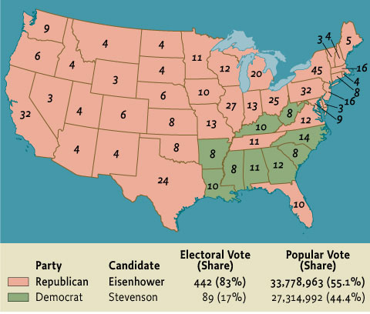
Map 24.2 The Presidential Election of 1952
Give Me Liberty!: An American history, 3rd Edition
Copyright © 2011 W.W. Norton & Company

Slide 14
The Eisenhower Era
With a Republican president after a long period of Democratic rule, business once again heavily influenced Washington and the executive branch. Ike, an ally of business and fiscal conservative, worked to reduce government spending, including the military budget. But while some Republicans wanted to roll back the New Deal, Ike knew this would be political suicide. Ike’s domestic agenda, called “Modern Republicanism,” was intended to end the Republicans’ association with Herbert Hoover, the Great Depression, and social indifference. Under Eisenhower, New Deal programs expanded and the size of the government grew. “Free enterprise” may have been a potent American weapon in the Cold War, but the “mixed economy,” in which government played a role in planning economic activity, was popular in the West. U.S. allies like Britain and France expanded welfare and nationalized key industries like steel, shipbuilding, and transportation, but the United States had a smaller welfare state than Western Europe and left major industries in private hands, while government spending, such as the creation of a national highway system, boosted productivity and employment.
The 1950s also saw stability in labor relations. The 1947 Taft-Hartley Act reduced labor militancy, and in 1955, the AFL and CIO merged into one organization representing 35 percent of all non-farm workers. In key industries, labor and management established what has been called a new “social contract.” Unions left decisions about capital investment, plant location, and output to managers and agreed to suppress unauthorized “wildcat” strikes,” in return for employers’ acceptance of unions, wage increases, and fringe benefits like private pensions, health insurance, and automatic adjustments to cover rises in living costs. Though unionized workers shared in 1950s prosperity, the social contract applied to few workers. Unions won increases in the minimum wage, but they did little for non-union workers in this period. Most workers did not enjoy the wages and benefits of unions workers. Non-union employers continued to combat labor unions, and some firms still moved production to the cheaper, non-union South. A 1959 strike provoked by steel companies in an attempt to reduce the unions’ power over production showed that by the 1960s the social contract was weakening.
Notes:
With a Republican president after a long period of Democratic rule, business once again heavily influenced Washington and the executive branch. Ike, an ally of business and fiscal conservative, worked to reduce government spending, including the military budget. But while some Republicans wanted to roll back the New Deal, Ike knew this would be political suicide. Ike’s domestic agenda, called “Modern Republicanism,” was intended to end the Republicans’ association with Herbert Hoover, the Great Depression, and social indifference. Under Eisenhower, New Deal programs expanded and the size of the government grew. “Free enterprise” may have been a potent American weapon in the Cold War, but the “mixed economy,” in which government played a role in planning economic activity, was popular in the West. U.S. allies like Britain and France expanded welfare and nationalized key industries like steel, shipbuilding, and transportation, but the United States had a smaller welfare state than Western Europe and left major industries in private hands, while government spending, such as the creation of a national highway system, boosted productivity and employment.
The 1950s also saw stability in labor relations. The 1947 Taft-Hartley Act reduced labor militancy, and in 1955, the AFL and CIO merged into one organization representing 35 percent of all non-farm workers. In key industries, labor and management established what has been called a new “social contract.” Unions left decisions about capital investment, plant location, and output to managers and agreed to suppress unauthorized “wildcat” strikes,” in return for employers’ acceptance of unions, wage increases, and fringe benefits like private pensions, health insurance, and automatic adjustments to cover rises in living costs. Though unionized workers shared in 1950s prosperity, the social contract applied to few workers. Unions won increases in the minimum wage, but they did little for non-union workers in this period. Most workers did not enjoy the wages and benefits of unions workers. Non-union employers continued to combat labor unions, and some firms still moved production to the cheaper, non-union South. A 1959 strike provoked by steel companies in an attempt to reduce the unions’ power over production showed that by the 1960s the social contract was weakening.

Slide 15
The Eisenhower Era
Once elected, Eisenhower quickly ended the Korean War. But Cold War tensions increased. In 1952, the United States exploded the first hydrogen bomb, which was far more destructive than the atom bomb. The next year, the Soviets had the hydrogen bomb, too, and both powers built long-range bombers capable of delivering nuclear weapons across the globe. Although Eisenhower was a professional soldier who hated war, his secretary of state, John Foster Dulles, relished it. In 1954, Dulles updated U.S. containment policy with his doctrine of “massive retaliation.” This policy stated that any Soviet attack on a U.S. ally would be met with a nuclear assault on the Soviet Union. This new focus on nuclear weapons let Eisenhower reduce spending on conventional military forces. During his presidency the size of the armed forces dropped, while the number of nuclear weapons increased dramatically to 18,000. Massive retaliation seemed to risk that even a small conflict might rapidly escalate into a nuclear war that would destroy the United States and the Soviet Union. Critics called it “brinksmanship,” but the reality that war would result in “mutual assured destruction” made the United States and USSR more cautious. It also spread fear of an imminent nuclear war. Government appeals to build bomb shelters in back yards, and school drills where students hid under their desks, were meant to convince Americans that they could survive a nuclear war. But these only increased widespread fear.
Though Eisenhower embraced Cold War rhetoric, he believed the Korean War’s end and Stalin’s death in 1953 signaled that the Soviets were reasonable and could be reached through normal diplomacy. In 1955, he met with Soviet premier Nikita Khrushchev in Switzerland. The next year, Khrushchev denounced Stalin’s crimes at a Moscow Communist Party Congress. These revelations sparked a crisis of belief and confidence in communists worldwide, including the United States, where most remaining members of the Communist Party abandoned it. That same year, Khrushchev called for “peaceful coexistence” with the United States. But this “thaw” in the Cold War ended when Soviet troops suppressed an anti-communist revolt in Hungary. While some Republicans called for liberating Europe, Ike did not aid the Hungarian rebels; he did not believe it was possible to “roll back” Soviet power in Eastern Europe. In 1958, the United States and USSR agreed to halt nuclear weapons tests (this lasted until 1961). In 1959, Khrushchev even toured the United States and met with Eisenhower. But in 1960, tensions returned when the Soviets shot down a U.S. spy plane over Soviet territory.
Notes:
Once elected, Eisenhower quickly ended the Korean War. But Cold War tensions increased. In 1952, the United States exploded the first hydrogen bomb, which was far more destructive than the atom bomb. The next year, the Soviets had the hydrogen bomb, too, and both powers built long-range bombers capable of delivering nuclear weapons across the globe. Although Eisenhower was a professional soldier who hated war, his secretary of state, John Foster Dulles, relished it. In 1954, Dulles updated U.S. containment policy with his doctrine of “massive retaliation.” This policy stated that any Soviet attack on a U.S. ally would be met with a nuclear assault on the Soviet Union. This new focus on nuclear weapons let Eisenhower reduce spending on conventional military forces. During his presidency the size of the armed forces dropped, while the number of nuclear weapons increased dramatically to 18,000. Massive retaliation seemed to risk that even a small conflict might rapidly escalate into a nuclear war that would destroy the United States and the Soviet Union. Critics called it “brinksmanship,” but the reality that war would result in “mutual assured destruction” made the United States and USSR more cautious. It also spread fear of an imminent nuclear war. Government appeals to build bomb shelters in back yards, and school drills where students hid under their desks, were meant to convince Americans that they could survive a nuclear war. But these only increased widespread fear.
Though Eisenhower embraced Cold War rhetoric, he believed the Korean War’s end and Stalin’s death in 1953 signaled that the Soviets were reasonable and could be reached through normal diplomacy. In 1955, he met with Soviet premier Nikita Khrushchev in Switzerland. The next year, Khrushchev denounced Stalin’s crimes at a Moscow Communist Party Congress. These revelations sparked a crisis of belief and confidence in communists worldwide, including the United States, where most remaining members of the Communist Party abandoned it. That same year, Khrushchev called for “peaceful coexistence” with the United States. But this “thaw” in the Cold War ended when Soviet troops suppressed an anti-communist revolt in Hungary. While some Republicans called for liberating Europe, Ike did not aid the Hungarian rebels; he did not believe it was possible to “roll back” Soviet power in Eastern Europe. In 1958, the United States and USSR agreed to halt nuclear weapons tests (this lasted until 1961). In 1959, Khrushchev even toured the United States and met with Eisenhower. But in 1960, tensions returned when the Soviets shot down a U.S. spy plane over Soviet territory.

Slide 16
The Eisenhower Era
Even though the Cold War permanently divided Europe into communist and capitalist regions without war, it sparked competition and military conflict in what came to be called the “Third World. The term was used to describe developing countries aligned with neither the United States or the USSR, which wanted to develop their economies without central government planning or free market capitalism. The 1955 Bandung Conference in Indonesia that brought together the leaders of 29 African and Asian nations seemed to mark the arrival of the Third World in international affairs, but all of these countries were strongly affected by the Cold War.
In the postwar period, Europe’s empires crumbled. Decolonization in Asia and Africa began when India and Pakistan achieved independence in 1947. In the late 1950s, other new nations, such as Ghana, Indonesia, Malaysia, Nigeria, and Kenya followed. In 1975, even Portugal, which had created Europe’s first modern overseas empire, gave independence to its African colonies, Mozambique and Angola. Facing decolonization, the United States feared that power vacuums in the former colonies would be penetrated by Soviet-allied communists. The Soviets supported the dissolution of Europe’s colonial empires, and communists participated in national movements for independence. Leaders of new nations often saw socialism in one form or another as the best means to economic independence and narrowing social inequalities created by imperialism. While most new Third World nations sided with neither power, the United States was admired by many nationalists for its own struggle for colonial independence. Ho Chi Minh, the communist leader of Vietnam’s movement to end French rule there, modeled his 1945 declaration of nationhood on the Declaration of Independence.
Notes:
Even though the Cold War permanently divided Europe into communist and capitalist regions without war, it sparked competition and military conflict in what came to be called the “Third World. The term was used to describe developing countries aligned with neither the United States or the USSR, which wanted to develop their economies without central government planning or free market capitalism. The 1955 Bandung Conference in Indonesia that brought together the leaders of 29 African and Asian nations seemed to mark the arrival of the Third World in international affairs, but all of these countries were strongly affected by the Cold War.
In the postwar period, Europe’s empires crumbled. Decolonization in Asia and Africa began when India and Pakistan achieved independence in 1947. In the late 1950s, other new nations, such as Ghana, Indonesia, Malaysia, Nigeria, and Kenya followed. In 1975, even Portugal, which had created Europe’s first modern overseas empire, gave independence to its African colonies, Mozambique and Angola. Facing decolonization, the United States feared that power vacuums in the former colonies would be penetrated by Soviet-allied communists. The Soviets supported the dissolution of Europe’s colonial empires, and communists participated in national movements for independence. Leaders of new nations often saw socialism in one form or another as the best means to economic independence and narrowing social inequalities created by imperialism. While most new Third World nations sided with neither power, the United States was admired by many nationalists for its own struggle for colonial independence. Ho Chi Minh, the communist leader of Vietnam’s movement to end French rule there, modeled his 1945 declaration of nationhood on the Declaration of Independence.

Slide 17
The Eisenhower Era
Containment policy soon created U.S. opposition to any government, whether communist or not, which appeared to threaten U.S. strategic or economic interests. Although Jacabo Arbenz Guzman in Guatemala and Mohammed Mossadegh in Iran were elected as homegrown nationalists and were not Soviet agents, their determination to end foreign corporations’ domination of their economies provoked American intervention. Arbenz enacted land reforms that threatened the domination of the Guatemalan economy by the U.S.-owned United Fruit Company. Mossadegh nationalized the Anglo-Iranian Oil Company, whose refinery in Iran was Britain’s largest overseas asset. Their enemies branded them as communists, and in 1953 and 1954, the CIA orchestrated coups against both governments, in violation of the UN charter. In 1956, Israel, Britain, and France invaded Egypt when that country’s nationalist leader, Gamal Abdel Nasser, nationalized the Suez Canal, which had been owned by Britain and France. Eisenhower forced them to abandon the invasion, and soon the United States replaced Britain as the dominant Western power in the Middle East, with American firms dominating the region’s oil fields. In 1957, Eisenhower extended containment policy to the Middle East and issued the Eisenhower Doctrine, which committed the United States to defend Middle Eastern governments threatened by communism or Arab nationalism.
Notes:
Containment policy soon created U.S. opposition to any government, whether communist or not, which appeared to threaten U.S. strategic or economic interests. Although Jacabo Arbenz Guzman in Guatemala and Mohammed Mossadegh in Iran were elected as homegrown nationalists and were not Soviet agents, their determination to end foreign corporations’ domination of their economies provoked American intervention. Arbenz enacted land reforms that threatened the domination of the Guatemalan economy by the U.S.-owned United Fruit Company. Mossadegh nationalized the Anglo-Iranian Oil Company, whose refinery in Iran was Britain’s largest overseas asset. Their enemies branded them as communists, and in 1953 and 1954, the CIA orchestrated coups against both governments, in violation of the UN charter. In 1956, Israel, Britain, and France invaded Egypt when that country’s nationalist leader, Gamal Abdel Nasser, nationalized the Suez Canal, which had been owned by Britain and France. Eisenhower forced them to abandon the invasion, and soon the United States replaced Britain as the dominant Western power in the Middle East, with American firms dominating the region’s oil fields. In 1957, Eisenhower extended containment policy to the Middle East and issued the Eisenhower Doctrine, which committed the United States to defend Middle Eastern governments threatened by communism or Arab nationalism.

Slide 18
The Eisenhower Era
In Vietnam in 1945, when the Japanese were expelled, the French moved to crush a national independence movement led by Ho Chi Minh and reassert its colonial rule. Anti-communism pulled the United States deeper into involvement in southeast Asia. Following a policy set by Truman, Eisenhower gave billions of dollars in aid for French efforts, and by the early 1950s, the United States was paying for four-fifths of the costs of France’s war in Vietnam. But Eisenhower did not sent U.S. troops in 1954, when French forces were on the verge of defeat. Rejecting National Security Council advice to use nuclear weapons, Eisenhower left France no choice but to concede Vietnamese independence. A peace conference in Geneva divided Vietnam temporarily into northern and southern districts, with elections in 1956 set to unify the country. But the anti-communist southern leader Ngo Dinh Diem, at the suggestion of the United States, refused to hold elections, which both parties knew would result in communist victory. Diem’s Catholicism and his ties to landlords in a country of small famers and Buddhists alienated him from many Vietnamese, and only U.S. aid let his regime survive. By 1960, Diem faced a guerrilla war launched by the communist-led National Liberation Front.
Events in Guatemala, Iran, and Vietnam set a trend in U.S. foreign relations. The United States became accustomed to intervention, both overt and covert, throughout the world. Despite Cold War language of freedom, U.S. leaders again and again allied with military regimes rather than democratic governments. In Guatemala, a series of military regimes ended Arbenz’s reforms and began a period of repression in which about 200,000 Guatemalans died. In Iran, the Shah replaced Mossadegh and gave U.S. and British companies 40 percent of Iranian oil revenues, remaining in office until the 1979 revolution ushered in a radical Islamic nationalist government. In Vietnam, U.S. support for Diem led to the most disastrous war in U.S. history.
Notes:
In Vietnam in 1945, when the Japanese were expelled, the French moved to crush a national independence movement led by Ho Chi Minh and reassert its colonial rule. Anti-communism pulled the United States deeper into involvement in southeast Asia. Following a policy set by Truman, Eisenhower gave billions of dollars in aid for French efforts, and by the early 1950s, the United States was paying for four-fifths of the costs of France’s war in Vietnam. But Eisenhower did not sent U.S. troops in 1954, when French forces were on the verge of defeat. Rejecting National Security Council advice to use nuclear weapons, Eisenhower left France no choice but to concede Vietnamese independence. A peace conference in Geneva divided Vietnam temporarily into northern and southern districts, with elections in 1956 set to unify the country. But the anti-communist southern leader Ngo Dinh Diem, at the suggestion of the United States, refused to hold elections, which both parties knew would result in communist victory. Diem’s Catholicism and his ties to landlords in a country of small famers and Buddhists alienated him from many Vietnamese, and only U.S. aid let his regime survive. By 1960, Diem faced a guerrilla war launched by the communist-led National Liberation Front.
Events in Guatemala, Iran, and Vietnam set a trend in U.S. foreign relations. The United States became accustomed to intervention, both overt and covert, throughout the world. Despite Cold War language of freedom, U.S. leaders again and again allied with military regimes rather than democratic governments. In Guatemala, a series of military regimes ended Arbenz’s reforms and began a period of repression in which about 200,000 Guatemalans died. In Iran, the Shah replaced Mossadegh and gave U.S. and British companies 40 percent of Iranian oil revenues, remaining in office until the 1979 revolution ushered in a radical Islamic nationalist government. In Vietnam, U.S. support for Diem led to the most disastrous war in U.S. history.

Slide 19
The Eisenhower Era
Despite the apparent rule of consensus in American society, in which McCarthyism made criticism of the status quo seem disloyal, in which freedom seemed to be located in the private enjoyment of consumer goods, and in which political debate was narrowed by the Cold War, dissent did exist. Some intellectuals thought that affluence and the Cold War mentality obscured the degree to which the United States did not live up to its own ideal of freedom. In 1957, political scientist Hans Morgenthau argued that free enterprise had created “new accumulations” of power that threatened individual liberty. Radical sociologist C. Wright Mills challenged the idea that democratic pluralism defined American life, and argued that America was ruled by a “power elite”—an interlocking directorate of corporate leaders, politicians, and military men who dominated government and society, making political democracy obsolete and denying real freedom of choice to Americans.
Some argued that modernity itself produced psychological and cultural discontent, and they worried that mass society produced a loneliness and anxiety that made people desire not freedom, but authority and stability. Social scientists and critics argued that Americans were conformists who were unable to be independent thinkers and actors and that corporate bureaucracies turned employees into “organization men” incapable of independent thought.
Other critics worried that Americans had lost their commitment to the common good. Economist John Kenneth Galbraith, in The Affluent Society (1958), wondered how American society could neglect investment in schools, parks, and public services while producing ever more goods to satisfy consumer desires. Other books criticized the monotony of modern work, the emptiness of suburban life, and the influence of advertising. But this social and cultural critique did little to transform American life in the 1950s.
Notes:
Despite the apparent rule of consensus in American society, in which McCarthyism made criticism of the status quo seem disloyal, in which freedom seemed to be located in the private enjoyment of consumer goods, and in which political debate was narrowed by the Cold War, dissent did exist. Some intellectuals thought that affluence and the Cold War mentality obscured the degree to which the United States did not live up to its own ideal of freedom. In 1957, political scientist Hans Morgenthau argued that free enterprise had created “new accumulations” of power that threatened individual liberty. Radical sociologist C. Wright Mills challenged the idea that democratic pluralism defined American life, and argued that America was ruled by a “power elite”—an interlocking directorate of corporate leaders, politicians, and military men who dominated government and society, making political democracy obsolete and denying real freedom of choice to Americans.
Some argued that modernity itself produced psychological and cultural discontent, and they worried that mass society produced a loneliness and anxiety that made people desire not freedom, but authority and stability. Social scientists and critics argued that Americans were conformists who were unable to be independent thinkers and actors and that corporate bureaucracies turned employees into “organization men” incapable of independent thought.
Other critics worried that Americans had lost their commitment to the common good. Economist John Kenneth Galbraith, in The Affluent Society (1958), wondered how American society could neglect investment in schools, parks, and public services while producing ever more goods to satisfy consumer desires. Other books criticized the monotony of modern work, the emptiness of suburban life, and the influence of advertising. But this social and cultural critique did little to transform American life in the 1950s.

Slide 20
The Eisenhower Era
These critics did not offer a political alternative or influence party politics or government. But with a very large and growing young population thanks to the baby boom, popular culture revealed tensions beneath the quiet surface of 1950s life. J. D. Salinger’s novel Catcher in the Rye (1951) and films like Rebel without a Cause (1955) emphasized the alienation of youth from the adult world. Such works stimulated adult fears of widespread “juvenile delinquency” and led even comic books publishers to regulate their publications. Indeed, cultural life was more daring than politics. Teenagers wore leather jackets and danced to rock and roll music that brought the hard rhythms and sexually provocative movements of black musicians and dancers to white audiences, embodied none more so than in the extremely popular Elvis Presley. The debut of magazines like Playboy openly flaunted a fantasy world of sexuality for men outside the family, and gay men and lesbians, though considered deviant by the larger society, established their own subcultures in America’s major cities.
In New York, San Francisco, and small college towns, the Beats, a small group of poets and writers, rebelled against mainstream culture. The term beat, invented by novelist Jack Kerouac, signified “beaten down” and beatified” (or saint-like). His book On the Road, written in the early 1950s but not published until 1957, captured the aimless wanderings of the main character across America and a spontaneous series of sights, sounds, and images. The book captivated a generation of young people who rejected middle-class life but offered no alternative to it. Likewise, Allen Ginsberg’s Howl (1955), written while the author was taking hallucinogenic drugs, was a sprawling poem that railed against materialism and conformism. The Beats rejected the work ethic, suburban middle-class materialism, and the Cold War’s militarization of American life. They celebrated impulsive action, immediate gratification (often enhanced by drugs), and sexual experimentation.
Notes:
These critics did not offer a political alternative or influence party politics or government. But with a very large and growing young population thanks to the baby boom, popular culture revealed tensions beneath the quiet surface of 1950s life. J. D. Salinger’s novel Catcher in the Rye (1951) and films like Rebel without a Cause (1955) emphasized the alienation of youth from the adult world. Such works stimulated adult fears of widespread “juvenile delinquency” and led even comic books publishers to regulate their publications. Indeed, cultural life was more daring than politics. Teenagers wore leather jackets and danced to rock and roll music that brought the hard rhythms and sexually provocative movements of black musicians and dancers to white audiences, embodied none more so than in the extremely popular Elvis Presley. The debut of magazines like Playboy openly flaunted a fantasy world of sexuality for men outside the family, and gay men and lesbians, though considered deviant by the larger society, established their own subcultures in America’s major cities.
In New York, San Francisco, and small college towns, the Beats, a small group of poets and writers, rebelled against mainstream culture. The term beat, invented by novelist Jack Kerouac, signified “beaten down” and beatified” (or saint-like). His book On the Road, written in the early 1950s but not published until 1957, captured the aimless wanderings of the main character across America and a spontaneous series of sights, sounds, and images. The book captivated a generation of young people who rejected middle-class life but offered no alternative to it. Likewise, Allen Ginsberg’s Howl (1955), written while the author was taking hallucinogenic drugs, was a sprawling poem that railed against materialism and conformism. The Beats rejected the work ethic, suburban middle-class materialism, and the Cold War’s militarization of American life. They celebrated impulsive action, immediate gratification (often enhanced by drugs), and sexual experimentation.

Slide 21
The Freedom Movement
The most significant challenge to 1950s complacency was the greatest citizens’ movement of the twentieth century—the black struggle for equality. The civil rights movement, though celebrated today, was at the time a great surprise. The causes today seem apparent, from World War II’s destabilization of the racial system and the mass migration out of the South that made black voters a larger part of the Democratic coalition, to the Cold War and the rise of the independent Third World, both of which exposed the gap between U.S. rhetoric and realities. But few predicted that a mass movement for civil rights would develop in the South. A few thought that a movement might emerge in the North, but there blacks’ allies and black groups had been damaged by McCarthyism and limited by the racism of union leaders and the exclusively legal strategy of the National Association for the Advancement of Colored People (NAACP).
The southern movement instead had its basis in the southern black church, which organized a militant but nonviolent assault on segregation. In the 1950s the United States was still a segregated and unequal society. Half of America’s black families lived in poverty. Because of seniority rules that protected white workers in the industrial workforce, blacks lost their jobs first when they economic soured. In the South, Jim Crow characterized all kinds of separate public institutions, and in the North and West, not law but custom barred blacks from colleges, hotels, restaurants, and most suburban housing. In 1950, seventeen southern and border states and Washington, D.C., required the racial segregation of public schools, and several more states allowed local districts to segregate. Few whites felt it was urgent to challenge racial inequality
Notes:
The most significant challenge to 1950s complacency was the greatest citizens’ movement of the twentieth century—the black struggle for equality. The civil rights movement, though celebrated today, was at the time a great surprise. The causes today seem apparent, from World War II’s destabilization of the racial system and the mass migration out of the South that made black voters a larger part of the Democratic coalition, to the Cold War and the rise of the independent Third World, both of which exposed the gap between U.S. rhetoric and realities. But few predicted that a mass movement for civil rights would develop in the South. A few thought that a movement might emerge in the North, but there blacks’ allies and black groups had been damaged by McCarthyism and limited by the racism of union leaders and the exclusively legal strategy of the National Association for the Advancement of Colored People (NAACP).
The southern movement instead had its basis in the southern black church, which organized a militant but nonviolent assault on segregation. In the 1950s the United States was still a segregated and unequal society. Half of America’s black families lived in poverty. Because of seniority rules that protected white workers in the industrial workforce, blacks lost their jobs first when they economic soured. In the South, Jim Crow characterized all kinds of separate public institutions, and in the North and West, not law but custom barred blacks from colleges, hotels, restaurants, and most suburban housing. In 1950, seventeen southern and border states and Washington, D.C., required the racial segregation of public schools, and several more states allowed local districts to segregate. Few whites felt it was urgent to challenge racial inequality.

Slide 22
The Freedom Movement
With the defeat of Truman’s civil rights initiative and the Eisenhower administrations’ reluctance to confront race relations, segregation was attacked first in the courts. In California, a challenge to segregation there by Latino groups led to the desegregation of public schools in that state in 1946. The governor who signed the measure, Earl Warren, had presided over Japanese-American internment, but after the war he came to oppose racial inequality. Eisenhower appointed Warren as the Supreme Court’s chief justice in 1953. Meanwhile, the NAACP, led by attorney Thurgood Marshall, continued its campaign of legal challenges to the “separate but equal” doctrine. By 1950, Supreme Court rulings in several cases suggested that segregated institutions of higher education for blacks were not actually equal to those open only to whites.
Marshall soon directly attacked racial segregation in public education. The NAACP worked on several cases challenging the unequal treatment of black children in schools across the country. In 1952, five of these cases were combined into a single appeal whose title was the first case listed, Brown v. Board of Education of Topeka, Kansas. In this case, Marshall attacked not the unfair application of the “separate but equal doctrine” but the doctrine itself. He argued that even with the same funding and facilities, segregation was unequal because it stigmatized one group of citizens as unfit to associate with others. Using psychological studies, Marshall stated that segregation inflicted lifelong damage on black children by undermining their self-esteem. The Eisenhower administration, in a brief on the case, urged the court to recognize the damage segregation inflicted on America’s reputation abroad in the context of the Cold War. The new chief justice, Earl Warren, read the unanimous decision on May 17, 1954, which stated that segregation in public education violated the equal protections of the law guaranteed by the Fourteenth Amendment, thus striking down the “separate but equal” doctrine protecting segregation.
Although hailed by the black press as a “second Emancipation Proclamation,” the decision did not outlaw segregation in institutions other than public schools or ban racial classification in the law. It did not address de facto school segregation in the North, based on residential segregation rather than state law. It did not order immediate implementation, but only hearings on how segregation in schools should be abolished. But the Brown decision signaled the beginning of the “Warren Court” as an active agent of social change, and it gave hope to many that segregation would soon end.
Notes:
With the defeat of Truman’s civil rights initiative and the Eisenhower administrations’ reluctance to confront race relations, segregation was attacked first in the courts. In California, a challenge to segregation there by Latino groups led to the desegregation of public schools in that state in 1946. The governor who signed the measure, Earl Warren, had presided over Japanese-American internment, but after the war he came to oppose racial inequality. Eisenhower appointed Warren as the Supreme Court’s chief justice in 1953. Meanwhile, the NAACP, led by attorney Thurgood Marshall, continued its campaign of legal challenges to the “separate but equal” doctrine. By 1950, Supreme Court rulings in several cases suggested that segregated institutions of higher education for blacks were not actually equal to those open only to whites.
Marshall soon directly attacked racial segregation in public education. The NAACP worked on several cases challenging the unequal treatment of black children in schools across the country. In 1952, five of these cases were combined into a single appeal whose title was the first case listed, Brown v. Board of Education of Topeka, Kansas. In this case, Marshall attacked not the unfair application of the “separate but equal doctrine” but the doctrine itself. He argued that even with the same funding and facilities, segregation was unequal because it stigmatized one group of citizens as unfit to associate with others. Using psychological studies, Marshall stated that segregation inflicted lifelong damage on black children by undermining their self-esteem. The Eisenhower administration, in a brief on the case, urged the court to recognize the damage segregation inflicted on America’s reputation abroad in the context of the Cold War. The new chief justice, Earl Warren, read the unanimous decision on May 17, 1954, which stated that segregation in public education violated the equal protections of the law guaranteed by the Fourteenth Amendment, thus striking down the “separate but equal” doctrine protecting segregation.
Although hailed by the black press as a “second Emancipation Proclamation,” the decision did not outlaw segregation in institutions other than public schools or ban racial classification in the law. It did not address de facto school segregation in the North, based on residential segregation rather than state law. It did not order immediate implementation, but only hearings on how segregation in schools should be abolished. But the Brown decision signaled the beginning of the “Warren Court” as an active agent of social change, and it gave hope to many that segregation would soon end.

Slide 23
The Freedom Movement
The Brown decision animated civil rights activists who, after being rather dormant in the early 1950s, now believed that federal courts would back them. Mass action against Jim Crow developed quickly. In December 1955, Rosa Parks, a black department store worker in Montgomery, Alabama, refused to surrender her seat on a city bus to a white rider, as local law required. Parks’ arrest provoked a year-long bus boycott which initiated the mass phase of the southern civil rights movement. Within a decade, the civil rights revolution overthrew legal segregation and regained the right to vote for black southerners.
While Parks was depicted as an ordinary woman fed up with Jim Crow, in fact she was a veteran of civil rights struggles in the 1930s and 1940s. When news of her arrest spread through Montgomery, hundreds of blacks gathered in a local church and refused to ride the bus until they received equal treatment. For more than a year, despite harassment and violence, Montgomery’s blacks boycotted. In November 1956, the Supreme Court ruled segregation in public transportation unconstitutional.
The Montgomery bus boycott launched a non-violent movement for racial justice based in the South’s black churches. It was supported by northern liberals and focused unprecedented international attention on U.S. racial policies. Through the boycott, Martin Luther King, Jr., a pastor at a local Baptist church, became the movement’s symbol. At the boycott’s first protest meeting, King inspired his audience when he said that southern blacks were “tired of going through the long night of captivity” and were “reaching out for the daybreak of freedom and justice and equality.” From its beginning, the language of freedom marked the black movement. Freedom meant many different things, but most of all it meant political rights and economic opportunities long denied because of skin color.
King’s rhetoric united ideas of freedom into a coherent whole. His most famous speech, “I Have a Dream,” given in 1963, began by noting the unfulfilled promise of emancipation and closed by invoking a cry from a black spiritual: “Free at last! Free at last! Thanks God Almighty, we are free at last!” King appealed to both blacks’ sense of injustice and the conscience of white America by making the case for black rights in terms that united blacks’ experience with that of the nation. A student of non-violent civil disobedience as proposed by Henry David Thoreau and Gandhi, King offered a philosophy of struggle in which evil was met by good, hate with Christian love, and violence with peaceful demands for change. His Christian themes came from the black church, and they resonated in the black community and America. He appealed to white America by emphasizing blacks’ loyalty to the nation and their devotion to its redemptive values.
Notes:
The Brown decision animated civil rights activists who, after being rather dormant in the early 1950s, now believed that federal courts would back them. Mass action against Jim Crow developed quickly. In December 1955, Rosa Parks, a black department store worker in Montgomery, Alabama, refused to surrender her seat on a city bus to a white rider, as local law required. Parks’ arrest provoked a year-long bus boycott which initiated the mass phase of the southern civil rights movement. Within a decade, the civil rights revolution overthrew legal segregation and regained the right to vote for black southerners.
While Parks was depicted as an ordinary woman fed up with Jim Crow, in fact she was a veteran of civil rights struggles in the 1930s and 1940s. When news of her arrest spread through Montgomery, hundreds of blacks gathered in a local church and refused to ride the bus until they received equal treatment. For more than a year, despite harassment and violence, Montgomery’s blacks boycotted. In November 1956, the Supreme Court ruled segregation in public transportation unconstitutional.
The Montgomery bus boycott launched a non-violent movement for racial justice based in the South’s black churches. It was supported by northern liberals and focused unprecedented international attention on U.S. racial policies. Through the boycott, Martin Luther King, Jr., a pastor at a local Baptist church, became the movement’s symbol. At the boycott’s first protest meeting, King inspired his audience when he said that southern blacks were “tired of going through the long night of captivity” and were “reaching out for the daybreak of freedom and justice and equality.” From its beginning, the language of freedom marked the black movement. Freedom meant many different things, but most of all it meant political rights and economic opportunities long denied because of skin color.
King’s rhetoric united ideas of freedom into a coherent whole. His most famous speech, “I Have a Dream,” given in 1963, began by noting the unfulfilled promise of emancipation and closed by invoking a cry from a black spiritual: “Free at last! Free at last! Thanks God Almighty, we are free at last!” King appealed to both blacks’ sense of injustice and the conscience of white America by making the case for black rights in terms that united blacks’ experience with that of the nation. A student of non-violent civil disobedience as proposed by Henry David Thoreau and Gandhi, King offered a philosophy of struggle in which evil was met by good, hate with Christian love, and violence with peaceful demands for change. His Christian themes came from the black church, and they resonated in the black community and America. He appealed to white America by emphasizing blacks’ loyalty to the nation and their devotion to its redemptive values.

Slide 24
The Freedom Movement
In 1956, building on success in Montgomery, King formed the Southern Christian Leadership Conference, a coalition of black ministers and civil rights activists, to organize desegregation efforts. But the fact that Montgomery’s officials agreed to desegregate only when forced to do by a Supreme Court ruling showed that more than local action was necessary to end Jim Crow. The white South’s refusal to accept the Brown decision showed that blacks would win their constitutional rights only by federal intervention. But the federal government did not step into the breach. Southern whites did, launching a campaign of “massive resistance” against desegregation in the South. In 1956, a full 82 of 106 southern congressmen signed a Southern Manifesto condemning Brown as an abuse of judicial power and calling for lawful resistance to “forced integration.” Southern states soon passed laws to block desegregation, and some even outlawed the NAACP. Virginia was the first state to enact desegregation but offer funds to white students, but not blacks, to attend private schools. Some localities shut down their schools entirely, rather than desegregate.
The federal government tried to stay uninvolved. In 1957, Senate majority leader Lyndon B. Johnson led successful efforts in Congress to pass the first national civil rights law since Reconstruction, focusing on black voters’ rights in the South, but it had weak enforcement and little effect. President Eisenhower offered no moral leadership, and called only for Americans to obey the law, while he publicly made it clear that he did not welcome civil rights agitation. In 1957, when Governor Orval Faubus of Arkansas used the National Guard to prevent the court-ordered integration of Little Rock’s Central High School, Eisenhower dispatched federal troops to the city to enforce it. Elsewhere the federal government did little to hasten desegregation.
Since the Cold War’s beginnings, U.S. leaders worried that segregation tarnished America’s reputation abroad. This continued in the late 1950s. Moreover, foreign nations and colonies also noticed the development of civil rights in America. Across the world, people of African descent celebrated the Brown decision, but the slow pace of change led to embarrassing criticisms of American diplomats.
Notes:
In 1956, building on success in Montgomery, King formed the Southern Christian Leadership Conference, a coalition of black ministers and civil rights activists, to organize desegregation efforts. But the fact that Montgomery’s officials agreed to desegregate only when forced to do by a Supreme Court ruling showed that more than local action was necessary to end Jim Crow. The white South’s refusal to accept the Brown decision showed that blacks would win their constitutional rights only by federal intervention. But the federal government did not step into the breach. Southern whites did, launching a campaign of “massive resistance” against desegregation in the South. In 1956, a full 82 of 106 southern congressmen signed a Southern Manifesto condemning Brown as an abuse of judicial power and calling for lawful resistance to “forced integration.” Southern states soon passed laws to block desegregation, and some even outlawed the NAACP. Virginia was the first state to enact desegregation but offer funds to white students, but not blacks, to attend private schools. Some localities shut down their schools entirely, rather than desegregate.
The federal government tried to stay uninvolved. In 1957, Senate majority leader Lyndon B. Johnson led successful efforts in Congress to pass the first national civil rights law since Reconstruction, focusing on black voters’ rights in the South, but it had weak enforcement and little effect. President Eisenhower offered no moral leadership, and called only for Americans to obey the law, while he publicly made it clear that he did not welcome civil rights agitation. In 1957, when Governor Orval Faubus of Arkansas used the National Guard to prevent the court-ordered integration of Little Rock’s Central High School, Eisenhower dispatched federal troops to the city to enforce it. Elsewhere the federal government did little to hasten desegregation.
Since the Cold War’s beginnings, U.S. leaders worried that segregation tarnished America’s reputation abroad. This continued in the late 1950s. Moreover, foreign nations and colonies also noticed the development of civil rights in America. Across the world, people of African descent celebrated the Brown decision, but the slow pace of change led to embarrassing criticisms of American diplomats.

Slide 25
The Election of 1960
The presidential campaign of 1960 was one of the closest in American history. The Republican vice-president Richard Nixon faced off against Democratic candidate John F. Kennedy, a young Massachusetts senator and Roman Catholic whose father had been U.S ambassador to Great Britain. Lyndon B. Johnson ran as Kennedy’s vice-presidential candidate. Although World War II’s atmosphere of tolerance had weakened anti-Catholicism, it persisted in claims that the Church was undemocratic, repressive, and un-American. Many Protestants were wary of voting for Kennedy, fearing that a Catholic president would follow church dictates in controversial public policy issues. Kennedy tried to dismiss such fears by disavowing any connection between his public positions and his church. Kennedy secured the Democratic nomination after he won the primary in the heavily Protestant West Virginia, and he soon faced off against Nixon.
Both candidates were ardent Cold Warriors. But Kennedy argued that the Soviet Union’s success in launching Sputnik, the first earth satellite, into orbit, and their tests of the first intercontinental ballistic missile, showed that the United States under the Republicans had let a “missile gap” develop and was lagging behind the USSR in the Cold War. Both Kennedy and Nixon knew that the U.S. military and economic capacity was far greater than the Soviets’. But Kennedy’s criticisms convinced many Americans that new leadership was needed. Kennedy’s stylish wife, Jacqueline, also charmed many Americans, who seemed to want a young and energetic first family. In the first-ever televised presidential debate, the handsome Kennedy bested Nixon, who had a cold and seemed tired and nervous. Those who listened to radio thought Nixon had won the debate, but in fact, Kennedy won by a very narrow margin, winning the popular vote by only 120,000.
In January 1961, shortly before leaving office, President Eisenhower delivered a televised Farewell Address. Ike warned against a new military buildup and urged Americans to think about the dangers of what he called a “military-industrial complex” that conjoined an enormous military establishment with a permanent arms industry, and greatly influenced politicians and policy. He warned that such an establishment should never “endanger our liberties or democratic processes.” But most Americans saw the military-industrial establishment not as a threat, but as a source of jobs and national security. The Vietnam War soon made Ike’s words of caution seem very relevant. By the 1960s, the foundations of 1950s life seemed to be collapsing. Cars and the chemicals produced and released by new consumer goods were found to be spoiling the environment and giving people cancer. Housewives rebelled against the roles given them in the suburban family. And blacks became impatient with the slow pace of racial progress. The 1960s had arrived.
Notes:
The presidential campaign of 1960 was one of the closest in American history. The Republican vice-president Richard Nixon faced off against Democratic candidate John F. Kennedy, a young Massachusetts senator and Roman Catholic whose father had been U.S ambassador to Great Britain. Lyndon B. Johnson ran as Kennedy’s vice-presidential candidate. Although World War II’s atmosphere of tolerance had weakened anti-Catholicism, it persisted in claims that the Church was undemocratic, repressive, and un-American. Many Protestants were wary of voting for Kennedy, fearing that a Catholic president would follow church dictates in controversial public policy issues. Kennedy tried to dismiss such fears by disavowing any connection between his public positions and his church. Kennedy secured the Democratic nomination after he won the primary in the heavily Protestant West Virginia, and he soon faced off against Nixon.
Both candidates were ardent Cold Warriors. But Kennedy argued that the Soviet Union’s success in launching Sputnik, the first earth satellite, into orbit, and their tests of the first intercontinental ballistic missile, showed that the United States under the Republicans had let a “missile gap” develop and was lagging behind the USSR in the Cold War. Both Kennedy and Nixon knew that the U.S. military and economic capacity was far greater than the Soviets’. But Kennedy’s criticisms convinced many Americans that new leadership was needed. Kennedy’s stylish wife, Jacqueline, also charmed many Americans, who seemed to want a young and energetic first family. In the first-ever televised presidential debate, the handsome Kennedy bested Nixon, who had a cold and seemed tired and nervous. Those who listened to radio thought Nixon had won the debate, but in fact, Kennedy won by a very narrow margin, winning the popular vote by only 120,000.
In January 1961, shortly before leaving office, President Eisenhower delivered a televised Farewell Address. Ike warned against a new military buildup and urged Americans to think about the dangers of what he called a “military-industrial complex” that conjoined an enormous military establishment with a permanent arms industry, and greatly influenced politicians and policy. He warned that such an establishment should never “endanger our liberties or democratic processes.” But most Americans saw the military-industrial establishment not as a threat, but as a source of jobs and national security. The Vietnam War soon made Ike’s words of caution seem very relevant. By the 1960s, the foundations of 1950s life seemed to be collapsing. Cars and the chemicals produced and released by new consumer goods were found to be spoiling the environment and giving people cancer. Housewives rebelled against the roles given them in the suburban family. And blacks became impatient with the slow pace of racial progress. The 1960s had arrived.

Slide 26
Additional Art for Chapter 24

Slide 27
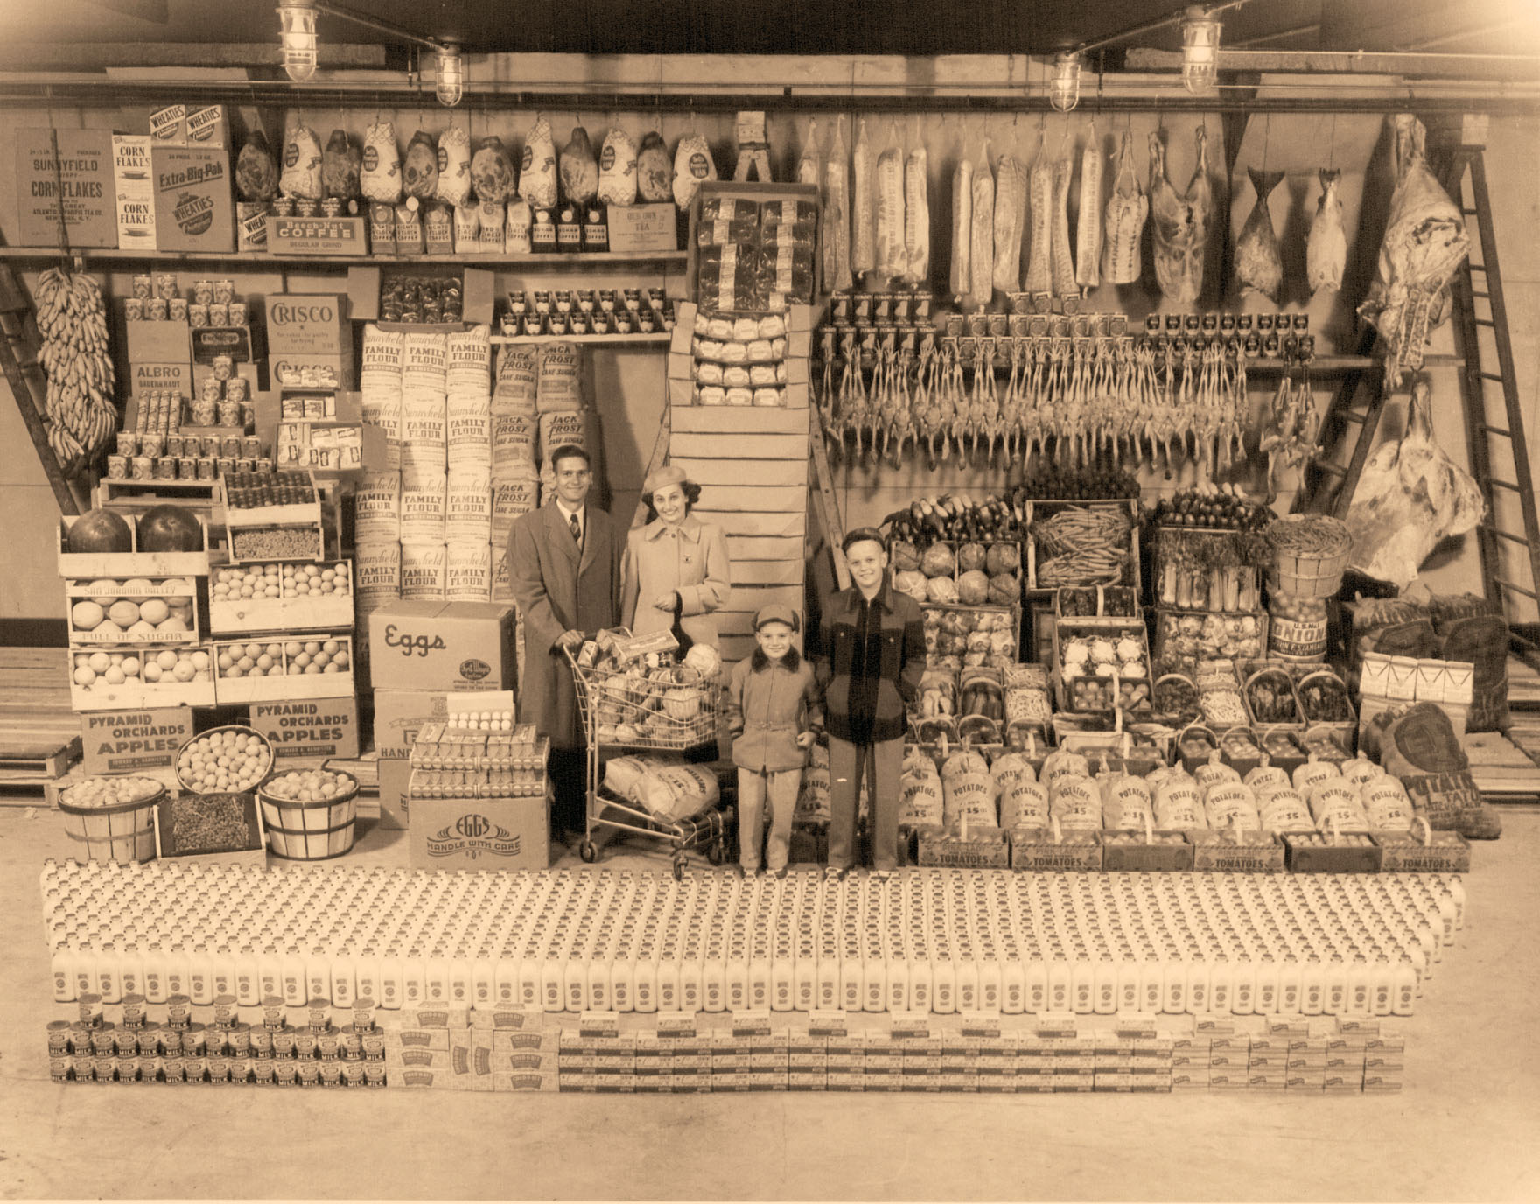
A portrait of affluence
Give Me Liberty!: An American history, 3rd Edition
Copyright © 2011 W.W. Norton & Company

Slide 28
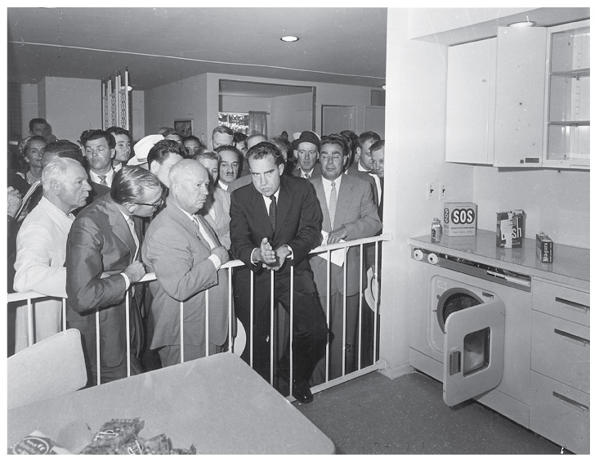
Vice President Richard Nixon
Give Me Liberty!: An American history, 3rd Edition
Copyright © 2011 W.W. Norton & Company

Slide 29
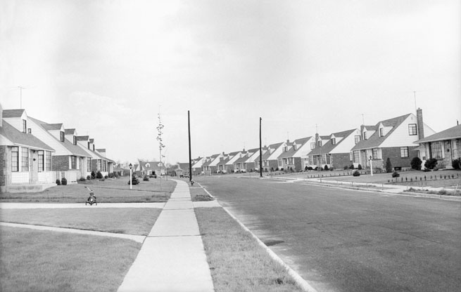
Levittown, New York
Give Me Liberty!: An American history, 3rd Edition
Copyright © 2011 W.W. Norton & Company

Slide 30
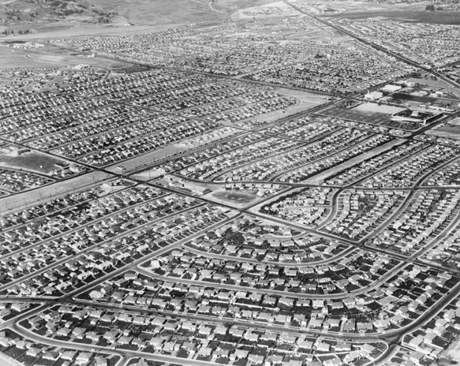
This aerial view of Westchester, a community
in Los Angeles
Give Me Liberty!: An American history, 3rd Edition
Copyright © 2011 W.W. Norton & Company

Slide 31
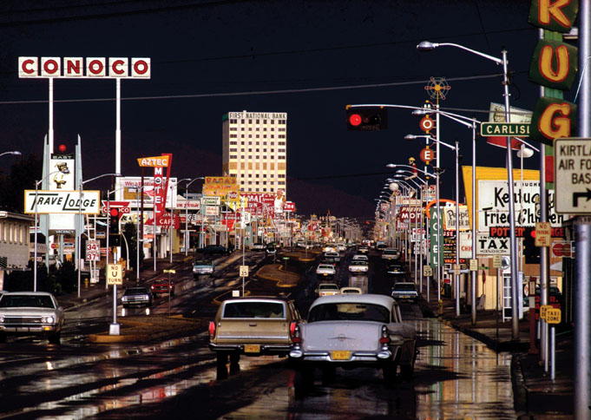
Ernst Haas’s 1969 photograph of Albuquerque,
New Mexico
Give Me Liberty!: An American history, 3rd Edition
Copyright © 2011 W.W. Norton & Company

Slide 32
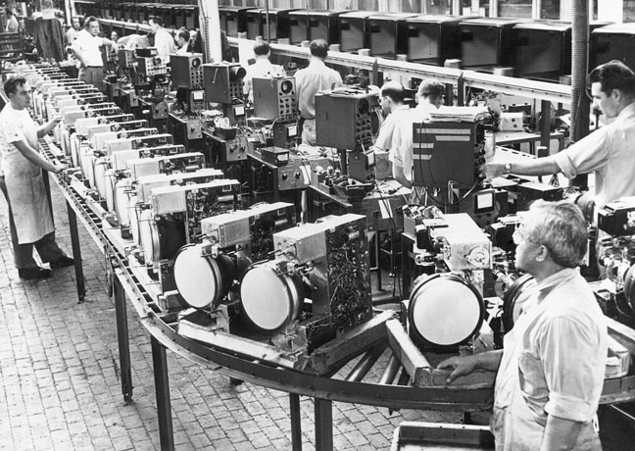
In this 1950 photograph, television sets move
through an assembly line.
Give Me Liberty!: An American history, 3rd Edition
Copyright © 2011 W.W. Norton & Company

Slide 33
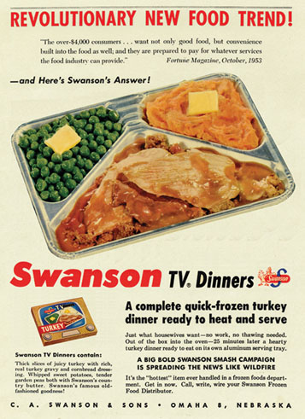
Introduced in 1954, the frozen TV dinner
was marketed in a package designed
Give Me Liberty!: An American history, 3rd Edition
Copyright © 2011 W.W. Norton & Company

Slide 34
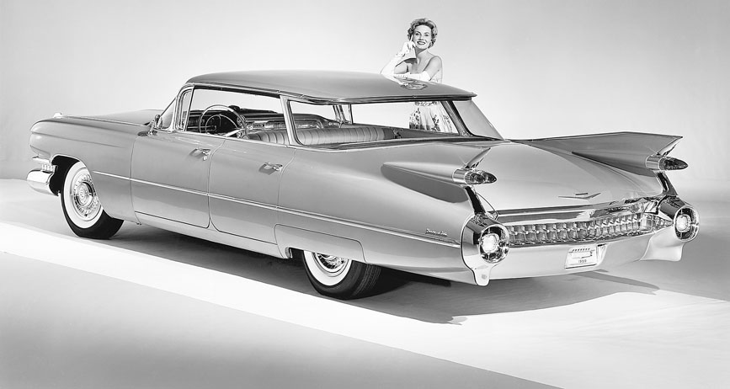
A 1959 Cadillac Eldorado Biarritz
Give Me Liberty!: An American history, 3rd Edition
Copyright © 2011 W.W. Norton & Company

Slide 35
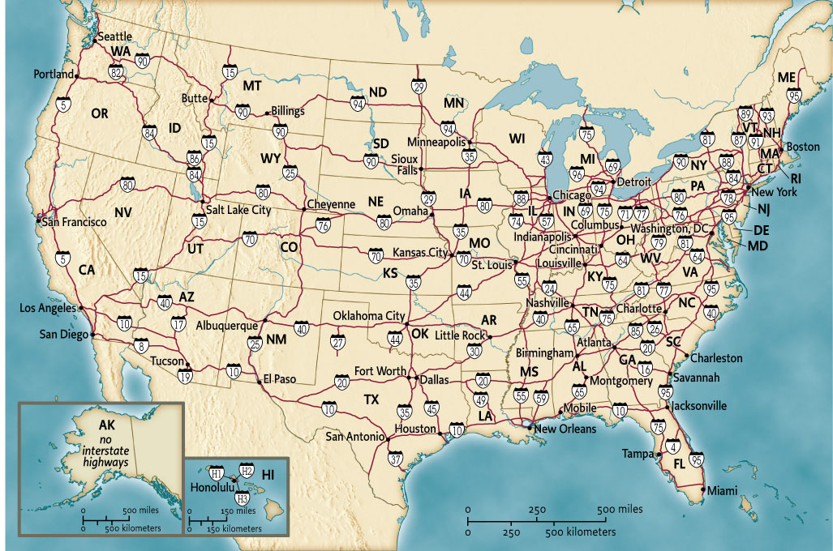
Map 24.1 The Interstate Highway System
Give Me Liberty!: An American history, 3rd Edition
Copyright © 2011 W.W. Norton & Company

Slide 36
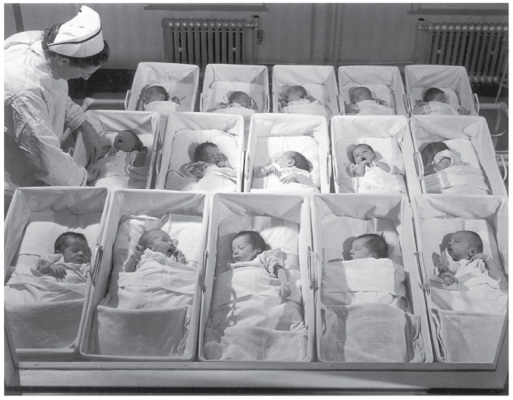
Jack Gould’s 1946 photograph
Give Me Liberty!: An American history, 3rd Edition
Copyright © 2011 W.W. Norton & Company

Slide 37
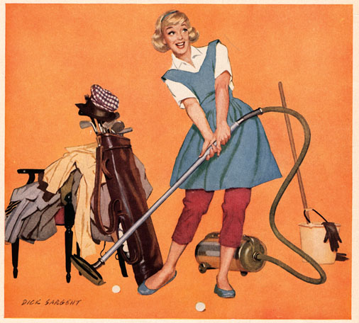
Advertisers during the 1950s
Give Me Liberty!: An American history, 3rd Edition
Copyright © 2011 W.W. Norton & Company

Slide 38
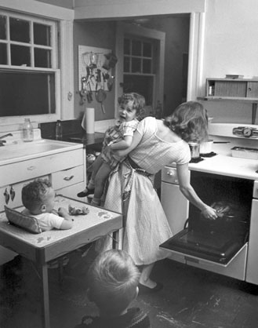
Elliott Erwitt’s
Give Me Liberty!: An American history, 3rd Edition
Copyright © 2011 W.W. Norton & Company

Slide 39
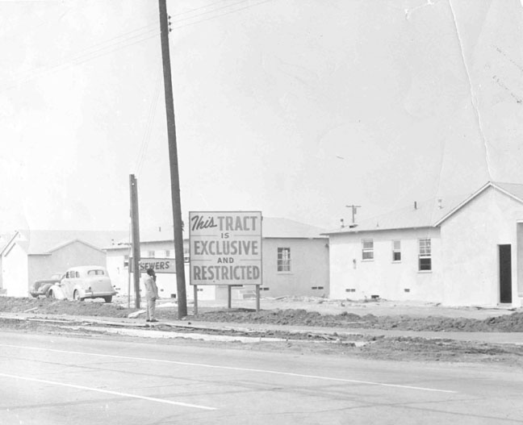
Suburban builders sometimes openly advertised
the fact
Give Me Liberty!: An American history, 3rd Edition
Copyright © 2011 W.W. Norton & Company

Slide 40
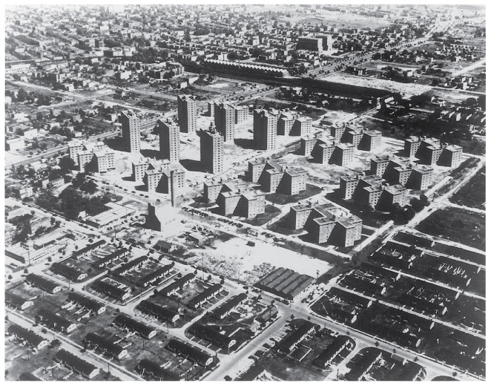
An aerial photograph of Boulevard Houses
Give Me Liberty!: An American history, 3rd Edition
Copyright © 2011 W.W. Norton & Company

Slide 41
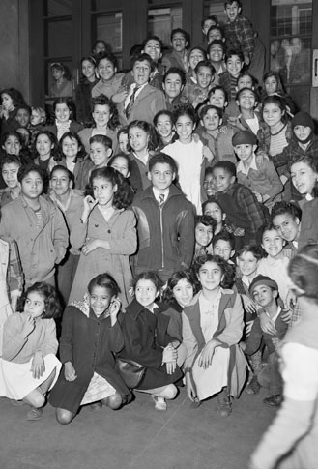
Students at an East Harlem elementary school in 1947.
.
Give Me Liberty!: An American history, 3rd Edition
Copyright © 2011 W.W. Norton & Company

Slide 42
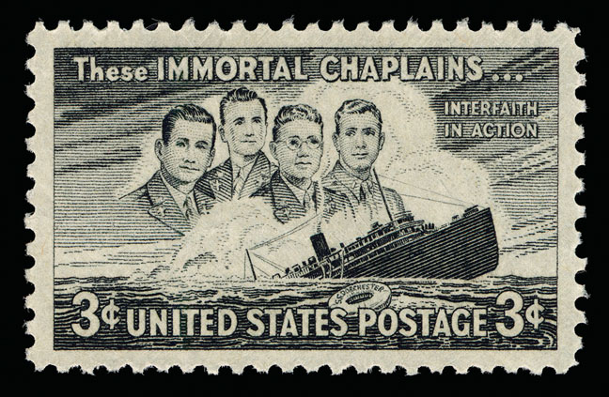
This postage stamp depicts four chaplains who
Perished during the sinking of an American ship
during World War II.
Give Me Liberty!: An American history, 3rd Edition
Copyright © 2011 W.W. Norton & Company

Slide 43
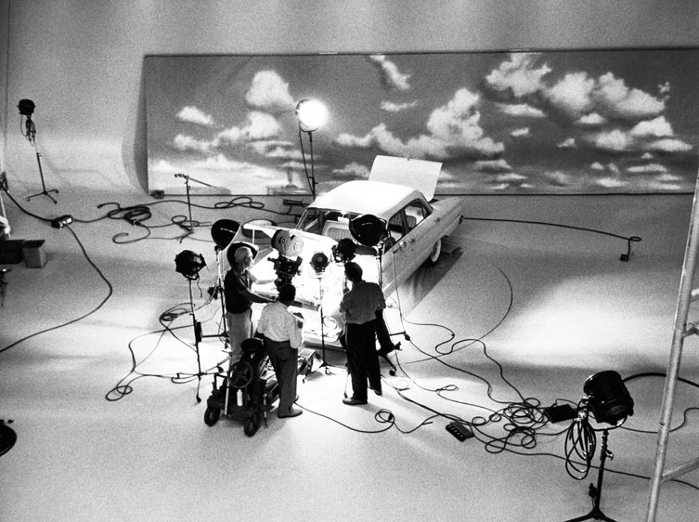
TV became the most effective advertising
medium in history.
Give Me Liberty!: An American history, 3rd Edition
Copyright © 2011 W.W. Norton & Company

Slide 44
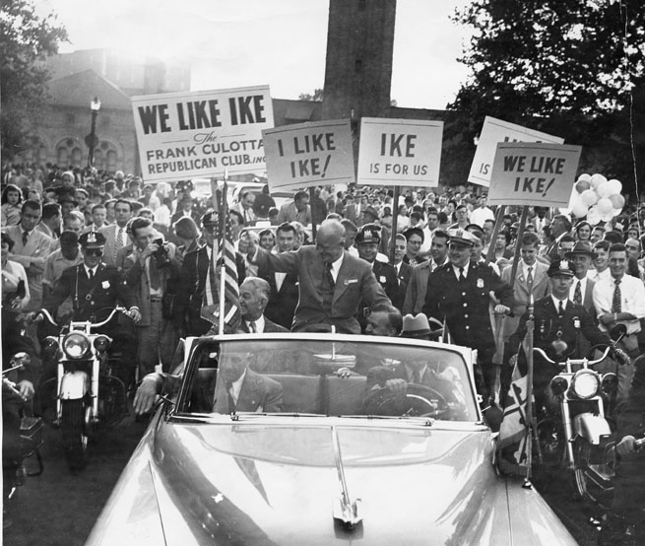
Dwight D. Eisenhower’s
Give Me Liberty!: An American history, 3rd Edition
Copyright © 2011 W.W. Norton & Company

Slide 45
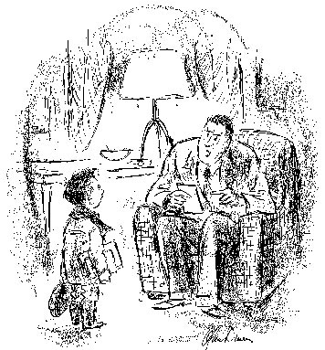
“Do you call C-minus catching up with
Russia?”
Give Me Liberty!: An American history, 3rd Edition
Copyright © 2011 W.W. Norton & Company

Slide 46
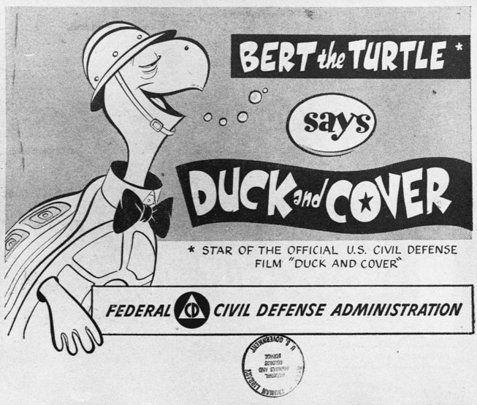
An advertisement for a government film explaining
to children
Give Me Liberty!: An American history, 3rd Edition
Copyright © 2011 W.W. Norton & Company

Slide 47
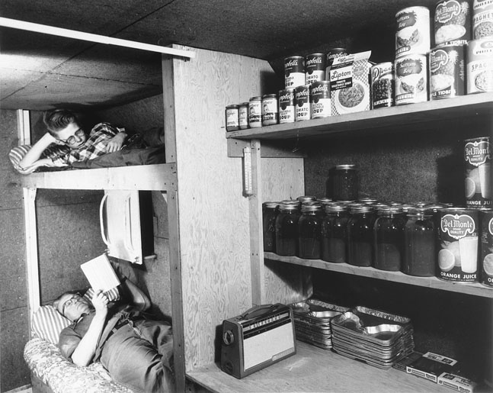
Louis Severance and his son in their underground
fallout shelter
Give Me Liberty!: An American history, 3rd Edition
Copyright © 2011 W.W. Norton & Company

Slide 48
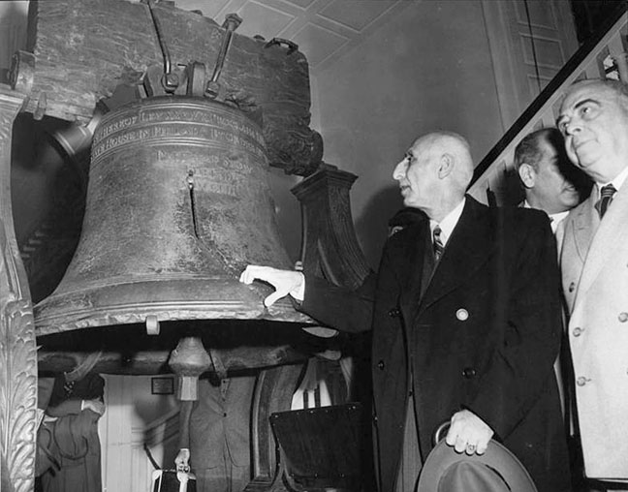
Mohammed Mossadegh, prime minister of Iran
Give Me Liberty!: An American history, 3rd Edition
Copyright © 2011 W.W. Norton & Company

Slide 49
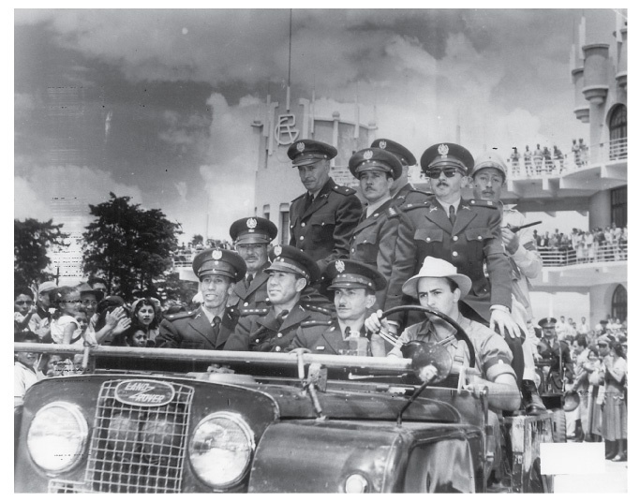
The military junta installed in Guatemala
Give Me Liberty!: An American history, 3rd Edition
Copyright © 2011 W.W. Norton & Company

Slide 50
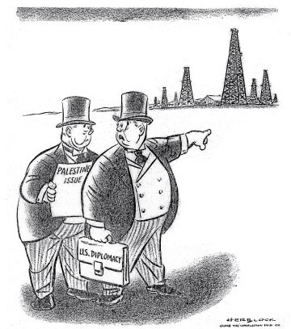
Save the Holy Places
Give Me Liberty!: An American history, 3rd Edition
Copyright © 2011 W.W. Norton & Company

Slide 51
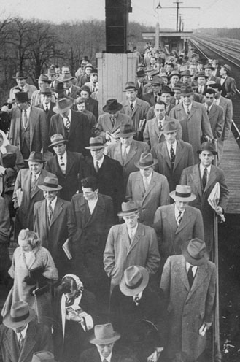
Commuters returning from work in downtown
Chicago
Give Me Liberty!: An American history, 3rd Edition
Copyright © 2011 W.W. Norton & Company

Slide 52
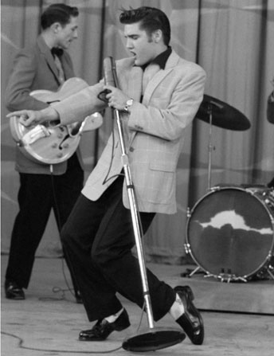
Elvis Presley’s gyrating hips appealed
Give Me Liberty!: An American history, 3rd Edition
Copyright © 2011 W.W. Norton & Company

Slide 53
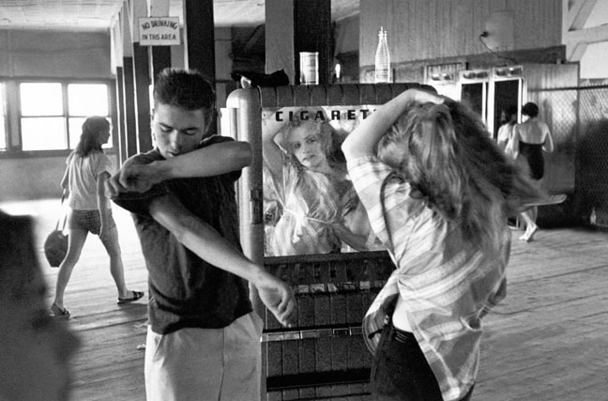
Rebels without a cause.
Give Me Liberty!: An American history, 3rd Edition
Copyright © 2011 W.W. Norton & Company

Slide 54
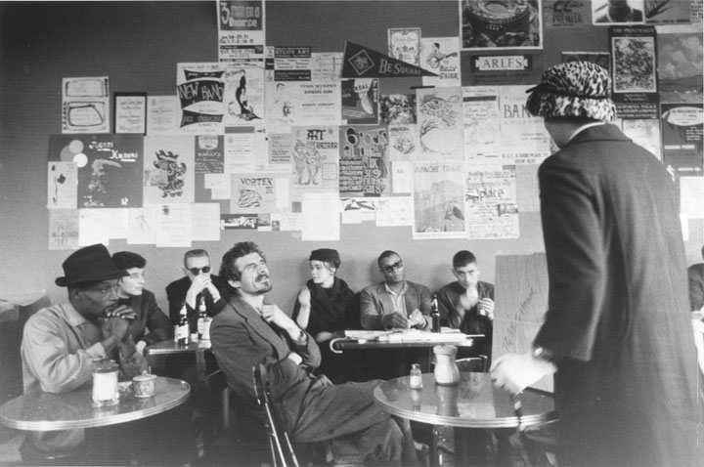
A Beat coffeehouse in San Francisco
Give Me Liberty!: An American history, 3rd Edition
Copyright © 2011 W.W. Norton & Company

Slide 55
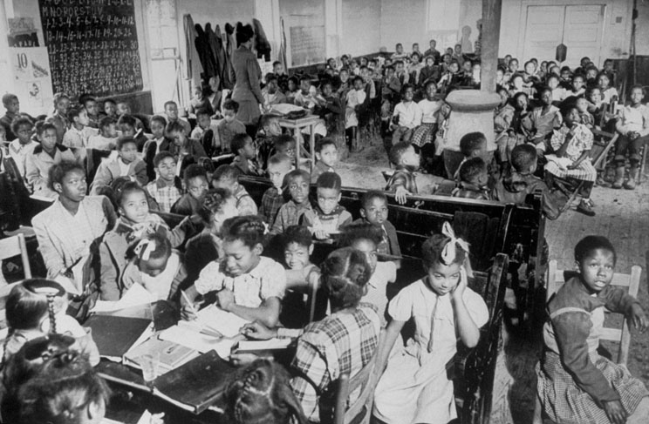
A segregated school in West Memphis
Give Me Liberty!: An American history, 3rd Edition
Copyright © 2011 W.W. Norton & Company

Slide 56
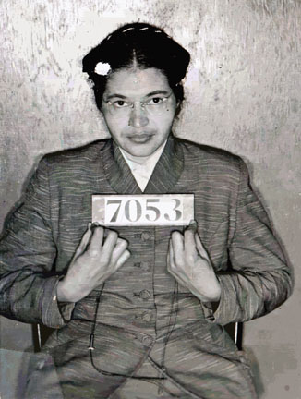
The mug shot of Rosa Parks
Give Me Liberty!: An American history, 3rd Edition
Copyright © 2011 W.W. Norton & Company

Slide 57
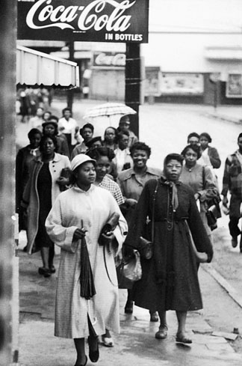
Black residents of Montgomery
Give Me Liberty!: An American history, 3rd Edition
Copyright © 2011 W.W. Norton & Company

Slide 58
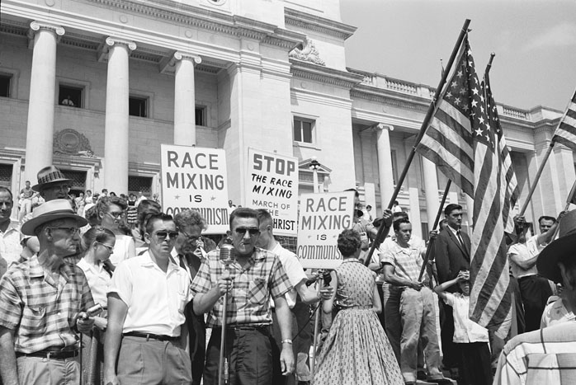
If the civil rights movement borrowed the
language of freedom
Give Me Liberty!: An American history, 3rd Edition
Copyright © 2011 W.W. Norton & Company

Slide 59
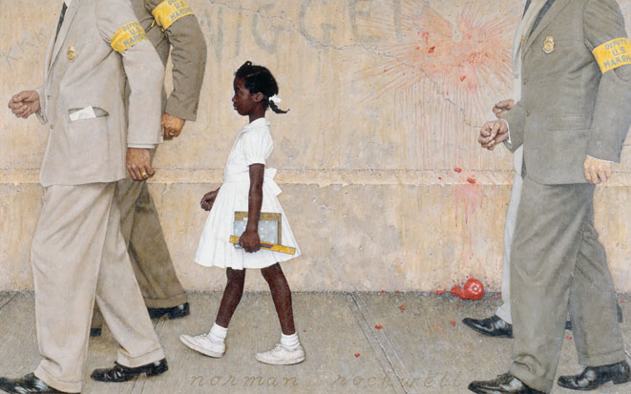
The Problem We All Live With
Give Me Liberty!: An American history, 3rd Edition
Copyright © 2011 W.W. Norton & Company

Slide 60
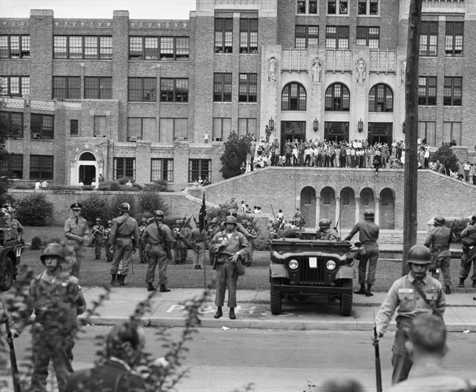
Federal troops at Little Rock’s Central
High School
Give Me Liberty!: An American history, 3rd Edition
Copyright © 2011 W.W. Norton & Company

Slide 61
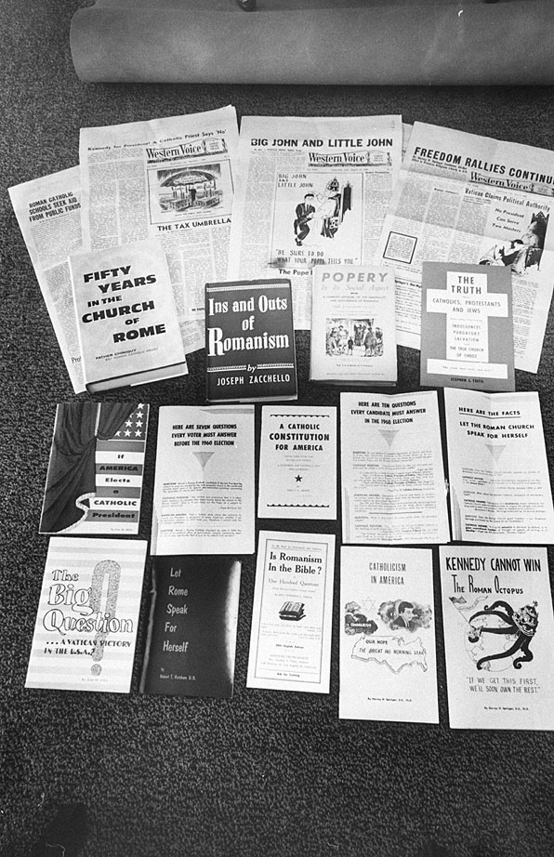
The 1960 presidential campaign produced a flood
of anti-Catholic propaganda.
Give Me Liberty!: An American history, 3rd Edition
Copyright © 2011 W.W. Norton & Company

Slide 62
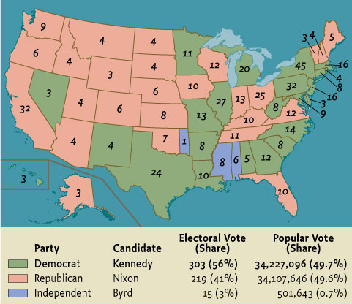
Map 24.3 The Presidential Election of 1960
Give Me Liberty!: An American history, 3rd Edition
Copyright © 2011 W.W. Norton & Company

Slide 63
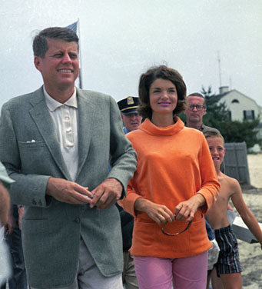
A photograph of John F. Kennedy and his Wife
Give Me Liberty!: An American history, 3rd Edition
Copyright © 2011 W.W. Norton & Company

Slide 64
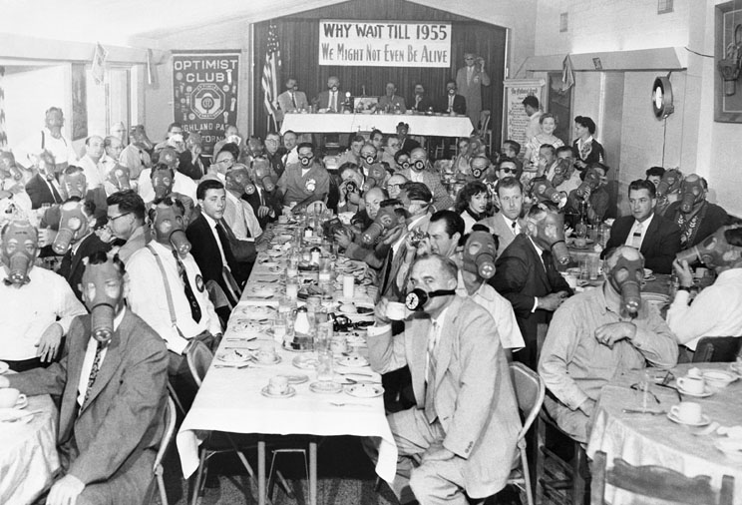
Residents of Los Angeles don gas masks at a 1954
Give Me Liberty!: An American history, 3rd Edition
Copyright © 2011 W.W. Norton & Company

Slide 65
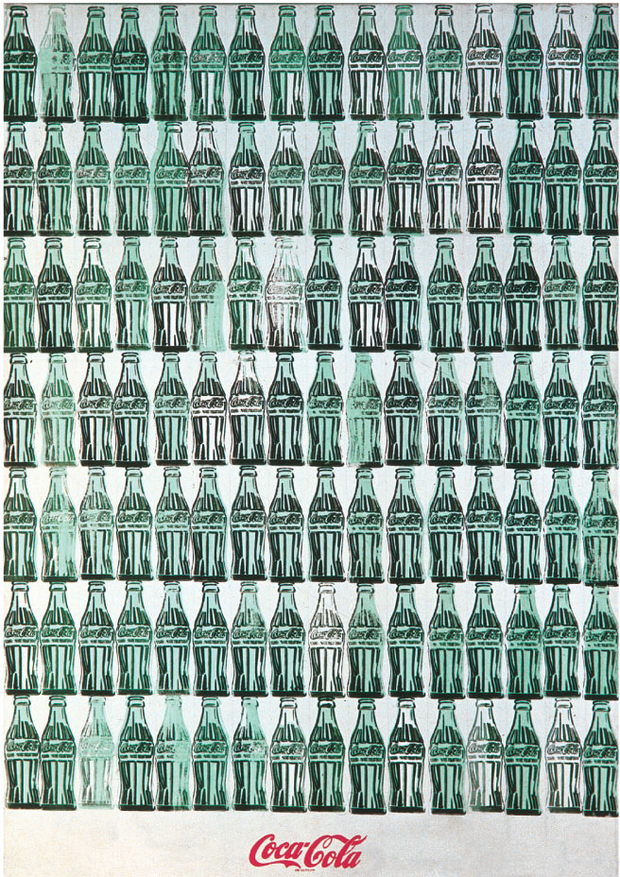
Andy Warhol’s 1962 painting
Give Me Liberty!: An American history, 3rd Edition
Copyright © 2011 W.W. Norton & Company

Slide 66
Norton Lecture Slides Independent and Employee-Owned
This concludes the Norton Lecture Slides
Slide Set for Chapter 24
Give Me Liberty!
AN AMERICAN HISTORY
THIRD EDITION
by
Eric Foner

