Slide 1
Labor Movement
1860’s - 1914

Slide 2
SIDE 1 – Labor Unions Members, Goals, Success, Problems
Knights of Labor, 1869
American Federation of Labor, 1886
Industrial Workers of the World, 1905

Slide 3
SIDE 2 – Strikes Location, Conflict, Major Events, Results/Impact
1877 Great Railroad Strike
1886 Haymarket Square
1892 Homestead Strike
1893-94 Coxey’s Army
1894 Pullman Strike
1911 International Lades' Garment Workers Union (ILGWU)
1912 Bread and Roses
1914 Ludlow, Colorado

Slide 4
GREAT RAILROAD STRIKE, 1877
Origin: Martinsburg, WV (spontaneous), July 16-17
Cause: wage cuts
Events: Baltimore & Ohio Railroad blocked from leaving Pittsburgh by workers, July 19
Violence –
Baltimore strikers attacked state militia troops who then fired on the crowd, killing 11
Pittsburgh throw rocks at militia, respond with shooting and killing 20
Destruction – 39 PA Railroad building, 104 engines, 1,200 freight cars
Strike spread Nationwide
(NY and NJ to Indiana and Illinois)
(St. Louis, Missouri workers took over city for a week)
(Kansas City to San Francisco)
(Black and White workers strike together)
Impact:
President Hayes used federal troops who used Gatling guns to end strike
Nation Guard units established with armories
Labor Unions developed
Video: Camden Station and the Great Railroad Strike of 1877 (2:08)

Slide 5
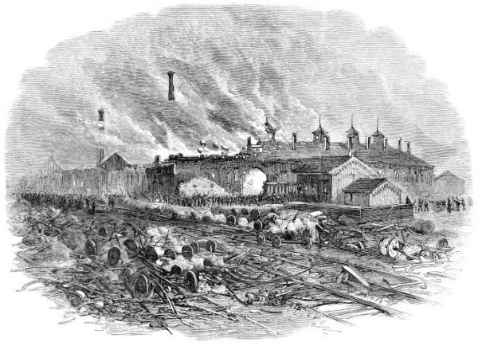
Credit: Courtesy of the Railroad Museum of Pennsylvania Striking workers during the violent year of 1877 often targeted the key properties of companies against which they were striking for arson and sabotage. The Round House at Pittsburgh was a hub of railroad activity and one of the company's most expensive properties.

Slide 6
KNIGHTS OF LABOR, 1869
1869 - Founded by tailors, Philadelphia
Emerge after 1877 Great Railroad Strike
Members: 700,000 by 1886
white/black workers (racial integration)
Immigrants
skilled / unskilled workers
Terence V Powderly, head (Grand Master Workman) 1870’s and 1880’s
Purpose: empower small labor unions and isolated workers to combat largest corporations
Mission:
Oppose violence
Agricultural cooperatives
8-hr work day
Equal Pay for Women
Government ownership of railroads and banks
Successes:
1883, Western Union Telegraph Co
1885, several Railroads restore lost wages and rehire strikers
Replaced by other unions

Slide 7
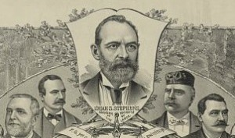
Uriah Stephens founded the Knights of Labor, the first national industrial union in the United States, in Philadelphia in December 1869 and led the organization until he resigned his post as Grand Master Workman in 1879. In this 1886 Kurz & Allison lithograph (seen in full in the media gallery), Stephens is honored as the “Founder of the Knights of Labor.” (Library of Congress)

Slide 8
AMERICAN FEDERATION OF LABOR, 1886
Labor organization formed in 1886
Federation of smaller elite craft unions joined together
Membership: 50,000 to 3 million by 1924 (cigar makers, plumbers, iron molders)
Samuel Gompers, President (Cigar Makers Union)1886 – 1924
Mission: avoid larger social/political issues, focus on practical changes
Increase wages
Job security
8-hr work day
Benefits
Right to collective bargaining

Slide 9
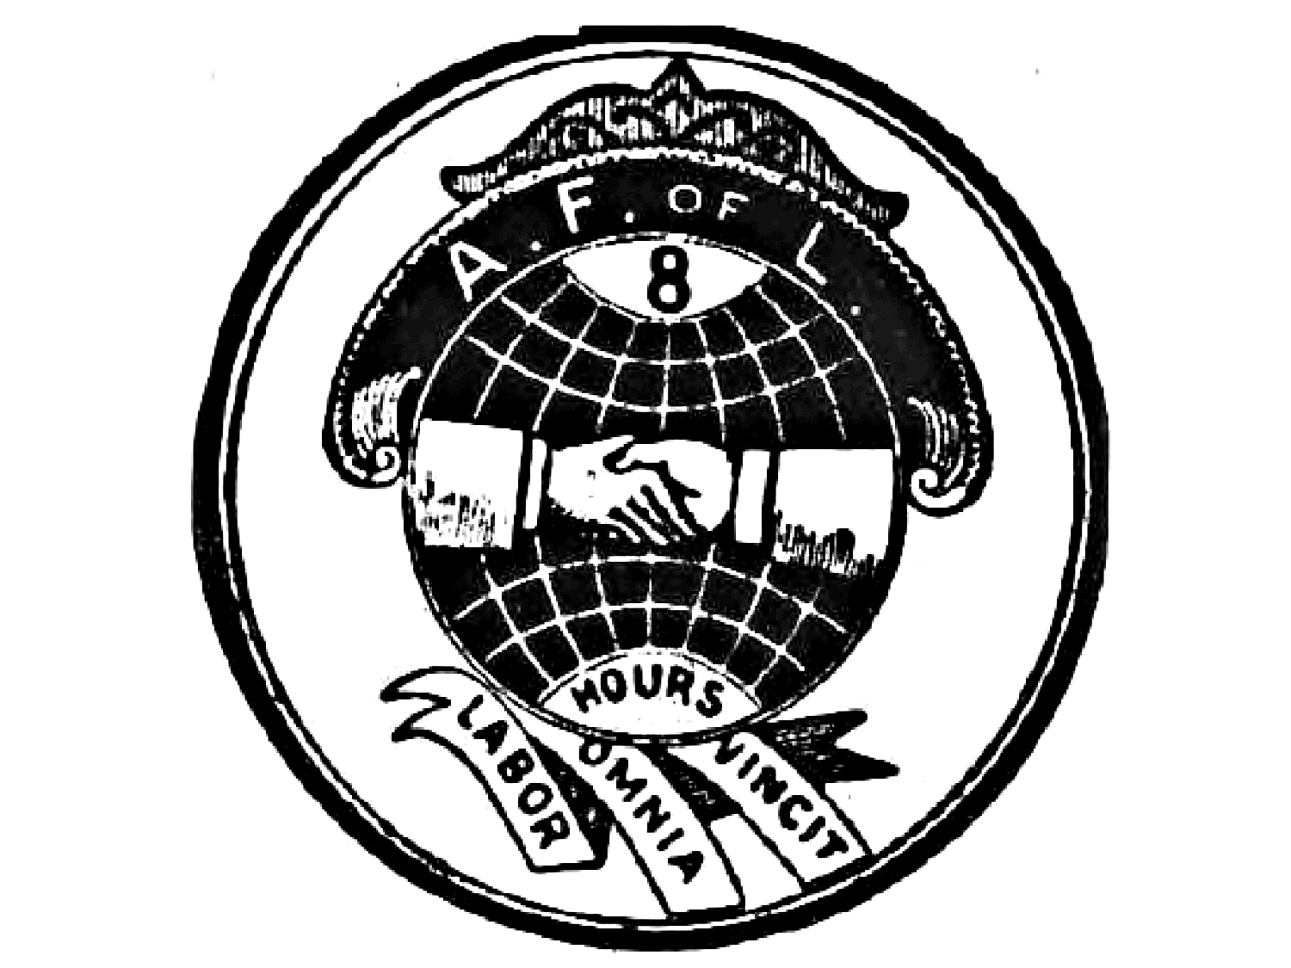

Slide 10
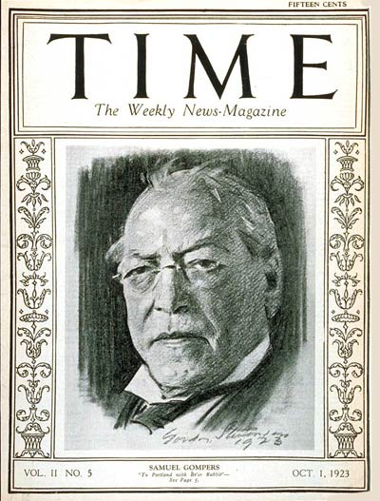
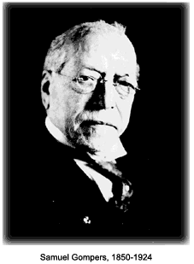
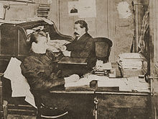
Samuel Gompers(1850 – 1924) Founder 1886

Slide 11
HAYMARKET SQUARE, 1886
May 4, 1886, Chicago, Illinois (Haymarket Square)
Strike, rally, and bombing that took place around Haymarket Square in Chicago in May 1886 which led to the executions of four leaders of the incident
Strikers - 40,000 – 60,000 Chicago workers strike on May 1
Demands: 8-hr work day
Supporters: AFL, Socialists, Anarchists, immigrants
Socialists – government / workers should own all private business (factories, business, land)
Anarchists – desire small, local, voluntary organizations to replace large government
Organizers: Albert Parsons and August Spies (socialists / anarchists)

Slide 12
HAYMARKET SQUARE, 1886
Violence: a bomb was thrown in the middle of police, killing 7 police
Bomb thrower a mystery
Parsons, Spies, and 6 other anarchists/ socialists blamed, tried, convicted for “a general conspiracy to annihilate the police force and destroy property” –
none could have possibly have done this (Parson's was drinking a beer in a nearby bar)
4 were hung on Nov. 11, 1887 - (including Spies and Parsons)
Impact: trial and execution caused many to lose faith in the rule of law, lack of justice left some to consider Spies and Parsons martyrs for labor issues
Video

Slide 13
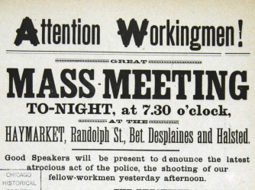

Slide 14
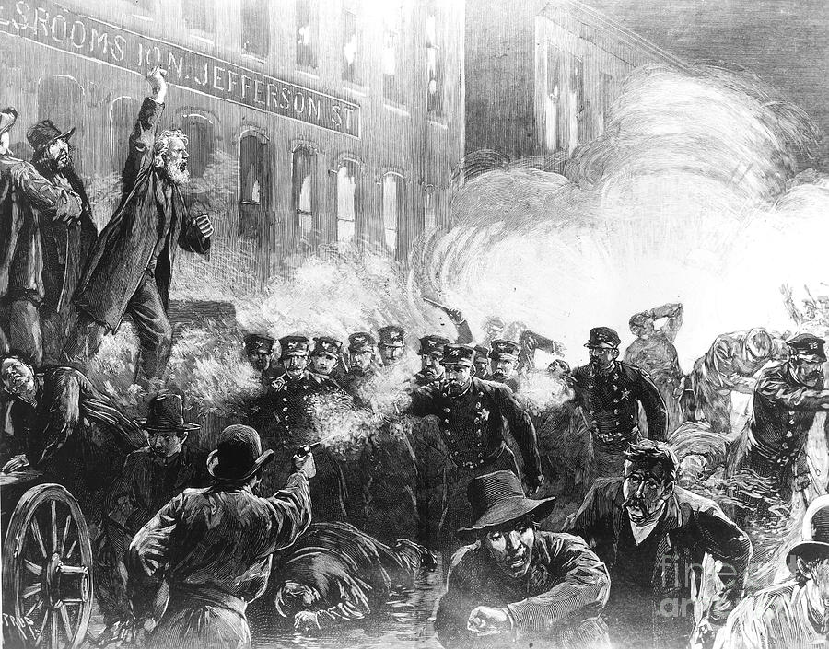
Haymarket Square, May 4, 1886 – “The time will come when our silence will be more powerful than the voices you strangle today.” — August Spies, one of eight men convicted of the Haymarket Square bombing, moments before he was executed by hanging

Slide 15
HOMESTEAD STRIKE, 1892
A strike by steel workers at Carnegie's Homestead, PA mill that resulted in a clash between workers and Pinkerton detectives. Violence led to dead on both side, but Frick, the manager of the mill was able to defeat workers and replace them with non-union workers that would accept less pay.
Production - 1/4 of nation's steel supply / $40 million per year in profits
Union: Amalgamated Association of Iron, Steel, and Tin workers (24,000 members)
Union rejected salary cut in new contract
Henry Clay Frick–
managed by strike while Carnegie at castle in Scotland
fired all workers, built 8 ft fence around facility, hired nonunion workers,
hired Pinkerton Agency to protect property
Violence: Strikers v Pinkerton detectives shoot it out (rushed at barge)
5-9 steelworkers die, 3-10 agents die
Results:
PA Governor and militia keep peace
Carnegie blame Frick (but doesn't reinstate union)
Union leaders arrested but acquitted
Public Opinion negative toward Carnegie
Mill reopens, Union defeated, Non Union workers hired

Slide 16
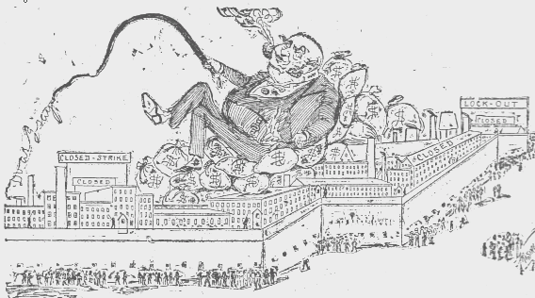
Sunday Globe 1892
Homestead Strike IMAGES

Slide 17
COXEY'S ARMY, 1893 - 94
A protest march of unemployed workers, led by businessman Jacob Coxey, demanding a public works highway program and guaranteed jobs during the depression of the 1890's
Panic of 1893 caused widespread unemployment
Ironic - Chicago World Fair (1893) showcase marvels of era (electric lights) while people suffered economically
Jacob Coxey (businessman in Ohio, Silica Sand Company, sand quarry) disheartened by the desperation and unemployment he viewed
Proposal for Employment –
federal government should appropriate $500 million in government bonds to build roads (dirt) and offer $1.50 per day for 8-hr work day to all men
Threatened to march an army of unemployed people to D.C if Congress failed to act
Coxey's Army marched from Ohio to D.C, growing from 100 to 600 then 1200 (March to August 1893)
Conclusion:
Congress was dominated by corporate interests. They did not provide relief to the unemployed
Coxey's Army was scattered by police and returned home.
Jacob Coxey continued to advocate for federally financed highway improvement, supported New Deal programs, died in 1951 at the age 97

Slide 18
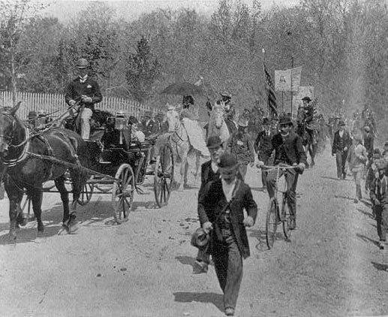
Library of Congress

Slide 19
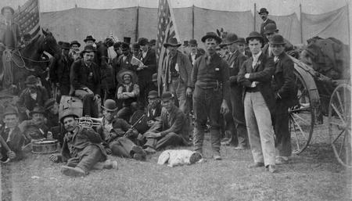
Followers of labor leader Jacob S. Coxey, known as Coxey's Army, on a march to Washington, D.C. in 1894 to protest the federal government's response to the
economic depression of the 1890s.

Slide 20
PULLMAN STRIKE, 1894
Eugene V. Debs
active in labor movement for decades
Born 1855, Indiana, worked on railroads at 15 yrs old
1875 joined Brotherhood of Locomotive Firemen
organized one union for all workers in railroad industry (unite engineers, firemen, brakemen)
American Railway Union - created 1893, led by Eugene V. Debs
American Railway union won strike against Great Northern Railroad (1894)
Strike against Pullman company failed
Pullman Strike
Debs arrested, jailed for 6 months (defy court injunction)
Jail shaped his views - felt economic system was stacked against workers and supported the Populist party
Socialist Party
Debs Founded the Socialist Party in the U.S.
government ownership of nation's major industries
higher wages
Debs ran for President in national elections 1904 - 1920 (except 1916)

Slide 21
PULLMAN STRIKE, 1894
George Pullman
made railway cars (sleeping cars allowed luxury travel across country), leased to rail lines
Pullman Town
Pullman, Illinois (12 miles outside of Chicago)
8,000 workers lived in 1,400 homes rented from company
Schools, athletic club, free lectures, theater, health care
Housing better than other industrial workers, Rents high
Strict Rules: no drinking, "spotters" oversea community behavior
Impact of Panic of 1893
workers let go
wages cut
rents stay high
stockholders receive dividends
strike by 90% of workers

Slide 22
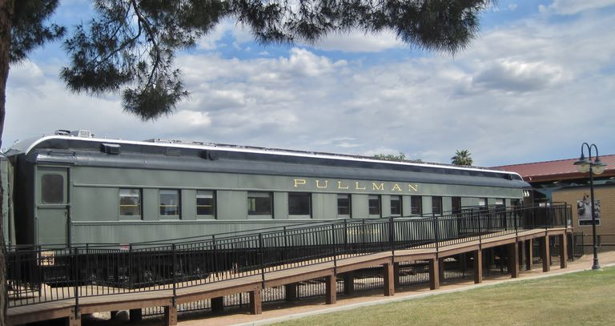

Slide 23
PULLMAN STRIKE, 1894
STRIKE:
Pullman workers ask American Railway Union for assistance in strike, Debs encouraged them to wait for Panic to end, but felt compelled to help when they refused
American Railway Union refused to handle trains with Pullman cars attached
Rail traffic in Chicago stopped
Federal mail trains were serviced to avoid intervention
Cleveland obtained injunction ordering workers to return to work, they refused
14,000 federal troops end strike in Chicago
Riot ensued, 34 killed
Eugene V. Debs arrested, Union disbanded by federal authorities

Slide 24
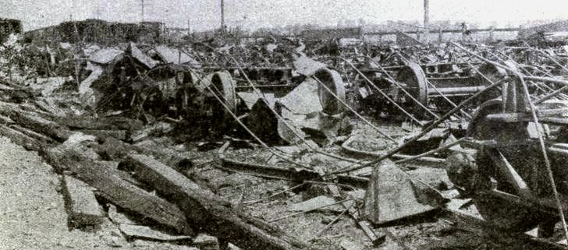
Remains of Illinois Central Railroad freight and coal cars damaged during riots at its Fordham Yard on July 5 and 6, 1894, during the Pullman Strike. On page 33 of the May 1922 Illinois Central Magazine.
Pullman Strike IMAGES

Slide 25
MINERS AND THEIR UNIONS
Coal Uses
fuel for smelting process of turning iron into steel
heated most cities
coal fired generators produce most of nation’s electricity
Mining of coal, gold and silver in high demand during industrialization
Wages Low (profit centered)
New immigrants often hired in mines
Mine disasters preceded industrializations
drown (stream break through)
tunnel collapse
methane and other gasses kill
fire dangers of coal

Slide 26
MINERS AND THEIR UNIONS
Strike 1875, Pennsylvania
Panic of 1873 led to wage cuts
failed - mine owners stockpiled coal to heat cities in winter, leaving miners to suffer
Molly Maguires – secret organization created by PA Irish miners; attacked, murdered foremen, superintendents, even mine owners
Pinkerton Detective agency infiltrated Molly Maquires → convicted and executed 10 men, 1877

Slide 27
MINERS AND THEIR UNIONS
United Mine Workers of America
a new union organized in 1890 to bring together mine workers in the Eastern half of the US in one organization that eventually became a national union
Coal miners from PA, OH, VA, WV
Founded 1890 in Columbus, OH
Goal – pay raises (wages that are “fully compatible with the dangers of our calling”)
Members open to all races, religions

Slide 28
MINERS AND THEIR UNIONS
Strike 1894, Alabama reflected a march of miners with no color distinction
Successes:
United Mine Workers got a 10% raise in 1900, another raise in 1903
Recognition of Union
Fair weighing of coal (paid by weight of coal they dug)
West Virginia Mining IMAGES
West Virginia Mine Wars Museum and Images

Slide 29
THE INDUSTRIAL WORKERS OF THE WORLD (IWW)
Convention, Chicago June 27, 1905
"By organizing industrially we are forming the structure of the new society within the shell of the old."
Wobblies made up the IWW to create "one big union“ https://www.iww.org/history
Members: workers of all trades and skills could join
Founders: Big Bill Haywood (Western Federation of Miners), Eugene V. Debs, Mother Jones, Lucy Parsons
Mission: revolutionize the working class by empowering them economically

Slide 30
GARMENT INDUSTRY AND THE TRIANGLE SHIRTWAIST FIRE OF 1911
Garment industry
one of nation's largest industries
NYC employed 40,000 workers (1900 - 1910)
Shirtwaists (ready-to-wear blouses) initially made in small sweatshops on Lower East Side, then they moved to larger factories (high-rises)

Slide 31
GARMENT INDUSTRY AND THE TRIANGLE SHIRTWAIST FIRE OF 1911
International Lades' Garment Workers Union (ILGWU) organizer, Clara Lemlich, emigrated from Russia in 1903
Strikes: workers often replaced by non union workers, police arrest, thugs beat them up
Anne Morgan (J.P. Morgan's daughter) sometimes joined strike lines with other social elites - arrested/beaten
ILGWU Strike (1909 - 1911): went on strike all over Manhattan, owners coordinated and refused to meet the demands
Support for their strike -A.F. L, Western Federation of Miners, Anne Morgan, African American women (refused jobs as strikebreakers, but asked for more consideration in hiring in the future for support)
Compromise: increase wages, create better working conditions, BUT Unions could not organize in factories

Slide 32
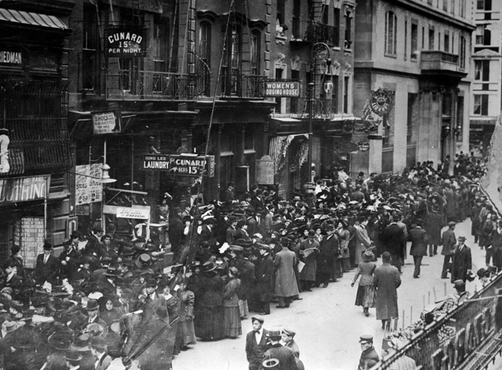
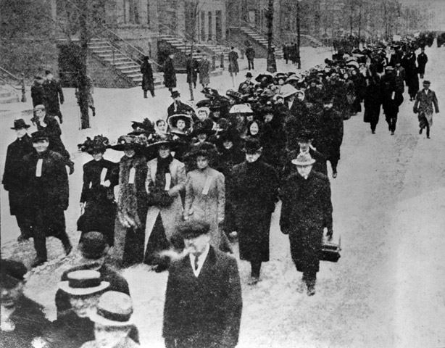
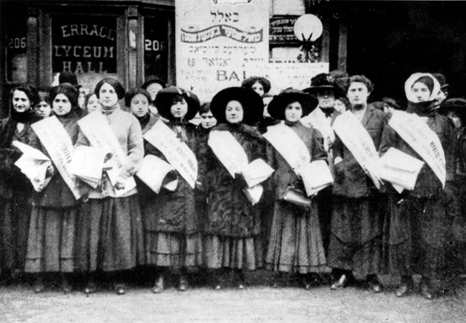
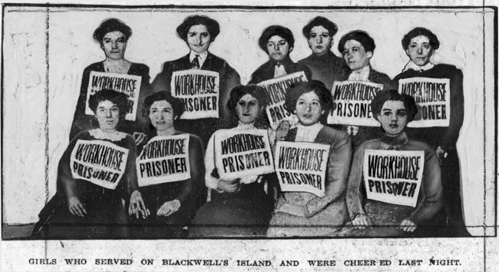

Slide 33
GARMENT INDUSTRY AND THE TRIANGLE SHIRTWAIST FIRE OF 1911
Triangle Shirtwaist Factory
Greenwich Village - 500 mostly women (Jewish, Italian)
Owners: Max Blanck, Isaac Harris
Triangle Shirtwaist Factory Fire:
Fire started at Triangle Shirtwaist Factory a month later, March 25, 1911
Tragedy: 146 workers died
Exits blocked (prevent theft)
firefighters ladders didn't reach 8th floor and up
50+ women jumped from the windows
20 killed on flimsy fire escape collapse
Reform: Resulted in new factory inspection and safety laws in NYC

Slide 34
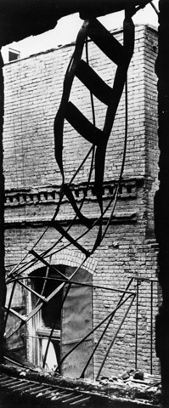
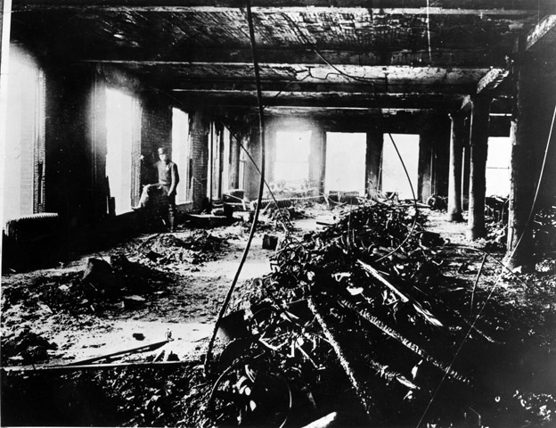
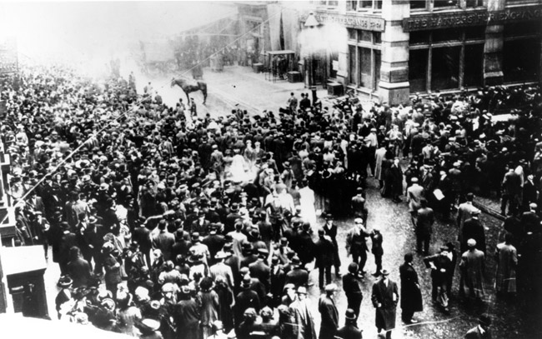
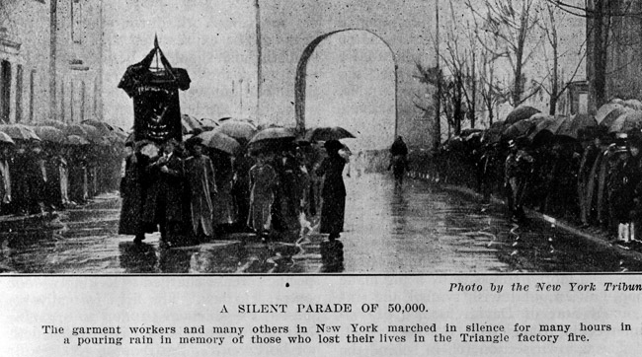
Triangle Shirtwaist Fire

Slide 35
BREAD AND ROSES: THE LAWRENCE STRIKE OF 1912
Lawrence, Massachusetts, New Year's Day
State Law limited the work week to 54 hours, rather than 56-hr norm in the mills so managers cut wages
Managers didn't fear a strike since most
not union members
45 different languages
divisions between crafts (picker, spinning, weaving rooms)

Slide 36
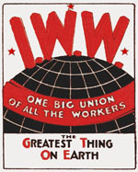
BREAD AND ROSES: THE LAWRENCE STRIKE OF 1912
Strike: Textile workers spontaneously walked off the job
14,000 mill workers walked off in one day from the Lawrence mills
IWW sent organizers to assist in Lawrence (planned meetings by language groups, larger rallies)
IWW member, Elizabeth Gurley Flynn, "The IWW has been accused of putting women in the front. The truth is, the IWW does not keep them in the back, and they go to the front."
Moms with babies carried signs "We Want Bread and Roses, Too"
Picket Line: devised a moving picket line around mill to get around a city ordinance banning gathering in from of mills
Result: salary increase, no discrimination with strikers

Slide 37
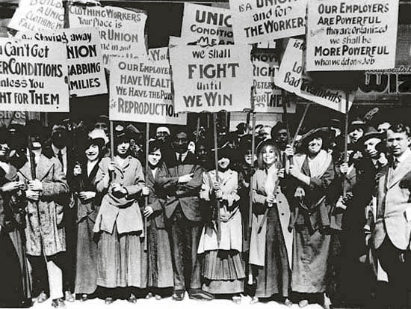

Slide 38
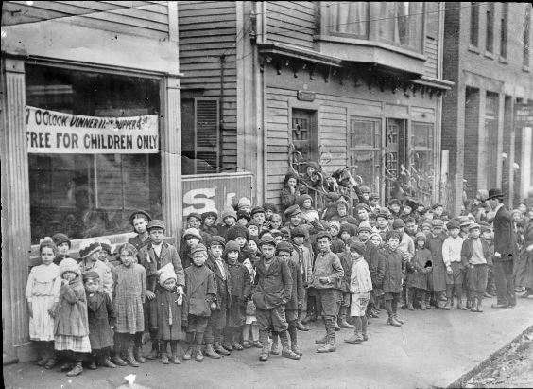
During the strike, the Franco-Belgian soup kitchen fed workers’ children. Image: Digital Public Library of America.

Slide 39
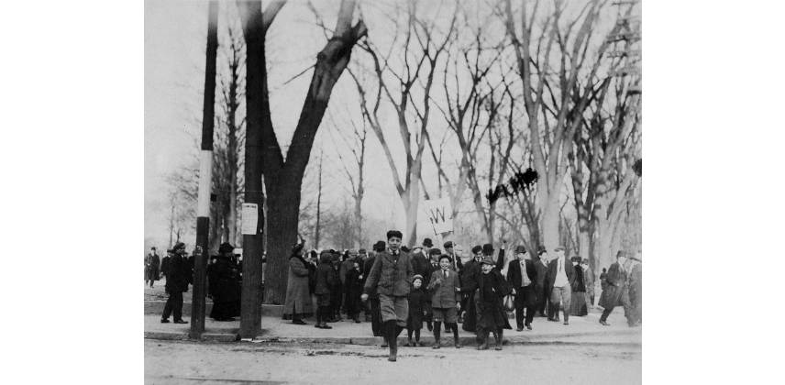
Strikers leaving victoriously from the mass meeting on the Lawrence Common on March 14, 1912
Parade through the streets upon the strikers’ victory, 1912, Lawrence, Mass
Source

Slide 40
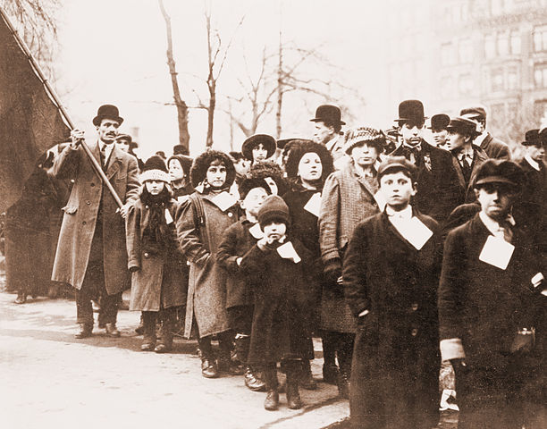
In late January, the strikers sent 100 children to New York City so they would be out of danger. They arrived to cheering crowds of thousands of supporters.
On February 24, the strikers tried to send another 100 children to Philadelphia, but the Lawrence City Marshal tried to stop them. Marshals and police clubbed mothers and children before dragging them away to jail. One woman miscarried. News photographers were there to record the brutality.
That turned the tide of public opinion against the mill owners. Congress investigated, questioning workers like Camella Teoli. The mill owners caved. On March 12, 1912, the strike was over.
Source

Slide 41
LUDLOW, COLORADO, 1914
Brutal working conditions in southern Colorado, owned by John D. Rockefeller
80-90% went on strike, 14 months, violent
Strike Demands: 10% raise
8-hr work day
right to elect who would weigh coal
have a choice of stores and doctors (not company owned)
enforcement of Colorado mining laws
Mother Jones encouraged miners to not be afraid

Slide 42
LUDLOW, COLORADO, 1914
Ludlow Massacre - Violence during a coal strike in Ludlow, Colorado in 1914
Violence -
coal companies evicted miners from company homes
union created tent camps
Guards and Strikers clashed (20 strikers dead in 1st month)
Militia troops hired by coal company and surrounded Ludlow camp
Fighting (guns) ensued for several hours
at least 30 people, including 11 children, were killed
Responses to Massacre:
Public outcry, Rockefeller name tarnished
President Woodrow Wilson sent U.S. army troops to restore order
United Mine Workers Union ended strike

Slide 43
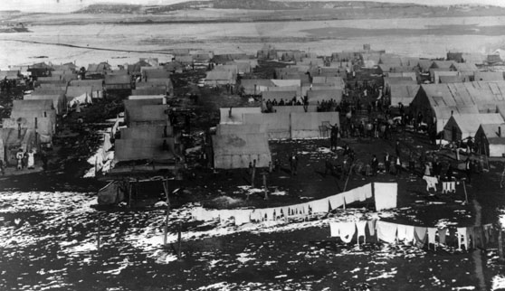
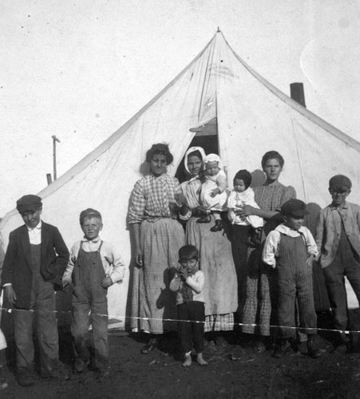
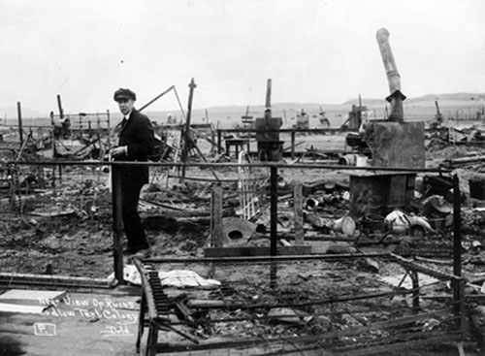
Families at Ludlow
The Ludlow Tent Colony before the massacre on April 20th, 1914
Striker family at Ludlow
Rear view of ruins, Ludlow Tent Colony. The Colony had been sprayed by machine gun and rifle fire and set on fire by the militia, and then looted by the militia after the attack.

