Slide 1
First Americans

Slide 2
Key Concept 1.1 As native populations migrated and settled across the vast expanse of North America over time, they developed distinct and increasingly complex societies by adapting to and transforming their diverse environments.
(Theme: Geography & Environment)
How did geographic and environmental factors shape the development of various communities?
How did competition for natural resources affect both interactions among different groups and the development of government policies?

Slide 3
Answer these questions using your knowledge from chapter 1 and this powerpoint.
How did geographic and environmental factors shape the development of various communities? Compare one choice below.
Anasazi and Moundbuilders
Pacific Coast and Great Plains Indians
Northeast Indians and Southwest Indians
Southeast and Pacific Coast
B) How did religion, trade, and technology lead to a period of exploration? (Use your reading from chapter 1 and the powerpoint to answer.)
C) What did explorers hope to gain on these water expeditions?
Use the Explorers Chart to answer.

Slide 4
Pre-Columbian People in present-day United States
Anasazi
Moundbuilders - Cahokia

Slide 5
Anasazi
“Ancient Ones” 850-1100
New Mexico & Arizona
Crops: maize, beans, squash, chilies
Trade: Turquoise
Chaco Canyon (New Mexico):
City built of adobe (mud bricks), up to 5 stories high
Over a dozen pueblos (large buildings)
City Area measured 8 miles by 2 miles
Kivas: underground circles for religious rites
Drought led to abandonment by 1100’s
Pueblo Bonita: Largest apartment (5 stories, 600 dwellings)

Slide 6
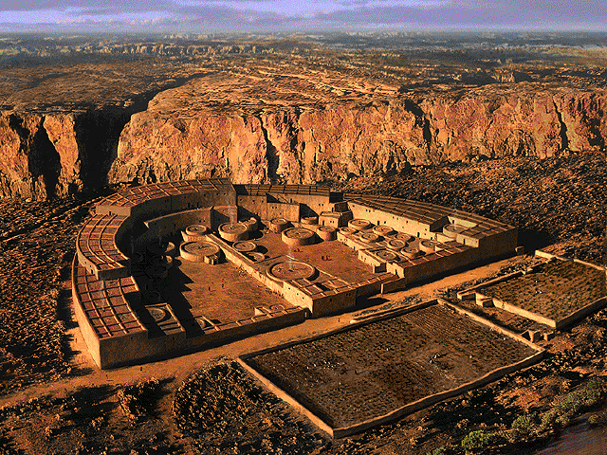
Chaco Canyon

Slide 7
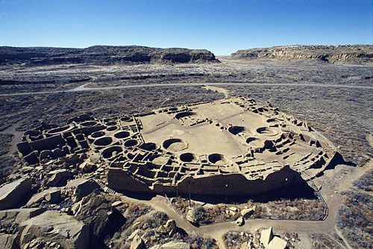
Pueblo Bonita – 5 stories, 600 multi-family dwellings

Slide 8
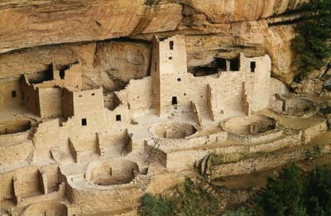
Mesa Verde

Slide 9
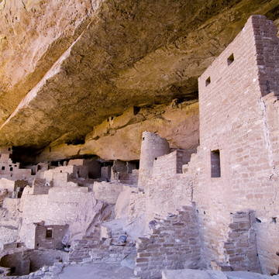
Mesa Verde
(Colorado) Cliff Dwellings
Villages of 50 - 200 rooms, protected from enemies

Slide 10
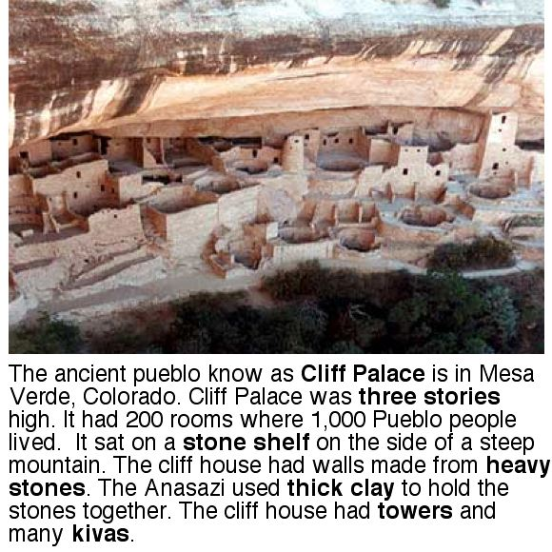
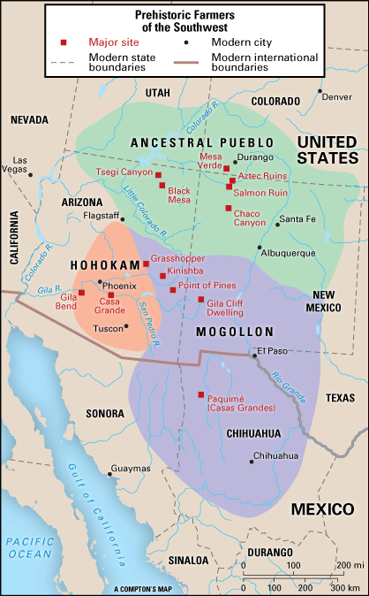

Slide 11
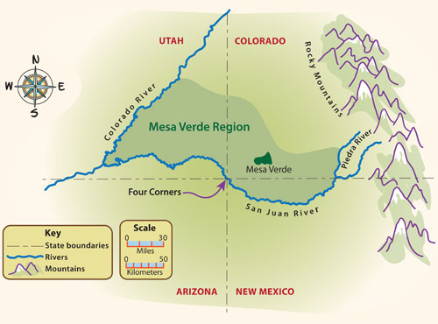

Slide 12
Cahokia - Moundbuilders
900 - 1350
Mississippi Valley – Illinois
Crops: squash, corn, beans
Mississippian Culture spread across region: Great Lakes to Florida
Largest pre-Columbian settlement north of Mexico
City of Cahokia:
Surrounded by wooden walls
Thatched covered houses
10,000 – 20,000 residents
Mounds up to 100 feet high
People: priests, chiefs, moundbuilders, farmers
Video (4:56) https://www.youtube.com/watch?v=Yg9ZXvulMQE

Slide 13
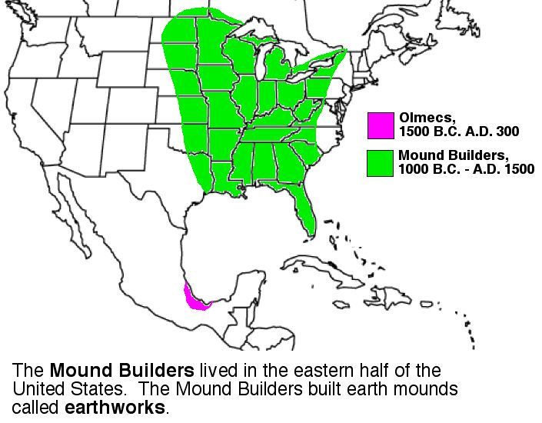

Slide 14
Cahokia -

Slide 15
North America, 1400 – 1500 Timeline
Complex societies
Environment / Climate shaped societies
Trade connected societies
Spoke many languages
500 – 600 independent societies
Varied: creation stories, approaches to hunting/farming, social structure, religion
Shared: close to nature, shamans/priests, community over individual, rituals evolve around crops, animism
Lack Collective Identity: American Indians, although aware of each other, were diverse and were independent of each other. They saw themselves as Seneca, Aztec, Hopi . . . Some fought over land encroachments, resources, and trade.

Slide 16
Native Americans prior to 1492
Native Americans Before the Arrival of Europeans Video (2:17)
Southwest – Pueblo People (AZ, NM)
Plains – Miss. River to Rocky Mts.
Pacific Coast – Northwest Coast/ California
Plateau – Cascade & Rocky Mountains
Great Basin – Shoshone (Nevada, Utah, western Colorado)
Southeast – Seminole, Creek
Northeast – Iroquois, Algonquin

Slide 17
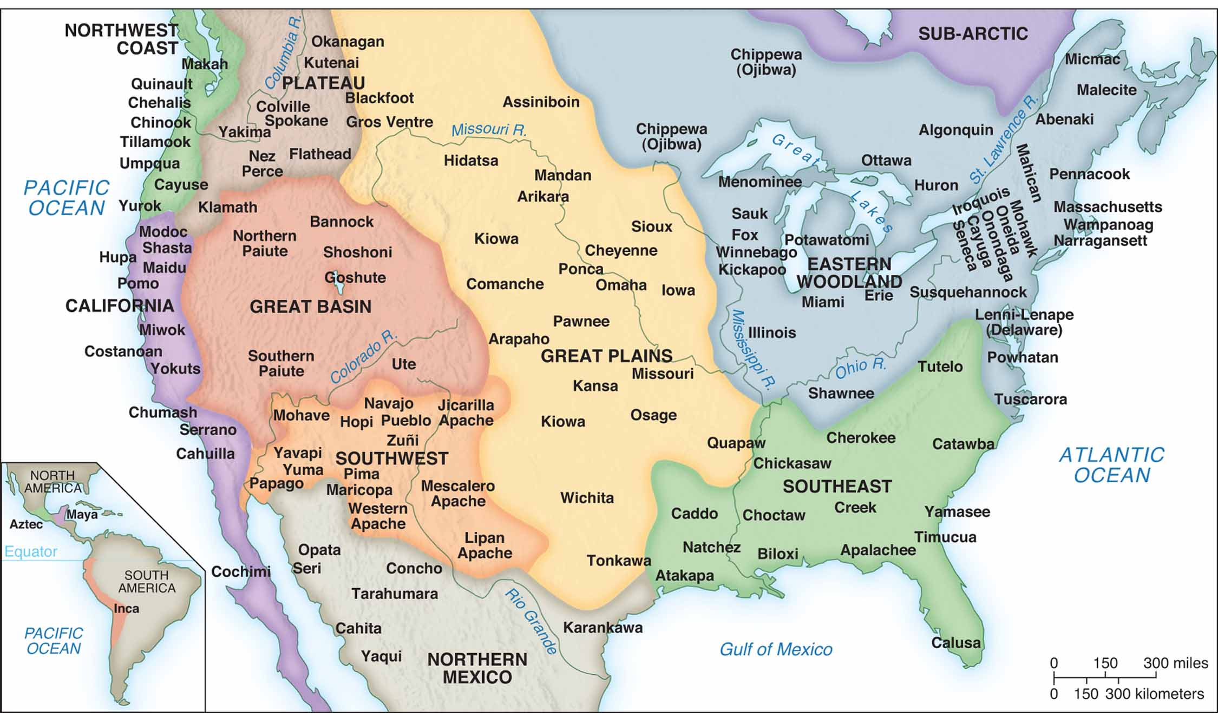

Slide 18
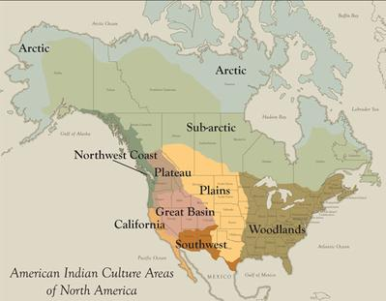

Slide 19
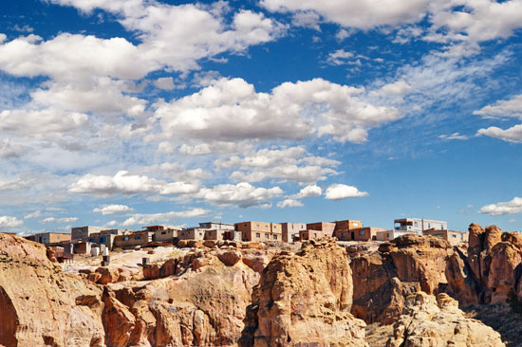
Americas in the 1400’s Southwest
New Mexico, Arizona
Pueblo People: Zuni,Hopi
Apache & Navajo arrive 1500 (hunter-gatherers)
Dry Climate: complex canals, dams, terracing support agriculture
Food: Maize, beans, squash, turkey
Some hunter-gatherers, others skilled farmers
Religion: kachinas (ritual masks), dances to support good crops

Slide 20
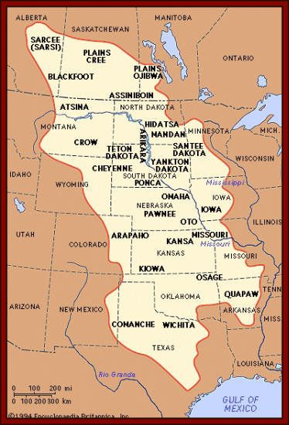
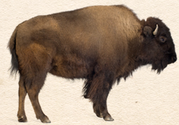
Americas in the 1400’s Great Plains
Miss. River to Rocky Mountains
Food/Resources: Buffalo herds, antelope
Sioux, Pawnee, Crow, Cheyenne, Comanche

Slide 21
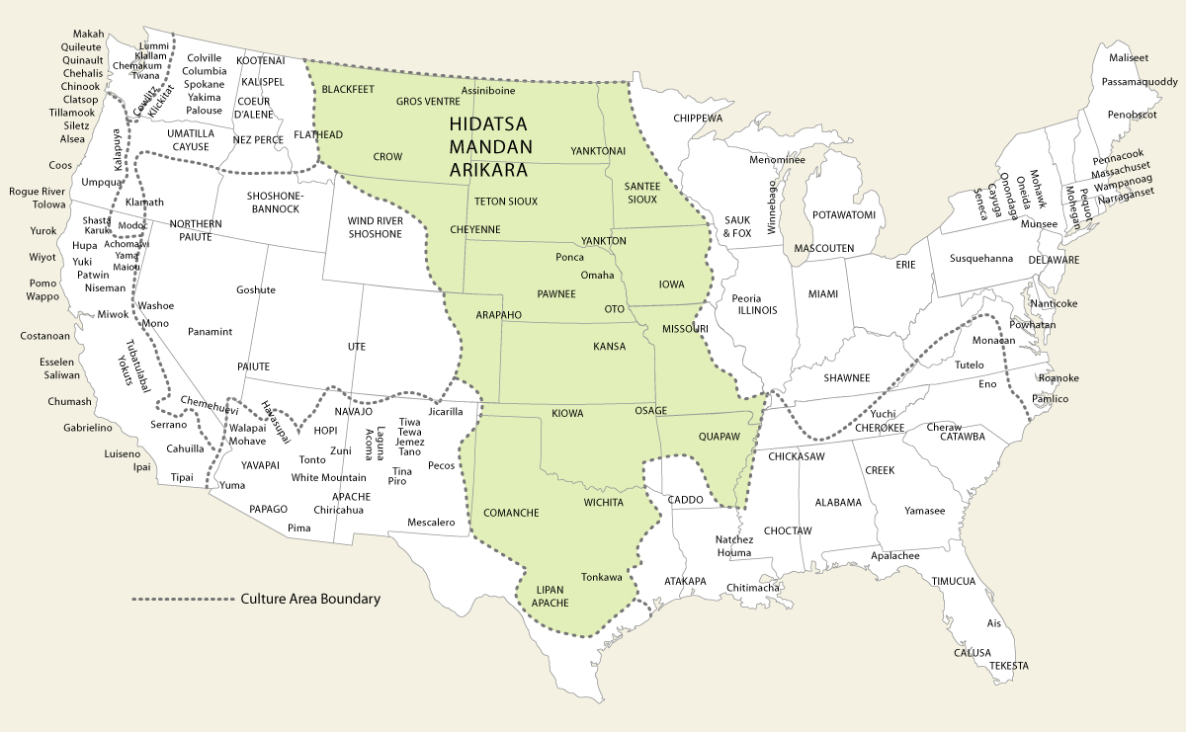
Great Plains Indians

Slide 22
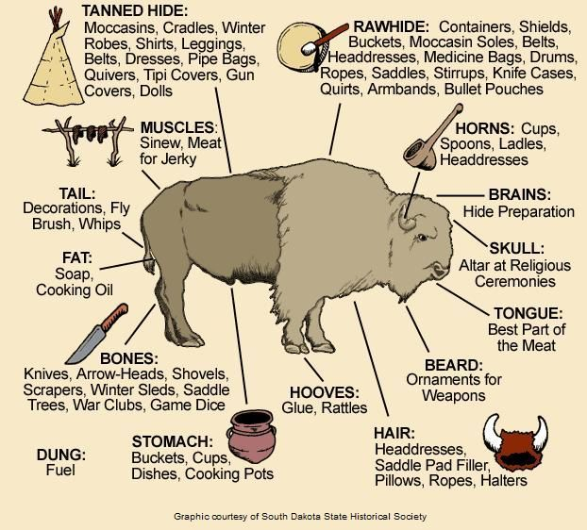

Slide 23
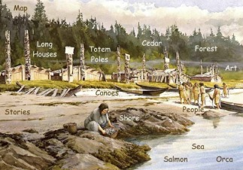
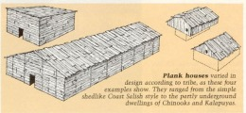
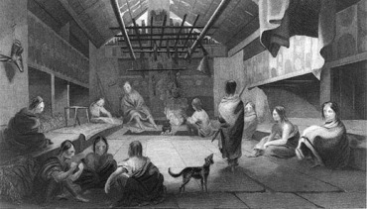
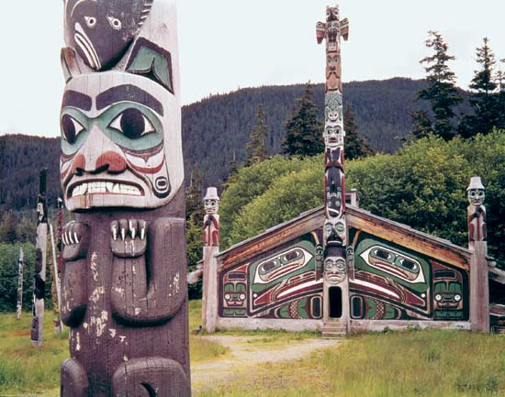
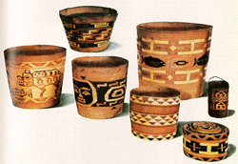
Americas in the 1400’s Pacific Coast
Northwest Coast –
Food provided by forests & sea (no need to farm)
Villages located near the Ocean
Large Homes built w/ vast resource of wood
Built large canoes that could hold 50 people (used giant redwoods)
California –
Over 100 Native American groups
Clans with extended family
Some lived by the sea - live off fishing and native plant life.
Some lived inland (Pomo) - hunted small game
Gathered acorns and pound them into mush to eat

Slide 24
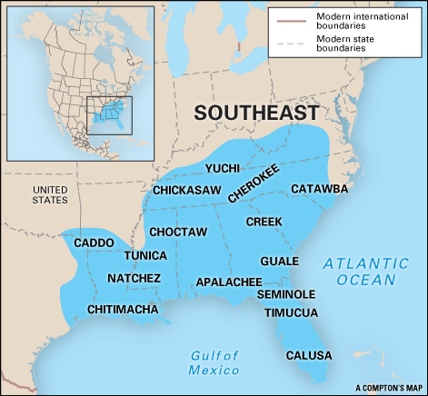
Americas in the 1400’s - Southeast
Small communities replace Cahokia (500 – 2,000 people)
Communities:
Wooden wall for defense
One House for several families
Shared fields for games/ceremonies
People: Creeks, Choctaws, Chickasaws, Cherokees
Trade: vast routes reached across region [copper, beads, shells, quartz (Rocky Mts)]
Food: deer, farming

Slide 25
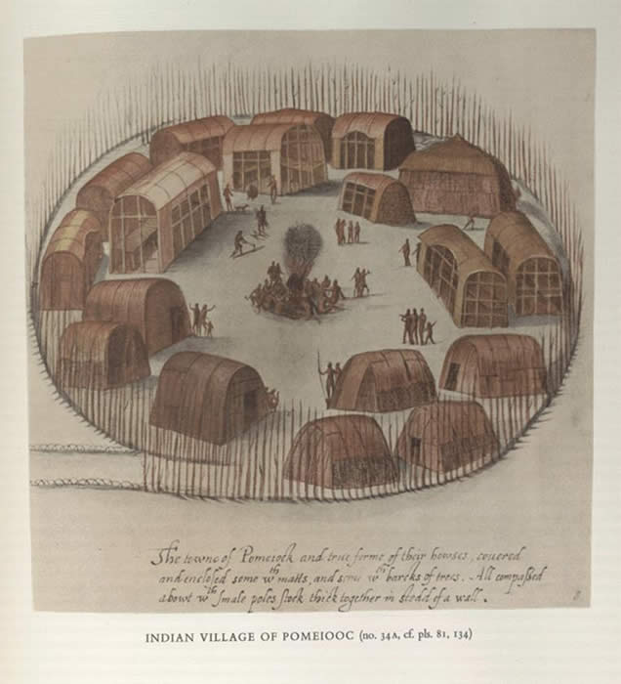
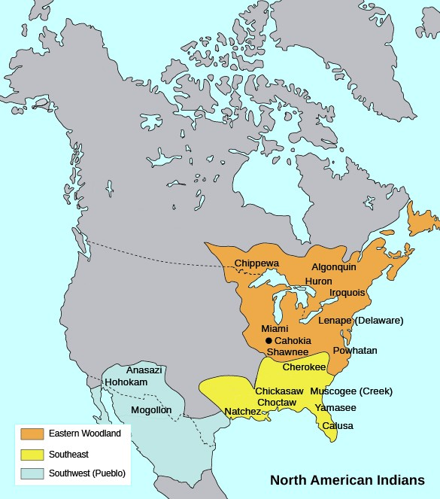
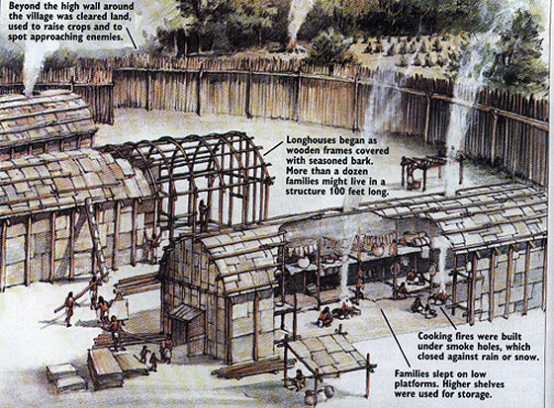
America in the 1400’s Northeast
Iroquois, Algonquin, Shawnee
Rich in Rivers and Forests
Food: hunt, fish, maize, squash (farming / hunter-gatherer)
Longhouses (permanent villages)

Slide 26
Answer the question below.
How did geographic and environmental factors shape the development of various communities? Compare one choice below.
Anasazi and Moundbuilders
Pacific Coast and Great Plains Indians
Northeast Indians and Southwest Indians
Southeast and Pacific Coast

Slide 27
Exploration
Reconquista
Protestant Reformation
Columbus → Exploration
Cortes
Spanish Empire

Slide 28
EXLORATION - Causes
1453 Constantinople falls to Muslim Ottoman Turks Istanbul
Control trade between Europe and Asia
Restrict access to routes over and across the Mediterranean
Result: new route to the Asia
1492 Reconquista “reconquest”
Isabella and Ferdinand conquered Moors (North African Muslims), who had controlled Iberian Peninsula (Spain/Portugal) since 711, and unified Spain
Culture of Islam (Arabic numerals, algebra, cotton) spread from Spain to other European nations dominated by Christianity
Catholicism was enforced on Muslims and Jews
Commission Columbus

Slide 29
Protestant Reformation
1493 Treat of Tordesillas - Pope Alexander VI divided the non-Christian New World between Spain and Portugal; Portugal would control Brazil and the rest of the western hemisphere went to Spain; missionary work to spread Catholicism would thus become a prominent goal
1517 Martin Luther - German priest, posted 95 Theses that accused the Church of worldliness and corruption (sell indulgences); this divided the Church and led to the rise of Protestant churches independent of Rome

Slide 30
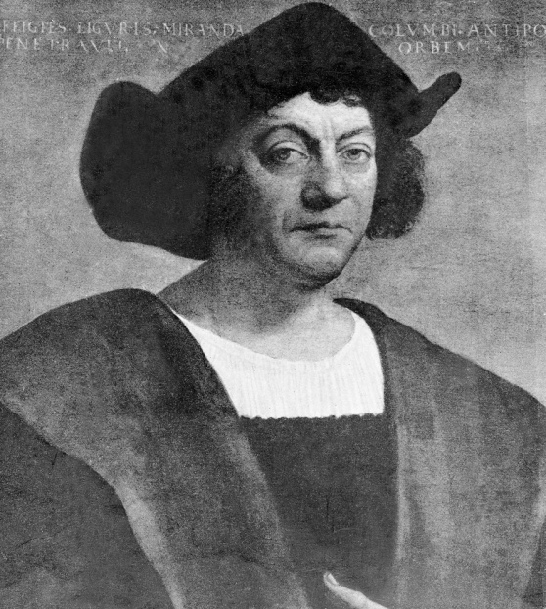
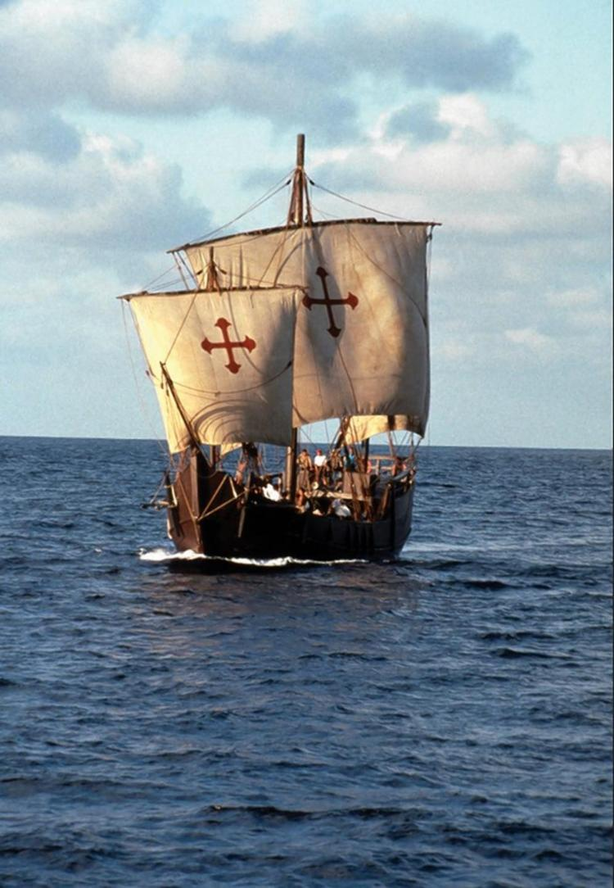
EXPLORATION – Columbus 1492
Believed to have found route to China & India by traveling west from Iberian peninsula
Financially backed by Spain (King Ferdinand and Queen Isabella)
Piety and Profit (Gold, Glory, God) Desired to circumvent the Middle East by finding a water route to the East for silk, spices, tea, porcelain, luxuries...
Oct. 12, 1492 - Discover Bahamas (Tainos were friendly and exchanged gifts), then Hispaniola, Cuba; return to Spain with 10 natives from Hispaniola
1430's - Gutenberg's movable type for printing helped many in Europe to hear about his voyage and stimulated exploration
Video (2:11) Columbus Sets Sail (History Channel)
Santa Maria

Slide 31
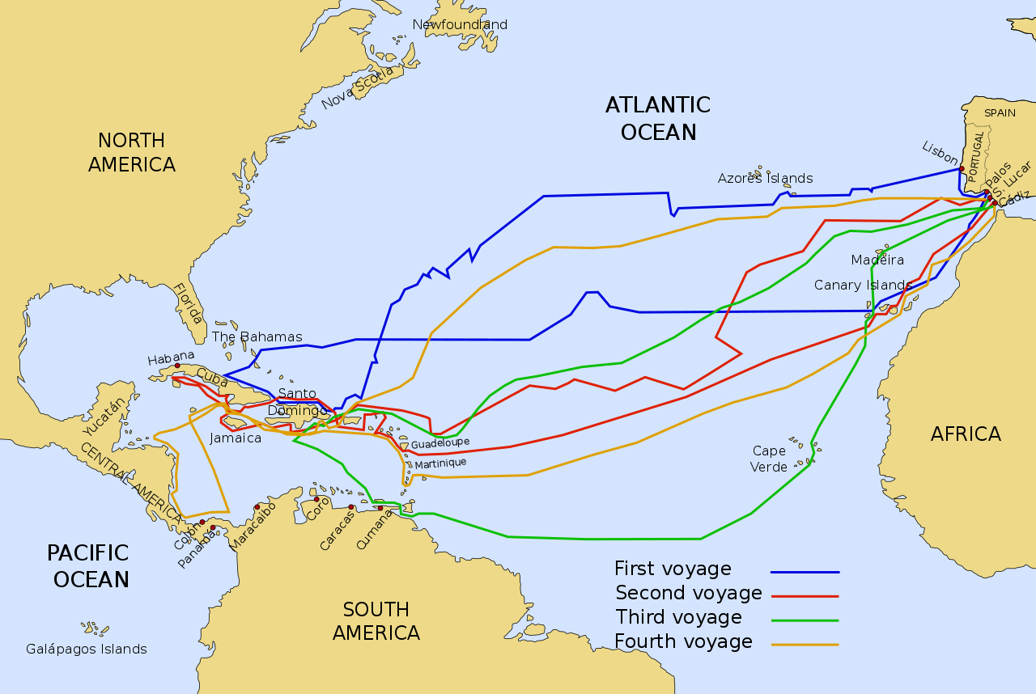
Voyages of Columbus

Slide 32
EXPLORATION
How did religion, trade, and technology lead to a period of exploration? (Use your reading from chapter 1 and the powerpoint to answer.)
What did explorers hope to gain on these water expeditions?
Use the Explorers Chart to answer.

Slide 33
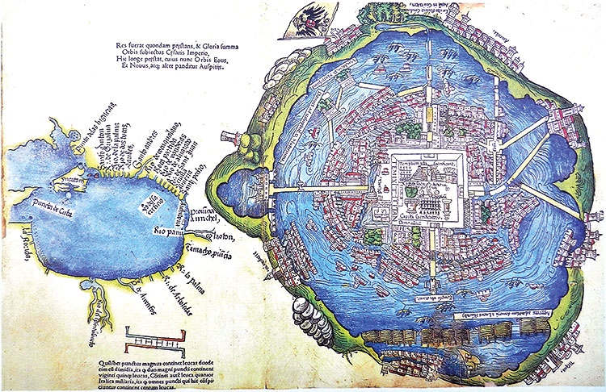
Aztecs 1325 - 1521 Aztec Video (5:21): https://www.youtube.com/watch?v=_nS6MpVbB_g
Tenochtitlan (capital)
250,000 population Mexico Lake Texcoco in the Valley of Mexico
O one of world's largest cities, complex city of canals, bridges, dams, gardens, zoos, great temple with royal palace

Slide 34
EXPLORATION Hernan Cortes conquered Tenochtitlan (Aztec capital)
1519
Emperor Montezuma (Motecuhzoma) initially friendly, then captured by Cortes
1520 - 1521
Montezuma/Aztecs repel attack at first
Spaniards attacked and conquered Tenochtitlan with the help of neighboring non-Aztec tribes who had been subjugated and sacrificed.
Tenochititlan transforms to reflect Spanish dominance / colonization
New Spain (Spanish empire)
Catholic Cathedral replace Aztec Temple
Viceroy – representative in New World who rules for King

Slide 35
Spanish Conquest dominates - Gold, Glory, God
1499 - 1502 - Amerigo Vespucci - exploration of South American coast reflect that not East Indies, but new world – America
1502 - Nicolas de Ovando - established Hispaniola as permanent Spanish base in New World, 1st center of Spanish Empire
1502 - Slave Trade begins with 1st Africans brought to Caribbean
1513 - Vasco Nunez de Balboa - 1st European to see Pacific Ocean after crossing isthmus of Panam
1519-1522 - Ferdinand Magellan - sail around the world
1519 - Hernan Cortes - 1st explore to encounter major civilization; Aztec in Tenochtitlan; 1521 conquered w/ native allies, gun powder, iron weapons, disease (smallpox) defeated Montezuma II
1532 - Francisco Pizzaro - conquer Incan Empire in Peru

Slide 36
Bartolome de Las Casas
Read pgs. 7 – 10 from your Voices of Freedom book. Complete HAPPY analysis and answer both questions in your ringed index cards.

Slide 37
Extras
Documentary Video: America Before Columbus (History Channel: 1:31)

