Slide 1

The Election of 1824
http://nierocks.areavoices.com/2010/10/19/elections-nie-guide/

Slide 2
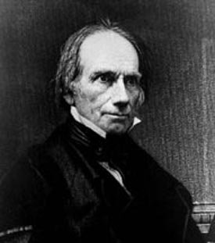
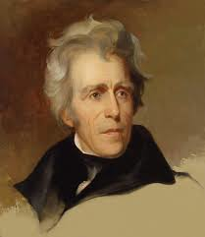
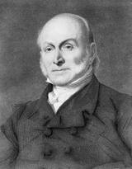
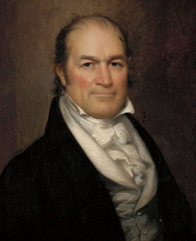
A. The Candidates
Candidates are all Democratic - Republicans
www.senate.gov
frontierpartisans.com
www.nndb.com
en.wikipedia.org
Henry Clay
Andrew Jackson
John Quincy Adams
William Crawford

Slide 3
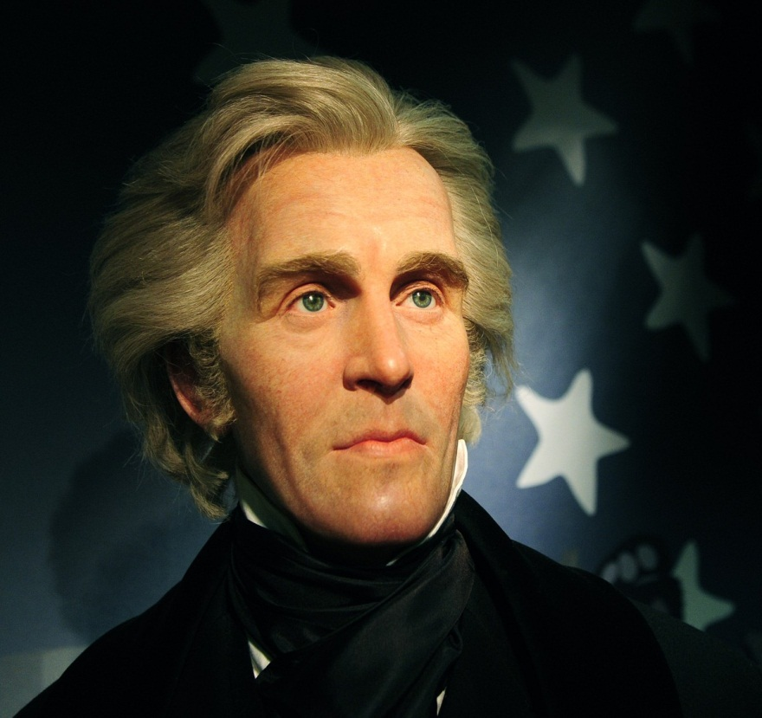
Andrew Jackson
From Tennessee- War Hero…Middle Class
Battle of New Orleans
“People’s President”

Slide 4
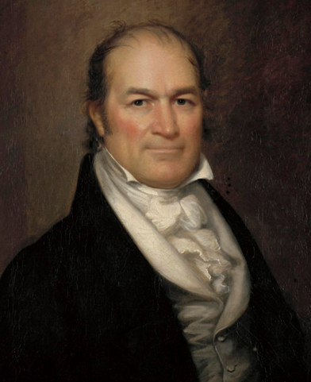
William Crawford
From Georgia- Pro Slavery
Secretary of Treasury
Member of Congress

Slide 5
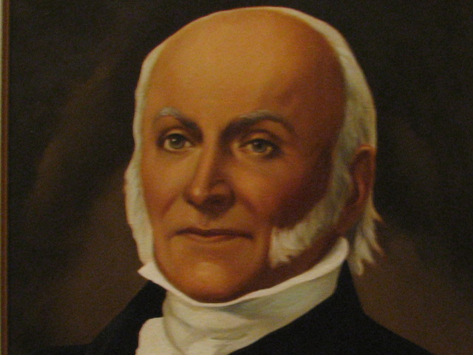
John Quincy Adams
From Massachusetts- Son of President
Secretary of State
Favors wealthy

Slide 6
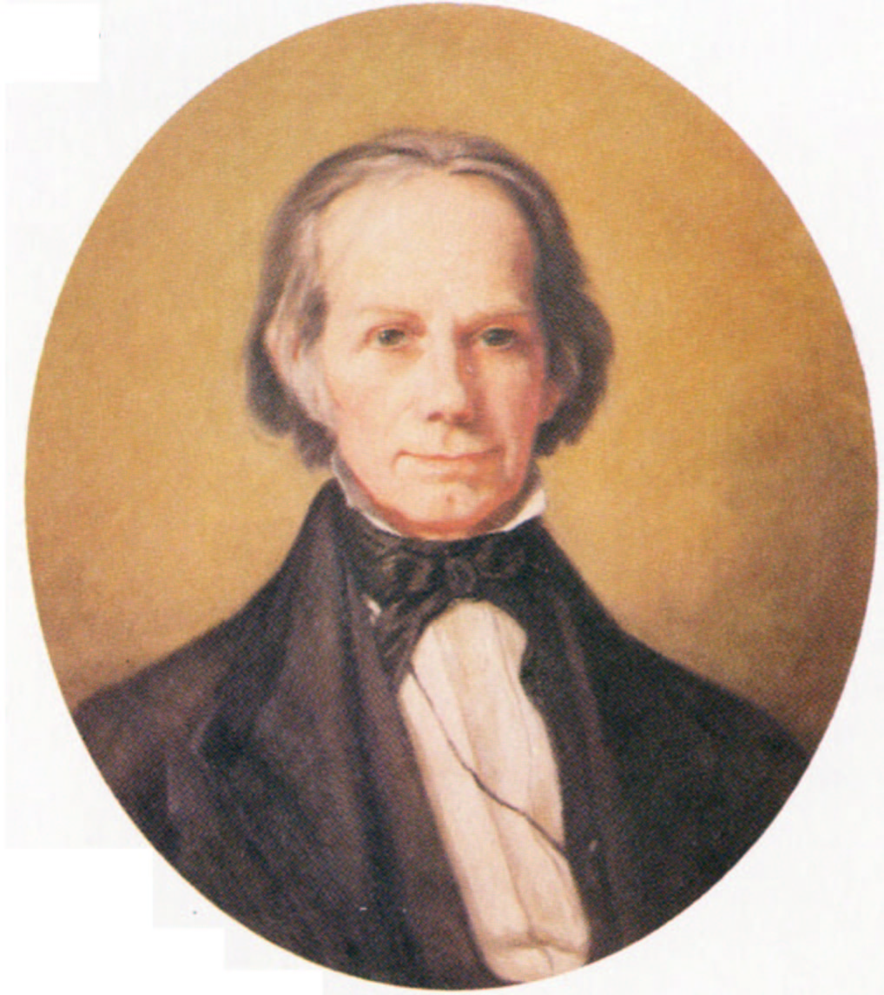
Henry Clay
Created Missouri Compromise
Speaker of House of Representatives

Slide 7
B. The Result
Although Jackson won the popular vote none of the candidates received the majority of the electoral college

Slide 8
Election Results
Jackson: 43% of popular vote
Adams: 30% of popular vote
Candidate | Popular Votes | Electoral Votes
William Crawford | 46,618 | 41
John Quincy Adams | 108,740 | 84
Andrew Jackson | 153,544 | 99
Henry Clay | 47,136 | 37
Who Wins??

Slide 9
What is a Majority?
50% +1

Slide 10
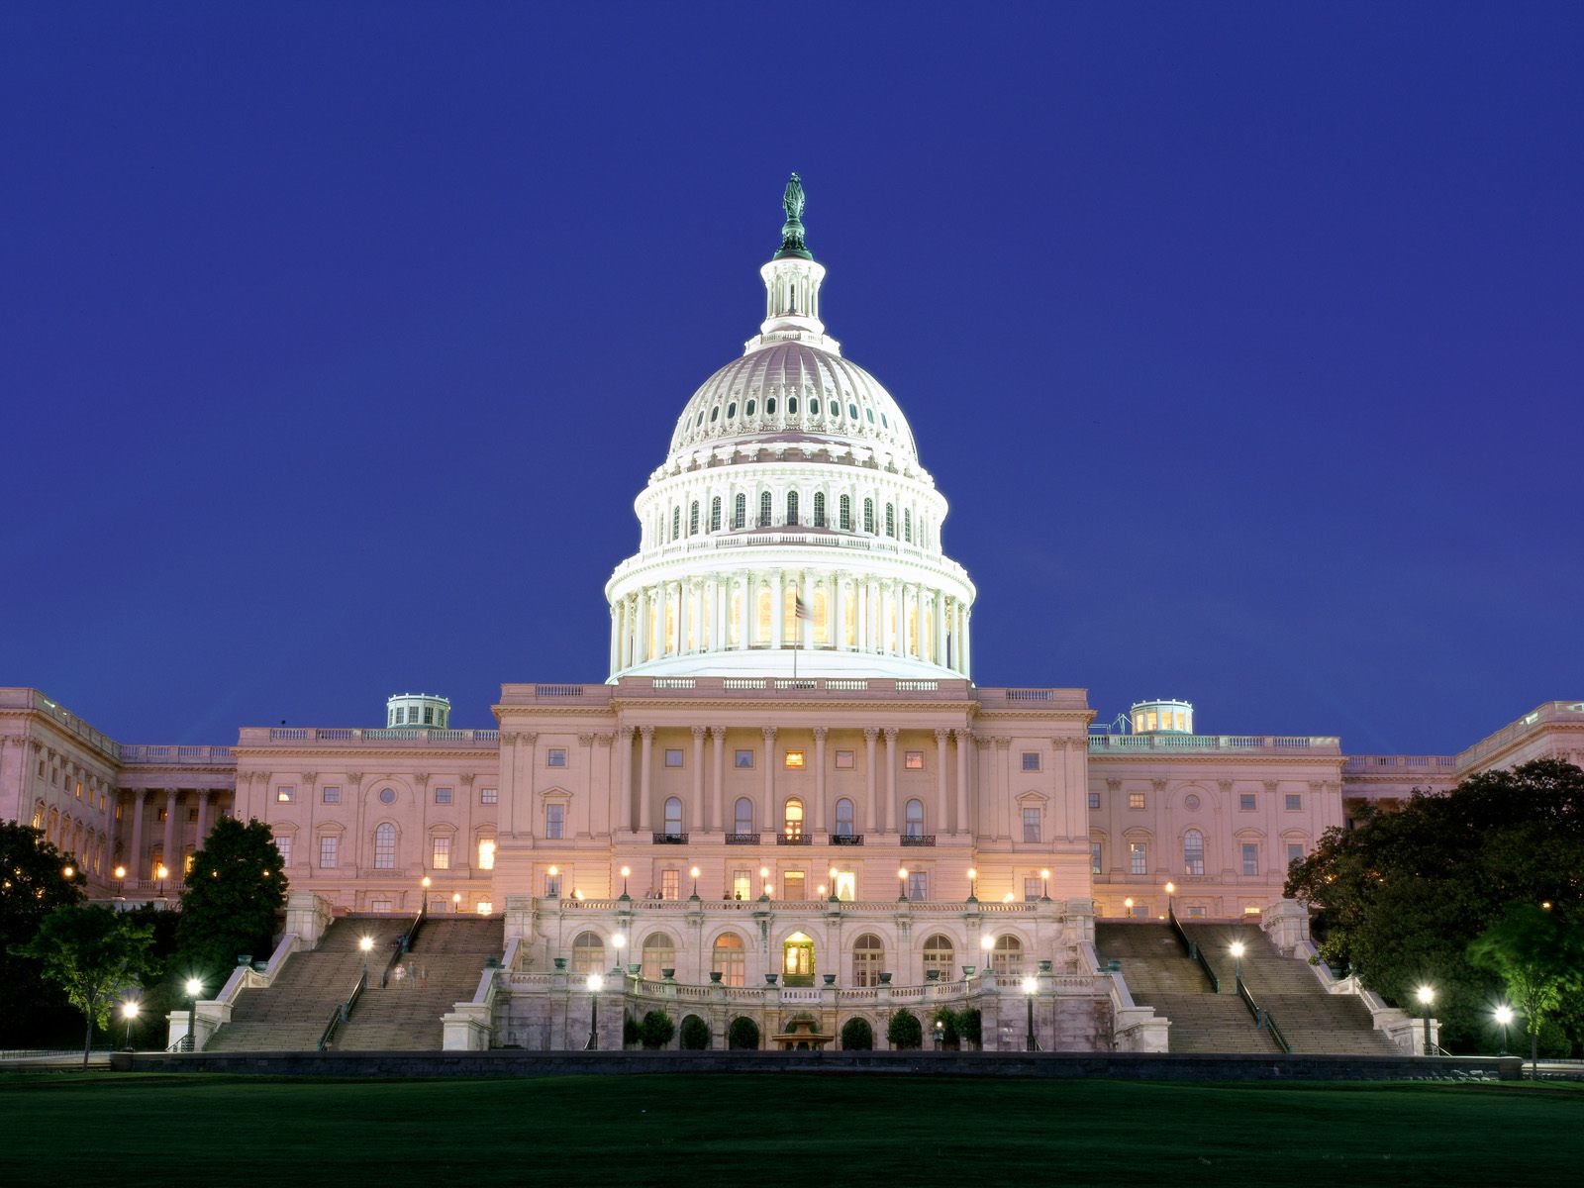
When no one gets a majority of the electoral votes the election goes to the House
fightcolorectalcancer.org

Slide 11

Only the top three go, so Henry Clay is Eliminated
www.senate.gov
frontierpartisans.com
www.nndb.com
en.wikipedia.org
Henry Clay
Andrew Jackson
John Quincy Adams
William Crawford

Slide 12
William Crawford has a stroke
William
Crawford
frontierpartisans.com
www.nndb.com
en.wikipedia.org
Andrew Jackson
John Quincy Adams
William Crawford
R.I.P

Slide 13
So the Election comes down to…
frontierpartisans.com
www.nndb.com
Andrew Jackson
John Quincy Adams

Slide 14
Henry Clay is Speaker of the House
He Selects John Quincy Adams

Slide 15
Adams selects Clay as his Secretary of State

Slide 16
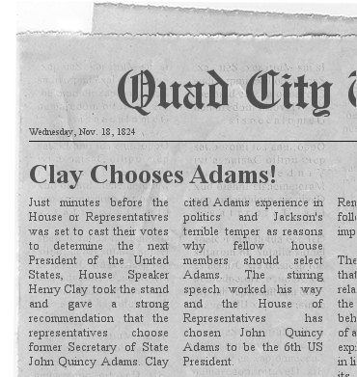

Slide 17
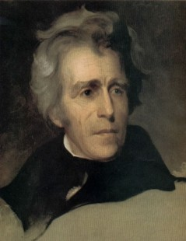
Jackson says he was cheated!
Corrupt Bargain!!!
To Jacksonians the ADAMS-CLAY ALLIANCE symbolized a corrupt system where elite insiders pursued their own interests without heeding the will of the people.

Slide 18
Corrupt Bargain
Election of 1824
Adams quickly made Clay his Secretary of State
  The past 3 Sec. of State had gone on to be President
Was a deal made?
Many wonder if Adams promised Clay he would make him Sec. of State if he could convince members of the House to vote for him.
What do you think?

