Slide 1
Chapter 16 America's Gilded Age, 1870–1890

Slide 2
What is the Gilded Age:
The Gilded Age - a book written by Mark Twain and Charles Dudley Warner (1873)
A tale about corruption, greed, and materialism
Named the era defined by corruption in politics, industrialization, monopolies
"What is the chief end of man?--to get rich. In what way?--dishonestly if we can; honestly if we must." -- Mark Twain-1871
Gilded = covered with a layer of gold, but suggests that the glittering surface covers a core of little real value and is therefore deceptive

Slide 3
Gilded age
Industrialization – Railroad, Steel, Mass Production
Urbanization
Mass Production & Name Brands - - National Brands - Ivory Soap, Quaker Oats - National Chains - A&P grocery stores - Mail-Order Firms - Montgomery Ward, Sears
Inventions
Political Corruption
Monopolies and Economic Growth
Immigration – population growth
Child Labor
Strikes and Labor Unions

Slide 4
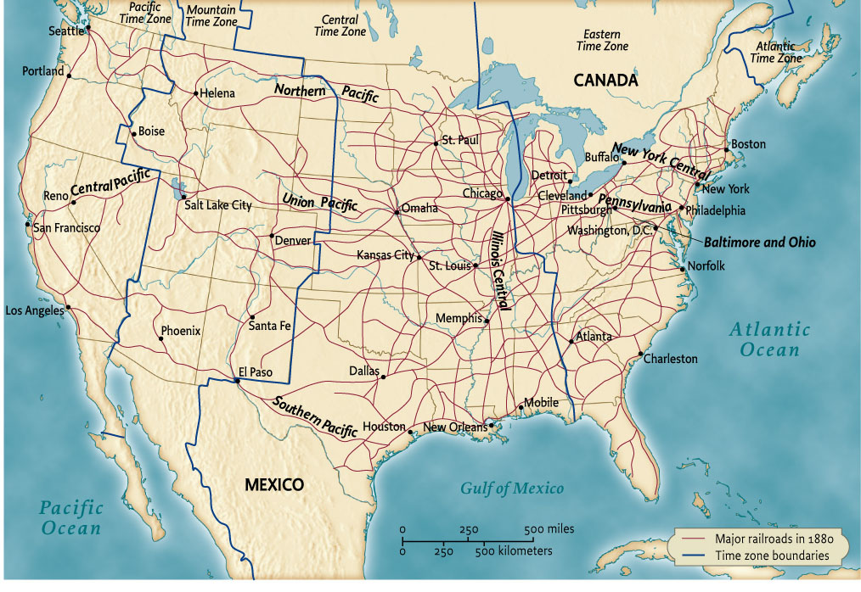
Map 16.1 The Rail Road Network, 1880
Give Me Liberty!: An American history, 3rd Edition
Copyright © 2011 W.W. Norton & Company

Slide 5
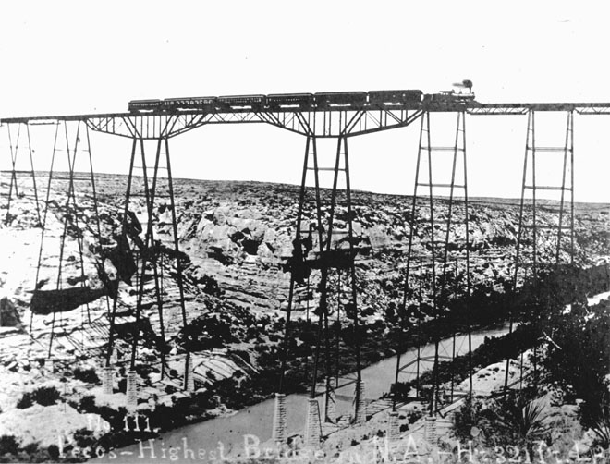
Building railroads in the West required
remarkable feats of engineering
Give Me Liberty!: An American history, 3rd Edition
Copyright © 2011 W.W. Norton & Company

Slide 6
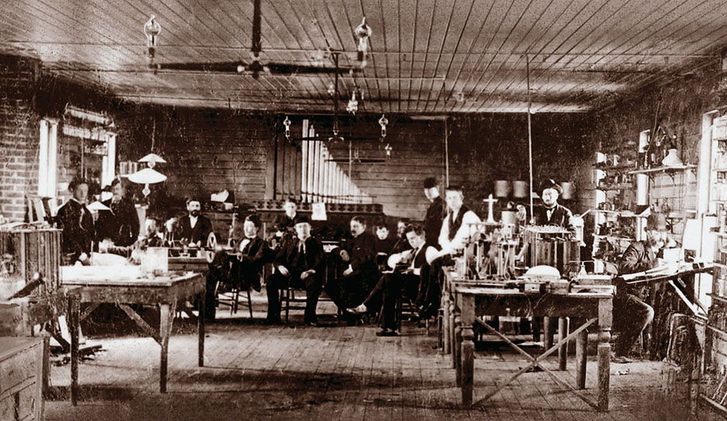
Thomas Edison’s laboratory at Menlo Park
http://behindthescenes.nyhistory.org/edison-lit-manhattan/
Give Me Liberty!: An American history, 3rd Edition
Copyright © 2011 W.W. Norton & Company

Slide 7
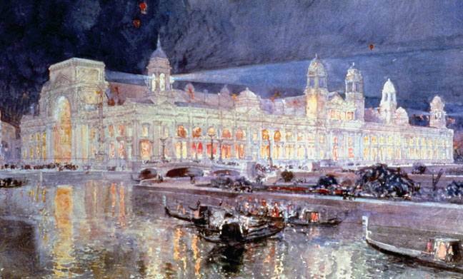
The Electricity Building at the Chicago World’s
Fair of 1893
Give Me Liberty!: An American history, 3rd Edition
Copyright © 2011 W.W. Norton & Company

Slide 8
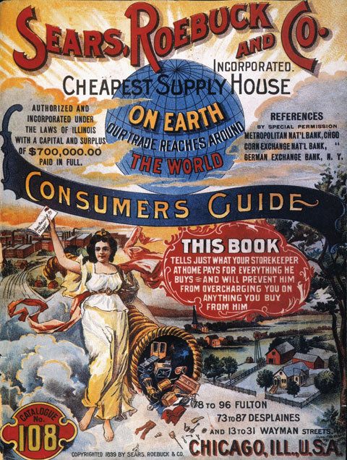
The cover of the 1897 Sears, Roebuck & Co. catalog.
Give Me Liberty!: An American history, 3rd Edition
Copyright © 2011 W.W. Norton & Company

Slide 9
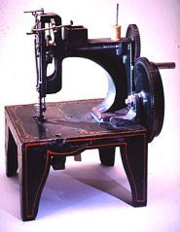
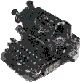
KEY INVENTIONS
BETWEEN 1860 TO 1900
Elevator---1852
Bessemer Process---1852
Sewing Machine---1853
Dynamite---1867
Typewriter---1868
Levi Blue Jeans/Basketball---1873
Telephone---1876
Phonograph---1878
Light bulb and cash register---1879
Zipper---1883
Gasoline automobile and skyscraper---1885
New York City---first city to have electricity--1890
Radio---1895
Subway---1897
X-ray---1900
Between 1800 to 1900, US Govt. issued 500,000 patents

Slide 10
The Airplane
Wilbur Wright Orville Wright
Kitty Hawk, NC – December 7, 1903

Slide 11
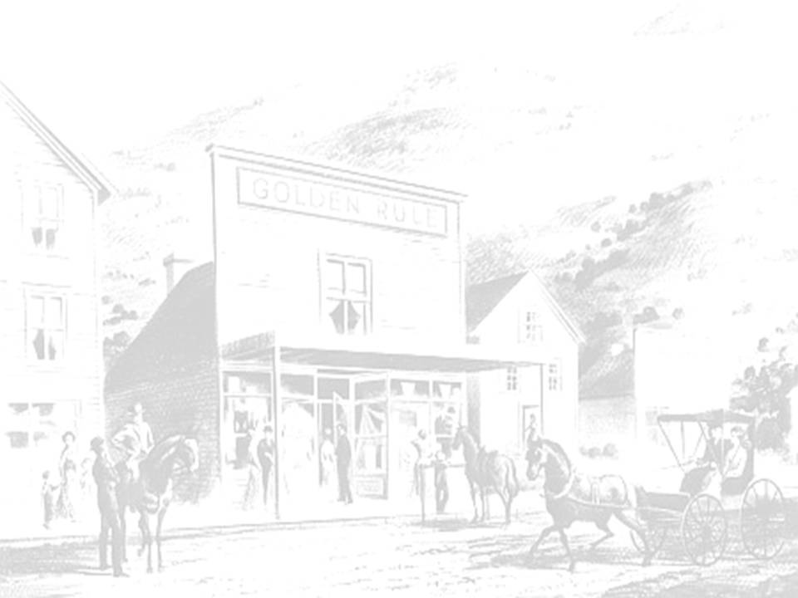
NEW STORES
BETWEEN 1860 TO 1900
Specialty stores----sold single line of goods
Department stores---combined specialty stores
Chain stores---stores with branches in cities
Mail catalog stores
New ways to advertise
Montgomery Wards, J.C. Penney, Macy’s, Sears and Roebuck and Woolworths

Slide 12
Gilded age
Industrialization – Railroad, Steel, Mass Production
Urbanization
Mass Production & Name Brands - - National Brands - Ivory Soap, Quaker Oats - National Chains - A&P grocery stores - Mail-Order Firms - Montgomery Ward, Sears
Inventions
Political Corruption
Monopolies and Economic Growth
Immigration – population growth
Child Labor
Strikes and Labor Unions

Slide 13
Industry & Industrialists – Businesses engaged in ruthless competition
Competition and Consolidation:
Economy: Depression plagued the economy between 1873 and 1897 - unemployment
http://teachinghistory.org/history-content/beyond-the-textbook/24579
Cutthroat Competition led to larger corporations gobbling up smaller ones
1897 - 1904, 4,000 firms vanished into larger corporations
Industrial Giants (corporations): 1 - U.S. Steel (bought from Carnegie by J.P. Morgan in 1901) 2 - Standard Oil (John D. Rockefeller) 3 - International Harvester

Slide 14
NEW INDUSTRIES
Oil
Mining
Sugar
Steel
Meatpacking
Beef/Cattle
Construction
Telegraph
Telephone
Railroad
Marketing
Sewing Machine
Vacuums
Typewriters
Automobile
Salt
Coal
Agricultural

Slide 15
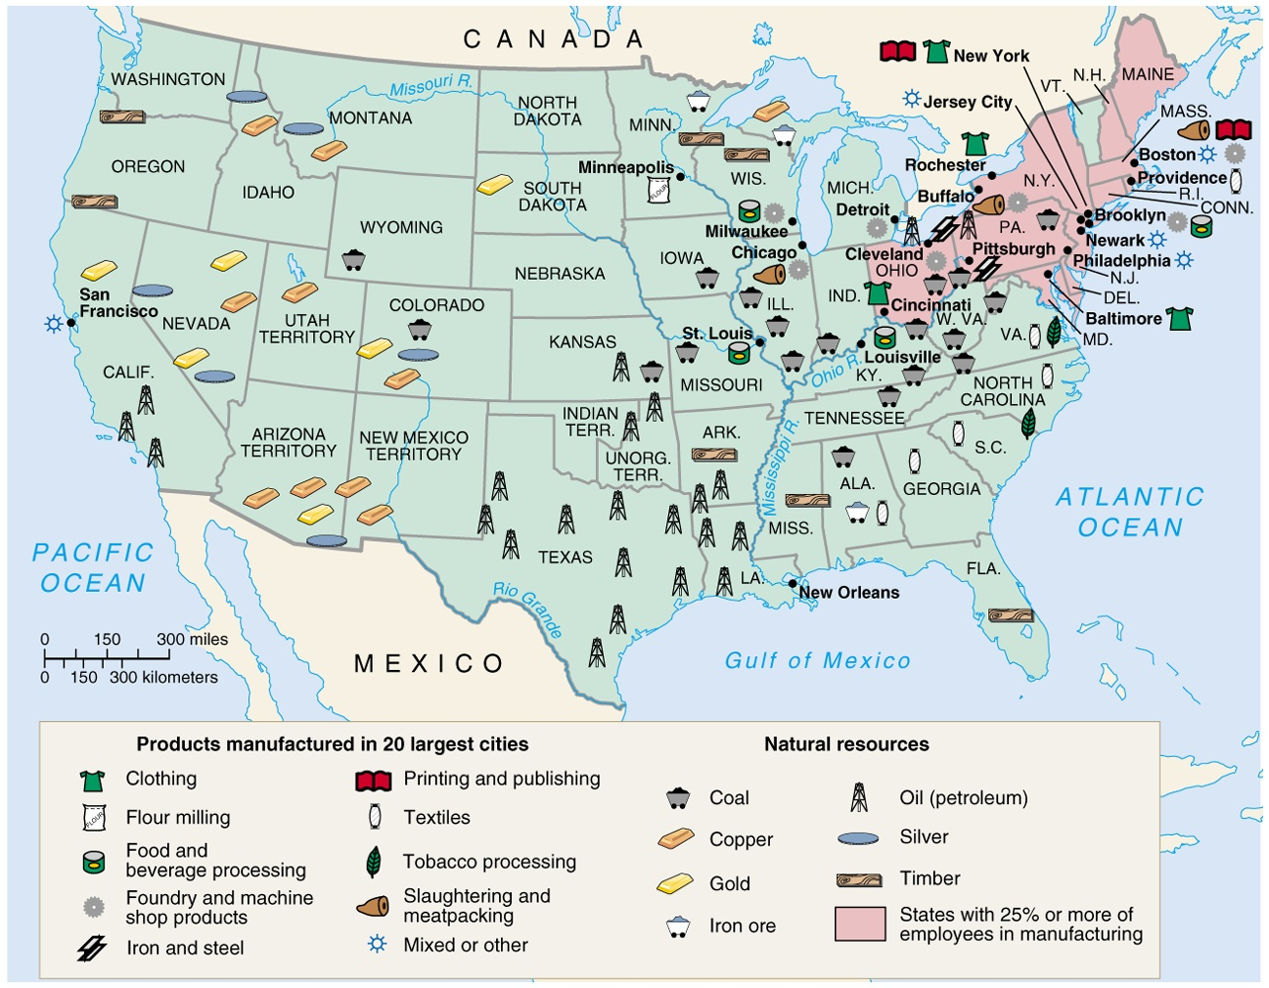

Slide 16
Captains of Industry or Robber Barons
Andrew Carnegie
Industrialists who made a fortune in steel in the late 1800’s, as a philanthropists, he gave away some $350 million.
Carnegie Steel
Gospel of Wealth -belief that the wealthy are “chosen by God” to be successful and were therefore responsible to look out for the well being of those less fortunate. Many Industrialist shared wealth although rarely through direct welfare. Started museums, etc.
John D Rockefeller
Industrialists who made a fortune in the oil refining industry
U.S Standard Oil

Slide 17
Gilded age recap
GILDED AGE - MARK TWAIN
the era is glittering on the surface, but corrupt underneath
Greed & Guile: Robber Barons, Speculators, monopolies, political scandals
Agrarian society of small producers transforms into an urban society (corporations)
WESTERN FRONTIER CLOSED 1865 - 1890
430 million acres settled west of Miss. R. (1862 Railway Act, Homestead Act)
Plains Indians wars (Sioux Wars, Battle of Little Bighorn, Wounded Knee)
INDUSTRIAL ECONOMY
National Communication and Transportation networks created (telephone, Transcontinental Railroad)
Corporation dominate business organization (vertical, horizontal, Carnegie Steel, Rockefeller Oil)
Labor Movement due to hazardous working conditions and long hours (strikes, unions)
POLITICS - PARTISANSHIP & REFORM
Civil Service Act - curb government corruption by requiring a competitive civil service exam based on merit (replace spoils system)
Sherman Antitrust Act - outlaw business monopolies
Interstate Commerce Act - end discrimination by railroads against small shippers
POPULIST CRUSADE
Farmers burdened with heavy debt and falling farm prices
Populist Party: increase circulation of money, govt help farmers pay debt, tariff reductions, graduated income tax

Slide 18
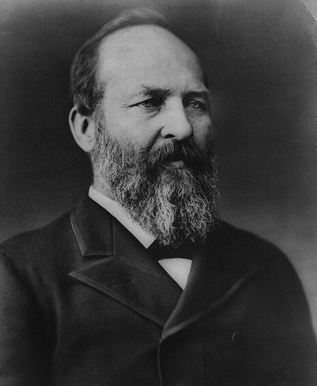
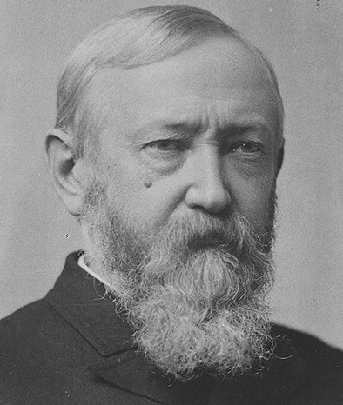
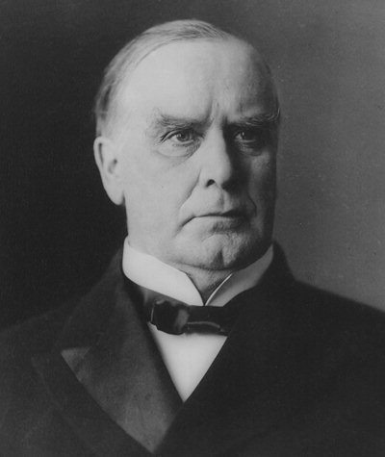
Presidents of the Gilded Age
U.S. Grant 1869-1877
Rutherford B. Hayes 1877-1881
James Garfield 1881
Chester A. Arthur 1881-1885
Grover Cleveland 1885-1889 and 1893-1897
Benjamin Harrison 1889-1893
William McKinley 1897-1901

Slide 19
Grant (Rep) – Reconstruction, Scandals
Hayes –
Compromise of 1877 (ends Reconstruction)
Garfield (Rep) – assassinated
Chester Arthur (Rep) –Pendleton Civil Service Reform Act
Grover Cleveland – 1st Democratic President since end of Civil War, serve 2 non-consecutive terms
Benjamin Harrison (Rep) – build up navy
William McKinley – (Rep) Spanish American War, 3rd President assassinated

Slide 20
Reconstruction Continued
1872 Credit Mobilier Scandal - Railroad companies overcharged millions of dollars for government contracts
Company directors bribed various government officials with company shares
1875 Whiskey Ring - distillers in the Midwest who were swindling the national government out of excise taxes with the help of federal agents.
U.S. Grant - R 1869-1877
Bargain of 1877
Reconstruction Ended
Rutherford B. Hayes
1877-1881

Slide 21
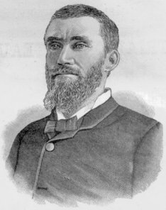
Corruption in Government
Patronage or Spoils System- giving government jobs to loyal party workers or friends
Were not qualified
Used position to get money from government (graft)
President James Garfield is assassinated by disappointed office seeker favoring Spoils System
President Chester Arthur signs Pendleton Civil Service Act of 1883
James Garfield
Charles Guiteau

Slide 22
Pendleton Civil Service Act 1883
Attempted to end Patronage/Spoils System
1. Creating the Civil Service Commission which required appointed govt. officials to pass the Civil Service Exam to base jobs on merit instead of friendship
2. Federal employees did not have to contribute to campaign funds
3. Federal employees could not be fired for political reasons
Chester A. Arthur signed Pendleton Act into effect

Slide 23
Presidents of the Gilded Age
Laissez-faire Economics - Govt. should not interfere
Mostly ignored the issues of industrialization
Social Darwinism
Used Darwin’s theory to explain business
Natural Selection, Survival of the Fittest
Govt. should not interfere

Slide 24
The Rise of Big Business
Sherman Anti-Trust Act of 1890
Law outlawing a combination of companies that restrained interstate trade or commerce; important to prevent monopolies. Not initially enforced properly.
Benjamin Harrison
“What can I do when both Parties insist on kicking”

Slide 25
The Rise of Political Machines
Political Machines –an organized group of people that controlled the activities of a political party
By giving voters services they needed, the machine won their vote and controlled city government
Tammany Hall – Democratic political machine in NYC that held immense influence over elections and its voters
Encouraged voters to select Tammany men
Rewarded voters with patronage
Included mayors, governors
City Boss was head of Political Machines….who controlled
Jobs in police, fire, and sanitation departments
Agencies that granted licenses to businesses
Money to fund large construction projects
“All Politics center around the Boss”

Slide 26
Elections
1876 – 1892
Election results were close and often the Congress and President were of different political parties.
Republicans: kept the memories of the Civil War alive by waving the “bloody shirt” (death of Lincoln, remember war wounds of Veterans)
Democrats: South, Northern big-city politicians (political machines), Immigrants (Catholics, Lutherans, Jew who object to temperance/prohibition)
Republicans: African Americans, Reformers, Business men, Middle-Class, Anglo-Saxon Protestants (temperance)

Slide 27
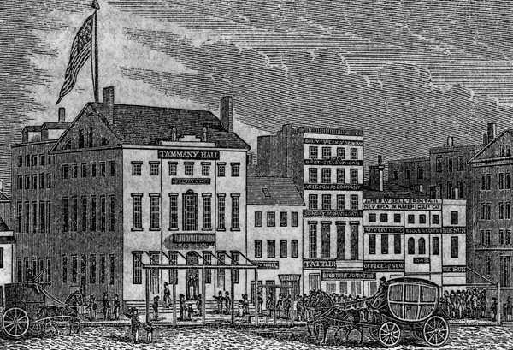

Slide 28
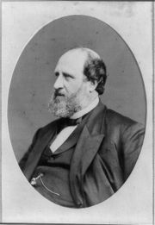
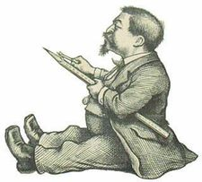
“Boss Tweed” and Thomas Nast
William “Boss” Tweed
City Boss of Tammany Hall- Democratic Political Machine in New York City
Thomas Nast –political cartoonist who was critical of machines and Tweed

Slide 29
"Boss" William M. Tweed
Head of the political machine in NYC
Organized politics in a variety of ways between the 1850's and 1870's
Connected immigrants with needed jobs and shelter in exchange for their vote
Gave jobs and government contracts to those who did him favors, kickbacks were common
This corruption was also seen as sort of Robin Hood acts by the poor
Most famous member of Tammany Hall
Tweed Ring:
Stole up to $200 million from NYC
Government contracts for city projects given to friends at a high cost
Skimmed contracts for personal gain
Used city resources for personal gain in real estate development

Slide 30
Political Machines
Cartoonist Thomas Nast :
Used political cartoons to expose political corruption and Boss Tweed
Boss Tweed was foreman of New York's Big Six Fire Company and wore equipment marked with a tiger's head.
He was elected a representative, a senator and served on NYC boards but later went to prison for corruption
Political machines loved immigrants, WHY?
Never voted, tried to sway votes by bribery, intimidation, and other means
Political machines used power to
Rig elections
Become wealthy from kickbacks-illegal payments
Control police force to stay out of trouble

Slide 32
