Slide 1
Chapter 20 From Business Culture to Great Depression: The Twenties, 1920–1932
Notes:
In May 1920, at the height of the Red Scare, police arrested two Italian immigrants alleged to have participated in a Massachusetts robbery at a factory in which a guard was killed. The accused, Nicola Sacco, a shoemaker, and Bartolomeo Vanzetti, were anarchists who hoped for a society without government, churches, and private property. They saw violence as an appropriate means for enacting social change. But very little evidence linked them to the crime, eyewitness testimony was contradictory, and other evidence was disputed. Nonetheless, in the anti-radical and anti-immigrant atmosphere of the Red Scare, their conviction was inevitable. When the men were found guilty and sentenced to death, their multiple appeals garnered international attention and sympathy. A movement to save their lives attracted support from many in the United States, including Felix Frankfurter, a future Supreme Court justice. The governor of Massachusetts responded to protests by appointing a commission headed by Abbot Lawrence Lowell, Harvard University’s president and a longtime official of the Immigration Restriction League. The commission upheld the verdict and death sentences, and on August 23, 1927, Sacco and Vanzetti were executed by electric chair.
The Sacco-Vanzetti case exposed much about America in the 1920s, from the Red Scare’s erosion of civil liberties to the cultural divisions sparked by immigration, and the seeming triumph of capital over labor in decade of apparent prosperity. Even though the decade has been called the “Jazz Age” and the Roaring Twenties, signaling its innovations in music, its sexually liberated women, roaring stock market, and consumer goods, not all Americans welcomed the emerging secular commercial culture. Some feared ethnic and racial diversity and what they saw as the moral degradation of urban life, and they expressed their apprehension in anti-immigrant and religious sentiment.

Slide 2
Sacco and Vanzetti Trial
Sacco & Vanzetti were sentenced to death in a controversial criminal trial:
Video: History Brief: The Red Scare (3:58) https://www.youtube.com/watch?v=OdbClUYYaOU
Video: Red Scare and Sacco & Vanzetti (3:22) https://www.youtube.com/watch?v=8vU0LdSYB84
Background: May 1920 - at the height of the Red Scare, police arrested two Italian immigrants alleged to have participated in a Massachusetts robbery at a factory in which a guard was killed.
The accused, Nicola Sacco, a shoemaker, and Bartolomeo Vanzetti, were anarchists who hoped for a society without government, churches, and private property. They saw violence as an appropriate means for enacting social change.
Trial: But very little evidence linked them to the crime, eyewitness testimony was contradictory, and other evidence was disputed.
Conviction: due to the anti-radical and anti-immigrant atmosphere of the Red Scare, their conviction was inevitable.
Internationally Condemned: When the men were found guilty and sentenced to death, their multiple appeals garnered international attention and sympathy. A movement to save their lives attracted support from many in the United States, including Felix Frankfurter, a future Supreme Court justice.
Commission Reviews Case: The governor of Massachusetts responded to protests by appointing a 3 member commission headed by Abbot Lawrence Lowell, Harvard University’s president and a longtime official of the Immigration Restriction League. The commission upheld the verdict and death sentences
Death Sentence: August 23, 1927, Sacco and Vanzetti were executed by electric chair.
The Sacco-Vanzetti case exposed much about America in the 1920s, from the Red Scare’s erosion of civil liberties to the cultural divisions sparked by immigration, and the seeming triumph of capital over labor in decade of apparent prosperity. Even though the decade has been called the “Jazz Age” and the Roaring Twenties, signaling its innovations in music, its sexually liberated women, roaring stock market, and consumer goods, not all Americans welcomed the emerging secular commercial culture. Some feared ethnic and racial diversity and what they saw as the moral degradation of urban life, and they expressed their apprehension in anti-immigrant and religious sentiment.

Slide 3
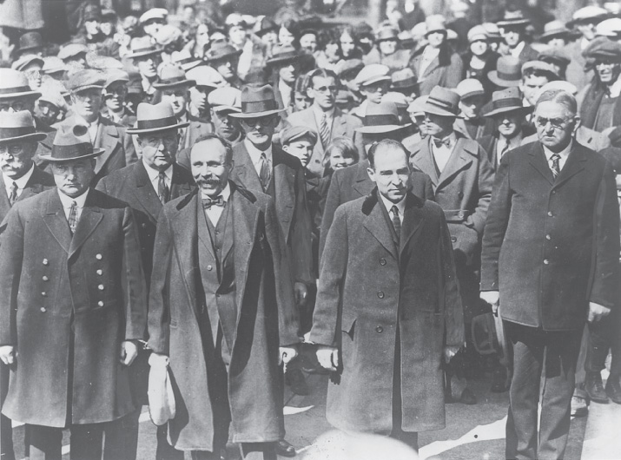
A 1927 photograph shows Nicola Sacco and Bartolomeo Vanzetti outside the courthouse in Dedham, Massachusetts, surrounded by security agents and onlookers. They are about to enter the courthouse, where the judge will pronounce their death sentence.

Slide 4
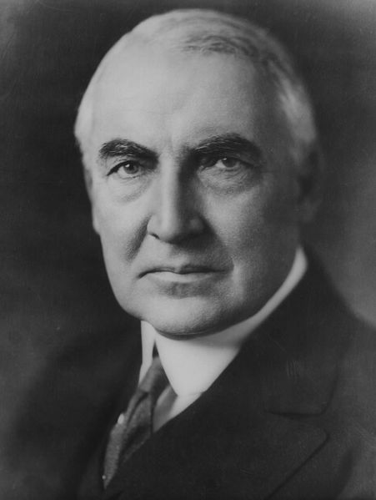
Presidents:
Woodrow Wilson, Democrat : World War I (1914 – 1918)
Election 1912 Served 1913 – 1916 Election 1916 Served 1917 – 1920
Background - http://www.biography.com/people/woodrow-wilson-9534272
Warren Harding, Republican:
Election of 1920 (1921 – 1923) Died in 1923 (heart attack) – VP Coolidge of VT becomes President
He was elected as the new President in 1921. World War I helped the economy. Factories expanded rapidly to meet the need for military supplies. When the war was over more than 2 million soldiers came home looking for jobs. At the same time factories stopped turning out materials. The result was a sharp recession, or economic slump.
Background - http://www.biography.com/people/warren-g-harding-9328336
Biography: (1:21) https://www.youtube.com/watch?v=Fqdd_qaUubk
Biography: (3:38) https://www.youtube.com/watch?v=Hq-Q88M5XbI

Slide 5
President Warren Harding (1921 – 193)
Promised a return to “normalcy” following an era of Progressive reform and WWI,
which meant a call for the regular order of things, without excessive reform
Scandals - extra-marital affairs, Administration riddled with crooks taking bribes
Teapot Dome Scandal – the secretary of interior, who received money in exchange for leasing government oil reserves to private companies
Video – C-Span 5:00: http://www.c-span.org/video/?73375-1/teapot-dome-scandal
Harding filled his cabinet positions with his old friends. The Teapot Dome Scandal, the 1st cabinet official was sent to prison for being involved in an oil bribery.
Harding died of a heart attack in 1923, Calvin Coolidge, the Vice President became the new President. Many believed Harding’s sudden death was attributed to the many scandals during his presidency.

Slide 6
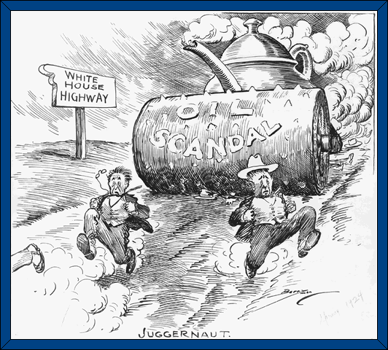
Teapot Dome
POLITICAL CARTOON
During the Teapot Dome scandal, people began to question the judgment and honesty of government leaders. This cartoon, called “Juggernaut,” was published in 1924 to show how harmful the scandal had been. A juggernaut is an indestructible force that crushes everything in its path.
What came to be known as the Teapot Dome scandal involved Secretary of the Interior Albert Fall, who accepted large sums of money and valuable gifts from private oil companies. In exchange, Fall allowed the companies to control government oil reserves in Elk Hills, California, and Teapot Dome, Wyoming. The U.S. Senate soon began investigating Fall was guilty of accepting bribes.
Image: A 1924 cartoon shows Washington officials fleeing in panic down an oil-slicked road to the White House, trying desperately to outpace the giant steamroller symbolizing the Teapot Dome scandal of President Warren G. Harding's administration.
How do the images in
the cartoon illustrate
the destructive force
of the scandal?
ANALYSIS
SKILL
Why do you think the artist called this cartoon
“Juggernaut”?

Slide 7
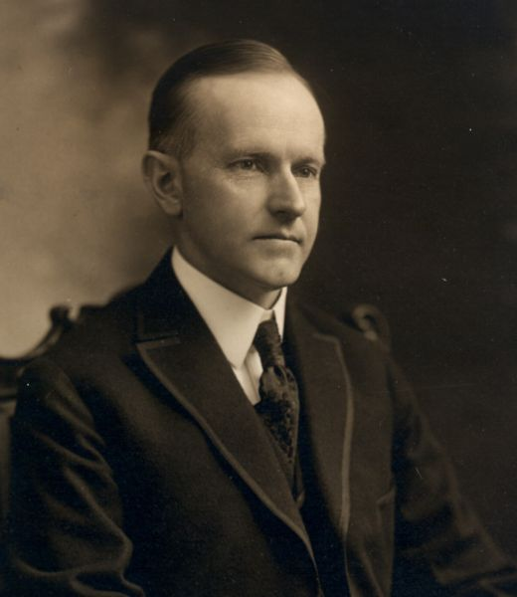
Presidents
Election 1924:
Calvin Coolidge, Republican
John Davis, Democrat
Robert La Follette, Progressive Party (1/6 of the electorate voted for him)
Video - http://www.biography.com/people/robert-m-la-follette-40226
President Calvin Coolidge: Election 1924 Served 1925 – 1928
Background - http://www.biography.com/people/calvin-coolidge-9256384?page=1
Herbert Hoover, Republican:
Election 1928 Served 1929 – 1932 Background - http://www.biography.com/people/herbert-hoover-9343371

Slide 8
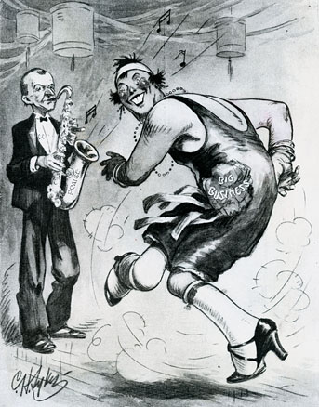
The policies of President Calvin Coolidge were music to the ears of big business, according to one 1920’s cartoonist.

Slide 9
The Business of America - A Decade of Prosperity
Economic Prosperity:
President Calvin Coolidge –
“The chief business of the American people is business,” said Calvin Coolidge, president after Warren G. Harding’s death in 1923
Economic expansion partnership between business and government, and business values seemed greater in the 1920s than at any previous point in American history. After the postwar recession receded in 1920, the decade was one of extraordinary prosperity.
Productivity and output skyrocketed - http://ecmweb.com/content/1920s-1920-1929
New industries- chemicals, electronics grew
Older industries - adopted Ford’s moving assembly line - Automobiles so stimulated economic growth that auto factories, not iron and steel mills, came to embody American industrial power.
Notes:
“The chief business of the American people,” said Calvin Coolidge, president after Warren G. Harding’s death in 1923, “is business.” Economic expansion, partnership between business and government, and business values seemed greater in the 1920s than at any previous point in American history. After the postwar recession receded in 1920, the decade was one of extraordinary prosperity. Productivity and output skyrocketed as new industries such as chemicals and electronics grew and older industries adopted Ford’s moving assembly line. Automobiles so stimulated economic growth that auto factories, not iron and steel mills, came to embody American industrial power. Car production tripled in the decade, General Motors surpassed Ford, and by 1929, half of American families owned cars. The auto industry sparked the growth of steel, rubber, oil production, road construction, and other economic sectors, and promoted tourism and the expansion of suburbs. In this decade, America’s multinational corporations also extended their penetration of international markets, the dollar became the most important currency in world trade, and American industry still led other nations in output.
In the 1920s, consumer goods for the first time became attainable by most Americans. Goods made available by credit and installment buying plans like vacuum cleaners, telephones, washing machines, and refrigerators transformed daily life. Advertising and marketing professionals found new ways to compel Americans to purchase items from the new industrial cornucopia. Americans spent more time on leisure activities, from vacations to sports and movies. Radios and phonographs brought mass entertainment into private homes and birthed a new celebrity culture. A French visitor, André Siegfried, wrote in 1928 that a “new society” had emerged in which Americans valued their “standard of living” above all else. Americans’ willingness to amass enormous debts in order to purchase consumer goods seemed to replace nineteenth-century values of thrift and self-denial. Work, once seen as a point of pride in skill or collective empowerment in trade unions, now seemed only a means to pursue individual fulfillment through consumption and entertainment.

Slide 10
The Business of America - A Decade of Prosperity
Automobiles - https://www.classzone.com/net_explorations/U7/U7_article4.cfm
Car production tripled in the decade
General Motors surpassed Ford, and by 1929, half of American families owned cars
Sparked the growth of steel, rubber, oil production, road construction, and other economic sectors, and promoted tourism and the expansion of suburbs.
Multinational Corporations –
General Electric, International Telephone & Telegraph, IBM, American control of rubber in Liberia and oil in Venzuela
http://www.americanforeignrelations.com/E-N/Multinational-Corporations-Expansion-1925-1930.html
America’s multinational corporations also extended to international markets
US dollar became the most important currency in world trade
American industry still led other nations in output.

Slide 11
Fordlandia –
Henry Ford carried on his tradition of Americanization (Immigrants in his US factories were subject to the critical eye of Ford’s sociological department)
Henry Ford created a town in the Brazil’s Amazon rainforest
2. Goal: cultivate rubber trees for rubber supply (car tires)
3. Local Workers: elevate to a “proper stands of life” (prohibit alcohol, tobacco, give up local diet for American diet
4. Unsuccessful due to destruction of rubber trees by insects, trees planted too close together
NPR, All Things Considered, audio 8 minutes: http://www.npr.org/templates/story/story.php?storyId=105068620
VIDEO - http://www.youtube.com/watch?v=3qYFKLDwrvU

Slide 12
A New Society
Consumer Goods –
1920’s consumer goods for the 1st time became attainable by most Americans
Credit - Goods made available by credit and installment buying plans
Goods: vacuum cleaners, telephones, washing machines, and refrigerators transformed daily life, Coca-Cola https://www.classzone.com/net_explorations/U7/U7_article3.cfm
Advertising and marketing - professionals found new ways to compel Americans to purchase items from the new industrial cornucopia.
Leisure Activities – vacations, sports, movies

Slide 13
A New Society
- Hollywood movies dominated production and culture: http://www.eyewitnesstohistory.com/gish.htm
Charlie Chaplin - http://www.charliechaplin.com/
Radios and phonographs https://www.classzone.com/net_explorations/U7/U7_article2.cfm
brought mass entertainment into private homes and spread a new celebrity culture.
Hays Code: 1922, the film industry adopted the Hays Code, a sporadically enforced set of guidelines that prohibited movies from depicting nudity, long kisses, adultery, and barred scripts that portrayed clergymen in a negative light or criminals sympathetically.

Slide 14
A New Society
André Siegfried, a French visitor, wrote in 1928 that a “new society” had emerged in which Americans valued their “standard of living” above all else.
Americans’ willingness to amass enormous debts in order to purchase consumer goods seemed to replace nineteenth-century values of thrift and self-denial.
Work, once seen as a point of pride in skill or collective empowerment in trade unions, now seemed only a means to pursue individual fulfillment through consumption and entertainment.

Slide 15
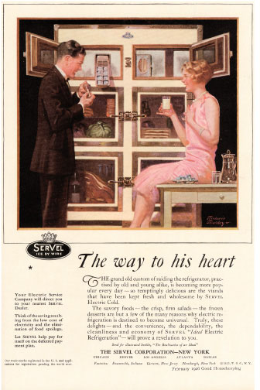
Advertisements, like this one for a refrigerator, promised that consumer goods
would enable Americans to fulfill their hearts’ desires.

Slide 16
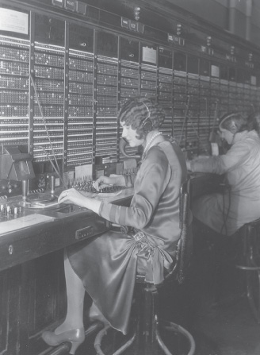
The spread of the telephone network hastened the nation’s integration and opened
further job opportunities for women. Lewis Hines photographed this telephone operator in the 1920’s.

Slide 17
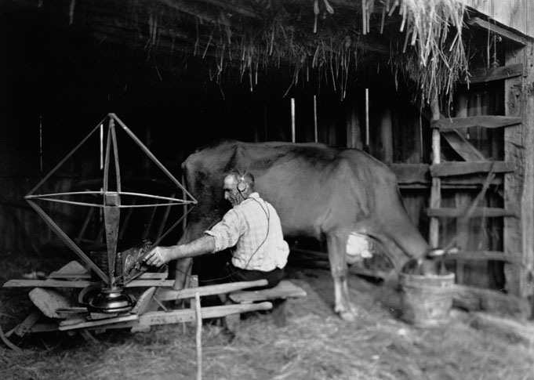
During the 1920s, radio penetrated virtually the entire country. In this photograph, a farmer tunes in to a program while milking a cow.

Slide 18
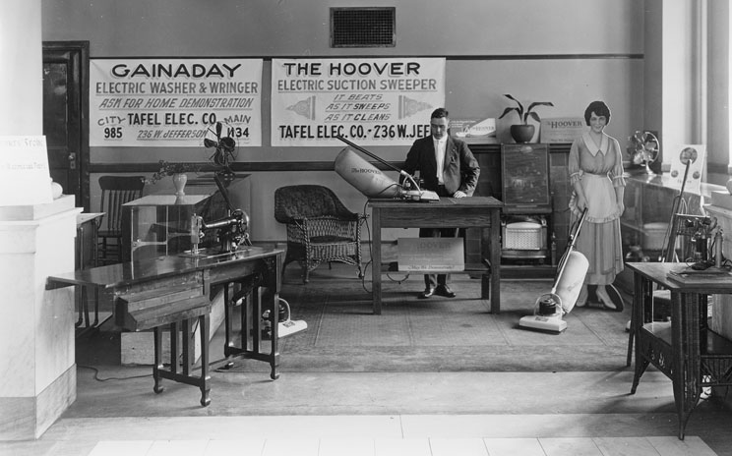
Electric washing machines and Hoover vacuum cleaners and Hoover vacuum cleaners were two of the home appliances that found their way into many American homes during the 1920’s. The woman on the right is a cardboard cutout.

Slide 19
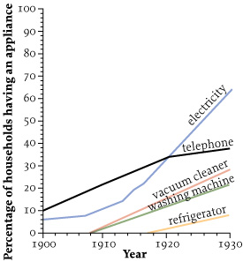
Figure 20.1 Household Appliances, 1900–1930
Give Me Liberty!: An American history, 3rd Edition
Copyright © 2011 W.W. Norton & Company

Slide 20
The Business of America Causes of the Great Depression
Limits of Prosperity
Decline of American Purchasing Power
The Purchasing Power of American consumers declined over time, causing a decrease in demand for goods, businesses then laid off workers due to decrease in demand for their products, causing further decreases in demand and an inability for Americans to purchase cars, washing machines, refrigerators, radios….snowballs out of control
Concentration of Wealth (Uneven Distribution of Wealth):
1922 – 1929 – Economic success was not shared by all
Despite the abundance of mass consumer society, the fruits of economic expansion were very unequally distributed.
Wages rose slightly for workers while Corporate Profits rose significantly
33% of all income was received by the top 5% richest Americans
A small number of businesses and banks controlled industry and finance
Richest people in the 1920’s http://www.victoriaclarkeadventures.com/production-blog/the-wealthiest-men-of-the-1920s
Notes:
Despite the abundance of mass consumer society, the fruits of economic expansion were very unequally distributed. Real wages rose by one-quarter between 1922 and 1929, but corporate profits rose at more than twice this rate, and economic concentration continued, with a smaller number of firms and banks controlling more of industry and finance. In early 1929, the share of national income of the wealthiest 5 percent of American families exceeded that of the bottom 60 percent, the majority of families had no savings, and 40 percent of Americans lived in poverty, unable to enjoy the new consumer economy. Improved productivity allowed goods to be made with fewer workers, and while employment grew in some sectors, such as the professions, retail, and education, manufacturing employment dropped significantly for the first time in American history. Deindustrialization began in the old industrial Northeast as business moved south to take advantage of cheaper and non-union labor.
Farmers were also excluded from prosperity. American agriculture had reached its zenith in World War I, when Europe’s need for food and government policies had kept farm prices high. But increasing mechanization and use of fertilizer and pesticides elevated output even as world demand stagnated, steadily reducing farm incomes and forcing tens of thousands of farm foreclosures. In the 1920s, for the first time in U.S. history, the number of farms and farmers declined. Extractive industries like mining and lumber also suffered from overproduction in the world market. Even before the 1930s, rural America was suffering from economic depression.

Slide 21
The Business of America - Causes of the Great Depression Limits of Prosperity
Lack of Wealth: early 1929
majority of families had no savings
40 % of Americans lived in poverty, unable to enjoy the new consumer economy
Excessive Use of Credit:
Middle Class Americans used credit to buy automobiles, washing machines …
When Americans were laid off, they were in debt from borrowing money to buy cars and other products and couldn’t pay back their loans
Caused consumers to default on loans & banks to fail

Slide 22
The Business of America - Causes of the Great Depression Limits of Prosperity
Production and Labor:
Improved productivity allowed goods to be made with fewer workers, and while employment grew in some sectors, such as the professions, retail, and education, manufacturing employment dropped significantly for the first time in American history.
Deindustrialization began in the old industrial Northeast as business moved south to take advantage of cheaper and non-union labor.
Laborers wages became stagnate, forcing them to not buy products or to buy on credit

Slide 23
The Business of America - Causes of the Great Depression Farmer’s Plight
Farmers were excluded from prosperity due to overproduction, high debt, and low farm prices.
http://www.americanhistoryusa.com/great-farm-depression-1920s/
Mechanization and farm innovations led to overproduction.
Demand for American farm products declined in Europe after WWI
Decline in Farm Incomes = Foreclosures (farmers can Not pay mortgages lose farms)
American agriculture had reached its zenith in World War I, when Europe’s need for food and government policies had kept farm prices high.
Increasing mechanization and use of fertilizer and pesticides elevated output even as world demand stagnated, steadily reducing farm incomes and forcing tens of thousands of farm foreclosures.
1920s, for the1st time in US history, the number of farms & farmers declined.
Extractive industries like mining and lumber also suffered from overproduction in the world market.
Even before the 1930s, rural America was suffering from economic depression.

Slide 24
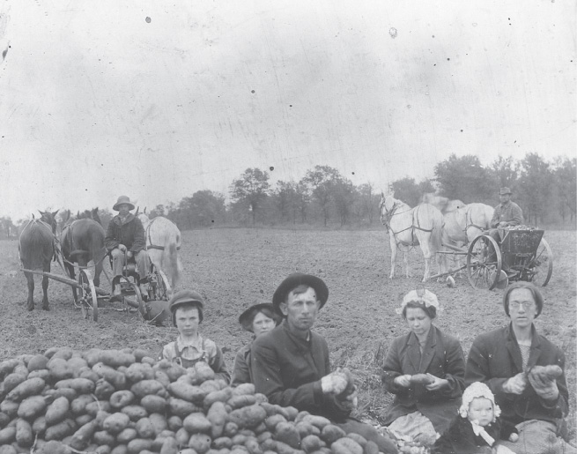
Farmers, like this family of potato growers in Rural Minnesota, did not share in the prosperity of the 1920’s.

Slide 25
The Business of America
Image of Business
American’s Image:
Although high unemployment crippled much of Europe in the 1920s, America’s high wages, efficient industry, and mass consumption projected a magical image of American wealth and permanent prosperity across the world.
Public Relations:
The Committee on Public Information’s propaganda campaigns during World War I persuaded advertisers that it was possible to “sway the minds of whole populations,” and many businesses established public relations departments to defend corporate practices and win a distrusting public.
They successfully changed public attitudes toward Wall Street.
Wall Street: origin video http://www.history.com/topics/new-york-city/videos/hidden-history-wall-street
background http://www.hermes-press.com/wshist1.htm
Pujo Investigation - Congressional hearings from 1912 to 1914 held by Louisiana congressman Arsène Pujo had exposed the big Wall Street’s banks’ manipulation of stock prices, and strengthened popular views that investors were fleeced in the stock market.
By the 1920s, however, with stock prices rising, the market gained more investors, and by 1928, 1.5 million Americans owned stock, more than at any previous time in U.S. history.
Notes:
Although high unemployment crippled much of Europe in the 1920s, America’s high wages, efficient industry, and mass consumption projected a magical image of American wealth and permanent prosperity across the world. The Committee on Public Information’s propaganda campaigns during World War I persuaded advertisers that it was possible to “sway the minds of whole populations,” and many businesses established public relations departments to defend corporate practices and win a distrusting public. They successfully changed public attitudes toward Wall Street. Congressional hearings from 1912 to 1914 held by Louisiana congressman Arsène Pujo had exposed the big Wall Street’s banks’ manipulation of stock prices, and strengthened popular views that investors were fleeced in the stock market. By the 1920s, however, with stock prices rising, the market gained more investors, and by 1928, 1.5 million Americans owned stock, more than at any previous time in U.S. history.
With the defeat of the 1919 labor revolt and the dissolution of wartime regulations, business used the language of Americanism and “industrial freedom” against unions. Some corporations in the 1920s adopted new styles of management, called “welfare capitalism,” in which they offered employees private pensions, medical insurance plans, job security, and leisure programs. These businesses celebrated their attention to the “human factor” in industry. But more employers adopted the “American Plan,” whose basis was the “open shop”—a workplace free of government regulation and unions (except, in some cases, “company unions” that were created and controlled by management). They believed collective bargaining infringed on the liberties of management, and argued that prosperity depended on complete freedom for business. Public relations campaigns linked unionism with socialism and sinister foreigners, and even progressive companies hired strikebreakers and detectives and blacklisted union members to prevent or defeat unions and strikes. In this hostile environment, unions lost more than 2 million members, and unions capitulated to employer demands in order to prevent their annihilation.

Slide 26
Stock Market Crash October 29, 1929
Rising Stock Prices in the 1920’s reflected the expanding economy
Stock prices rose for 18 consecutive months from March 1928- Oct. 1929)
Stock Exchange: a place where stocks are bought and sold (Wall Street, NYC)
Bank Credit and Loans were often used by consumers to buy shares of stock (Buying on the Margin)
Stock Market Speculation (gambling on stocks) and Buying on the Margin hurt investors in 1929 when the market declined
Panic ensued and investors sold their stock quickly, further causing a downward spiral
Stockholders lost over $40 billion

Slide 27
Stock Market Crash of 1929
How the Stock Exchange Works: (3:33) https://www.youtube.com/watch?v=F3QpgXBtDeo
History of the Stock Market: (1:47) https://www.youtube.com/watch?v=g9mYUt2wfJU
Causes of the Great Depression: (4:49) https://www.youtube.com/watch?v=Y5YPWRjSVJE

Slide 28
The Business of America
Decline of Labor
With the defeat of the 1919 labor revolt and the dissolution of wartime regulations, business used the language of Americanism and “industrial freedom” against unions.
Welfare Capitalism:
Some corporations in the 1920s adopted new styles of management, they offered employees private pensions, medical insurance plans, job security, and leisure programs.
These businesses celebrated their attention to the “human factor” in industry.
American Plan – “open shop”
More employers adopted the “American Plan,” whose basis was the “open shop”—a workplace free of government regulation and unions (except, in some cases, “company unions” that were created and controlled by management).
They believed collective bargaining infringed on the liberties of management, and argued that prosperity depended on complete freedom for business.
Unions Diminished:
Public relations campaigns linked unionism with socialism and sinister foreigners, and even progressive companies hired strikebreakers and detectives and blacklisted union members to prevent or defeat unions and strikes.
In this hostile environment, unions lost more than 2 million members, and unions capitulated to employer demands in order to prevent their annihilation.

Slide 29
The Business of America
Equal Rights Amendment
Suffrage in 1920 ended the ties of solidarity that had united various groups of women reformers.
Black feminists now insisted that the movement demand the enforcement of the Fifteenth Amendment in the South, but white activists offered little support.
Tradition Woman v Liberated Woman
Long-standing divisions between two competing conceptions of woman’s freedom—one based on motherhood, the other on individual autonomy and the right to work— now took shape in a debate over an Equal Rights Amendment (ERA) to the Constitution, advocated by Alice Paul and the National Woman’s Party.
Proposed amendment would eliminate all legal distinctions “on account of sex.”
Paul argued that now that women had the vote, they no longer needed special legal protections, and needed equal access to employment, education, and other opportunities.
Opposition:
But women reformers who supported mothers’ pension and laws limiting women’s work hours, which the ERA threatened to dismantle, vehemently opposed the ERA.
Every major women’s organization other than the National Woman’s Party opposed the ERA.
The ERA campaign failed, and in 1929, Congress repealed the Sheppard-Towner Act of 1921, which had offered federal assistance to programs for infant and child health. http://history.house.gov/HistoricalHighlight/Detail/36084?ret=True
Notes:
Like unions, feminists tried to adapt to the new conservative atmosphere of the 1920s. Suffrage in 1920 ended the ties of solidarity that had united various groups of women reformers. Black feminists now insisted that the movement demand the enforcement of the Fifteenth Amendment in the South, but white activists offered little support. Long-standing divisions between two competing conceptions of woman’s freedom—one based on motherhood, the other on individual autonomy and the right to work— now took shape in a debate over an Equal Rights Amendment (ERA) to the Constitution, advocated by Alice Paul and the National Woman’s Party. The proposed amendment would eliminate all legal distinctions “on account of sex.” Paul argued that now that women had the vote, they no longer needed special legal protections, and needed equal access to employment, education, and other opportunities. But women reformers who supported mothers’ pension and laws limiting women’s work hours, which the ERA threatened to dismantle, vehemently opposed the ERA. Every major women’s organization other than the National Woman’s Party opposed the ERA. The ERA campaign failed, and in 1929, Congress repealed the Sheppard-Towner Act of 1921, which had offered federal assistance to programs for infant and child health.
Prewar feminism’s emphasis on personal freedom blossomed in a growing consumer society, and women’s liberation became a lifestyle promoted by advertisers and mass entertainment, detached from political or social radicalism. Sexual freedom now meant individual autonomy or personal rebellion. The young, single “flapper” who smoked and danced, sported short hair and skirts, and used new birth-control devices, came to symbolize the “new woman.”

Slide 30
Flapper
Prewar feminism’s emphasis on personal freedom blossomed in a growing consumer society, and women’s liberation became a lifestyle promoted by advertisers and mass entertainment, detached from political or social radicalism.
Sexual freedom now meant individual autonomy or personal rebellion.
The young, single “flapper” who smoked and danced, sported short hair and skirts, and used new birth-control devices, came to symbolize the “new woman.”
Video 2:29 http://video.about.com/history1900s/Flapper-Music.htm
Video 3:37 - http://www.youtube.com/watch?v=pVE5IWCHLF0

Slide 31
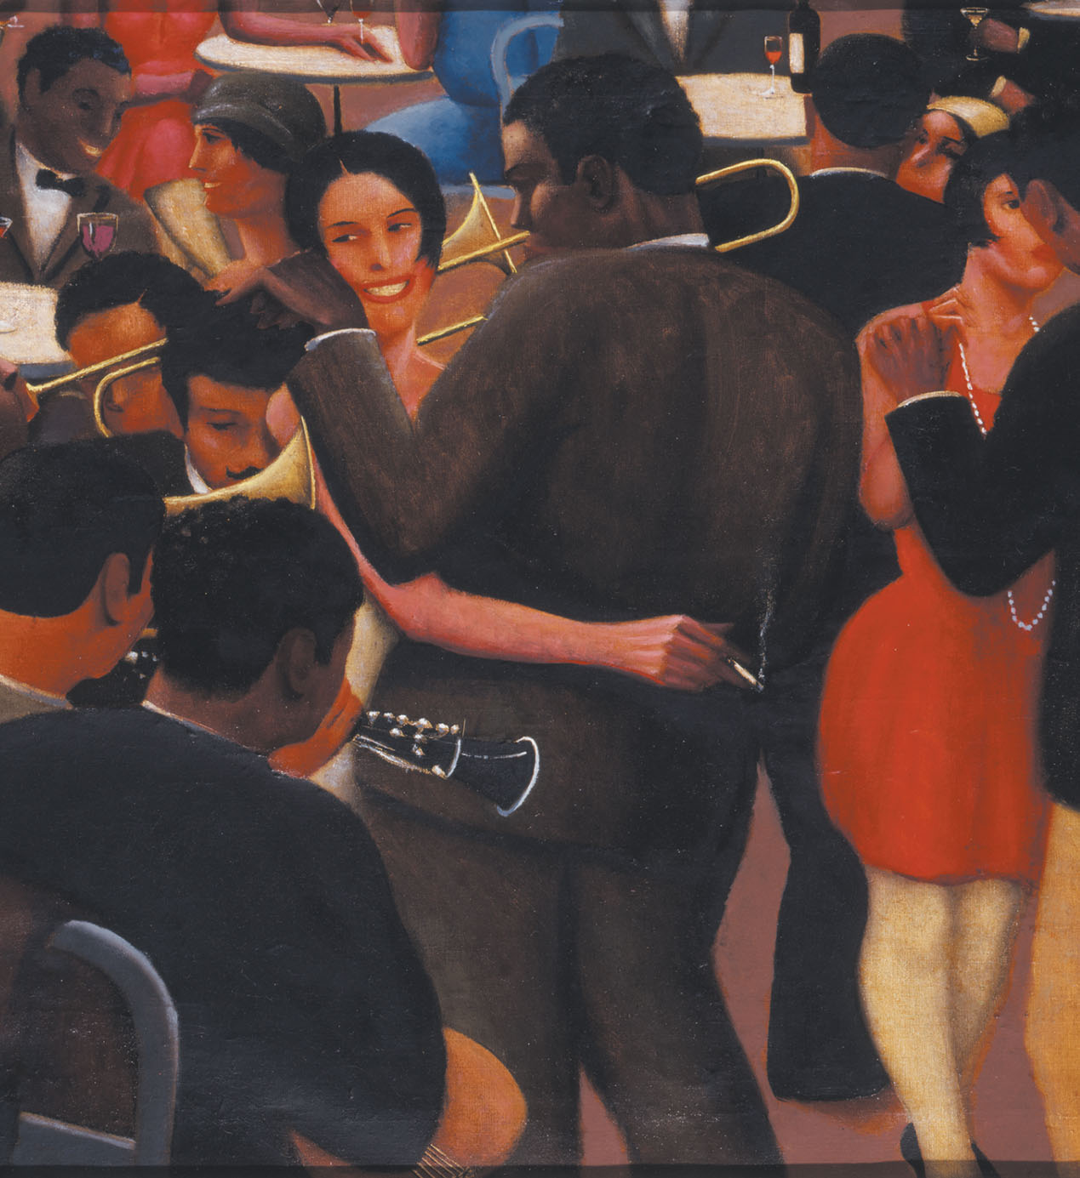
Blues, a 1929 painting by Archibald Motley Jr., depicts one side of the 1920s: dance halls, jazz bands, and drinking despite the advent of Prohibition

Slide 32
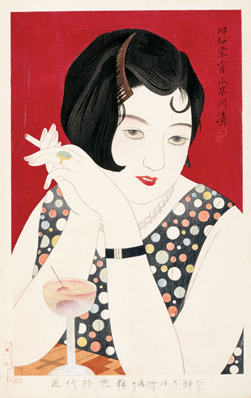
Tipsy, a 1930 painting by the Japanese artist Kobayakawa Kiyoshi, illustrates the global appeal of the “new woman” of the 1920’s. The subject, a moga (“modern girl” in Japanese), sits alone in a nightclub wearing Western clothing, makeup, and hairstyle, accompanied by a cigarette and a martini.

Slide 33
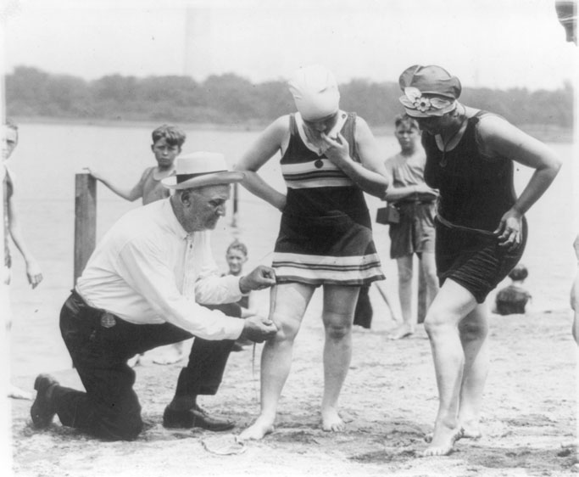
Many American authorities were no more welcoming to “new women.” The superintendent of public buildings and grounds in Washington D.C., decreed that women’s bathing suits must fall no higher than six inches above the knee. Here, in 1922, he enforces his edict.

Slide 34
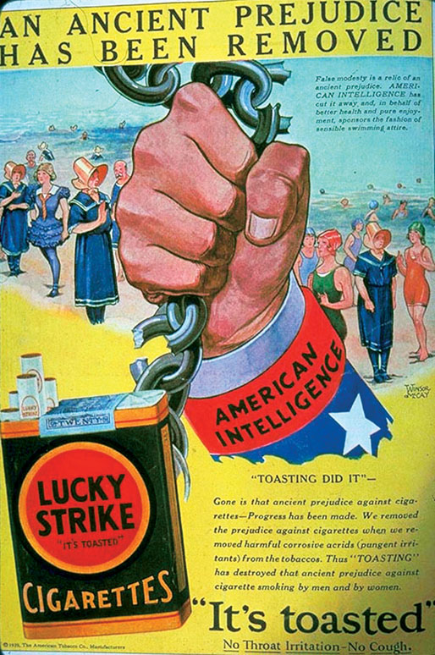
Advertisers marketed cigarettes to women as symbols of female independence. This 1929 ad for Lucky Srike reads: “Legally, politically and socially, woman has been emancipated from those chains which bound her…Gone is that ancient prejudice against cigarettes.”

Slide 35
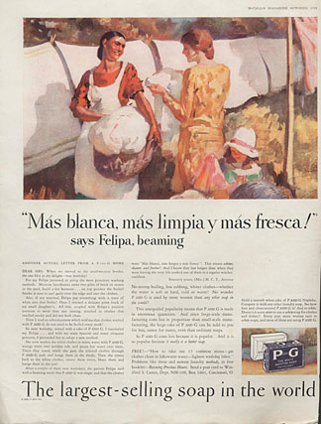
An ad for Procter & Gamble laundry detergent urges modern women to modernize the methods of their employees. The text relates how a white woman in the Southwest persuaded Felipa, her Mexican-American domestic worker, to abandon her “primitive washing methods.” Felipa, according to the ad, agrees that the laundry is now “whiter, cleaner, and fresher.”

Slide 36
Business and Government
Progressivism disintegrated in the 1920s. Government success in creating mass hysteria during the war appeared to erode the foundation of democracy—the rational, self-directed citizen. Sigmund Freud pointed to the unconscious, instinctual basis of human behavior. IQ tests seemed to show that many American were mentally unfit for self-government.
In the 1920s, Walter Lippman published two incisive critiques of democracy, Public Opinion and The Phantom Public, in which he repudiated Progressive beliefs that “intelligence” could solve social problems in a mass democracy. Lippman argued that American voters were ill-informed, irrational, and failed to scrutinize policies or candidates; most problems, he argued, were beyond the understanding of ordinary men and women. The independent citizen was a myth. The government, journalists, and advertisers, he suggested, had perfected the art of creating and manipulating public opinion—what Lippman called the “manufacture of consent.” In 1929, sociologists Robert and Helen Lynd published Middletown, a study of life in Muncie, Indiana, a typical Midwestern community. They found that leisure and consumption had replaced politics as the center of public life, and declining voter participation, among other indicators, confirmed their observations.
Notes:
Progressivism disintegrated in the 1920s. Government success in creating mass hysteria during the war appeared to erode the foundation of democracy—the rational, self-directed citizen. Sigmund Freud pointed to the unconscious, instinctual basis of human behavior. IQ tests seemed to show that many American were mentally unfit for self-government.
In the 1920s, Walter Lippman published two incisive critiques of democracy, Public Opinion and The Phantom Public, in which he repudiated Progressive beliefs that “intelligence” could solve social problems in a mass democracy. Lippman argued that American voters were ill-informed, irrational, and failed to scrutinize policies or candidates; most problems, he argued, were beyond the understanding of ordinary men and women. The independent citizen was a myth. The government, journalists, and advertisers, he suggested, had perfected the art of creating and manipulating public opinion—what Lippman called the “manufacture of consent.” In 1929, sociologists Robert and Helen Lynd published Middletown, a study of life in Muncie, Indiana, a typical Midwestern community. They found that leisure and consumption had replaced politics as the center of public life, and declining voter participation, among other indicators, confirmed their observations.

Slide 37
Business and Government
Government policy reflected the pro-business climate of the decade. Business lobbyists dominated national Republican Party conventions, calling on the federal government to lower taxes on personal incomes and corporate profits, maintain high tariffs, and reinforce employers’ anti-union campaigns. To some, Presidents Warren G. Harding and Calvin Coolidge appointed so many pro-business members of the Federal Reserve Board, Federal Trade Commission, and other Progressive-Era agencies that they seemed to repeal the regulatory state altogether. The government resumed issuing court injunctions to halt strikes, as it did with the walkout of 250,000 railroad workers in 1922. Under William H. Taft, appointed chief justice in 1921, the Supreme Court stayed extremely conservative, and a return to laissez-faire jurisprudence diminished Progressive policies that had enhanced federal power. In 1923, the Court struck down Muller v. Oregon in a decision that overturned a minimum wage law for women in the nation’s capital.
The administration of the lackluster president Warren G. Harding became one of the most corrupt in the nation’s history. Although his cabinet had a few men of talent and integrity, such as Secretary of State Charles Evans Hughes and Secretary of Commerce Herbert Hoover, Harding appointed cronies who used their office for private gain. The most famous of several corruption scandals involved the leasing of government oil reserves to businessmen at Teapot Dome, Wyoming, by secretary of the interior Albert Fall, who was paid $500,000 for his services. As a result, Fall became the first cabinet member in history to receive a felony conviction.
Notes:
Government policy reflected the pro-business climate of the decade. Business lobbyists dominated national Republican Party conventions, calling on the federal government to lower taxes on personal incomes and corporate profits, maintain high tariffs, and reinforce employers’ anti-union campaigns. To some, Presidents Warren G. Harding and Calvin Coolidge appointed so many pro-business members of the Federal Reserve Board, Federal Trade Commission, and other Progressive-Era agencies that they seemed to repeal the regulatory state altogether. The government resumed issuing court injunctions to halt strikes, as it did with the walkout of 250,000 railroad workers in 1922. Under William H. Taft, appointed chief justice in 1921, the Supreme Court stayed extremely conservative, and a return to laissez-faire jurisprudence diminished Progressive policies that had enhanced federal power. In 1923, the Court struck down Muller v. Oregon in a decision that overturned a minimum wage law for women in the nation’s capital.
The administration of the lackluster president Warren G. Harding became one of the most corrupt in the nation’s history. Although his cabinet had a few men of talent and integrity, such as Secretary of State Charles Evans Hughes and Secretary of Commerce Herbert Hoover, Harding appointed cronies who used their office for private gain. The most famous of several corruption scandals involved the leasing of government oil reserves to businessmen at Teapot Dome, Wyoming, by secretary of the interior Albert Fall, who was paid $500,000 for his services. As a result, Fall became the first cabinet member in history to receive a felony conviction.

Slide 38
Business and Government
Harding’s successor, Calvin Coolidge, who won fame as Massachusetts’ governor for using state troops to end a Boston policemen’s strike in 1919, was uncharismatic, but compared to Harding seemed an honest Yankee. Coolidge continued Harding’s policies, without the corruption and scandal. In 1924, Coolidge was re-elected by a huge margin, defeating Democratic candidate John W. Davis, a Wall Street lawyer who had been nominated by a badly divided Democratic convention. One-sixth of the electorate in 1924 voted for Robert La Follette, the candidate of a new Progressive Party whose platform called for higher taxes on wealth, public ownership of railroads, farm relief, and a ban on child labor. Coolidge described the Progressive platform as a plan for a “communistic and socialistic” America. La Follette won the endorsements of Progressives like Jane Addams and the American Federation of Labor, but raised little money, and he carried only Wisconsin. But his candidacy showed that discontent persisted under the surface of prosperity and conservatism.
Foreign affairs also reflected the alliance between business and government. The decade saw a retreat from Wilsonian internationalism toward unilateral American actions mostly intended to boost exports and investment opportunities abroad. The so-called “isolationism” of the 1920s was a reaction against disappointments over Wilson’s aggressive military and diplomatic stance. The United States hosted the Washington Naval Arms Conference of 1922, which secured smaller navies for Britain, France, Japan, Italy, and the United States. But the country stayed outside the League of Nations, and American tariffs were raised to their highest levels in history, repudiating Wilson’s commitment to free trade.
Foreign policy was largely developed in private economic relationships rather than government activity. The United States emerged from World War I as the world’s major manufacturing and financial power. In the 1920s, New York bankers, sometime acting alone and sometimes with help from the Harding and Coolidge administrations, made huge loans to European and Latin American governments. American industrial firms, especially in auto, agricultural machinery, and electrical equipment manufacturing, established overseas plants to supply the world market and find cheaper labor. American investors gained control over raw materials such as copper in Chile, and oil in Venezuela. When American economic interests seemed threatened, the government sent in the troops—invading once more in Nicaragua to suppress a nationalist revolt.
Notes:
Harding’s successor, Calvin Coolidge, who won fame as Massachusetts’ governor for using state troops to end a Boston policemen’s strike in 1919, was uncharismatic, but compared to Harding seemed an honest Yankee. Coolidge continued Harding’s policies, without the corruption and scandal. In 1924, Coolidge was re-elected by a huge margin, defeating Democratic candidate John W. Davis, a Wall Street lawyer who had been nominated by a badly divided Democratic convention. One-sixth of the electorate in 1924 voted for Robert La Follette, the candidate of a new Progressive Party whose platform called for higher taxes on wealth, public ownership of railroads, farm relief, and a ban on child labor. Coolidge described the Progressive platform as a plan for a “communistic and socialistic” America. La Follette won the endorsements of Progressives like Jane Addams and the American Federation of Labor, but raised little money, and he carried only Wisconsin. But his candidacy showed that discontent persisted under the surface of prosperity and conservatism.
Foreign affairs also reflected the alliance between business and government. The decade saw a retreat from Wilsonian internationalism toward unilateral American actions mostly intended to boost exports and investment opportunities abroad. The so-called “isolationism” of the 1920s was a reaction against disappointments over Wilson’s aggressive military and diplomatic stance. The United States hosted the Washington Naval Arms Conference of 1922, which secured smaller navies for Britain, France, Japan, Italy, and the United States. But the country stayed outside the League of Nations, and American tariffs were raised to their highest levels in history, repudiating Wilson’s commitment to free trade.
Foreign policy was largely developed in private economic relationships rather than government activity. The United States emerged from World War I as the world’s major manufacturing and financial power. In the 1920s, New York bankers, sometime acting alone and sometimes with help from the Harding and Coolidge administrations, made huge loans to European and Latin American governments. American industrial firms, especially in auto, agricultural machinery, and electrical equipment manufacturing, established overseas plants to supply the world market and find cheaper labor. American investors gained control over raw materials such as copper in Chile, and oil in Venezuela. When American economic interests seemed threatened, the government sent in the troops—invading once more in Nicaragua to suppress a nationalist revolt.

Slide 39
The Birth of Civil Liberties
Wartime and postwar repression, Prohibition, and pro-business policies in wartime and the 1920s damaged Progressives’ belief that the federal government could represent national purpose and enhance freedom. Progressives gained a new appreciation of civil liberties—rights that an individual may assert even against democratic majorities—as fundamental features of American freedom. Reformers now encouraged open and democratic debate and in the 1920s, and a coherent concept of civil liberties and legal protections for freedom of speech against the government began to emerge.
Wartime and postwar repression persisted in the 1920s. Lynchings continued, and people endorsing free speech or radical doctrines were arrested and attacked by authorities and private citizens. Government agencies such as the Postal and Customs Services censored books considered obscene. A “Watch and Ward Committee” in Boston excluded dozens of books from bookstores, including works by novelists Upton Sinclair, Theodore Dreiser, and Ernest Hemingway. Movie producers feared that scandals involving actors might reinforce beliefs that movies promoted immorality, and in 1922, the film industry adopted the Hays code, which barred movies from depicting nudity, adultery, and long kisses. Only in 1951 would the Supreme Court offer First Amendment protections for film.
Though more and more Europeans consumed American popular culture, some began to see America as culturally vapid. The British novelist D. H. Lawrence, who lived briefly in the United States, said that America might take pride in being the “land of the free,” but “the free mob” had destroyed the right to dissent. American artists dissatisfied with America’s conservatism and materialism (and wanted to drink legally) migrated to Paris.
Notes:
Wartime and postwar repression, Prohibition, and pro-business policies in wartime and the 1920s damaged Progressives’ belief that the federal government could represent national purpose and enhance freedom. Progressives gained a new appreciation of civil liberties—rights that an individual may assert even against democratic majorities—as fundamental features of American freedom. Reformers now encouraged open and democratic debate and in the 1920s, and a coherent concept of civil liberties and legal protections for freedom of speech against the government began to emerge.
Wartime and postwar repression persisted in the 1920s. Lynchings continued, and people endorsing free speech or radical doctrines were arrested and attacked by authorities and private citizens. Government agencies such as the Postal and Customs Services censored books considered obscene. A “Watch and Ward Committee” in Boston excluded dozens of books from bookstores, including works by novelists Upton Sinclair, Theodore Dreiser, and Ernest Hemingway. Movie producers feared that scandals involving actors might reinforce beliefs that movies promoted immorality, and in 1922, the film industry adopted the Hays code, which barred movies from depicting nudity, adultery, and long kisses. Only in 1951 would the Supreme Court offer First Amendment protections for film.
Though more and more Europeans consumed American popular culture, some began to see America as culturally vapid. The British novelist D. H. Lawrence, who lived briefly in the United States, said that America might take pride in being the “land of the free,” but “the free mob” had destroyed the right to dissent. American artists dissatisfied with America’s conservatism and materialism (and wanted to drink legally) migrated to Paris.

Slide 40
The Birth of Civil Liberties
The concern for civil liberties grew from the arrests of anti-war dissenters under the Espionage and Sedition Acts, which inspired the formation of a group in 1917 that three years later became the American Civil Liberties Union (ACLU). For the rest of the twentieth century, the ACLU took on many of the important legal cases that established the “rights revolution” in America. The ACLU helped inject meaning into traditional liberties such as freedom of speech, and invented new rights such as the right to privacy. But the ACLU began as a coalition of pacifists, Progressives, and lawyers outraged by the violation of Americans’ rights by the government during World War I.
Before the war, the Supreme Court had done little to protect the rights of unpopular minorities. Initially the Court itself restricted civil liberties. In 1919, the Court upheld the constitutionality of the Espionage Act and the conviction of Charles T. Schenck, a socialist who sent anti-draft leaflets through the mails. Justice Oliver Wendell Holmes spoke for the Court when he declared that the First Amendment did not prevent Congress from prohibiting speech that presented a “clear and present danger” of inspiring illegal activity. Free speech “would not protect a man in falsely shouting fire in a theater and causing a panic.” This became the basis of Supreme Court decisions in future Supreme Court cases, but since it allowed public officials to determine what kind of speech was “dangerous,” it proved an arbitrary doctrine.
In 1919, the Court also upheld the conviction of Jacob Abrams and five other men for passing out pamphlets criticizing America’s military intervention in Russia after the Bolshevik Revolution. But a minority dissented, forming the basis for future defenses of free speech as necessary in the “great marketplace of ideas” later on that decade. By the end of the 1920s, the Court had invalidated state laws making it illegal to advocate unlawful acts or changes in the political or economic system.
Notes:
Concern for civil liberties grew from the arrests of anti-war dissenters under the Espionage and Sedition Acts, which inspired the formation of a group in 1917 that three years later became the American Civil Liberties Union (ACLU). For the rest of the twentieth century, the ACLU took on many of the important legal cases that established the “rights revolution” in America. The ACLU helped inject meaning into traditional liberties such as freedom of speech, and invented new rights such as the right to privacy. But the ACLU began as a coalition of pacifists, Progressives, and lawyers outraged by the violation of Americans’ rights by the government during World War I.
Before the war, the Supreme Court had done little to protect the rights of unpopular minorities. Initially the Court itself restricted civil liberties. In 1919, the Court upheld the constitutionality of the Espionage Act and the conviction of Charles T. Schenck, a socialist who sent anti-draft leaflets through the mails. Justice Oliver Wendell Holmes spoke for the Court when he declared that the First Amendment did not prevent Congress from prohibiting speech that presented a “clear and present danger” of inspiring illegal activity. Free speech “would not protect a man in falsely shouting fire in a theater and causing a panic.” This became the basis of Supreme Court decisions in future Supreme Court cases, but since it allowed public officials to determine what kind of speech was “dangerous,” it proved an arbitrary doctrine.
In 1919, the Court also upheld the conviction of Jacob Abrams and five other men for passing out pamphlets criticizing America’s military intervention in Russia after the Bolshevik Revolution. But a minority dissented, forming the basis for future defenses of free speech as necessary in the “great marketplace of ideas” later on that decade. By the end of the 1920s, the Court had invalidated state laws making it illegal to advocate unlawful acts or changes in the political or economic system.

Slide 41
The Culture Wars
Not all Americans embraced modern urban culture and its religious and ethnic pluralism, mass entertainment, and sexual liberation. Evangelical Protestants felt threatened by an apparent decline in traditional values and the increased visibility of Catholicism and Judaism caused by immigration. They also opposed “modernists” within Protestant denominations who wanted to integrate science and religion and adapt Christianity to the new secular culture. Fundamentalists, convinced that the Bible’s literal truth was the basis of Christian doctrine, started campaigns to exorcise modernism from Christianity and restrict individual freedoms. Billy Sunday, a professional baseball player who became a revivalist preacher, was perhaps the best known of the fundamentalists, and he may have preached to as many as 100 million people with messages damning Darwinism and drink. Fundamentalism flowered both in rural and urban areas, and it succeeded, through Prohibition, in reducing alcohol consumption in many places. But many Americans saw prohibition as a violation of their personal freedoms. Prohibition also earned huge profits for those who trafficked in illegal alcohol, and it made for pervasive government corruption.
A 1925 trial in Tennessee exposed the division between traditionalism and modern, secular culture. John Scopes, a public school teacher, was arrested for violating a state law that prohibited the teaching of Charles Darwin’s theory of evolution. His trial attracted national attention, and was carried live on national radio. To fundamentalist Christians, the idea that humans had evolved over millions of years from simian ancestors contradicted the Bible’s account of creation. To Scope’s defenders, including the ACLU, freedom meant the right to independent thought and self-expression, and Tennessee’s law showed the dangers of mixing church and state. The well-known labor lawyer Clarence Darrow defended Scopes and created a sensation when he called William Jennings Bryan to the stand as an “expert witness” on the Bible. Bryan showed a near-complete ignorance of modern science and an inability to deflect Darrow’s sarcastic interrogation regarding the factual accuracy of biblical stories. Embarrassed, Bryan died shortly after the trial ended in a guilty verdict for Scopes (though the decision was later overturned), and the movement for anti-evolution state laws expired.
Notes:
Not all Americans embraced modern urban culture and its religious and ethnic pluralism, mass entertainment, and sexual liberation. Evangelical Protestants felt threatened by an apparent decline in traditional values and the increased visibility of Catholicism and Judaism caused by immigration. They also opposed “modernists” within Protestant denominations who wanted to integrate science and religion and adapt Christianity to the new secular culture. Fundamentalists, convinced that the Bible’s literal truth was the basis of Christian doctrine, started campaigns to exorcise modernism from Christianity and restrict individual freedoms. Billy Sunday, a professional baseball player who became a revivalist preacher, was perhaps the best known of the fundamentalists, and he may have preached to as many as 100 million people with messages damning Darwinism and drink. Fundamentalism flowered both in rural and urban areas, and it succeeded, through Prohibition, in reducing alcohol consumption in many places. But many Americans saw prohibition as a violation of their personal freedoms. Prohibition also earned huge profits for those who trafficked in illegal alcohol, and it made for pervasive government corruption.
A 1925 trial in Tennessee exposed the division between traditionalism and modern, secular culture. John Scopes, a public school teacher, was arrested for violating a state law that prohibited the teaching of Charles Darwin’s theory of evolution. His trial attracted national attention, and was carried live on national radio. To fundamentalist Christians, the idea that humans had evolved over millions of years from simian ancestors contradicted the Bible’s account of creation. To Scope’s defenders, including the ACLU, freedom meant the right to independent thought and self-expression, and Tennessee’s law showed the dangers of mixing church and state. The well-known labor lawyer Clarence Darrow defended Scopes and created a sensation when he called William Jennings Bryan to the stand as an “expert witness” on the Bible. Bryan showed a near-complete ignorance of modern science and an inability to deflect Darrow’s sarcastic interrogation regarding the factual accuracy of biblical stories. Embarrassed, Bryan died shortly after the trial ended in a guilty verdict for Scopes (though the decision was later overturned), and the movement for anti-evolution state laws expired.

Slide 42
The Culture Wars
Many rural and small-town native-born Protestants found immigrants and their culture strange and threatening. Wartime demands for “100% Americanism” persisted in the 1920s in public policy and behavior. The most militant expression of beliefs that American freedom’s enjoyment should be limited according to religion and ethnicity was the rebirth of the Ku Klux Klan in the early 1920s. By the mid-1920s, the group claimed more than 3 million members, almost all white and native-born Protestants, many of whom were not in the South but in the North and West. Going beyond attacks on blacks, the new Klan targeted immigrants, especially Jews and Catholics, and other forces (feminism, unions, immorality) that seemed to threaten American civilization and “individual liberty.”
Although the Klan’s influence waned by the end of the decade, its attacks on modern secularism and political radicalism and its insistence that control of the nation be given back to “citizens of the old stock” represented popular sentiments. Many new laws transformed national identity and citizenship with newly exclusive definitions and restrictions. Immigration policy most represented this shift. Restrictions on immigration were nothing new, with the Naturalization Act of 1790 barring non-whites from migration, and the exclusion of various groups after 1875, including prostitutes and anarchists. But before World War I, the nation’s doors were open to almost all white persons.
In the 1920s, pressures for immigration restriction became overwhelming, signaled more than anything by the decline in the traditional opposition to restriction from employers, who had welcomed a large labor supply as a check on higher wages. Fears of immigrant-based political radicalism now outweighed demands for cheap labor, which employers found in African-Americans who had left the South. A 1921 law restricted immigration from Europe to 357,000 per year. In 1924, Congress imposed a permanent limitation on European immigration to 150,000 per year, distributed according to a series of national quotas that sharply restricted the numbers from southern and eastern Europe—intended to ensure that the descendants of the old immigrants would always outnumber those of the new. The 1924 law barred entry of all those ineligible for naturalized citizenship—all Asians, except for Filipinos, who were designated “American nationals.” But Congress in 1934 established a timetable for the Philippines’ independence, largely as a way to end immigration. The 1924 law for the first time effectively created the category of the “illegal alien.”
Notes:
Many rural and small-town native-born Protestants found immigrants and their culture strange and threatening. Wartime demands for “100% Americanism” persisted in the 1920s in public policy and behavior. The most militant expression of beliefs that American freedom’s enjoyment should be limited according to religion and ethnicity was the rebirth of the Ku Klux Klan in the early 1920s. By the mid-1920s, the group claimed more than 3 million members, almost all white and native-born Protestants, many of whom were not in the South but in the North and West. Going beyond attacks on blacks, the new Klan targeted immigrants, especially Jews and Catholics, and other forces (feminism, unions, immorality) that seemed to threaten American civilization and “individual liberty.”
Although the Klan’s influence waned by the end of the decade, its attacks on modern secularism and political radicalism and its insistence that control of the nation be given back to “citizens of the old stock” represented popular sentiments. Many new laws transformed national identity and citizenship with newly exclusive definitions and restrictions. Immigration policy most represented this shift. Restrictions on immigration were nothing new, with the Naturalization Act of 1790 barring non-whites from migration, and the exclusion of various groups after 1875, including prostitutes and anarchists. But before World War I, the nation’s doors were open to almost all white persons.
In the 1920s, pressures for immigration restriction became overwhelming, signaled more than anything by the decline in the traditional opposition to restriction from employers, who had welcomed a large labor supply as a check on higher wages. Fears of immigrant-based political radicalism now outweighed demands for cheap labor, which employers found in African-Americans who had left the South. A 1921 law restricted immigration from Europe to 357,000 per year. In 1924, Congress imposed a permanent limitation on European immigration to 150,000 per year, distributed according to a series of national quotas that sharply restricted the numbers from southern and eastern Europe—intended to ensure that the descendants of the old immigrants would always outnumber those of the new. The 1924 law barred entry of all those ineligible for naturalized citizenship—all Asians, except for Filipinos, who were designated “American nationals.” But Congress in 1934 established a timetable for the Philippines’ independence, largely as a way to end immigration. The 1924 law for the first time effectively created the category of the “illegal alien.”

Slide 43
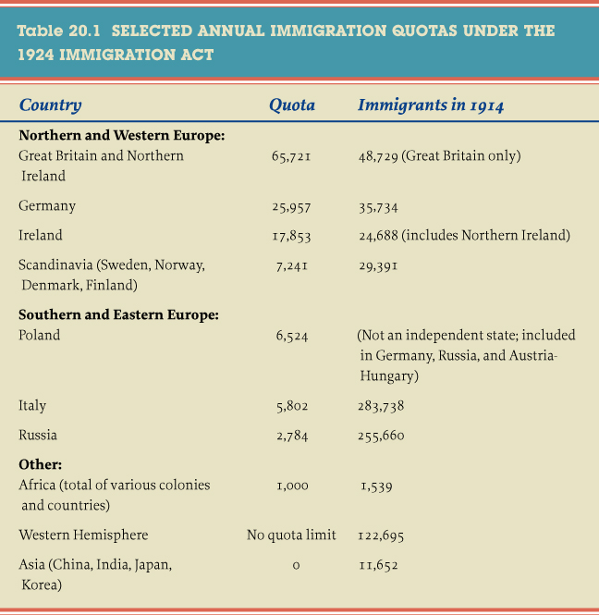
Table 20.1 Selected Annual Immigration
Give Me Liberty!: An American history, 3rd Edition
Copyright © 2011 W.W. Norton & Company

Slide 44
The Culture Wars
The new immigration law demonstrated the intensified influence of “race” on public policy. By the early 1920s, both northern and southern political leaders agreed that blacks should be second-class citizens. But “race policy” did not just concern blacks but who would be “American,” particularly in regard to immigration. President Coolidge’s secretary of labor, James J. Davis, argued that immigration policy, while once based on labor needs and the idea of America as an asylum of liberty, should now rest on a biological definition of the ideal population. The law also reflected Progressive interests in improving the “quality” of democratic citizenship, and showed that Progressive goals were infused with pseudo-scientific ideas about the superiority and inferiority of particular “races.” The Supreme Court admitted that the entire concept of race, used to determine the immigration quotas, lacked a scientific basis, when it rejected the claims of an Indian-born World War I veteran who wanted to become naturalized that he was a “pure Aryan” and therefore white. The Court argued that “white” was not a scientific concept but part of “common speech, to be interpreted with the understanding of the common man.”
Notes:
The new immigration law demonstrated the intensified influence of “race” on public policy. By the early 1920s, both northern and southern political leaders agreed that blacks should be second-class citizens. But “race policy” did not just concern blacks but who would be “American,” particularly in regard to immigration. President Coolidge’s secretary of labor, James J. Davis, argued that immigration policy, while once based on labor needs and the idea of America as an asylum of liberty, should now rest on a biological definition of the ideal population. The law also reflected Progressive interests in improving the “quality” of democratic citizenship, and showed that Progressive goals were infused with pseudo-scientific ideas about the superiority and inferiority of particular “races.” The Supreme Court admitted that the entire concept of race, used to determine the immigration quotas, lacked a scientific basis, when it rejected the claims of an Indian-born World War I veteran who wanted to become naturalized that he was a “pure Aryan” and therefore white. The Court argued that “white” was not a scientific concept but part of “common speech, to be interpreted with the understanding of the common man.”

Slide 45
The Culture Wars
Some Americans resisted the notion that southern and eastern Europeans could not become citizens or could only do so by adopting Anglo-Saxon culture. Horace Kallen, of German-Jewish origins, coined the phrase “cultural pluralism” to describe a society that celebrated ethnic diversity instead of suppressing it. Kallen argued that toleration of difference was uniquely American. Anthropologists such as Franz Boas and Ruth Benedict insisted that no basis existed in science for theories of racial superiority or a hierarchy of civilizations. But these had little effect on public policy. The new immigrants themselves were the best advocates of a pluralist America. Each ethnic group established its own ethnic enclaves with their own institutions, churches, theaters, and newspapers. Nevertheless, they were integrated into American culture through mass consumption and mass culture.
Immigrant groups facing Prohibition, the Klan, and widespread anti-Semitism and anti-Catholicism affirmed the validity of cultural diversity and defined the toleration of difference as an essential quality of American freedom. They reinvented themselves as “ethnic” Americans, claiming an equal right to participate in American life while remaining culturally distinct. Catholics and Jews celebrated their religious and ethnic culture without surrendering their belief that they should not experience discrimination or bigotry in public life. The Supreme Court helped secure this shift in law by striking down a Nebraska statute prohibiting instruction in languages other than English, a law intended to ban German from education.
Notes:
Some Americans resisted the notion that southern and eastern Europeans could not become citizens or could only do so by adopting Anglo-Saxon culture. Horace Kallen, of German-Jewish origins, coined the phrase “cultural pluralism” to describe a society that celebrated ethnic diversity instead of suppressing it. Kallen argued that toleration of difference was uniquely American. Anthropologists such as Franz Boas and Ruth Benedict insisted that no basis existed in science for theories of racial superiority or a hierarchy of civilizations. But these had little effect on public policy. The new immigrants themselves were the best advocates of a pluralist America. Each ethnic group established its own ethnic enclaves with their own institutions, churches, theaters, and newspapers. Nevertheless, they were integrated into American culture through mass consumption and mass culture.
Immigrant groups facing Prohibition, the Klan, and widespread anti-Semitism and anti-Catholicism affirmed the validity of cultural diversity and defined the toleration of difference as an essential quality of American freedom. They reinvented themselves as “ethnic” Americans, claiming an equal right to participate in American life while remaining culturally distinct. Catholics and Jews celebrated their religious and ethnic culture without surrendering their belief that they should not experience discrimination or bigotry in public life. The Supreme Court helped secure this shift in law by striking down a Nebraska statute prohibiting instruction in languages other than English, a law intended to ban German from education.

Slide 46
The Culture Wars
The decade also saw a rising black self-consciousness, especially in the North’s urban ghettoes. Almost 1 million blacks had left the South in the Great Migration, moving to New York, Chicago, and countless smaller cities. Harlem in New York became a center of African-American life, attracting migrants from the South and the West Indies, among whom were many well-educated professional and white-collar workers who were shocked by American racism. Whites “slummed” in Harlem, visiting its dance halls, jazz clubs, and speakeasies, contributing to depictions of Harlem as a place of primitive passions. But the real Harlem was a place of poverty and low-wage work created and reinforced by housing discrimination.
Harlem contained a dynamic black cultural community with connections to New York’s artistic mainstream. Poets and novelists like Langston Hughes and Claude McKay were sponsored by white intellectuals and published by white presses, and Broadway for the first time presented black actors in serious roles and black singers. In art, the term “New Negro” meant rejecting established stereotypes and a search for black values to replace them. This led the writers of what became called the Harlem Renaissance to the roots of the black experience, in Africa, the rural South’s folk culture, and life in the urban ghetto.
Notes:
The decade also saw a rising black self-consciousness, especially in the North’s urban ghettoes. Almost 1 million blacks had left the South in the Great Migration, moving to New York, Chicago, and countless smaller cities. Harlem in New York became a center of African-American life, attracting migrants from the South and the West Indies, among whom were many well-educated professional and white-collar workers who were shocked by American racism. Whites “slummed” in Harlem, visiting its dance halls, jazz clubs, and speakeasies, contributing to depictions of Harlem as a place of primitive passions. But the real Harlem was a place of poverty and low-wage work created and reinforced by housing discrimination.
Harlem contained a dynamic black cultural community with connections to New York’s artistic mainstream. Poets and novelists like Langston Hughes and Claude McKay were sponsored by white intellectuals and published by white presses, and Broadway for the first time presented black actors in serious roles and black singers. In art, the term “New Negro” meant rejecting established stereotypes and a search for black values to replace them. This led the writers of what became called the Harlem Renaissance to the roots of the black experience, in Africa, the rural South’s folk culture, and life in the urban ghetto.

Slide 47
Scopes Trial
Who: John Scopes, a Biology teacher
Where: Dayton, Tennessee 1925
What: Accused of violating state law which prohibited teaching the theory of evolution
Significance: Nationally observed as religious fundamentalism
Traditionalists (Religious Fundamentalists): worried about societies lack of morals and opposed teaching evolution, support creationism
Modernists: support evolution

Slide 48
Scopes “monkey” trial
ACLU (American Civil Liberties Union)
organization founded during World War I to protest the suppression of freedom of expression in wartime
Played a major role in major court cases which protected American civil liberties
Teamed with attorney Clarence Darrow to defend Scopes
Scopes intentionally taught evolution to challenge the Tennessee law banning it

Slide 49
Scopes Trial
Defense: Clarence Darrow, ACLU
Prosecutors: William Jennings Bryan Presidential Candidate for Democrats, Populism in 1896, 1900, 1908 Secretary of State for Woodrow Wilson (1913-1915)
Verdict: Scopes was found guilty Supreme Court overturned verdict based on a trial error
Significance:
Evolution wouldn’t reappear in science books until the 1960’s
Evolution and its scientific backing became a public discussion
Reflected the struggle between Fundamentalists and Modernists in an era with significant social change
Video (4:40) https://www.youtube.com/watch?v=vzp3n51phHg

Slide 50
The Great Depression
Herbert Hoover seemed destined for a successful term as president. The son of an Iowa blacksmith and schoolteacher, Hoover made a fortune as a mining engineer in Asia, Africa, and Europe. He became famous for coordinating food relief in Europe during World War I. Hoover exemplified what was called the “new era” of American capitalism. In 1922, while secretary of commerce, Hoover published American Individualism, in which he condemned government regulation as an interference with the economic opportunities of ordinary Americans. Yet he also argued that self-interest should be subordinated to public interest. Hoover thought himself a Progressive, but he preferred what he termed “associational action,” in which private agencies directed regulatory and welfare policies, to government intervention in economy.
When Coolidge declined to run for president, Hoover won the Republican nomination, celebrated the era’s prosperity, and promised an end to poverty. He faced Democrat Alfred E. Smith, the first Catholic presidential nominee of a major party. Smith had been born into poverty on New York’s Lower East Side, became a Tammany Hall politician, and although Irish, emerged as the spokesman for the new immigrants. The Triangle Shirtwaist fire caused him to support Progressive social legislation, and in his three terms as New York’s governor secured laws limiting working hours for women and children. Smith denounced the Red Scare and called for Prohibition’s repeal. The Democratic platform substantially differed from the Republicans’ only on the issue of prohibition. Smith’s Catholicism became the primary campaign issue, and symbolized a cultural clash between native-born Protestant whites and the new immigrants. Although Hoover was elected by 58% of the vote, riding on the prosperity of the decade, Smith’s campaign, which won the support of urban voters and farmers, laid the basis for the triumphant Democratic coalition of the 1930s.
Notes:
Herbert Hoover seemed destined for a successful term as president. The son of an Iowa blacksmith and schoolteacher, Hoover made a fortune as a mining engineer in Asia, Africa, and Europe. He became famous for coordinating food relief in Europe during World War I. Hoover exemplified what was called the “new era” of American capitalism. In 1922, while secretary of commerce, Hoover published American Individualism, in which he condemned government regulation as an interference with the economic opportunities of ordinary Americans. Yet he also argued that self-interest should be subordinated to public interest. Hoover thought himself a Progressive, but he preferred what he termed “associational action,” in which private agencies directed regulatory and welfare policies, to government intervention in economy.
When Coolidge declined to run for president, Hoover won the Republican nomination, celebrated the era’s prosperity, and promised an end to poverty. He faced Democrat Alfred E. Smith, the first Catholic presidential nominee of a major party. Smith had been born into poverty on New York’s Lower East Side, became a Tammany Hall politician, and although Irish, emerged as the spokesman for the new immigrants. The Triangle Shirtwaist fire caused him to support Progressive social legislation, and in his three terms as New York’s governor secured laws limiting working hours for women and children. Smith denounced the Red Scare and called for Prohibition’s repeal. The Democratic platform substantially differed from the Republicans’ only on the issue of prohibition. Smith’s Catholicism became the primary campaign issue, and symbolized a cultural clash between native-born Protestant whites and the new immigrants. Although Hoover was elected by 58% of the vote, riding on the prosperity of the decade, Smith’s campaign, which won the support of urban voters and farmers, laid the basis for the triumphant Democratic coalition of the 1930s.

Slide 51
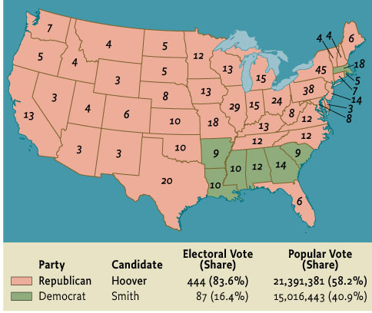
Map 20.1 The Presidential Election of 1928
Give Me Liberty!: An American history, 3rd Edition
Copyright © 2011 W.W. Norton & Company

Slide 52
The Great Depression
On October 29, 1929, soon known as Black Tuesday, the stock market crashed. A panic ensured, and in five hours $10 billion in market value disappeared. The United States quickly found itself in the Great Depression, the greatest economic calamity in modern history.
Signals of impending disaster were visible before October, 1929. Southern California and Florida had experienced spectacular real-estate booms and busts which resulted in failed banks and foreclosed mortgages. The highly unequal distribution of income and persistent depression in farming areas reduced Americans’ purchasing power. Sales of new autos and household consumer goods stagnated after 1926, and European demand for American goods also declined. A fall in the stock market bubble that had been created in the 1920s by speculators was inevitable, but when it happened, it was so severe that it destroyed many investment companies, wiping out thousands of investors and squelching consumer confidence. Around 26,000 businesses failed in 1930, and those that survived cut back on employment and investment. The gold standard-based financial system could not effectively meet the downturn; Germany defaulted on its reparations payments to France and Britain, which in turn stopped repaying debts to the U.S. Banks failed throughout the world as depositors withdrew money, and millions of families lost their life savings.
Stocks momentarily rebounded but soon resumed their precipitous decline. In 1932, the economy hit rock bottom, with GNP down by a third, prices down by 40 percent, and more than 11 million workers—25 percent of the labor force—unemployed. Those who had jobs faced reduced wages and hours. Every industrial economy suffered, but the United States was hit hardest. The Depression quickly transformed American’s lives, as hundreds of thousands took to the road to look for work, stood in bread lines, erected shack cities called “Hoovervilles,” and cities exhausted their poor relief. The Depression actually reversed the long-standing migration of Americans from farms to cities, as people tried to find land to grow food for their families. The suicide rate rose to its highest level in American history, and the birthrate dropped to its lowest. Also damaged was the public image of big business and Wall Street, which were shown to have thrived on the shady dealings, such as the sale of worthless bonds.
Notes:
On October 29, 1929, soon known as Black Tuesday, the stock market crashed. A panic ensured, and in five hours $10 billion in market value disappeared. The United States quickly found itself in the Great Depression, the greatest economic calamity in modern history.
Signals of impending disaster were visible before October, 1929. Southern California and Florida had experienced spectacular real-estate booms and busts which resulted in failed banks and foreclosed mortgages. The highly unequal distribution of income and persistent depression in farming areas reduced Americans’ purchasing power. Sales of new autos and household consumer goods stagnated after 1926, and European demand for American goods also declined. A fall in the stock market bubble that had been created in the 1920s by speculators was inevitable, but when it happened, it was so severe that it destroyed many investment companies, wiping out thousands of investors and squelching consumer confidence. Around 26,000 businesses failed in 1930, and those that survived cut back on employment and investment. The gold standard-based financial system could not effectively meet the downturn; Germany defaulted on its reparations payments to France and Britain, which in turn stopped repaying debts to the U.S. Banks failed throughout the world as depositors withdrew money, and millions of families lost their life savings.
Stocks momentarily rebounded but soon resumed their precipitous decline. In 1932, the economy hit rock bottom, with GNP down by a third, prices down by 40 percent, and more than 11 million workers—25 percent of the labor force—unemployed. Those who had jobs faced reduced wages and hours. Every industrial economy suffered, but the United States was hit hardest. The Depression quickly transformed American’s lives, as hundreds of thousands took to the road to look for work, stood in bread lines, erected shack cities called “Hoovervilles,” and cities exhausted their poor relief. The Depression actually reversed the long-standing migration of Americans from farms to cities, as people tried to find land to grow food for their families. The suicide rate rose to its highest level in American history, and the birthrate dropped to its lowest. Also damaged was the public image of big business and Wall Street, which were shown to have thrived on the shady dealings, such as the sale of worthless bonds.

Slide 53
The Great Depression
Many Americans responded to the Depression with resignation or blamed themselves for their economic woes. Others responded with protests that were at first spontaneous and lacking in coordination, because the unions, socialist groups and others that might have led them had been devastated in the 1920s. In early 1932, 20,000 unemployed World War I veterans who marched on Washington to demand early payment of a bonus due in 1945 were dispersed by federal troops. Throughout America, demonstrations of the unemployed demanded work and relief. Farmers protested low prices by temporarily blocking roads to prevent goods from getting to market. The small Communist Party was the only group that seemed able to channel and direct the discontent. Communists formed unemployed councils that organized marches, demonstrated for public assistance, and opposed evictions of unemployed families. The newspapers worried that America was close to revolution.
To many Americans, President Hoover’s response to the Depression seemed inadequate and lacking in compassion. His advisors told him that depressions were a normal function of capitalism that removed uncompetitive firms and encouraged moral virtue among the unfortunate. Businessmen vehemently opposed federal assistance to the jobless and many suggested that individuals would survive the depression through thrift. Federal policymakers who had never faced an economic crisis of this magnitude did not realize how consumer spending supported much of the economy. Most did not believe that federal assistance to the unemployed would spur economic recovery. Hoover maintained his commitment to “associational action,” strongly opposed direct federal economic intervention, and believed that private charity and voluntary action by business to keep up investment and employment would suffice. He called together business and labor leaders and established commissions to encourage firms to coordinate maintaining prices and wages without government regulation. Hoover’s public reassurances that the economy was recovering clashed with reality and made him seem ignorant of the problems facing many ordinary Americans.
Notes:
Many Americans responded to the Depression with resignation or blamed themselves for their economic woes. Others responded with protests that were at first spontaneous and lacking in coordination, because the unions, socialist groups and others that might have led them had been devastated in the 1920s. In early 1932, 20,000 unemployed World War I veterans who marched on Washington to demand early payment of a bonus due in 1945 were dispersed by federal troops. Throughout America, demonstrations of the unemployed demanded work and relief. Farmers protested low prices by temporarily blocking roads to prevent goods from getting to market. The small Communist Party was the only group that seemed able to channel and direct the discontent. Communists formed unemployed councils that organized marches, demonstrated for public assistance, and opposed evictions of unemployed families. The newspapers worried that America was close to revolution.
To many Americans, President Hoover’s response to the Depression seemed inadequate and lacking in compassion. His advisors told him that depressions were a normal function of capitalism that removed uncompetitive firms and encouraged moral virtue among the unfortunate. Businessmen vehemently opposed federal assistance to the jobless and many suggested that individuals would survive the depression through thrift. Federal policymakers who had never faced an economic crisis of this magnitude did not realize how consumer spending supported much of the economy. Most did not believe that federal assistance to the unemployed would spur economic recovery. Hoover maintained his commitment to “associational action,” strongly opposed direct federal economic intervention, and believed that private charity and voluntary action by business to keep up investment and employment would suffice. He called together business and labor leaders and established commissions to encourage firms to coordinate maintaining prices and wages without government regulation. Hoover’s public reassurances that the economy was recovering clashed with reality and made him seem ignorant of the problems facing many ordinary Americans.

Slide 54
The Great Depression
Some of Hoover’s actions, such as the Hawley-Smoot Tariff, which raised already high taxes on imported goods, caused other nations to retaliate, and decreased international trade, exacerbated the crisis. A tax increase Hoover won from Congress in order to balance the budget further reduced consumers’ purchasing power. By 1932, even Hoover conceded that voluntary measures were insufficient. He signed laws creating the Reconstruction Finance Corporation, which loaned money to failing banks, railroads, and other businesses, and the Federal Home Loan Bank System, which gave aid to homeowners threatened with foreclosure. Although he had vetoed bills to create employment with public-works projects like road and bridge construction, he now approved $2 billion for such projects and local relief. But Hoover refused to do anything further, including direct aid to the unemployed which, he told Congress, would be a “disservice” to the jobless.
In the mid-1920s, some intellectuals had worried that the prevailing notion of freedom in America celebrated unbound economic enterprise yet accepted limits on free speech and expression and other civil liberties. Though the prosperity of the 1920s reinforced this laissez-faire conception of freedom, the Great Depression and Hoover’s failed response discredited it. By 1932, the basis for a new conception of freedom based on Progressive-style positive state action in the economy and a respect for civil liberties, and cultural pluralism was already present and would become the foundation of modern twentieth century liberalism.
Notes:
Some of Hoover’s actions, such as the Hawley-Smoot Tariff, which raised already high taxes on imported goods, caused other nations to retaliate, and decreased international trade, exacerbated the crisis. A tax increase Hoover won from Congress in order to balance the budget further reduced consumers’ purchasing power. By 1932, even Hoover conceded that voluntary measures were insufficient. He signed laws creating the Reconstruction Finance Corporation, which loaned money to failing banks, railroads, and other businesses, and the Federal Home Loan Bank System, which gave aid to homeowners threatened with foreclosure. Although he had vetoed bills to create employment with public-works projects like road and bridge construction, he now approved $2 billion for such projects and local relief. But Hoover refused to do anything further, including direct aid to the unemployed which, he told Congress, would be a “disservice” to the jobless.
In the mid-1920s, some intellectuals had worried that the prevailing notion of freedom in America celebrated unbound economic enterprise yet accepted limits on free speech and expression and other civil liberties. Though the prosperity of the 1920s reinforced this laissez-faire conception of freedom, the Great Depression and Hoover’s failed response discredited it. By 1932, the basis for a new conception of freedom based on Progressive-style positive state action in the economy and a respect for civil liberties, and cultural pluralism was already present and would become the foundation of modern twentieth century liberalism.

Slide 55
Great Depression - Main Causes -
Declining American Purchasing Power:
Sales in autos and consumer goods stagnated after 1926
Farmers experience an agricultural recession
Unequal distribution of wealth
Land speculation in Florida

Slide 56
Additional Art for Chapter 20

Slide 57
Blues, a 1929 painting by Archibald Motley Jr., depicts
one side of the 1920s:
Give Me Liberty!: An American history, 3rd Edition
Copyright © 2011 W.W. Norton & Company

Slide 58
A 1927 photograph shows Nicola Sacco
and Bartolomeo Vanzetti
Give Me Liberty!: An American history, 3rd Edition
Copyright © 2011 W.W. Norton & Company

Slide 59
Advertisements, like this one for a refrigerator,
promised that consumer goods
Give Me Liberty!: An American history, 3rd Edition
Copyright © 2011 W.W. Norton & Company

Slide 60
The spread of the telephone network
Give Me Liberty!: An American history, 3rd Edition
Copyright © 2011 W.W. Norton & Company

Slide 61
During the 1920s, radio penetrated virtually
the entire country.
Give Me Liberty!: An American history, 3rd Edition
Copyright © 2011 W.W. Norton & Company

Slide 62
Electric washing machines and Hoover
vacuum cleaners
Give Me Liberty!: An American history, 3rd Edition
Copyright © 2011 W.W. Norton & Company

Slide 63
Figure 20.1 Household Appliances, 1900–1930
Give Me Liberty!: An American history, 3rd Edition
Copyright © 2011 W.W. Norton & Company

Slide 64
Farmers, like this family of potato growers in
Rural Minnesota
Give Me Liberty!: An American history, 3rd Edition
Copyright © 2011 W.W. Norton & Company

Slide 65
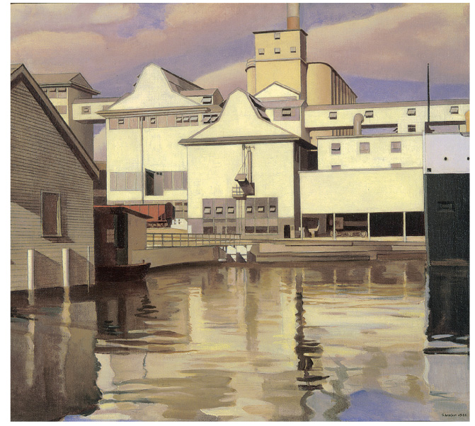
River Rouge Plant
Give Me Liberty!: An American history, 3rd Edition
Copyright © 2011 W.W. Norton & Company

Slide 66
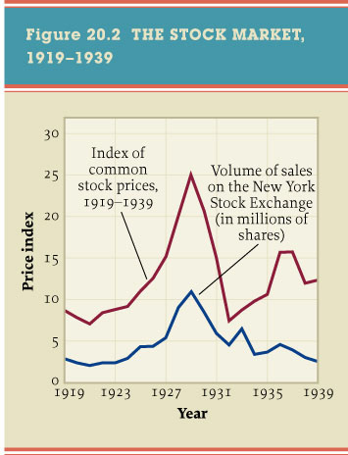
Figure 20.2 The Stock Market, 1919-1939
Give Me Liberty!: An American history, 3rd Edition
Copyright © 2011 W.W. Norton & Company

Slide 67
Tipsy, a 1930 painting by the Japanese
artist Kobayakawa Kiyoshi
Give Me Liberty!: An American history, 3rd Edition
Copyright © 2011 W.W. Norton & Company

Slide 68
Many American authorities were no more
welcoming to “new women.”
Give Me Liberty!: An American history, 3rd Edition
Copyright © 2011 W.W. Norton & Company

Slide 69
Advertisers marketed cigarettes to women as symbols
of female independence.
Give Me Liberty!: An American history, 3rd Edition
Copyright © 2011 W.W. Norton & Company

Slide 70
An ad for Procter & Gamble laundry detergent
Urges modern women to modernize the methods
of their employees.
Give Me Liberty!: An American history, 3rd Edition
Copyright © 2011 W.W. Norton & Company

Slide 71
The policies of President Calvin Coolidge
were music to the ears of big business
Give Me Liberty!: An American history, 3rd Edition
Copyright © 2011 W.W. Norton & Company

Slide 72
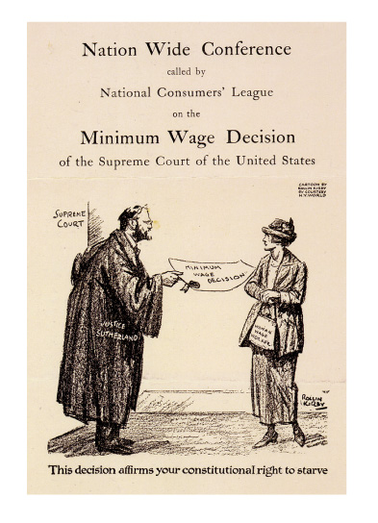
“This decision affirms your
constitutional right to starve.”
Give Me Liberty!: An American history, 3rd Edition
Copyright © 2011 W.W. Norton & Company

Slide 73
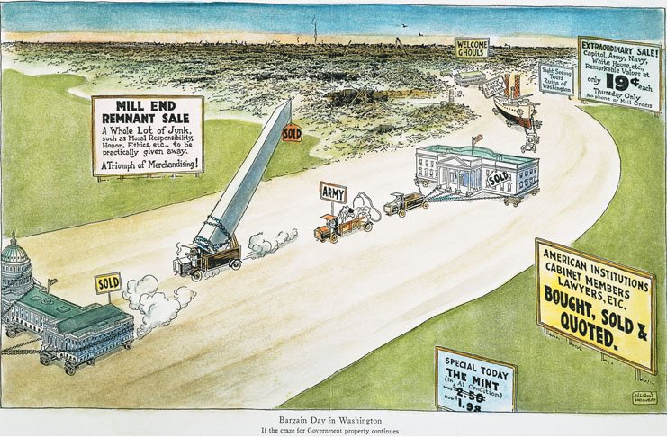
A 1924 cartoon commenting on the scandals of the
Harding administration.
Give Me Liberty!: An American history, 3rd Edition
Copyright © 2011 W.W. Norton & Company

Slide 74
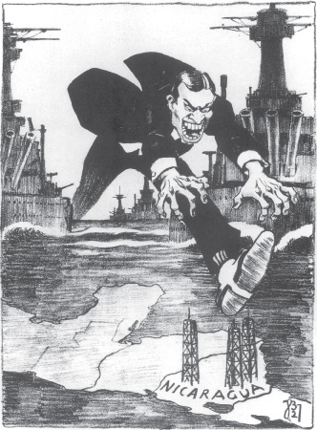
A German cartoon inspired by President Calvin Coolidge’s
dispatch of American troops to Nicaragua.
Give Me Liberty!: An American history, 3rd Edition
Copyright © 2011 W.W. Norton & Company

Slide 75
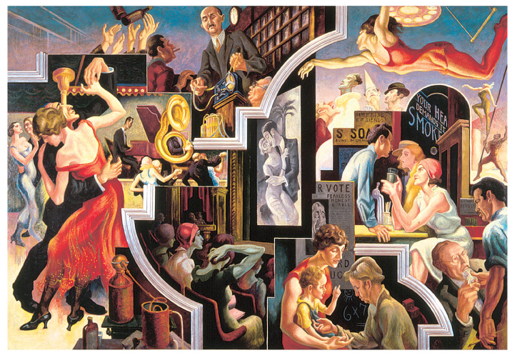
City Activities with Dance Hall.
Give Me Liberty!: An American history, 3rd Edition
Copyright © 2011 W.W. Norton & Company

Slide 76
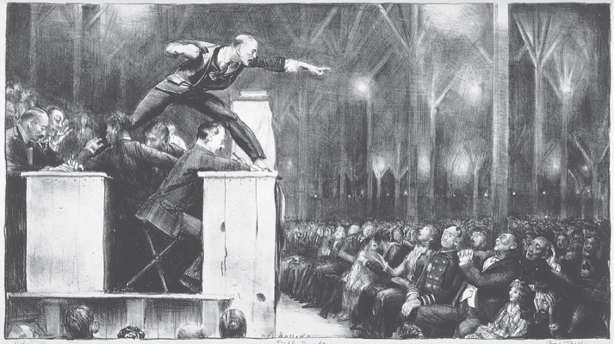
A 1923 lithograph by George Bellows
Give Me Liberty!: An American history, 3rd Edition
Copyright © 2011 W.W. Norton & Company

Slide 77
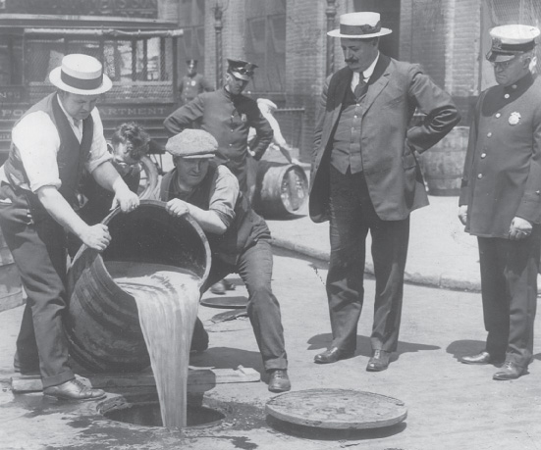
Federal agents pour confiscated liquor into
a sewer in 1920
Give Me Liberty!: An American history, 3rd Edition
Copyright © 2011 W.W. Norton & Company

Slide 78
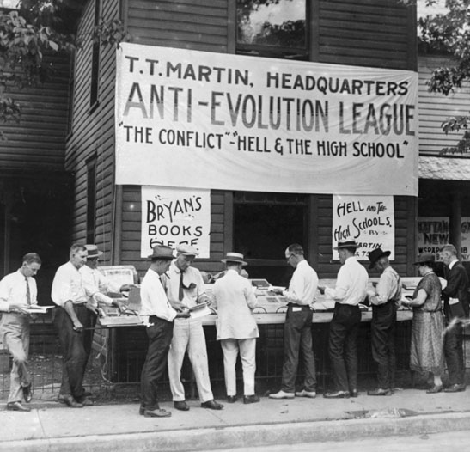
The Anti-Evolution League selling its
publications outside the Tennessee
Give Me Liberty!: An American history, 3rd Edition
Copyright © 2011 W.W. Norton & Company

Slide 79
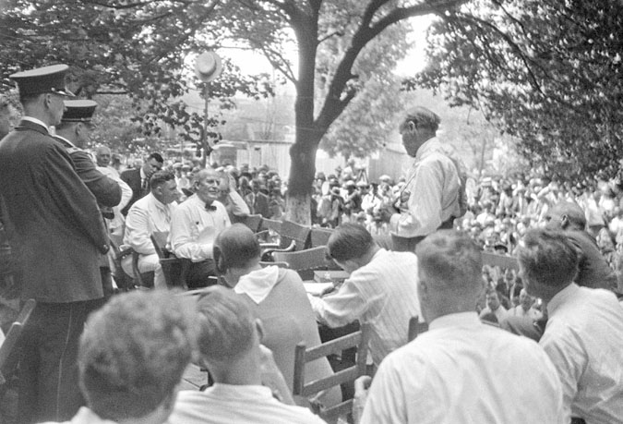
Because of extreme heat, some sessions of
the Scopes trial were held outdoors
Give Me Liberty!: An American history, 3rd Edition
Copyright © 2011 W.W. Norton & Company

Slide 80
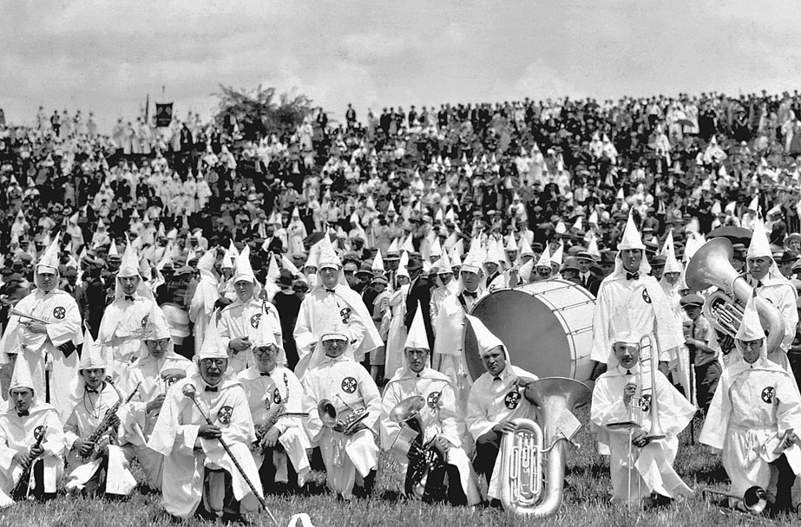
A Ku Klux Klan gathering in Jackson
Give Me Liberty!: An American history, 3rd Edition
Copyright © 2011 W.W. Norton & Company

Slide 81
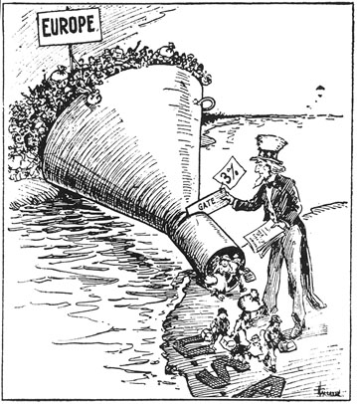
The Only Way to Handle It, a cartoon endorsing
immigration restriction.
Give Me Liberty!: An American history, 3rd Edition
Copyright © 2011 W.W. Norton & Company

Slide 82
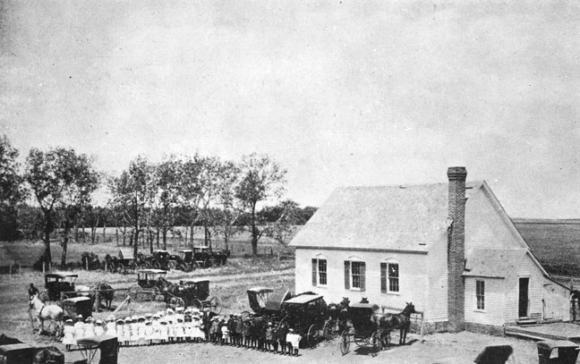
The Zion Lutheran Church in Nebraska
Give Me Liberty!: An American history, 3rd Edition
Copyright © 2011 W.W. Norton & Company

Slide 83
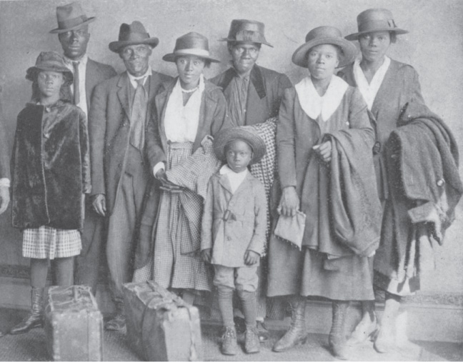
A black family arriving in Chicago in 1922
Give Me Liberty!: An American history, 3rd Edition
Copyright © 2011 W.W. Norton & Company

Slide 84
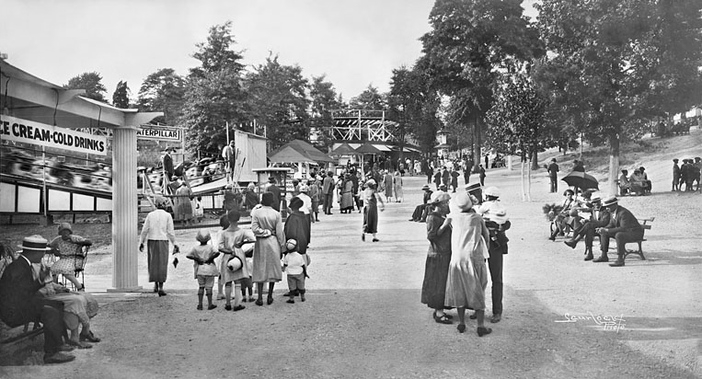
Segregated institutions sprang up to serve
the expanding black communities
Give Me Liberty!: An American history, 3rd Edition
Copyright © 2011 W.W. Norton & Company

Slide 85
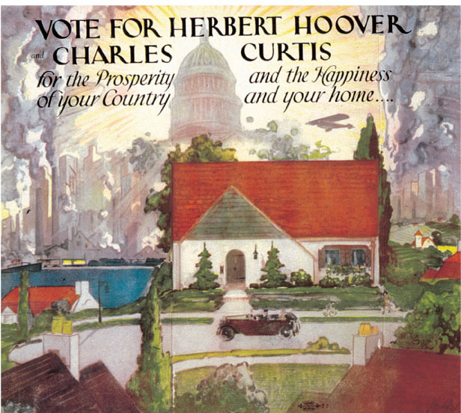
A 1928 campaign poster for the Republican ticket
Of Herbert Hoover and Charles Curtis.
Give Me Liberty!: An American history, 3rd Edition
Copyright © 2011 W.W. Norton & Company

Slide 86
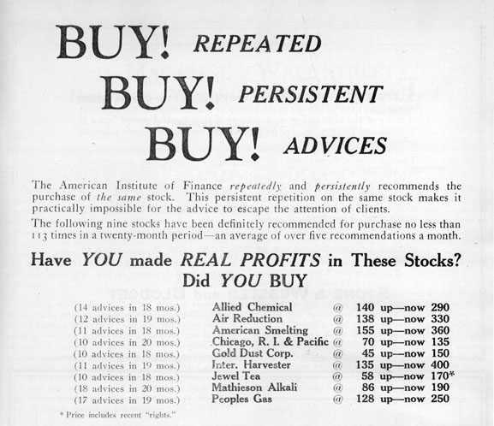
Three months before the stock market crash
Give Me Liberty!: An American history, 3rd Edition
Copyright © 2011 W.W. Norton & Company

Slide 87
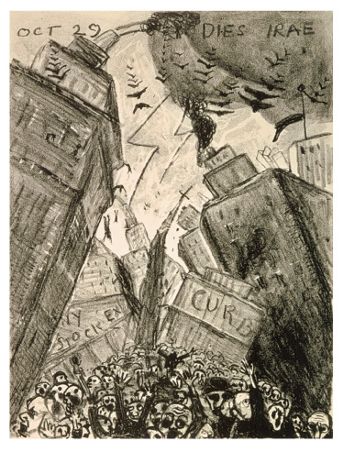
Oct. 29—Dies Irae, a 1929 lithograph
by James N. Rosenberg
Give Me Liberty!: An American history, 3rd Edition
Copyright © 2011 W.W. Norton & Company

Slide 88
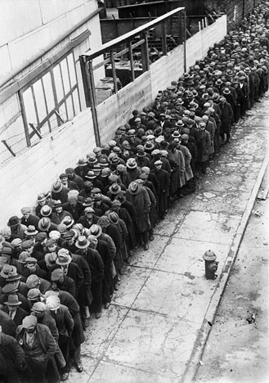
Unemployed men, lined up at the New York
Municipal Lodging House in 1930.
Give Me Liberty!: An American history, 3rd Edition
Copyright © 2011 W.W. Norton & Company

Slide 89
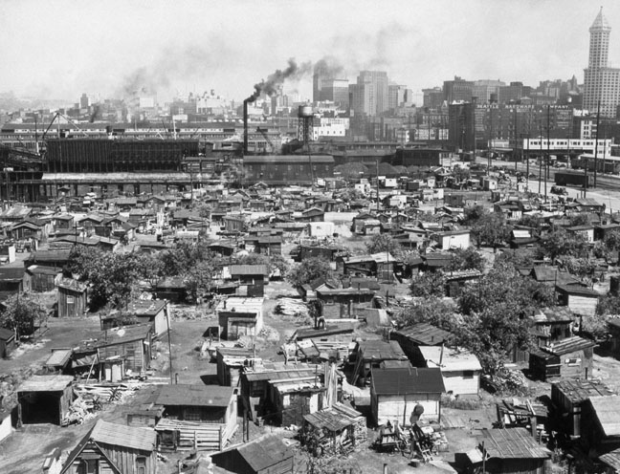
A Hooverville—a shantytown created by
homeless squatters—outside Seattle
Give Me Liberty!: An American history, 3rd Edition
Copyright © 2011 W.W. Norton & Company

Slide 90
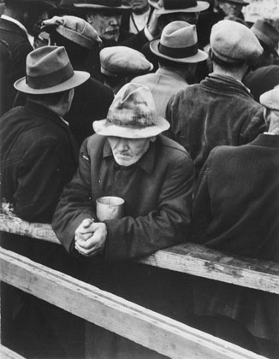
The celebrated photographer Dorothea Lange took this
photograph of an unemployed man on a San Francisco
Give Me Liberty!: An American history, 3rd Edition
Copyright © 2011 W.W. Norton & Company

Slide 91
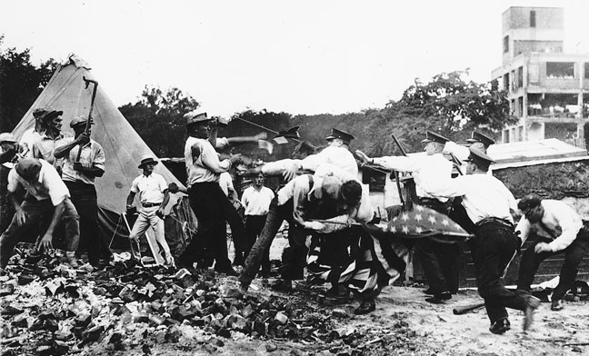
Police battling “bonus marchers” in Washington,
D.C., July 1932.
Give Me Liberty!: An American history, 3rd Edition
Copyright © 2011 W.W. Norton & Company

Slide 92
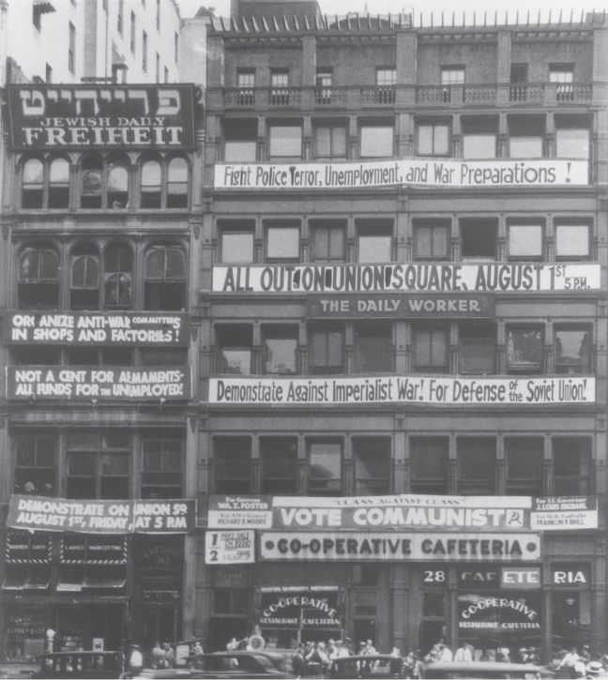
Communist Party headquarters in New
York City, 1932.
Give Me Liberty!: An American history, 3rd Edition
Copyright © 2011 W.W. Norton & Company

Slide 93
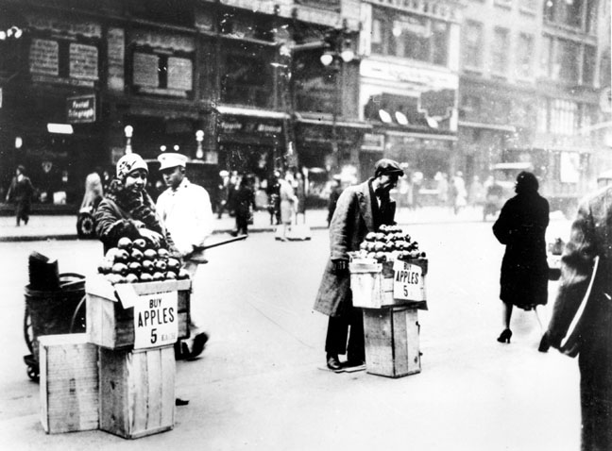
An unemployed man and woman selling
apples on a city street
Give Me Liberty!: An American history, 3rd Edition
Copyright © 2011 W.W. Norton & Company

Slide 94
Norton Lecture Slides Independent and Employee-Owned
This concludes the Norton Lecture Slides
Slide Set for Chapter 20
Give Me Liberty!
AN AMERICAN HISTORY
THIRD EDITION
by
Eric Foner

