Slide 1
Chapter 12 An Age of Reform, 1820–1840
Antebellum: period just before the Civil War http://www.merriam-webster.com/dictionary/antebellum
Utopian Literature: http://brbl-archive.library.yale.edu/exhibitions/utopia/utopcom.html
Notes:
Abolitionism was one of many antebellum efforts to reform American society. Lacking a powerful national government, Americans’ political and social activities were organized through tens of thousands of voluntary associations, such as churches, fraternal orders, and political clubs. Americans established groups to prevent the making and selling of liquor, end public entertainments and mail delivery on Sunday, improve prisons, expand public education, improve working conditions, and reorganize society on a cooperative rather than competitive basis.
Most of these groups worked to convert public opinion in their favor. They lectured, petitioned, and published pamphlets. Many reformers confronted more than one issue. While some reform campaigns flourished throughout the nation, others, like labor reform and abolitionism, never took hold in the South. Reform was international, and many groups created ties with reformers in Europe.
Reformers tried a variety of tactics, from “moral suasion” to using government power to force changes in others’ behavior. Some reformers withdrew from society altogether and established their own communities. While never a majority, reformers significantly influenced American politics and society.

Slide 2
THEMES:
1. The antebellum period was an era of reform during which many Americans, particularly in the middle class, sought to change society.
2. The reform impulse resulted in the founding of utopian communities, organized movements to abolish drinking, and efforts to improve schools, prisons and mental institutions.
3. Abolitionism, the movement to abolish slavery, was a key component of antebellum reform.
4. Women were important players in the reform movements of this period and their efforts included new ideas about the rights and roles of women in American society.

Slide 3
REFORM: What were the major movements & goals of antebellum reform?
Utopian Communities:
Abolition
Women’s Rights
Temperance
Asylums

Slide 4
SAQ – Utopian Communities
A) Describe one Utopian community that was religious based and one that was secular.
B) Evaluate the successes and failures of both communities.
C) Identity and describe a shared trait between these two communities.

Slide 5
Utopian Communities
About 100 reform communities were established in the decades before the Civil War.
Purpose:
Create cooperative communities
Close the widening gap between rich and poor
Reject excessive individualism and materialism caused by the market revolution
Private Property: many Americans weren’t attracted to utopian societies because they often required that members give up private property

Slide 6
Utopian Communities
http://www.history.com/news/history-lists/5-19th-century-utopian-communities-in-the-united-states
Structure:
Cooperative communities: Productive property communally owned (not privately); introduced “socialism” and “communism” into political language
Socialism: government owns the means of production and distribution of goods http://www.merriam-webster.com/dictionary/socialism
Communism: government owns all property (land, resources, transportation)
http://www.merriam-webster.com/dictionary/communism?show=0&t=1416160748
Governance varied: Charismatic leaders, Some Democratic
Religiously motivated (most), few with secular origins
Non-Traditional Gender roles and Marriage traditions Often transformed to abolish man’s “property” over women (as they abolish private property)
Notes:
About 100 reform communities were established before the Civil War. These “utopian” communities varied in structure and motivation. Some were governed by a charismatic leader, others were democratic. Most were religiously motivated, but some had secular origins in desires to reverse social and economic changes unleashed by the market revolution. Nearly all of these communities sought to make society cooperative, restoring social harmony in an increasingly individualistic society, and closing the widening gap between rich and poor. Their efforts to own productive property communally rather than as private individuals introduced “socialism” and “communism” into America’s political language. Most utopian communities also attempted in some way to transform traditional gender roles and marriage patterns, insisting that the abolition of private property must be matched by the abolition of man’s “property” in women.
The Shakers were the most successful of the religious utopians, and at their height in the 1840s, they had settlements from Maine to Kentucky totaling 5,000 members. Founded in the late eighteenth century by Mother Ann Lee, a British emigrant claiming to be directed by God, the Shakers believed that men and women were spiritual equals and that their work was equally important. They eschewed traditional families; men and women abstained from sex and lived separately in communal dorms. They were called Shakers for their religious services, which included frenzied dancing. Though they rejected private property, the Shakers found economic success by marketing plant seeds, breeding cattle, and making furniture.

Slide 7
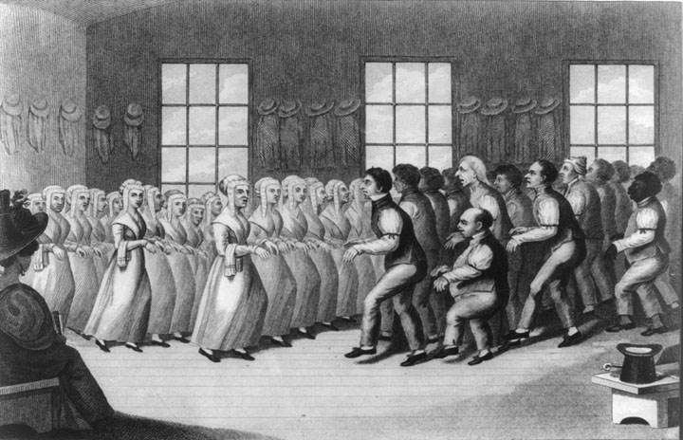
An engraving of a Shaker dance
Give Me Liberty!: An American history, 3rd Edition
Copyright © 2011 W.W. Norton & Company

Slide 8
The Shakers
Moderate background: http://www.pbs.org/wnet/ihas/icon/shakers.html
In depth background: http://xroads.virginia.edu/~HYPER/HNS/Cities/shakers.html In depth background: http://www.nps.gov/nr/travel/shaker/shakers.htm
Most successful of the religious utopians
“Shakers” (Shaking Quakers) who would dance under the influence of God
Founded : Mother Ann Lee, (daughter of an English blacksmith), Christ compelled her to emigrate to America,
Settlements: peek in 1840s, totaling 5,000 members, from Maine – Kentucky
Beliefs:
Men and women were spiritual equals
Non-Traditional families – Celibacy (populations decrease over time due to lack of natural reproduction)
Men and Women live separately
Structure:
Rejected private property
Economic success:
marketed vegetable and flower seeds
Cattle
Furniture http://www.metmuseum.org/toah/hd/shak/hd_shak.htm

Slide 9
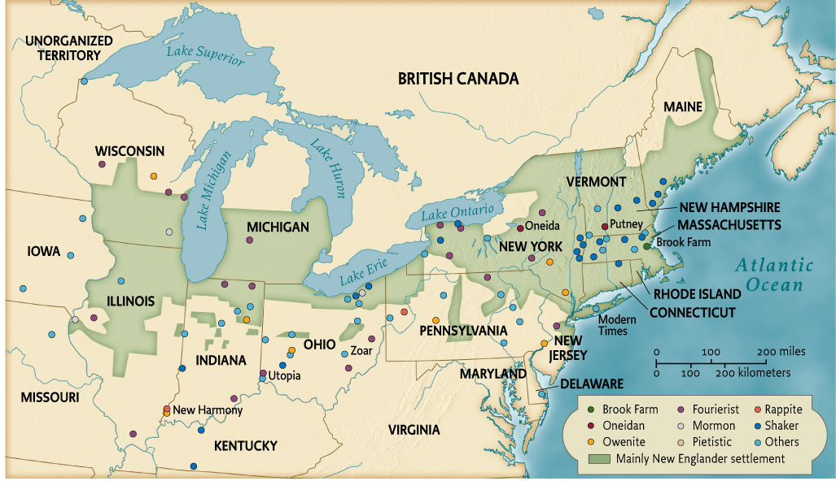
Map 12.1 Utopian Communities, Mid-Nineteenth Century
Give Me Liberty!: An American history, 3rd Edition
Copyright © 2011 W.W. Norton & Company

Slide 10
Mormons
http://www.pbs.org/mormons/view/
Members of the Church of Jesus Christ of Latter-Day Saints.
Founded: Joseph Smith, late 1820’s, upstate NY
Beliefs: he found ancient tablets, which he transcribed as the Book of Mormon, the ancient Hebrews emigrated to the New World and were the ancestors of American Indians http://www.mrm.org/eleven-witnesses
Notes:
Another influential group was the Mormons, the members of the Church of Jesus Christ of Latter-Day Saints. Joseph Smith, claiming to have found ancient tablets, which he transcribed as the Book of Mormon, founded the church in the late 1820s in upstate New York. His absolute authority over his followers and Mormons’ refusal to separate church and state alarmed many, as did their practice of polygamous marriage, in which one man could have more than one wife. The Mormons were persecuted and driven from state to state, until Mormon leader Brigham Young led more than 10,000 Mormons to the shores of Great Salt Lake in modern-day Utah. The case of the Mormons showed the limits of religious toleration in nineteenth-century America.
Oneida, founded in 1848 in upstate by John Humphrey Noyes, was also influential. Noyes, having become an evangelical, preached that he and his followers had achieved moral perfection and were free of sin. Noyes first founded a community in Putney, Vermont, where private property was abolished and “complex marriage” practiced. In Noyes’s system of complex marriage, any man could propose sexual relations with any woman, who was free to accept or reject the invitation. Tried for adultery, Noyes left Vermont and founded Oneida, a dictatorial community ruled by Noyes in which an early form of eugenics was practiced, which lasted until 1881.

Slide 11
The Mormons’ Trek
Governance & Relocation:
Smith’s absolute authority over his followers and Mormons’ refusal to separate church and state alarmed many, as did their practice of polygamous marriage (not typical of Mormons today) http://www.pbs.org/weta/thewest/people/s_z/smith.htm
The Mormons were persecuted and driven from state to state
Smith’s Successor , Brigham Young led more than 10,000 Mormons to the shores of Great Salt Lake in modern-day Utah, by 1847 Background: http://www.history.com/this-day-in-history/mormons-settle-salt-lake-valley IMAGES: http://www.mormonnewsroom.org/article/mormonism-pictures-pioneers-trek-west Day in a Pioneer’s Life: http://history.lds.org/chdaily/pioneer-day-infographic-2014jpg?lang=eng
The case of the Mormons showed the limits of religious toleration in nineteenth-century America http://www.pbs.org/weta/thewest/people/s_z/young.htm

Slide 13
Oneida
http://www.nyhistory.com/central/oneida.htm
Founded: John Noyes - 1836 in Putney, VT then moved 1848 to upstate NY
Beliefs: Religious
Noyes preached that he and his followers had achieved moral perfection and were free of sin (influenced by the revivalist message that man could achieve “purity of the heart”)
Governance & Structure:
Abolished private property
“complex marriage”– open relationships rather than monogamy
Dictatorial community ruled by Noyes, strict rules
eugenics was practiced which lasted until 1881 (a committee would decide which couples could reproduce)
Eugenics: regulating reproduction to “improve” the human race http://dictionary.reference.com/browse/eugenics

Slide 14
Brook Farm
Founded: New England Transcendentalists in 1841 near Boston
Goals: Academic
Show that manual and intellectual labor could coexist
Modeled their community on the ideas of Charles Fourier, a French social reformer who planned communities with communal living and working arrangements
Private property rights retained for individuals.
Culture & Structure:
His settlements, called “phalanxes,” were planned to the last detail (# of residents, charges for sightseers http://www.merriam-webster.com/dictionary/phalanx
Leisure Time: music, dancing, drama, intellectual discussion
Brook Farm became a salon of sorts, attracting ministers, writers, and teachers, until residents’ dislike for farm labor caused it to disband after a few years.
Failed in part because many intellectuals disliked farm labor
Brook Farm: http://econc10.bu.edu/economic_systems/Theory/NonMarx_Socialism/Utopian_socialism/Brook_farm.htm http://bwht.org/brook-farm/
Notes:
Religious utopian communities, with their spiritual devotion, strong leaders, and undemocratic governance, tended to last longer than secular utopian communities, which often failed due to internal strife. One notable secular community was Brook Farm, founded by New England transcendentalists in 1841 near Boston. They hoped to show that manual and intellectual labor could coexist, and modeled their community on the ideas of Charles Fourier, a French social reformer who planned communities with communal living and working but private property for individuals. His settlements, called “phalanxes,” were planned to the last detail. Brook Farm became a salon of sorts, attracting ministers, writers, and teachers, until residents’ dislike for farm labor caused it to disband after a few years.
The most important secular communitarian was Robert Owen, a British industrialist, who was appalled by early industrial conditions and built a model textile factory town at New Lanark in Scotland. In 1824, he purchased Harmony, a utopian religious community in Ohio founded earlier in the nineteenth century by a German Protestant, George Rapp. Here Owen established “New Harmony.” Owen envisioned a society in which all children would receive education, women would have equal rights, including access to education and divorce rights, and property would be held in common. But divisions at New Harmony led to its dissolution after a few years. Owenism influenced the early labor movement, educational reforms, and women’s rights advocates. Other secular communities included Utopia, Ohio, and Modern Times, New York, founded by anarchist Josiah Warren, who believed that all institutions that exercise power over individuals are illegitimate.

Slide 15
The Owenites
Founded: by secular communitarian was Robert Owen, a British industrialist, who was appalled by early industrial conditions and 1st built a model textile factory town at New Lanark in Scotland.
Scotland – 1815, textile community that was the largest center of cotton manufacturing in the world
Laborers were part of a cooperative community rather than ruled over by an industrialist
Robert Owen Background: http://humanistheritage.org.uk/articles/Robert-Owen/
New Harmony: http://www.indianamuseum.org/explore/new-harmony
New Harmony: 1824, Owen purchased Harmony, Indiana from George Rapp who was a German Protestant leader who initially established a community in the early nineteenth century
Central Beliefs: Owen envisioned a society in which all children would receive education, women would have equal rights, including access to education and divorce rights, and property would be held in common.
Divisions at New Harmony: divisions over their constitution and property ended the community within a few years
Impact: Owenism influenced the early labor movement, educational reforms, and women’s rights advocates.
Notes:
Other Communites – Anarchist:
Other secular communities included Josiah Warrens anarchist communities of Utopia, Ohio, and Modern Times, New York,
He believed that all institutions that exercise power over individuals are illegitimate, even government.

Slide 16
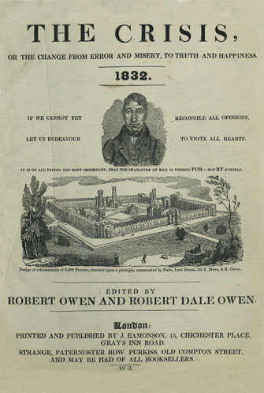
The Crisis, a publication by the communitarian
Robert Owen
Give Me Liberty!: An American history, 3rd Edition
Copyright © 2011 W.W. Norton & Company

Slide 17
Religion and Reform
Most Americans saw private property as the basis of economic independence and freedom and marriage as the basis of the social order, so they were unlikely to join these utopian communities.
Common Reform Movements: Abolition, women’s rights, temperance, asylums
Many of these movements were inspired by the religious revivalism of the Second Great Awakening, which encouraged people to believe that sinners were “free moral agents” who could reform and “perfect” both themselves and the world.
Background on 2nd Great Awakening: http://www.let.rug.nl/usa/outlines/history-1994/the-formation-of-a-national-government/the-second-great-awakening.php
Notes:
Most Americans saw private property as the basis of economic independence and freedom and marriage as the basis of the social order, so they were unlikely to join these utopian communities. More typical of the reform impulse were movements directed to freeing men and women from external restraints, such as slavery, or from personal behavior, such as drinking or criminality. Many of these movements were inspired by the religious revivalism of the Second Great Awakening, which encouraged people to believe that sinners were “free moral agents” who could reform and “perfect” both themselves and the world.
One such movement was temperance, which had its origins in the North’s emerging middle-class culture and its search for respectability through individual self-control. Founded in 1826, the American Temperance Society tried to convince Americans to stop drinking altogether. In the 1830s, the society claimed to have helped hundreds of thousands to stop drinking liquor. But temperance invited great hostility from many Americans who resented other’s efforts to change their behavior, which they thought no less moral than that of the temperate.

Slide 18
The Temperance Movement
Alcohol in US Society:
Drinking was prominent at everyday celebrations and events.
Taverns were popular meeting places for workingmen and sites of political discussion, organizational meetings, and popular recreation.
Some Americans saw reform as an assault on their own freedoms
Origins:
North’s emerging middle-class culture and its search for respectability through individual self-control
2nd Great Awakening – Christian denominations denounce alcohol
Reformers – alcohol led to social issues (violence, unemployment, missing work)
Notes:
Many Americans saw reform as an assault on their own freedoms. Drinking was prominent at everyday celebrations and events. Taverns were popular meeting places for workingmen and sites of political discussion, organizational meetings, and popular recreation. American Catholics, in particular Irish and German immigrants, often opposed reform efforts. Unlike Protestant reformers, they viewed sin as inevitable in society and individuals, and they viewed the belief that the world could be perfected as irreligious and productive of reformers’ attempts to impose their own worldview on others. Catholics tended to place less emphasis on the individual as a free moral agent and emphasized communities centered on family and church.
Reformers faced a contradiction between their hopes to establish a moral order and expand personal freedom. Their notion of freedom was both liberating and controlling. They said their goal was to help Americans enjoy genuine liberty by liberating them from the “slavery” of drink, poverty, and sin. Yet they believed that self-fulfillment derived from self-discipline and that the free individual fully practiced self-control. Reformers worried that western settlers and immigrants lacked self-control and required either private reform groups or the government to change their behaviors.

Slide 19
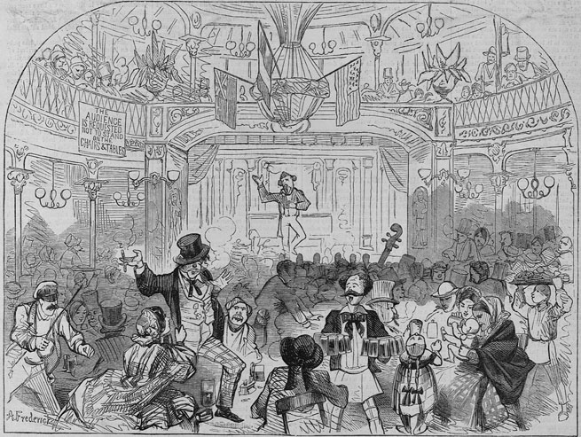
A German Beer Garden on Sunday
Give Me Liberty!: An American history, 3rd Edition
Copyright © 2011 W.W. Norton & Company

Slide 20
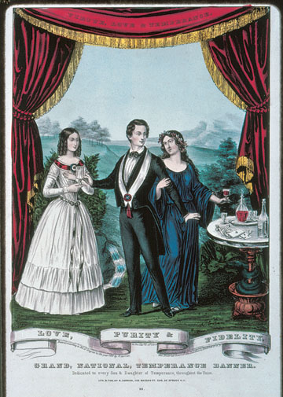
A temperance banner from around 1850
Give Me Liberty!: An American history, 3rd Edition
Copyright © 2011 W.W. Norton & Company

Slide 21
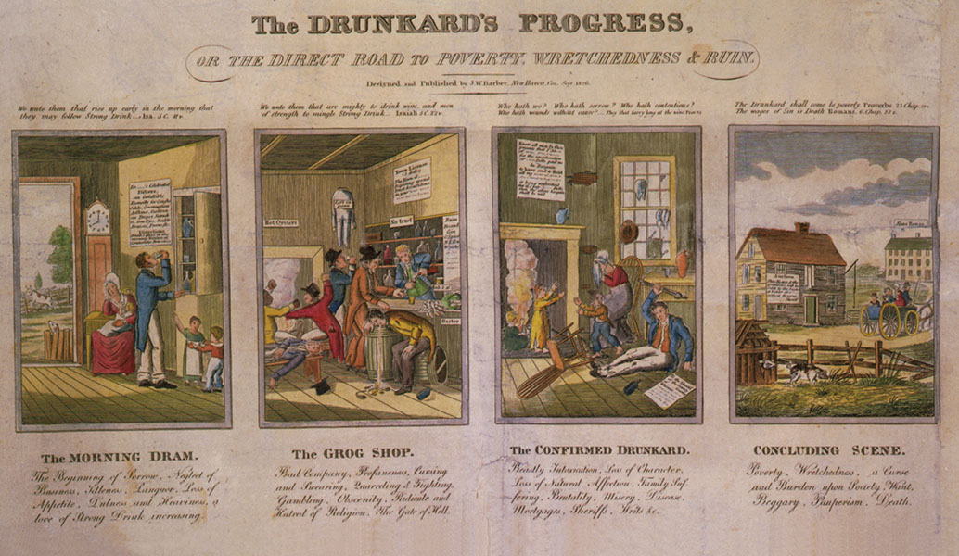
The Drunkard’s Progress, an 1826
Give Me Liberty!: An American history, 3rd Edition
Copyright © 2011 W.W. Norton & Company

Slide 22
The Reform Impulse
The Temperance Movement
Goal: tried to convince Americans to stop drinking altogether
Founded: in 1826, the American Temperance Society
Success:
By 1840, the temperance movement encouraged a substantial decrease in the consumption of alcohol
Opposition:
Temperance invited great hostility from many Americans who resented other’s efforts to change their behavior
Division among Temperance reformers over total abstinence from all alcohol versus abstinence from only liquor
Background & Video http://www.pbs.org/kenburns/prohibition/roots-of-prohibition/
Background: http://law.jrank.org/pages/10714/Temperance-Movement.html

Slide 23
The Reform Impulse
Reformers and Freedom
Reformers faced a contradiction between their hopes to establish a moral order and expand personal freedom. Their notion of freedom was both liberating and controlling.
They said their goal was to help Americans enjoy genuine liberty by liberating them from the “slavery” of drink, poverty, and sin. Yet they believed that self-fulfillment derived from self-discipline and that the free individual fully practiced self-control.
Reformers worried that western settlers and immigrants lacked self-control and required either private reform groups or the government to change their behaviors.
Reform efforts created a multitude of new institutions designed to transform individuals into free, morally upright citizens, performing services once rendered in the family or small community.

Slide 24
The Invention of the Asylum
In the 1830s and 1840s, Americans built jails for criminals, asylums for the mentally ill, and orphanages for children.
Reformers’ believed that social ills could be cured and eliminated with rehabilitation
Reformers hoped to remake the afflicted into productive, self-disciplined citizens who could be part of society again
Dorothea Dix influenced the building of 32 humane institutions in the United States
Video (10 minutes)– Dorothea Dix and the Conditions of Jails and Asylums: http://www.youtube.com/watch?v=nSYM4IS_jiA
Notes:
Reform efforts created a multitude of new institutions designed to transform individuals into free, morally upright citizens, performing services once rendered in the family or small community. In the 1830s and 1840s, Americans built jails for criminals, asylums for the mentally ill, and orphanages. These institutions emerged from reformers’ belief that social ills could be cured and eliminated by placing individuals in an environment where their character could be changed. Reformers hoped to remake the afflicted into productive, self-disciplined citizens.
The most significant institution-building effort before the Civil War was the move to establish common schools—tax-supported state school systems open to all children. In the early nineteenth century, most children were educated, if at all, in local schools, private academies, or at home. Many children had no access to education. Horace Mann, a Massachusetts lawyer and Whig politician, led efforts to create new common schools. Mann embraced industrialization, but hoped that universal public education would restore social equality by bringing children from all social classes together and giving them an equal opportunity for upward social mobility. Mann also insisted that schools would stabilize society by disciplining children and building individual character, teaching obedience to authority and adherence to strict time periods. With support from labor unions, factory owners, and middle class reformers, by 1860 every northern state had tax-supported schools systems for children. The South, where planters did not want to be taxed to support the education of poor white children, only slowly developed public schools.

Slide 25
Prisons & Asylums
Dorothea Dix promoted rehabilitation in jails and asylums for the mentally ill
1841 – Teacher who volunteered to teach Sunday school to women in a Massachusetts prison
Horrible conditions of the jail caused her to research prisons and poorhouses
Her research helped convince the Massachusetts legislature to reform the conditions in prisons
Reformed how prisoners and people with mental illnesses were treated
1802-1887
Dorothea Dix Complete Background: http://www.history.com/topics/womens-history/dorothea-lynde-dix

Slide 26
The Common School
Common School: The most significant institution-building effort before the Civil War was the move to establish common schools—tax-supported state school systems open to all children. (public school)
Education Limited: Most children were educated, if at all, in local schools, private academies, or at home. Many children had no access to education.
1860 - Education in the North and South:
NORTH every northern state had tax-supported schools systems for children.
SOUTH only slowly developed public schools . Planters did not want to be taxed to support the education of poor white children.

Slide 27
The Common School
Horace Mann: Massachusetts, advocate common schools
Believed education would “equalize the conditions of men”
Bio Video (3:41) https://www.youtube.com/watch?v=R6LplmYyOJE
Social Advancement: Hoped that universal public education would restore social equality by bringing children from all social classes together and giving them an equal opportunity for upward social mobility.
Build Character & Discipline: schools would stabilize society by disciplining children and building individual character, teaching obedience to authority and adherence to strict time periods.

Slide 28
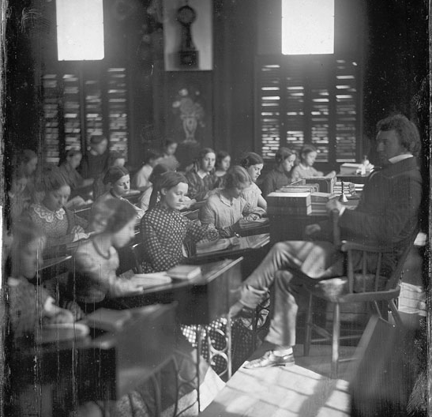
This daguerreotype from around 1850
Give Me Liberty!: An American history, 3rd Edition
Copyright © 2011 W.W. Norton & Company

Slide 29
The Crusade against Slavery
Colonization
Compared to drinking, Sabbath-breaking, and illiteracy, the greatest evil in American society first attracted the least attention from reformers. For decades, the only criticism of slavery seemed to come from Quakers, slaves, and free blacks.
Colonization: Before the 1830s, most white Americans who called for the abolition of slavery also supported the “colonization” of free slaves, or their deportation, to Africa, the Caribbean, or Central America.
American Colonization Society, founded in 1816, which promoted the gradual abolition of slavery and the settlement of black Americans in Africa. It soon established Liberia on the coast of West Africa, to which some free blacks did emigrate.
Most free African Americans were adamantly opposed to the colonization of freed US slaves to Africa
Freetown, Sierra Leone (British freed slaves) & Monrovia, Liberia (US freed slaves) http://www.history.com/this-day-in-history/freed-us-slaves-depart-on-journey-to-africa
American Colonization Society (background) http://www.pbs.org/wgbh/aia/part3/3p1521.html
American Colonization Society (background) http://www.loc.gov/exhibits/african/afam002.html
Notes:
Compared to drinking, Sabbath-breaking, and illiteracy, the greatest evil in American society first attracted the least attention from reformers. For decades, the only criticism of slavery seemed to come from Quakers, slaves, and free blacks. Before the 1830s, most white Americans who called for the abolition of slavery also supported the “colonization” of free slaves, or their deportation, to Africa, the Caribbean, or Central America. In 1816, supporters of this idea founded the American Colonization Society, which promoted the gradual abolition of slavery and the settlement of black Americans in Africa. It soon established Liberia on the coast of West Africa, to which some free blacks did emigrate.
Even though many saw colonization as impractical, prominent political leaders in the Jacksonian era, such as Henry Clay, John Marshall, Daniel Webster, and even Jackson, supported the Colonization Society. Many in the North saw colonization as the only means of ending slavery, while southern colonizationists urged free blacks, whom they regarded a degraded group that endangered white society, to leave the country. Others simply thought racism so entrenched that it was safer for blacks, once freed, to leave the nation. Colonization rested on the premise that America was fundamentally a white society. Of course, while several thousand free blacks did migrate to Liberia, most African-Americans opposed the idea of colonization and argued that, as Americans, they had the right to remain in the United States as free and equal citizens.

Slide 30
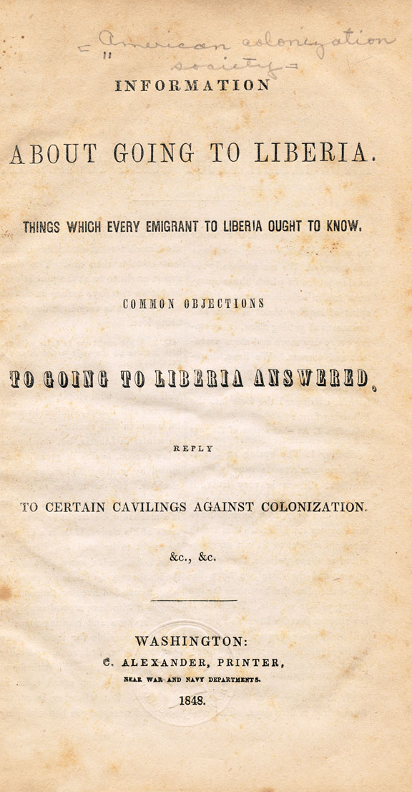
A pamphlet issued in 1848 by the American
Colonization Society
Give Me Liberty!: An American history, 3rd Edition
Copyright © 2011 W.W. Norton & Company

Slide 31
The Crusade against Slavery
Blacks and Colonization
Even though many saw colonization as impractical, prominent political leaders in the Jacksonian era, such as Henry Clay, John Marshall, Daniel Webster, and even Jackson, supported the Colonization Society.
Many in the North saw colonization as the only means of ending slavery, while southern colonizationists urged free blacks, whom they regarded a degraded group that endangered white society, to leave the country.
Others simply thought racism so entrenched that it was safer for blacks, once freed, to leave the nation. Colonization rested on the premise that America was fundamentally a white society.
Of course, while several thousand free blacks did migrate to Liberia, most African-Americans opposed the idea of colonization and argued that, as Americans, they had the right to remain in the United States as free and equal citizens.
American Colonization Society 1816 – 1860: Read 1 section (Introduction, Background, Beginning of the ACS, Liberia, or Protest AND Watch the 1st video, Lois Horton on Integration v Colonization)
http://www.ushistoryscene.com/uncategorized/americancolonizationsociety/

Slide 32
The Crusade against Slavery
Militant Abolitionism
The 1830’s abolitionist movement of the 1830s arose in opposition to colonization.
Religious Influence: The new abolitionists drew on the religious idea that slavery was a sin and a secular commitment to the values of the Declaration of Independence.
Immediate Abolition :They rejected gradual emancipation, the method primarily advocated in the earlier movement, and demanded the immediate abolition of slavery.
Reject Colonization: They vociferously criticized slavery and slaveholders and affirmed that blacks, once freed, should become equal citizens of the republic, and not colonizers of distant lands. While white abolitionists were hardly free of racism, they demanded that race should not prevent the equal enjoyment of economic, civil, and political rights in the United States. They opposed racism in all its forms.
Notes:
The abolitionist movement of the 1830s arose in opposition to colonization and its supporters. The new abolitionists drew on the religious idea that slavery was a sin and a secular commitment to the values of the Declaration of Independence. They rejected gradual emancipation and demanded the immediate abolition of slavery. They vociferously criticized slavery and slaveholders and affirmed that blacks, once freed, should become equal citizens of the republic, and not colonizers of distant lands. While white abolitionists were hardly free of racism, they demanded that race should not prevent the equal enjoyment of economic, civil, and political rights in the United States. They opposed racism in all its forms.
The first sign of this new abolitionism was An Appeal to the Coloured Citizens of the World, an 1829 pamphlet written by David Walker, a free black in Boston. Walker called on black Americans to mobilize for abolition, with arms if necessary, and warned Americans that God would punish them if they did not end slavery. Walker invoked the Bible and the Declaration of Independence, but he also asked blacks to take pride in African civilizations’ achievements and claim their rights as Americans.
Though Walker’s pamphlet alarmed many in the North and South, he soon died under mysterious circumstances. Only with the appearance in 1831 of The Liberator, the weekly journal of Bostonian William Lloyd Garrison, did the new abolitionism take root. Garrison was strident in his rhetoric and unbending in his commitment to abolition. Garrison even suggested that the North should abrogate the Constitution and dissolve the Union in order to end its complicity with slavery. While few abolitionists supported this notion, many adopted his criticisms of colonization and called for immediate abolition.

Slide 33
A Crusade Against Slavery Militant Abolitionism
An Appeal to the Coloured Citizens of the World, an 1829 pamphlet by David Walker:
A free black in Boston, Walker called on black Americans to mobilize for abolition, with arms if necessary, and warned Americans that God would punish them if they did not end slavery.
Walker invoked the Bible and the Declaration of Independence, but he also asked blacks to take pride in African civilizations’ achievements and claim their rights as Americans.
David Walker’s, An Appeal to the Coloured Citizens of the World: http://www.pbs.org/wgbh/aia/part4/4h2931.html
Impact of slave narratives and anti-slavery rhetoric (Frederick Douglass, David Walker, William Lloyd Garrison, Solomon Northup – Twelve Years a Slave): http://www.pbs.org/wgbh/aia/part4/4p2958.html

Slide 34
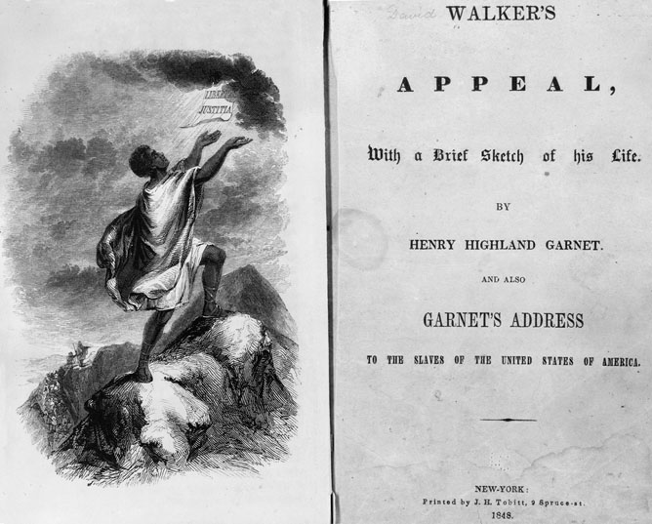
The frontispiece of the 1848 edition
Give Me Liberty!: An American history, 3rd Edition
Copyright © 2011 W.W. Norton & Company

Slide 35
The Crusade against Slavery
The Emergence of Garrison
William Lloyd Garrison: published the abolitionist newspaper The Liberator, (1831), the weekly journal (Boston, Massachusetts)
Background: http://www.ushistory.org/us/28a.asp
Thoughts on African Colonization Garrison explained that blacks were not “strangers” in America to be shipped abroad, but should be recognized as permanent part of American society.
Actual Pamphlet: https://archive.org/details/thoughtsonafrica00garr
Garrison was strident in his rhetoric and unbending in his commitment to abolition. Garrison even suggested that the North should abrogate the Constitution and dissolve the Union in order to end its complicity with slavery.
While few abolitionists supported this notion, many adopted his criticisms of colonization and called for immediate abolition.

Slide 36
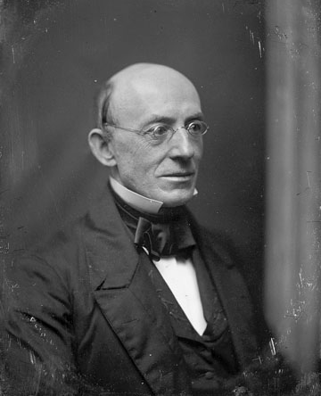
William Lloyd Garrison
Give Me Liberty!: An American history, 3rd Edition
Copyright © 2011 W.W. Norton & Company

Slide 37
The masthead of William Lloyd Garrison’s
The Liberator
Give Me Liberty!: An American history, 3rd Edition
Copyright © 2011 W.W. Norton & Company

Slide 38
The Crusade against Slavery
Spreading the Abolitionist Message
The abolitionist movement quickly spread from a handful of activists to thousands of villages, towns, and cities throughout the North.
About 100,000 Northerners joined local abolition groups.
Impact of Print: They took advantage of new print technology and expanding literacy by printing and distributing enormous amounts of pamphlets, newspapers, books, novels, and broadsides.
Printing Press (steam powered): https://multimediaman.wordpress.com/tag/steam-powered-press/
American Anti-Slavery Society (1833 and 1840)
formed to advocate immediate emancipation American Anti-Slavery Society: http://www.loc.gov/exhibits/african/afam006.html
Notes:
The abolitionist movement quickly spread from a handful of activists to thousands of villages, towns, and cities throughout the North. They took advantage of new print technology and expanding literacy by printing and distributing enormous amounts of pamphlets, newspapers, books, novels, and broadsides. Between the formation of the American Anti-Slavery Society in 1833 and 1840, about 100,000 Northerners joined local abolition groups. Most were ordinary citizens, although a few prominent men, like New York merchants Arthur and Lewis Tappan, also joined. Theodore Weld, an evangelical minister, helped create a mass constituency for abolition by using the methods of the revivalists, calling slavery a sin which could only be resolved by immediate abolition.
While many southerners believed the abolitionists hoped to incite a slave insurrection, nearly all abolitionists, despite their militant rhetoric, rejected violence as a means of ending slavery. Many were pacifists or “non-resistants,” who believed that coercion had to be eliminated from all human institutions and relationships. They adopted the strategy of “moral suasion,” or convincing slaveholders to end their sinful ways and shaming Northerners into action. Abolitionists were the first in American history to try to transform society by changing mass opinion through education and agitation, instead of using political parties.

Slide 39
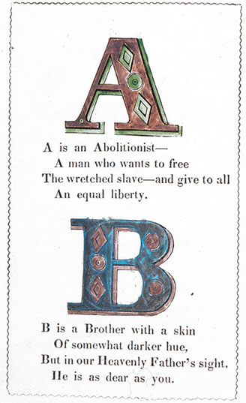
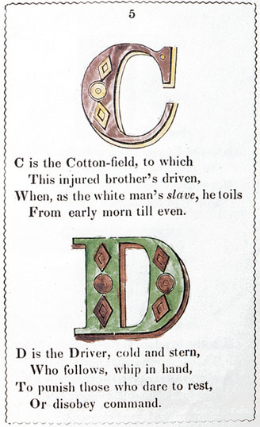
Pages from an abolitionist book for children.
Give Me Liberty!: An American history, 3rd Edition
Copyright © 2011 W.W. Norton & Company

Slide 40
The Crusade against Slavery
Slavery and Moral Suasion
While many southerners believed the abolitionists hoped to incite a slave insurrection, nearly all abolitionists, despite their militant rhetoric, rejected violence as a means of ending slavery.
Pacifists: Many were pacifists or “non-resistants,” who believed that coercion had to be eliminated from all human institutions and relationships.
“Moral Suasion”: the strategy involved convincing slaveholders to end their sinful ways and shaming Northerners into action.
Impact: Abolitionists were the first in American history to try to transform society by changing mass opinion through education and agitation, instead of using political parties.

Slide 41
The Crusade against Slavery
Abolitionists and the Idea of Freedom
Freedom Defined: Abolitionism both reaffirmed and challenged common understandings of freedom in Jacksonian America. It helped spread the notion, reinforced by the market revolution, that personal freedom derived, not from ownership of productive property such as land, but from ownership of one’s self and the ability to enjoy the fruits of one’s labor.
“Wage-Slavery” : Abolitionists rejected the idea of “wage-slavery” popularized by the labor movement and proslavery arguments. They argued that, compared to the slave, the wage-worker embodied freedom, since he could change jobs, accumulate property, and have a stable family.
Abolitionists argued that slavery was so entrenched in American life that its destruction would require fundamental changes in both the North and South. They demanded that the inherent, natural, and absolute right to personal liberty, regardless of race, should take precedence over other freedoms, such as the right to accumulate and maintain property or the right to self-government by local political communities.
Notes:
Abolitionism both reaffirmed and challenged common understandings of freedom in Jacksonian America. It helped spread the notion, reinforced by the market revolution, that personal freedom derived, not from ownership of productive property such as land, but from ownership of one’s self and the ability to enjoy the fruits of one’s labor. Abolitionists rejected the idea of “wage-slavery” popularized by the labor movement. They argued that, compared to the slave, the wage-worker embodied freedom, since he could change jobs, accumulate property, and have a stable family. Yet, abolitionists argued that slavery was so entrenched in American life that its destruction would require fundamental changes in both the North and South. They demanded that the inherent, natural, and absolute right to personal liberty, regardless of race, should take precedence over other freedoms, such as the right to accumulate and maintain property or the right to self-government by local political communities.
The abolitionists tried to reassert that freedom was a universal entitlement in an age when freedom and citizenship had become associated with whiteness. The idea that Americans could be a single people undifferentiated by race has its origins with the abolitionists, not the founding fathers. Anti-slavery activists viewed slaves and free blacks as equal members of the national community. They argued that birthplace, not race, should determine who was an American, an idea later enshrined in the Fourteenth Amendment. They were the first to argue that human rights were more important than national sovereignty, and they urged enforcement of international laws against the slave trade and slavery. While some abolitionists like Garrison detested the Constitution as a covenant with slaveowners, others, like Frederick Douglass, believed that it offered no protections to slavery. But abolitionists invented the concept of equality before the law, regardless of race. And they consciously presented abolition as the culmination of the Revolution’s values of liberty and equality.

Slide 42
The Crusade against Slavery
A New Vision of America
Freedom is a universal entitlement : abolitionists promoted this idea in an age when freedom and citizenship had become associated with whiteness.
Unity and Diversity: Abolitionists felt that Americans could be a single people undifferentiated by race
Equality before the Law: Anti-slavery activists viewed slaves and free blacks as equal members of the national community. They argued that birthplace, not race, should determine who was an American, an idea later enshrined in the Fourteenth Amendment. Abolitionists invented the concept of equality before the law, regardless of race.
Some abolitionists like Garrison detested the Constitution as a covenant with slaveowners, others, like Frederick Douglass, believed that it offered no protections to slavery.
Declaration of Independence and Freedom: http://www.elcivics.com/us_declaration_preamble.html
They consciously presented abolition as the culmination of the Revolution’s values of liberty and equality. They seized on the preamble to the Declaration of Independence as an attack against slavery.

Slide 43
Black and White Abolitionism
Black Abolitionists
Blacks played a leading role in the abolitionist movement. Northern blacks attracted to Garrison’s opposition to colonization and his demand for equal rights were half of The Liberator’s subscribers.
Several blacks were leaders of the American Anti-Slavery Society, and northern-born blacks and fugitive slaves such as Frederick Douglass quickly became major organizers and speakers.
Many fugitive slaves published accounts of their experience of slavery, which became powerful tools in communicating the reality of slavery to Northern audiences.
Uncle Tom’s Cabin, a novel published by Harriet Beecher Stowe in 1852, was based on one fugitive slave’s life and sold more than 1 million copies in only a few years.
Uncle Tom's Cabin to some extent modeled on the autobiography of fugitive slave Josiah Henson, which displayed the terrible conditions of slavery https://www.harrietbeecherstowecenter.org/utc/
http://www.history.com/this-day-in-history/uncle-toms-cabin-is-published
Notes:
Blacks played a leading role in the abolitionist movement. Northern blacks attracted to Garrison’s opposition to colonization and his demand for equal rights were half of The Liberator’s subscribers. Several blacks were leaders of the American Anti-Slavery Society, and northern-born blacks and fugitive slaves such as Frederick Douglass quickly became major organizers and speakers. Many fugitive slaves published accounts of their experience of slavery, which became powerful tools in communicating the reality of slavery to Northern audiences. Uncle Tom’s Cabin, a novel published by Harriet Beecher Stowe in 1852, was based on one fugitive slave’s life and sold more than 1 million copies in only a few years.
Even though abolitionism was the first racially integrated social movement in American history and the first to make equal rights for blacks central to its agenda, the movement could not avoid the racism prevalent in white America. White abolitionists could not entirely free themselves of racial prejudice. They monopolized key decision-making positions and resources in the movement. By the 1840s, black abolitionists frustrated with white control started to hold their own black abolitionist conventions. Some, like Henry Highland Garnet, departed from the white movement by calling for violent resistance to slavery. Nevertheless, white and black abolitionists did mount legal and political campaigns against racial discrimination in northern states. They had a few victories, including ending school segregation in Massachusetts. Black abolitionists in particular challenged whites to recognize blacks as equal citizens and fellow human beings, and they undermined intellectual and cultural arguments for white supremacy.

Slide 44
Black and White Abolitionism
Abolitionism and Race
Even though abolitionism was the first racially integrated social movement in American history and the first to make equal rights for blacks central to its agenda, the movement could not avoid the racism prevalent in white America.
White abolitionists could not entirely free themselves of racial prejudice. They monopolized key decision-making positions and resources in the movement.
By the 1840s, black abolitionists frustrated with white control started to hold their own black abolitionist conventions. Some, like Henry Highland Garnet, departed from the white movement by calling for violent resistance to slavery.
Nevertheless, white and black abolitionists did mount legal and political campaigns against racial discrimination in northern states. They had a few victories, including ending school segregation in Massachusetts.
Black abolitionists in particular challenged whites to recognize blacks as equal citizens and fellow human beings, and they undermined intellectual and cultural arguments for white supremacy.
Racism and Science: According to physician and racial theorists Josiah Nott and George Gliddon, there was a hierarchy of races, with blacks forming a separate species between whites and chimpanzees.
http://www.understandingrace.org/history/science/one_race.html

Slide 45
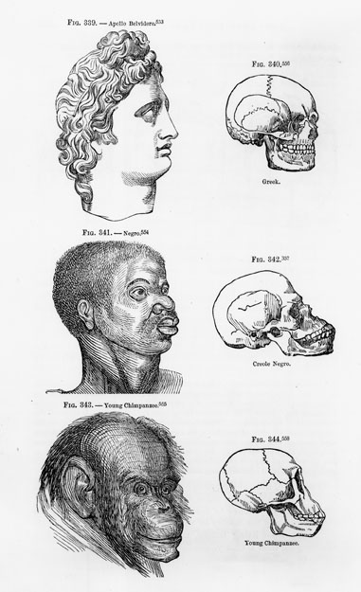
An illustration from Types of Mankind, an 1854 book by physicians and racial theorists Josiah C. Nott and George R. Gliddon, who argued that blacks formed a separate species, midway between whites and chimpanzees. Abolitionists sought to counter the pseudoscientific defenses of slavery and racism.

Slide 46
Black and White Abolitionism
Slavery and American Freedom
Black abolitionists rejected America’s claim to be a land of freedom, and many free blacks dramatically reversed the common association of the United States with the progress of liberty.
Black communities, barred from celebrating Independence Day in many northern communities, instead celebrated January 1, the day the foreign slave trade was abolished, or August 1, the anniversary of West Indian emancipation.
Blacks openly praised Great Britain as a nation of freedom, contrasting it with America as a land of tyranny. More than white counterparts, black abolitionists forged an ideal of color-blind citizenship. They also argued that black poverty was caused by slavery and that freedom had an economic dimension as well.
Frederick Douglass in Rochester, New York in 1852. Speaking after Independence Day festivities, Douglass asked “What, to the Slave, is the Fourth of July?” He answered that Fourth of July celebrations showed the hypocrisy of a nation proclaiming its commitment to liberty and yet daily committing “practices more shocking and bloody” than any other nation. But Douglass also claimed the Revolution’s legacy and its “rich inheritance of justice, liberty, prosperity, and independence.” Douglass suggested that America could restore its original mission to spread freedom only when it abolished slavery and freed the “great doctrines” of the Declaration of Independence from the “narrow bounds” of race.
Frederick Douglass – 4th of July Speech: http://www.pbs.org/wgbh/aia/part4/4h2927.html
Notes:
Black abolitionists rejected America’s claim to be a land of freedom, and many free blacks dramatically reversed the common association of the United States with the progress of liberty. Black communities, barred from celebrating Independence Day in many northern communities, instead celebrated January 1, the day the foreign slave trade was abolished, or August 1, the anniversary of West Indian emancipation. Blacks openly praised Great Britain as a nation of freedom, contrasting it with America as a land of tyranny. More than white counterparts, black abolitionists forged an ideal of color-blind citizenship. They also argued that black poverty was caused by slavery and that freedom had an economic dimension as well.
The greatest speech on American slavery and American freedom was delivered by Frederick Douglass in Rochester, New York in 1852. Speaking after Independence Day festivities, Douglass asked “What, to the Slave, is the Fourth of July?” He answered that Fourth of July celebrations showed the hypocrisy of a nation proclaiming its commitment to liberty and yet daily committing “practices more shocking and bloody” than any other nation. But Douglass also claimed the Revolution’s legacy and its “rich inheritance of justice, liberty, prosperity, and independence.” Douglass suggested that America could restore its original mission to spread freedom only when it abolished slavery and freed the “great doctrines” of the Declaration of Independence from the “narrow bounds” of race.

Slide 47
Black and White Abolitionism
Gentlemen of Property and Standing
Abolitionism initially sparked violent hostility from northerners who thought the movement threatened to dissolve the Union, interfere with profits originating in slave labor, and overthrow white supremacy.
Led by “gentlemen of property and standing,” usually merchants with economic ties to the South, mobs disrupted abolitionist meetings, destroyed abolitionists’ printing presses, and assaulted abolitionist activists.
William Lloyd Garrison was nearly lynched by one Boston mob. In 1837, anti-slavery editor Elijah Lovejoy was killed by a mob in Illinois while defending the printing press for his newspaper from assault, for the fifth and final time.
Andrew Jackson’s attorney general allowed abolitionist literature to be removed from the mails.
In 1836, when abolitionists flooded the House of Representatives with petitions calling for emancipation in Washington, D.C., the House adopted the “gag rule”, which prohibited that body from considering the petitions. The rule was repealed in 1844, in great part due to the efforts of former president John Quincy Adams.
Notes:
Abolitionism initially sparked violent hostility from northerners who thought the movement threatened to dissolve the Union, interfere with profits originating in slave labor, and overthrow white supremacy. Led by “gentlemen of property and standing,” usually merchants with economic ties to the South, mobs disrupted abolitionist meetings, destroyed abolitionists’ printing presses, and assaulted abolitionist activists. William Lloyd Garrison was nearly lynched by one Boston mob. In 1837, anti-slavery editor Elijah Lovejoy was killed by a mob in Illinois while defending the printing press for his newspaper from assault, for the fifth and final time. Andrew Jackson’s attorney general allowed abolitionist literature to be removed from the mails. In 1836, when abolitionists flooded the House of Representatives with petitions calling for emancipation in Washington, D.C., the House adopted the “gag rule,” which prohibited that body from considering the petitions. The rule was repealed in 1844, in great part due to the efforts of former president John Quincy Adams.
By then, attacks on the free speech of abolitionists convinced many Northerners that slavery was incompatible with the democratic liberties of white Americans. Abolitionists broadened their appeal in order to win the support of northerners who cared little for black rights, but could be persuaded that slavery threatened their own freedoms. The struggle to discuss slavery and its abolition in public made abolitionism the first great struggle for free speech in American history.

Slide 48
Black and White Abolitionism
Slavery and Civil Liberties
By then, attacks on the free speech of abolitionists convinced many Northerners that slavery was incompatible with the democratic liberties of white Americans.
Abolitionists broadened their appeal in order to win the support of northerners who cared little for black rights, but could be persuaded that slavery threatened their own freedoms.
The struggle to discuss slavery and its abolition in public made abolitionism the first great struggle for free speech in American history.

Slide 49
The Origins of Feminism
The Rise of the Public Woman
Women Abolitionists: Much of abolitionism’s strength was found in northern women, who joined it in large numbers. Most were evangelical Protestants, New England Congregationalists, or Quakers, who thought that slavery violated Christian belief and practice.
Literacy & Advocacy: The public sphere was open to women in ways that government and party politics were not. Women could use their writing and speaking skills to make social changes.
Rights: They could not vote, but they could circulate petitions, attend meetings, march in parades, and speak in public.
Other Reforms: Women were active in the temperance movement, building asylums (mental health treatment), and redemption of prostitutes
Notes:
Much of abolitionism’s strength was found in northern women, who joined it in large numbers. Most were evangelical Protestants, New England Congregationalists, or Quakers, who thought that slavery violated Christian belief and practice. The public sphere was open to women in ways that government and party politics were not. They could not vote, but they could circulate petitions, attend meetings, march in parades, and speak in public. Women were active in the temperance movement, building asylums, and other reform campaigns. Women were also critical in campaigns to redeem prostitutes from sin and protect the morality of single women, and they attacked the sexual double standard by identifying men who frequented prostitutes or abused women.
Women’s participation in abolitionism inspired the early movement for women’s rights. In fighting for the rights of slaves, women gained a new understanding of their own subordination in society and law. Angelina and Sarah Grimké, daughters of a South Carolina slaveholder, converted to Quakerism and abolitionism while visiting Philadelphia and begin to denounce slavery in public. They had been preceded by Fanny Wright, a Scottish-born follower of Robert Owen, who spoke on communitarianism, slavery, and labor reform in the late 1820s and early 1830s. The Grimké sisters used controversy over their speeches to denounce the idea that it was unfeminine for women to engage in public activity. Male criticism led them to advocate the necessity for sexual equality in all spheres of life.

Slide 50
The Origins of Feminism The Rise of the Public Women
Dorothea Dix - advocated the construction of humane mental hospitals for the insane
“Dorothea Dix: The Asylum Movement: http://www.history.com/topics/womens-history/dorothea-lynde-dix
Background: http://www.massmoments.org/moment.cfm?mid=96

Slide 51
The Origins of Feminism
Women and Free Speech
Women’s participation in abolitionism inspired the early movement for women’s rights. In fighting for the rights of slaves, women gained a new understanding of their own subordination in society and law.
Angelina and Sarah Grimké, daughters of a South Carolina slaveholder, converted to Quakerism and abolitionism while visiting Philadelphia and begin to denounce slavery in public.
The Grimké sisters used controversy over their speeches to denounce the idea that it was unfeminine for women to engage in public activity. Male criticism led them to advocate the necessity for sexual equality in all spheres of life.
The Grimké sisters were the first to apply the abolitionist doctrine of universal freedom and equality to women’s status. Their work and writings helped inspire other women to adopt the standard of women’s rights in the early 1840s.
Grimke Sisters:
http://www.gilderlehrman.org/history-by-era/slavery-and-anti-slavery/essays/angelina-and-sarah-grimke-abolitionist-sisters
http://www.nps.gov/wori/historyculture/grimke-sisters.htm

Slide 52
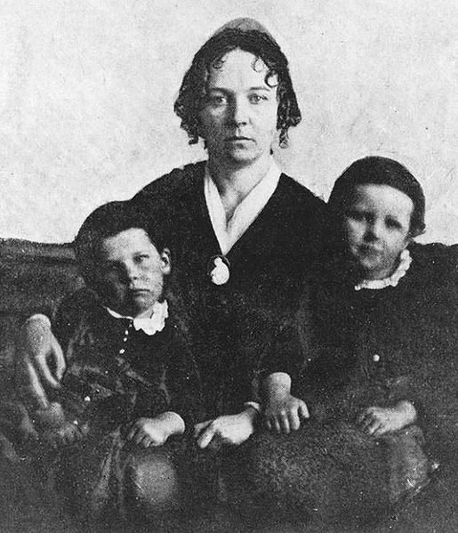
Historical Context Seneca Falls Convention 1848
Women’s Rights Convention in Seneca Falls, New York
Map
First American document to advocate women’s suffrage
Elizabeth Cady Stanton
with her children

Slide 53
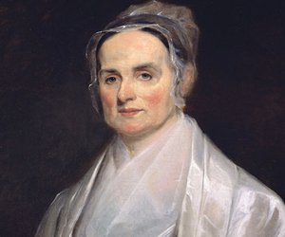
Historical Context - Women’s Rights
Elizabeth Cady Stanton
Lucretia Mott (1793 – 1880)– Quaker, detested slavery and gender inequality
key organizers of the Seneca Falls Convention, (1848), women’s rights convention
anti-slavery activists.
Barred from abolitionist meetings because of their gender.
Notes:
The Grimké sisters were the first to apply the abolitionist doctrine of universal freedom and equality to women’s status. Their work and writings helped inspire other women to adopt the standard of women’s rights in the early 1840s. Elizabeth Cady Stanton and Lucretia Mott, who became key organizers of the Seneca Falls Convention (the women’s rights convention of 1848), were anti-slavery activists. They had been barred from abolitionist meetings because of their sex. The Seneca Falls Convention raised the issue of women’s suffrage for the first time in American history. The Seneca Falls “Declaration of Sentiments,” modeled on the Declaration of Independence, added women to Jefferson’s proposition that “all men are created equal,” and listed the injuries men had inflicted on women, including denying them the right to vote. The Seneca Falls Convention further denounced an entire social structure that denied women access to education, employment, property and wages, and children in the event of divorce, deprived women of independent legal status when they married, and restricted them to the home.
Many middle-class women criticized restrictions that made it impossible for them to gain an education, enter a profession, or otherwise develop and use their talents. Early feminists argued that women deserved the range of choices that made up the essence of freedom. Women, they argued, should be allowed the same opportunities to fully develop themselves as men enjoyed.

Slide 54
Elizabeth Cady Stanton
Elizabeth and her growing family lived in Seneca Falls from 1847 to 1862. During that time Stanton helped organize the 1848 First Woman’s Rights Convention and launched the reform movement for women’s rights to which she dedicated the rest of her life. She later wrote in her autobiography: “The general discontent I felt with women’s portion as wife, mother, housekeeper, physician, and spiritual guide, the chaotic conditions into which everything fell without constant supervision, impressed me with a strange feeling that some active measures should be taken to remedy the wrongs…of women.”

Slide 55
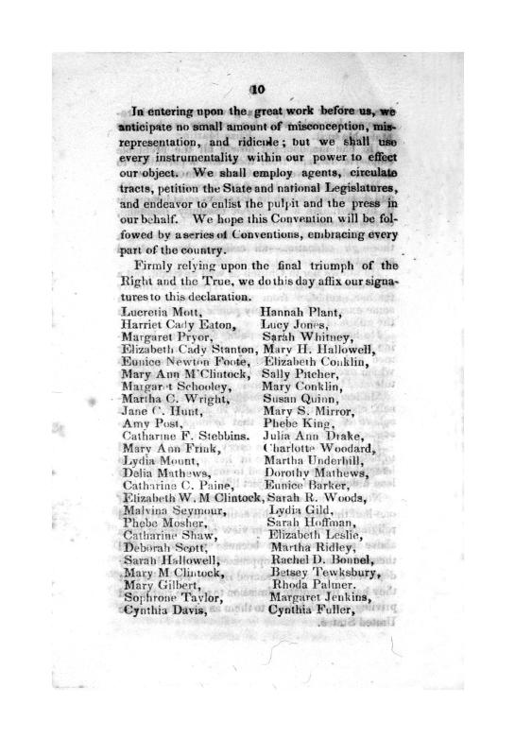
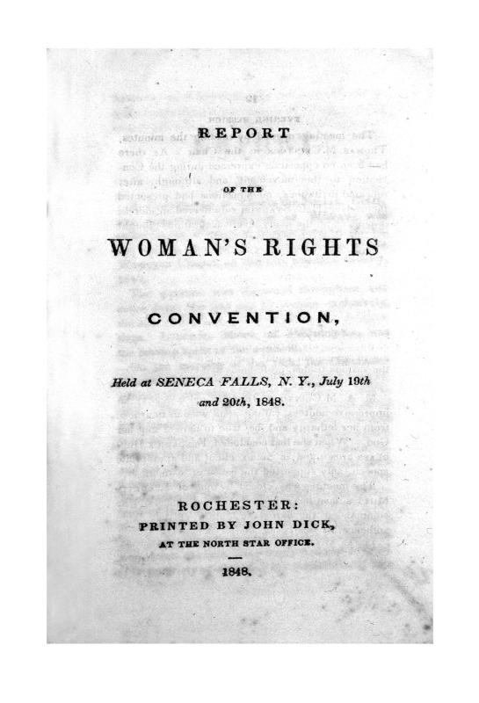
Audience
Men and Women Reformers from middle class
Attendees: 68 Women + 32 Men

Slide 56
Purpose
Advocate for Women’s Rights: Vote, Own Property

Slide 57
Point of View
Elizabeth Cady Stanton – white female abolitionist who rewrote the Declaration of Independence to frame women’s rights
“We hold these truths to be self-evident: that all men and women are created equal…”
Women should have access to voting, education, property, equality in the home, economic equality

Slide 58
Y (Significance) Seneca Falls Convention & Declaration of Rights and Sentiments
First American document to advocate women’s suffrage
Denounced the social structure that denied women access to education, employment, property and wages, and children in the event of divorce, deprived women of independent legal status when they married, and restricted them to the home
Beginning of the Women’s Rights Movement
Led to the passage of the 19th Amendment (1920)
Reflects reliance on ideals and freedoms in the Declaration of Independence being expanded to women

Slide 59
The Seneca Falls “Declaration of Sentiments”
Question 1: Key Demands
Right to Vote
Right to hold property
Equal to her Husband (end coverture)
Don’t tax property (unmarried) if can’t vote
Equality if work (equal pay and job opportunity)
modeled on the Declaration of Independence
added women to Jefferson’s proposition that “all men are created equal,”
listed the injuries men had inflicted on women – denying them the right to vote. http://www.fordham.edu/halsall/mod/senecafalls.asp

Slide 60
The Seneca Falls “Declaration of Sentiments”
Question 2:
The Declaration of Sentiments defines freedom for women by rejecting traditional roles for women (coverture, Republican Motherhood, Cult of Domesticity, subservience socially, economically, politically).
modeled on the Declaration of Independence
“We hold these truths to be self-evident: that all men and women are created equal…”

Slide 61
Women in the 19th Century: Crash Course US History #16
Describe each of the following:
Coverture
Republican Motherhood
Cult of Domesticity
Jobs attained by Poor Women
Temperance
Amelia Bloomer

Slide 62
Women in the 19th Century: Crash Course US History #16
Describe each of the following:
Coverture (husband has authority of wife's legal/social life)
Republican Motherhood (post American Revolution, women expected to prepare sons for Republican society; gave access to education, counted toward representation in House)
Cult of Domesticity (response to the Market Revolution, women do less production in home, woman's place is in the home by providing food, love/friendship/mutual obligation)
Jobs attained by Poor Women: factories, domestic servants, seamstress, teaching (wages controlled by husband)
Temperance: protect against domestic abuse
Amelia Bloomer help women adapt to work with Bloomers

Slide 63
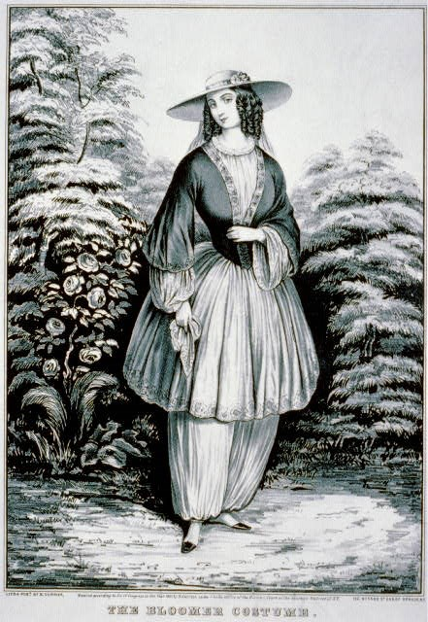

Slide 64
Women and Work
Early feminists challenged the idea of a “women’s sphere” in a number of ways.
Some wore a new style of dress made of loose-fitting tunics and trousers, called “bloomers,” intended to liberate women from the extremely restrictive dresses and corsets that so confined them as to make it impossible for them to engage in much physical activity. Traditional clothing was cumbersome and heavy (whale bone corsets).
Amelia Bloomer Background: https://www.nps.gov/wori/learn/historyculture/amelia-bloomer.htm
Bloomers Image: http://www.loc.gov/exhibits/treasures/images/vc006204.jpg
Notes:
Women also insisted on the right to participate in the market revolution. Although women at Seneca Falls were mostly middle class, attendees rejected the notion that the home was “women’s sphere.” Early feminists challenged this idea in a number of ways. Some wore a new style of dress made of loose-fitting tunics and trousers, called “bloomers,” intended to liberate women from the extremely restrictive dresses and corsets that so confined them as to make it impossible for them to engage in much physical activity. While feminism, by calling for rights equal to men, in one sense demanded an expansion of freedom rather than its redefinition, in another sense feminism challenged prevailing notions of women’s innate difference—that women were naturally dependent and irrational, that the world was divided into public and private spheres, and that issues of justice and fairness did not apply to family relations.
Feminists used slavery to coin a concept, the “slavery of sex,” which critiqued all aspects of women’s subordination to male authority. While Mary Wollstonecraft had long ago made an analogy between marriage and slavery, this analogy was spread by abolitionism. Southern defenders of slavery often linked slavery and marriage as natural forms of inequality. Of course, while slavery and marriage were technically different, married women, until the passage of women’s property and wage laws around the time of the Civil War, could not own their own property or retain their own wages, which instead accrued to their husbands.

Slide 65
Feminism and Freedom
Many middle-class women criticized restrictions that made it impossible for them to gain an education, enter a profession, or otherwise develop and use their talents.
Early feminists argued that women deserved the range of choices that made up the essence of freedom. Women, they argued, should be allowed the same opportunities to fully develop themselves as men enjoyed.

Slide 66
The Origins of Feminism
While feminism, by calling for rights equal to men, in one sense demanded an expansion of freedom rather than its redefinition, in another sense feminism challenged prevailing notions of women’s innate difference—that women were naturally dependent and irrational, that the world was divided into public and private spheres, and that issues of justice and fairness did not apply to family relations.
Women also insisted on the right to participate in the market revolution.

Slide 67
The Origins of Feminism
The Slavery of Sex
Feminists used slavery to coin a concept, the “slavery of sex,” which critiqued all aspects of women’s subordination to male authority.
While Mary Wollstonecraft had long ago made an analogy between marriage and slavery, this analogy was spread by abolitionism.
Southern defenders of slavery often linked slavery and marriage as natural forms of inequality.
While slavery and marriage were different, married women, until the passage of women’s property and wage laws around the time of the Civil War, could not own their own property or retain their own wages, which instead accrued to their husbands.

Slide 68
The Origins of Feminism
“Social Freedom”
Inspired by abolitionism, women’s rights advocates turned the popular understanding of self-ownership, or control over one’s person, in a new direction.
The abolitionist’s emphasis on the slave master’s violation of the slave woman’s body lent a new reality to the ideal of self-ownership for women’s rights activists.
The law of domestic relations assumed a husband’s right of sexual access to his wife and his right to inflict corporal punishment on her. Courts generally did not interfere in cases of physical or sexual abuse unless it was extreme.
The issue of women’s private freedom showed underlying differences in the women’s rights movement. A belief in equality between the sexes and notions of natural differences between men and women co-existed in the movement.
Even as some feminists entered the public sphere and challenged aspects of the “cult of domesticity, they accepted other dimensions of women’s subordination.
Even staunch feminists like Susan B. Anthony avoided discussion of women’s sexual freedoms, in and out of marriage. Yet the gradual decline in birthrates over the course of the nineteenth century indicates that many women exercised more freedom in their intimate lives.
Notes:
Inspired by abolitionism, women’s rights advocates turned the popular understanding of self-ownership, or control over one’s person, in a new direction. The abolitionist’s emphasis on the slave master’s violation of the slave woman’s body lent a new reality to the ideal of self-ownership for women’s rights activists. The law of domestic relations assumed a husband’s right of sexual access to his wife and his right to inflict corporal punishment on her. Courts generally did not interfere in cases of physical or sexual abuse unless it was extreme.
The issue of women’s private freedom showed underlying differences in the women’s rights movement. A belief in equality between the sexes and notions of natural differences between men and women co-existed in the movement. Even as some feminists entered the public sphere and challenged aspects of the “cult of domesticity, they accepted other dimensions of women’s subordination. Even staunch feminists like Susan B. Anthony avoided discussion of women’s sexual freedoms, in and out of marriage. Yet the gradual decline in birthrates over the course of the nineteenth century indicates that many women exercised more freedom in their intimate lives.

Slide 69
The Abolitionist Schism
Objection to Women’s Role in Reform:
Even in reform circles, the issue of women’s rights was very controversial.
Abolitionist men who welcomed women’s participation typically did not welcome their advocacy of rights for themselves.
American Anti-Slavery Society Divides:
Disagreement over women’s proper role in abolitionist activity sparked a split in abolitionist ranks in 1840.
The appointment of a female abolitionist (Abby Kelly) to the business committee of the American Anti-Slavery Society caused male abolitionists who believed women should not occupy such a prominent position to form their own rival organization, the American and Foreign Anti-Slavery Society.
Notes:
Even in reform circles, the issue of women’s rights was very controversial. Abolitionist men who welcomed women’s participation typically did not welcome their advocacy of rights for themselves. Disagreement over women’s proper role in abolitionist activity sparked a split in abolitionist ranks in 1840. The appointment of a female abolitionist to the business committee of the American Anti-Slavery Society caused male abolitionists who believed women should not occupy such a prominent position to form their own rival organization, the American and Foreign Anti-Slavery Society. Behind the split was a fear among some abolitionists that Garrison’s radicalism on issues like women’s rights, and his refusal to endorse voting or running candidates for office, was stunting the movement’s growth. To make abolitionism a political movement, these men formed the Liberty Party, whose candidate for president in 1840 received only one-third of 1 percent of the total vote.
By 1840, the abolitionist movement had accomplished its most important work. It had spread the message of anti-slavery throughout the North and awakened a broad array of people and groups to the evils of slavery and the necessity of its abolition. The movement’s greatest achievement was ending the conspiracy of silence that attempted to maintain national unity by suppressing public debate on slavery.

Slide 70
The Abolitionist and Politics
Liberty Party
To make abolitionism a political movement, these men formed the Liberty Party, whose candidate for president in 1840 received only one-third of 1 percent of the total vote.
By 1840, the abolitionist movement had accomplished its most important work. It had spread the message of anti-slavery throughout the North and awakened a broad array of people and groups to the evils of slavery and the necessity of its abolition. The movement’s greatest achievement was ending the conspiracy of silence that attempted to maintain national unity by suppressing public debate on slavery.

Slide 71
Additional Art for Chapter 12

Slide 72
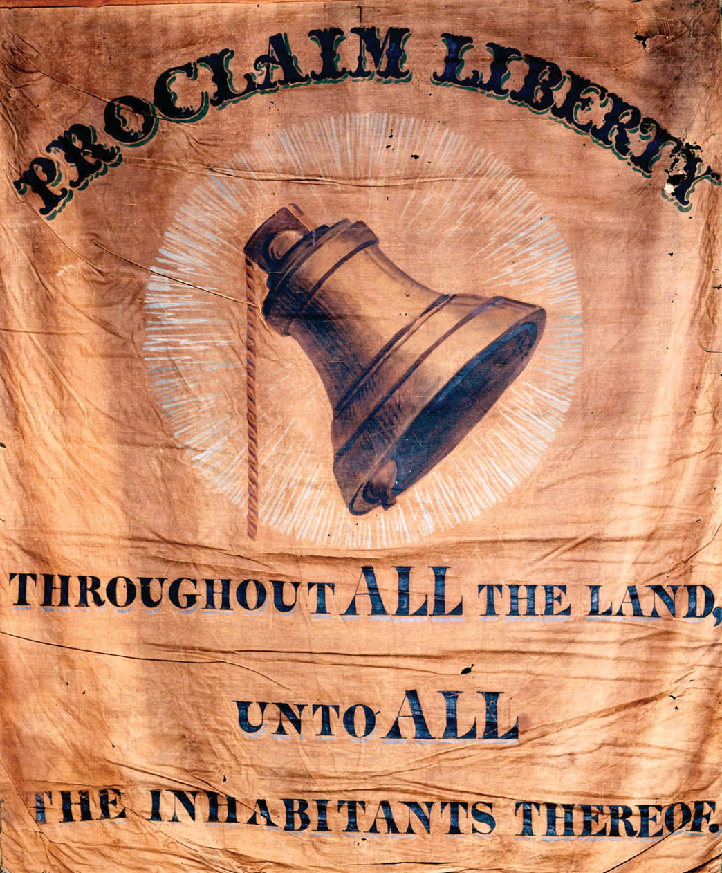
An abolitionist banner.
Give Me Liberty!: An American history, 3rd Edition
Copyright © 2011 W.W. Norton & Company

Slide 73
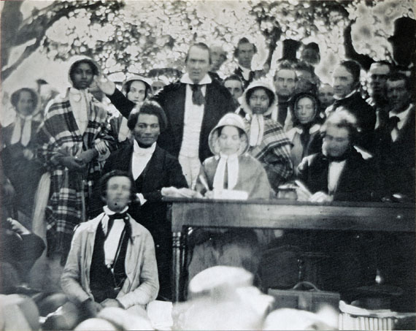
A rare photograph of an abolitionist meeting in
New York State around 1850.
Give Me Liberty!: An American history, 3rd Edition
Copyright © 2011 W.W. Norton & Company

Slide 74
An engraving of a Shaker dance
Give Me Liberty!: An American history, 3rd Edition
Copyright © 2011 W.W. Norton & Company

Slide 75
The Crisis, a publication by the communitarian
Robert Owen
Give Me Liberty!: An American history, 3rd Edition
Copyright © 2011 W.W. Norton & Company

Slide 76
The Drunkard’s Progress, an 1826
Give Me Liberty!: An American history, 3rd Edition
Copyright © 2011 W.W. Norton & Company

Slide 77
A temperance banner from around 1850
Give Me Liberty!: An American history, 3rd Edition
Copyright © 2011 W.W. Norton & Company

Slide 78
A German Beer Garden on Sunday
Give Me Liberty!: An American history, 3rd Edition
Copyright © 2011 W.W. Norton & Company

Slide 79
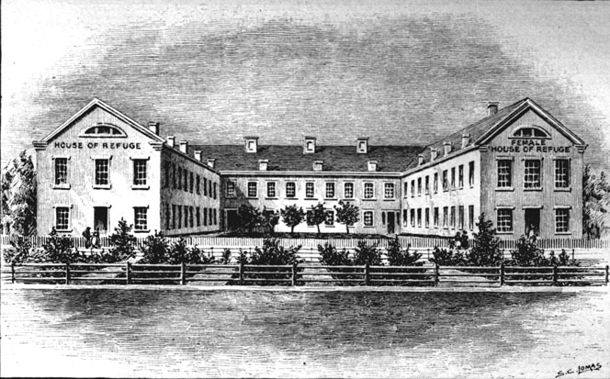
The New York House of Refuge
Give Me Liberty!: An American history, 3rd Edition
Copyright © 2011 W.W. Norton & Company

Slide 80
This daguerreotype from around 1850
Give Me Liberty!: An American history, 3rd Edition
Copyright © 2011 W.W. Norton & Company

Slide 81
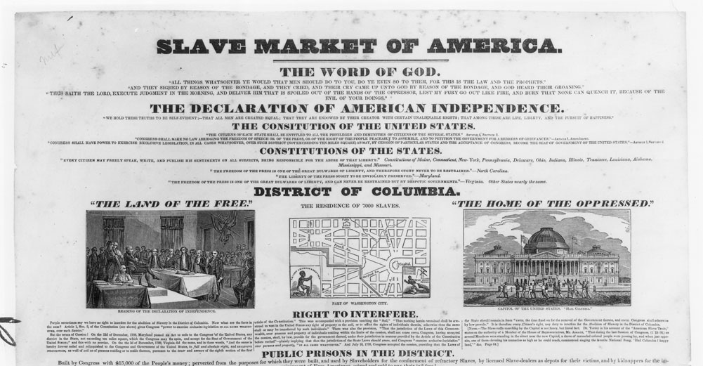
Slave Market of America
Give Me Liberty!: An American history, 3rd Edition
Copyright © 2011 W.W. Norton & Company

Slide 82
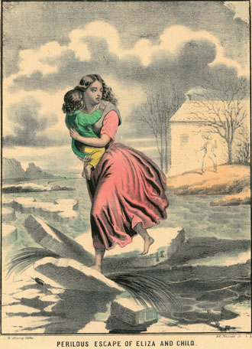
One of many popular lithographs illustrating scenes
Give Me Liberty!: An American history, 3rd Edition
Copyright © 2011 W.W. Norton & Company

Slide 83
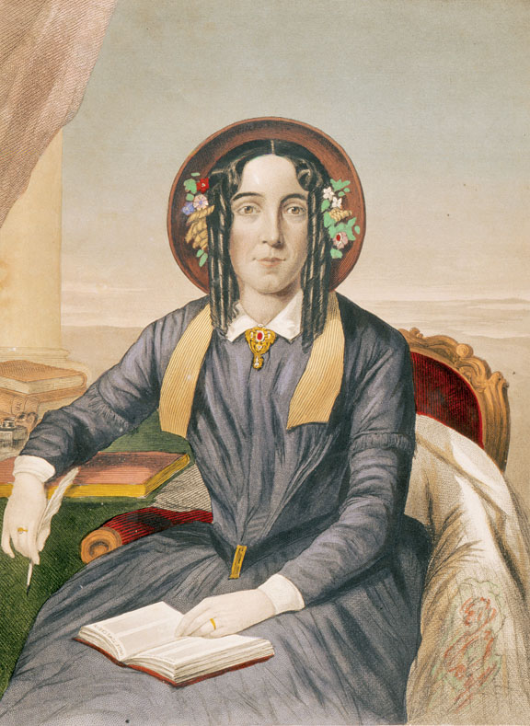
Harriet Beecher Stowe
Give Me Liberty!: An American history, 3rd Edition
Copyright © 2011 W.W. Norton & Company

Slide 84
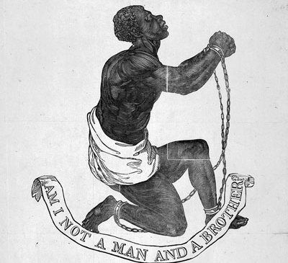
Am I Not a Man and a Brother?
Give Me Liberty!: An American history, 3rd Edition
Copyright © 2011 W.W. Norton & Company

Slide 85
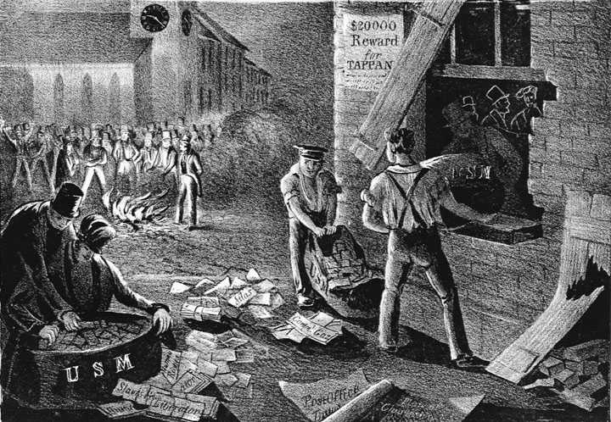
A New Method of Assorting the Mail
Give Me Liberty!: An American history, 3rd Edition
Copyright © 2011 W.W. Norton & Company

Slide 86
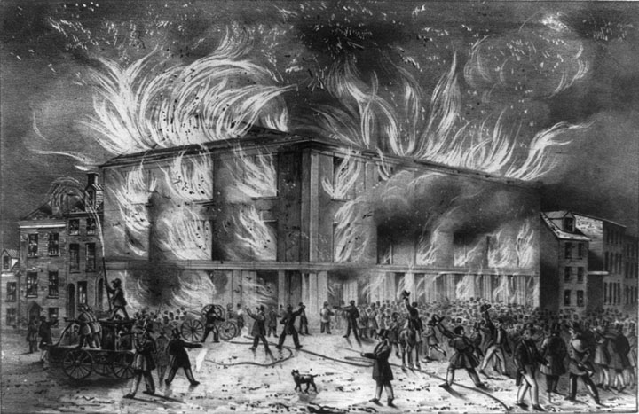
Destruction by Fire of Pennsylvania
Give Me Liberty!: An American history, 3rd Edition
Copyright © 2011 W.W. Norton & Company

Slide 87
A Women’s Rights Quilt.
Give Me Liberty!: An American history, 3rd Edition
Copyright © 2011 W.W. Norton & Company

Slide 88
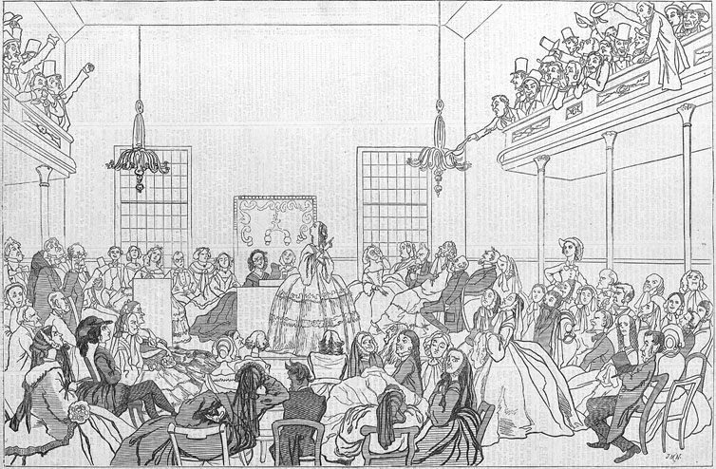
The May Session of the Woman’s Rights Convention
Give Me Liberty!: An American history, 3rd Edition
Copyright © 2011 W.W. Norton & Company

Slide 89
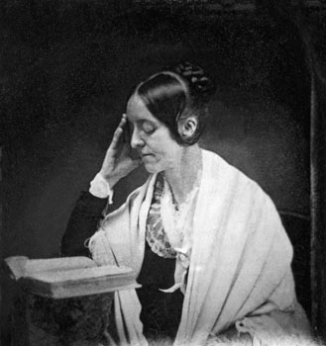
Portrait of feminist Margaret Fuller (1810–1850)
Give Me Liberty!: An American history, 3rd Edition
Copyright © 2011 W.W. Norton & Company

Slide 90
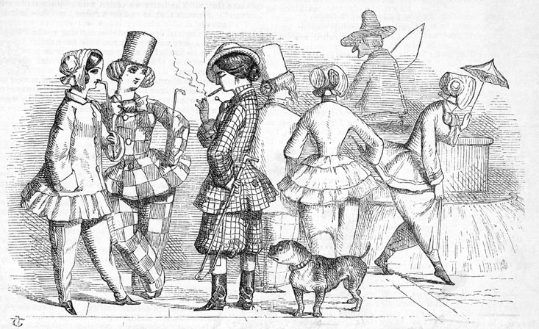
Woman’s Emancipation
Give Me Liberty!: An American history, 3rd Edition
Copyright © 2011 W.W. Norton & Company

Slide 91
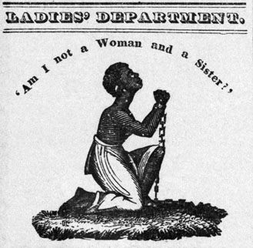
Am I Not a Woman and a Sister?
Give Me Liberty!: An American history, 3rd Edition
Copyright © 2011 W.W. Norton & Company

Slide 92
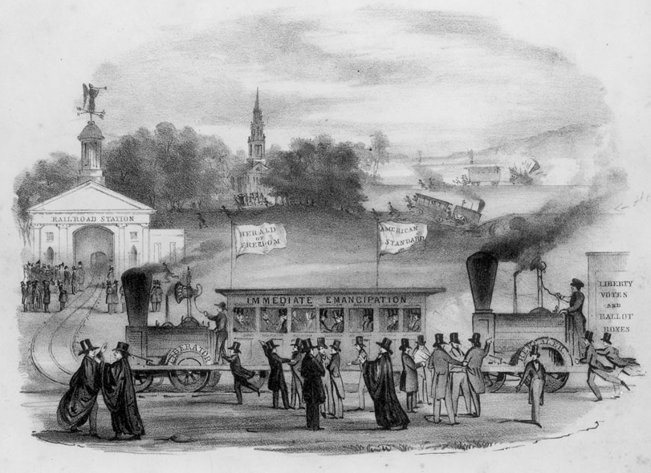
This image appeared on the cover of
the sheet music for “Get Off the Track!”.
Give Me Liberty!: An American history, 3rd Edition
Copyright © 2011 W.W. Norton & Company

Slide 93
Norton Lecture Slides Independent and Employee-Owned
This concludes the Norton Lecture Slides
Slide Set for Chapter 12
Give Me Liberty!
AN AMERICAN HISTORY
THIRD EDITION
by
Eric Foner

