Slide 1
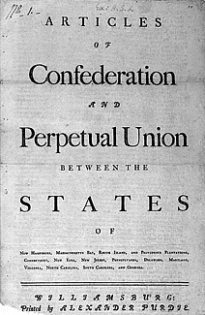
ARTICLES OF CONFEDERATION
DRAFTED: 1777
RATIFIED: 1781 – 1787
PURPOSE:
This document was a constitution written during the American Revolution to establish the powers of the new national government.
PROBLEM: They were too weak to support the government of the newly established United States of America.
Office of the Historian: https://history.state.gov/milestones/1776-1783/articles

Slide 2
The Articles of Confederation 1781-1788
1st Constitution
PURPOSE:
During the Revolution, the new United States needed a functioning government
Modeled after colonial governments
States would retain sovereignty
Founders were fearful of concentrated power due to past experience with the British
Notes:
The Articles of Confederation were crafted from a combination of urgent necessity and past experience. After the colonies declared their independence in 1776, the leaders needed a government to oversee the operation of the war and, if victorious, help the country settle the peace. Fundamental issues needed to be addressed: How much political power should be given to the central government when cooperation among the states was so important? Would France gamble on aiding the fledgling nation if the United States appeared weak? How would the central government speak for all the states while each state maintained its sovereignty?
In 1777, the “Articles of Confederation and Perpetual Union” were drafted and submitted to the states for ratification, but the states didn’t approve the document until March of 1781. The Articles were modeled after the colonial charters, with the legislative branch having supremacy over the other branches. The Articles’ creators made sure that each state would remain sovereign and would retain all power not expressly given to the national Congress. This would insure that all decisions made by the government were subject to discussion and debate and that the states would never face a distant dominant power as when they were colonies under Britain.

Slide 3
How is Confederal different from Federalism?
Confederal:
States are more powerful than the national gov.
Federalism: National government and the States SHARE power

Slide 4
A Limited Government
Articles established a “firm league of friendship” among the states
Bills were passed on nine of thirteen votes
Amending the Articles took unanimous consent of the states
Second Continental Congress established a “league of friendship” among the 13 independent states
Notes:
The Articles established a government which it characterized as a “league of friendship” for common defense, communication with other nations, and to administer and operate the government. It was assumed that most legislation and enforcement of laws would occur within the states and that laws passed by the national Congress would only be to administer the powers it was given. Even so, any law passed would have to be carried by a “supermajority” of over 67 percent, with nine of thirteen states voting in the affirmative. To further insure that the central government would not be granted any increase in power, any amendment to the Articles needed the unanimous consent of all the states.

Slide 5
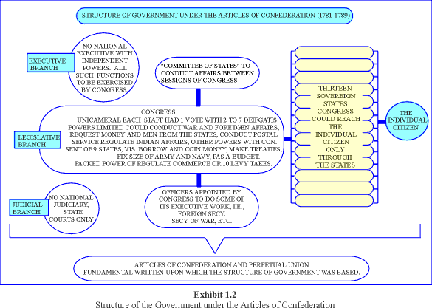
Structure of Government
.
Legislature: Unicameral (single house) legislative body
Each state had one vote regardless of population size
NO Executive or Judicial branch
Notes:
The creators of the Articles believed that government was an agreement with the people and that power originated from the people. They further believed the best form of government was a republic, in which the people’s wishes were addressed by chosen representatives. The legislative body would be elected by and directly responsible to the people.
Soon after independence had been declared, many smaller states expressed concern regarding the overlapping claims to western lands made by many of the states with larger populations. The small states feared their voices would be drowned out if representation was based solely on population. Thus, to equalize representation in Congress, each state had one vote—regardless of the size of its population.
Congress was given the responsibility for governing the country; however, it wasn’t given much power to do so. An executive committee was meant to oversee the operations of the government, but it ended up serving more like a cabinet of advisors than as actual leadership. Congress had the authority to establish temporary courts to hear disputes among the states, but these courts could act only as mediators because they and the executive committee had no power to enforce the laws.

Slide 6
Powers Granted to National Government under the Articles of Confederation
Declare war and make peace
Make treaties with foreign countries
Establish an army and navy
Appoint high-ranking military officials
Requisition, print, and borrow money
Establish weights and measures
Hear disputes among the states related to trade or boundaries
Notes:
The Articles of Confederation granted Congress important powers to operate the government. When the document was drafted in 1777, the immediate concern was conducting the war and hopefully crafting a favorable peace treaty. To carry out the war, Congress needed the power to make treaties with foreign nations and to establish an army and navy and appoint military officers. Such powers gave Congress authority over affairs with foreign nations.
To help pay for the war and for the operation of the government after independence had been won, Congress would need to requisition funds and to print and borrow money. This requisitioning power allowed Congress to ask the states for funds, which the states would provide if they were able or inclined to do so.
Under the Articles, Congress also had the power to hear disputes among the states related to trade and boundaries. During and after the war, individual states sometimes established tariffs in order to raise revenue and discourage the sale of imports from foreign countries or neighboring states that competed with homegrown products. Other states targeted by these tariffs usually retaliated in kind.

Slide 7
Powers Denied to National Government
NO power to raise funds for an army or navy
No power to tax, impose tariffs, or collect duties
No power to regulate commerce
No power to control trade among the states
No power to regulate the value of currency
No power to force states to honor obligations
No executive branch to enforce laws
No national court system to resolve disputes
Notes:
The Articles didn’t provide the government with enough authority to fully carry out the tasks it was given. Though Congress could declare war and raise military forces, it couldn’t pay for them because it lacked the power to tax. Congress could requisition funds from the states, but had no power to make them part with their money. Congress could borrow money, but had no way to raise funds to pay off the debt except to ask the states for funds. If a state disagreed with the way Congress spent the funds, it would refuse or delay payment.
Congress could appoint a court to hear the disputes between states, but it couldn’t enforce decisions the courts made. Thus, if a court ruled in favor of one state over another, the losing state wouldn’t have to comply with the decision.
After the war, the Treaty of Paris stipulated that British citizens still living in the former colonies would receive compensation for land or property seized. However, individual states did not force their citizens to make such restitution and Congress had no authority to compel the states to obey the treaty’s provisions.
To pay off the debt from the war, Congress was authorized to print money; however, each of the states had the power to print money as well. The resulting increase in currency, combined with a slowdown in the postwar economy, sent the young country into a deep economic depression. Inflation rose so high that the Continental Dollar became virtually worthless.

Slide 8
Weaknesses in Cartoon
http://www.mrvanduyne.com/CriticalPeriod/ArticlesWup2/ArticlesWup2.htm

Slide 9
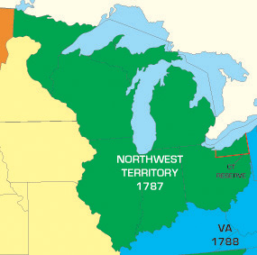
Accomplishments of the Articles of Confederation
American Revolution
Treaty of Paris – 1783
Northwest Ordinance 1787
Map of the land settled in the Northwest Ordinance of 1787
Notes:
Though they had many shortcomings, the Articles of Confederation cannot be considered a total failure. Under them, the government operated for nearly 12 years and managed to conduct a successful war of rebellion against what was then the most powerful country in the world.
Under the Articles, the United States also negotiated a very favorable peace treaty in which Britain formally recognized the United States and agreed to remove all British troops from U.S. territory. From the land granted to the United States as a result of the treaty, the country doubled in size, gaining land that today holds the states of Ohio, Indiana, Michigan, Illinois, Wisconsin, and part of Minnesota.
Many historians view the Northwest Ordinance as the most important piece of legislation to come out of this period. The Ordinance provided a method for admitting new states into the Union and for placing them on an equal footing with existing states. Thus, citizens from these new states would enjoy all the rights for which Americans had fought in the Revolution. The Ordinance even provided a bill of rights, something both the Articles and the original Constitution lacked.

Slide 10
Accomplishments of the
Articles of Confederation
NORTHWEST ORDINANCE OF 1787
Adopted by the Confederation Congress on July 13, 1787
Who: Thomas Jefferson, Nathan Dane, Manasseh Cutler, Rufus King
WHAT:
established a government for the Northwest Territory
outlined the process for admitting a new state to the Union
guaranteed equality to the original thirteen states
protected civil liberties (trial by jury, religious freedom)
outlawed slavery in the new territories
create schools

Slide 11
Accomplishments of the
Articles of Confederation
NORTHWEST ORDINANCE OF 1787 – HOW?
Divided the territory into 5 states: Ohio, Indiana, Illinois, Michigan, Wisconsin
Townships = 36 square miles, one reserved for a school
Outlined the process for admitting a new state to the Union
1- Executive & Judicial: Congress chooses Territorial Leaders (Governor, Secretary, 3 judges ) 2- Legislature: Population of 5,000 Free men live in territory, then residents then elect a bicameral legislature Voters: = adult males, 50 acres
3- Statehood: Population = 60,000 (apply for statehood) Constitutional Convention form to write state constitution, approved by Congress

Slide 12
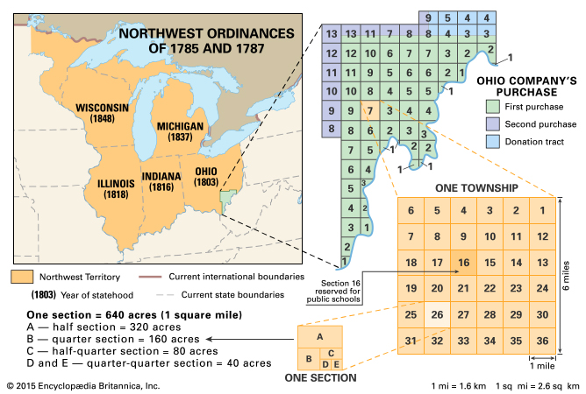

Slide 13
Problems Facing the New Nation: You Decide
Trade with foreign nations
Financing the nation
Foreign relations
Interstate relations
Notes:
Note to teacher: Have your students address the questions in the next series of four slides describing the problems the United States faced under the Articles of Confederation. Students should review the details of the problem as stated on the slide, then examine the potential remedy or remedies to address the problem. Finally, have students discuss the reasons the Articles could not adequately address each problem.

Slide 14
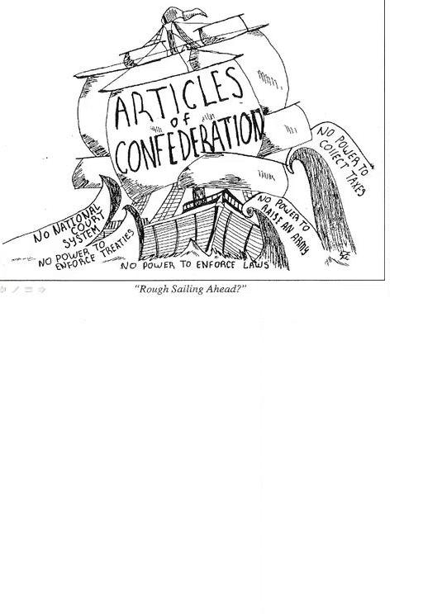
Problems Facing the New Nation
Trade with foreign nations
Financing the nation
Foreign relations
Interstate relations
Notes:
In the years after the Treaty of Paris, the United States experienced a number of near-crippling problems that made the task of governing more difficult. The leaders of the United States had virtually no international experience beyond the confines of the British Empire. They would have to establish diplomatic and economic relations with countries that had been in existence for hundreds of years.
The new nation first had to reestablish trade relations with foreign nations under its own flag rather than that of the powerful British Empire. In addition, Britain would no longer treat the United States as its “favorite child,” and this demotion in status would make establishing trade relations with other countries even more difficult. The U.S. also had to deal with financial troubles. During the war, America had racked up an impressive debt and owed money both to foreign nations and to U.S. citizens.
The states of the new nation would soon prove to be “United” in name only. The colonies had always possessed a sense of separation from one another in times of peace, and had competed often with one another for British favor and economic advantage. The only time the states had truly come together was during the Revolutionary War, and that had only occurred because it suited their needs. With most of the nation’s power residing in state legislatures, the nation under the Articles of Confederation had only a fragile unity at best.

Slide 15
Problems with Trade
U.S. no longer the favorite trading partner of Great Britain
U.S. exports to British ports had to be on British ships
Many U.S.-produced goods were barred from British ports
Britain sent vast amounts of cheap goods to U.S.
US denied access to British West Indies markets
Potential Remedy
Establish a tariff on British goods
Weakness in Articles of Confederation preventing this solution
Notes:
After the war, the United States lost its “favored nation” status with the British Empire and was treated like any other non-allied nation competing in the mercantile system. In retaliation for its rebellion, all U.S. goods exported to any port in the British Empire had to be carried on British ships. This dealt a blow to the fledgling American shipping industry, since Britain was still America’s main trading partner. In addition, some U.S. goods that competed with British-made goods were barred altogether. To help shore up its economy and keep production going, British merchants began flooding American markets with inexpensive goods that often competed with similar goods made in the United States. This drastically hurt local industries that couldn’t compete with the more cheaply manufactured British goods.
Potential Remedy: Establish a tariff on British goods.
Weakness in the Articles: The Articles prevented Congress from imposing any taxes, including tariffs on imports. Individual states could levy tariffs, but these were not binding on other states, and foreign shippers would respond by sending their goods to states that didn’t have a tariff in place.

Slide 16
Review: What were the Weaknesses of the Articles of Confederation ?
9 out of 13 states needed to pass a law
Few laws would ever get passed
All 13 states needed to agree for an amendment
Nearly impossible for all to agree
Could not regulate trade between states
States would fight between themselves over rivers, taxes
Government could not tax
Couldn’t operate effectively
No president to carry out laws
No leadership, nothing gets done
Video: The Articles of Confederation and the Northwest Ordinance (2:33) https://www.youtube.com/watch?v=ML8qtTpVuDs

Slide 20
Newburgh Conspiracy
Washington calmed a potential rebellion of officers concerned with not getting paid by US Congress - more reason to revise the Articles of Confederation
Video: (3:56) https://www.youtube.com/watch?v=loTYJYXpZhE

Slide 22
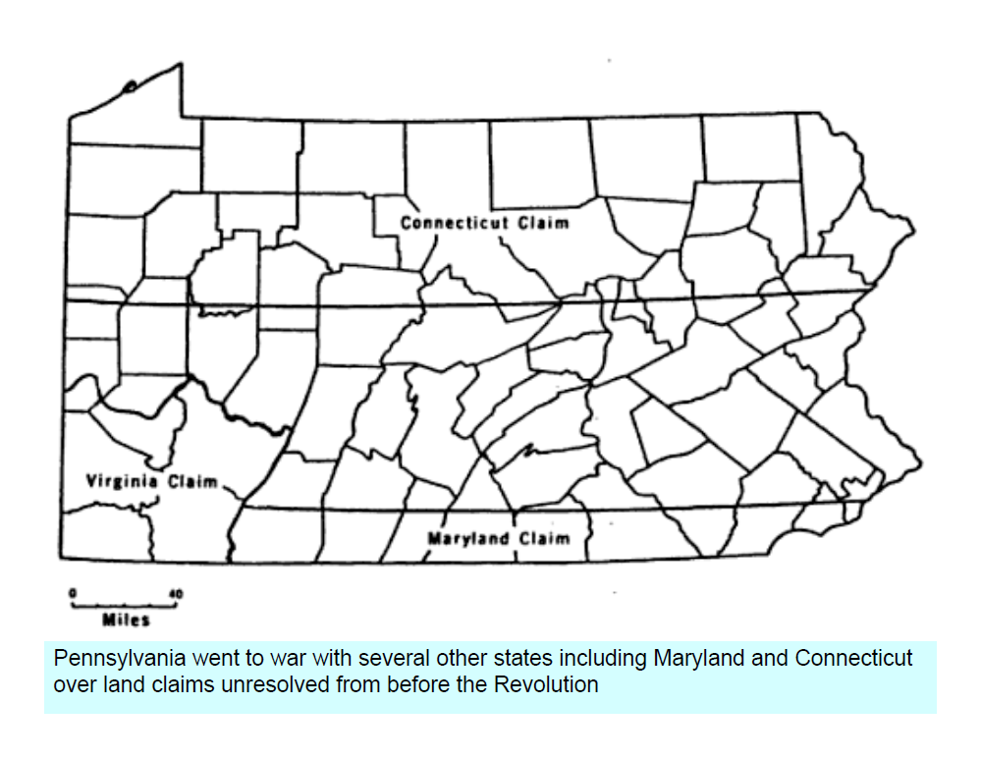

Slide 26
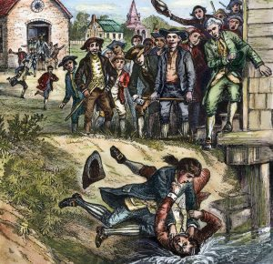
Shay’s Rebellion 1786-1787
Who: Massachusetts Gov’t vs. Farmers
When: 1780's economic crisis (1786-7887)
What:
farmers resist mortgage foreclosures
1st major armed rebellion in post-Rev.
1786 - close courts using violence, liberate debtors from jail
Daniel Shays - leader of revolt, captain in Continental Army (unpaid for service, came home to debt, and the Massachusetts legislature was unresponsive to petitions change)
Massachusetts Militia ended rebellion - armed force crushed rebels
Rebellions similar had occurred in Maine, CT, NY, PA... because of widespread economic hardship

Slide 27
Shay’s Rebellion 1786-1787
Why:
The rebellion stemmed from a post-Revolutionary War depression and a shortage of hard money that left western farmers in danger of losing their land to foreclosures as a result of their failure to pay debts and taxes
Mass. government does not have "pro-debtor laws" so local sheriffs take farms and jail debtors.
Mass. farmers are unable to pay their mortgage and taxes that have increased, resulting in the loss of their farm and jail time
Video of Shay’s Rebellion: (4:08) https://www.youtube.com/watch?v=hjzOPV3NTZw

Slide 28
Shay’s Rebellion - Results
Popular resistance in the states led to pro-debtor governments
National leaders reconsidered the abilities of the national government under the Articles of Confederation
Annapolis Convention 1786 (Maryland) - discuss commercial matters, agreed to meet again in Philadelphia to solve the weaknesses of the national government
May 25, 1787 Philadelphia Convention - 55 delegates, (RI - refused to send anyone because they didn't want a stronger central government) agree to begin drafting the US Constitution, rather than revising Articles of Confederation

