Slide 1
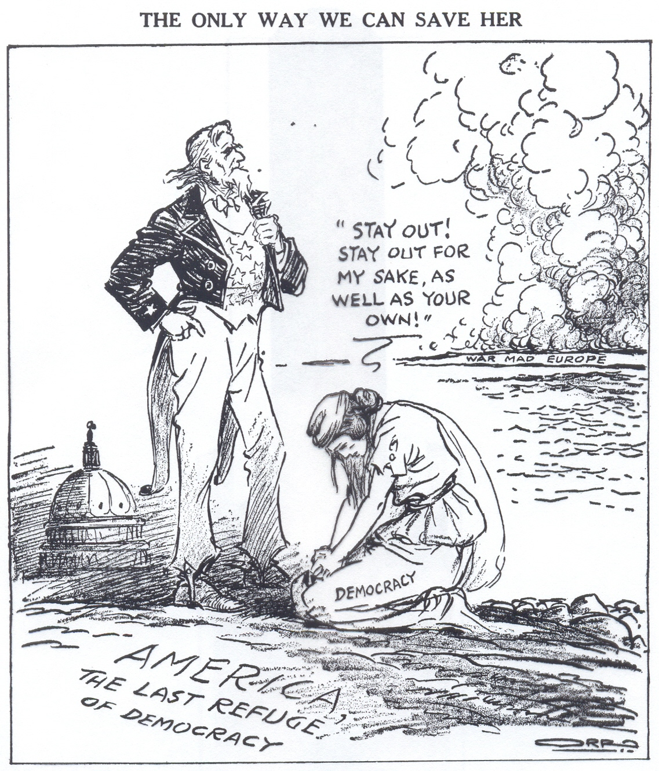
American Isolationism
Motives for Isolationism
Tradition of Neutrality in European Affairs
War would tax economic & human resources
War was Uncivilized & Un-democratic
Ethnic Diversity
  Large Irish & German Populations
Pacifist Movement
  Women
  Socialists

Slide 2
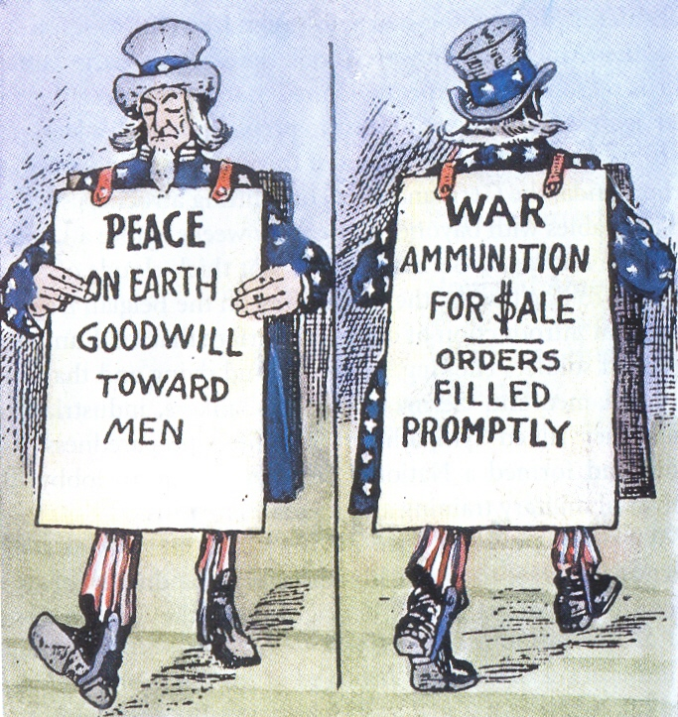
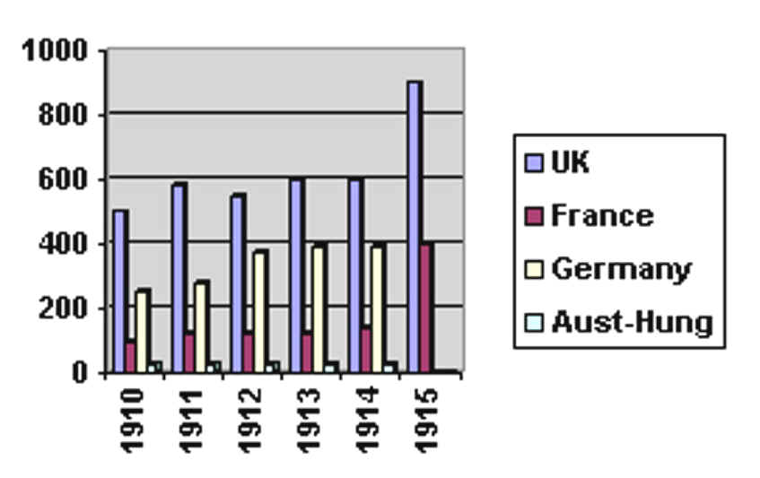
U.S. Entry into World War I
Cause #1: Heavy Trade w/ Allies

Slide 3
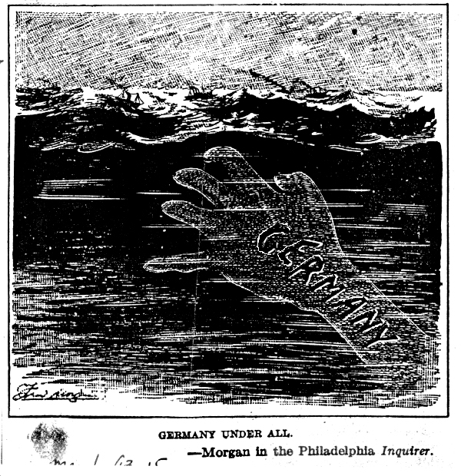
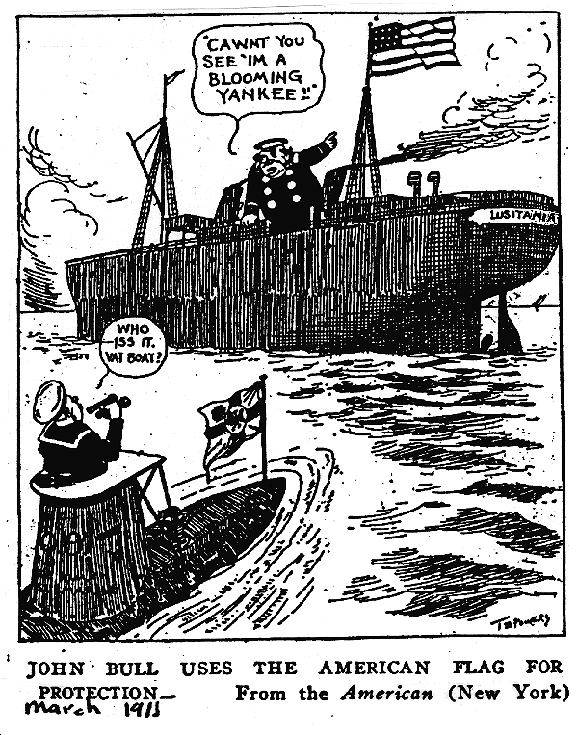
Cause #2: Freedom of the Seas
Un-restricted Submarine Warfare
Sinking of the Lusitania

Slide 4
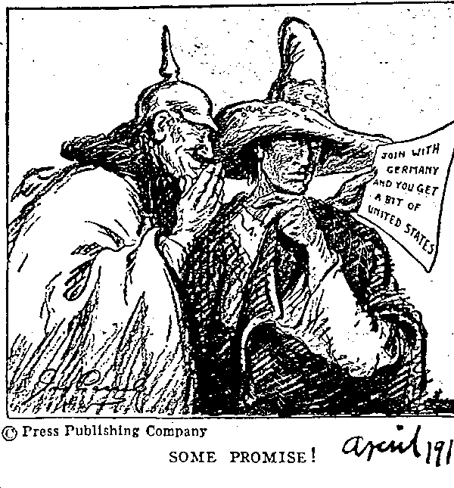
Cause #3: The Zimmerman Note
Germany would support Mexican claims to re-gain American Southwest if Mexico allied w/ Germany

Slide 5
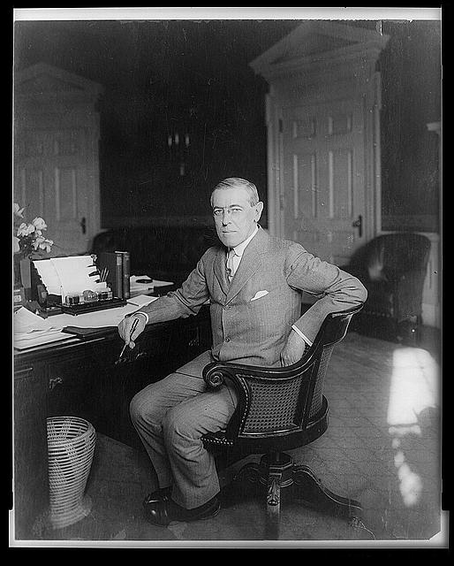
Cause #4: To Make the World Safe for Democracy
“…[T]here can be no assured security for the democratic governments of the world. We are now about the accept gauge of battle with this natural foe to liberty... We are glad, now that we see the facts with no veil of false pretence about them, to fight thus for the ultimate peace of the world and for the liberation of its peoples, the German peoples included: for the rights of nations great and small and the privilege of men everywhere to choose their way of life and of obedience. The world must be made safe for democracy. Its peace must be planted upon the tested foundations of political liberty.” -Woodrow Wilson, 1917

