Slide 1
American Indians and the west 1800’s

Slide 2
Settlers go west
West populated due to railroads
Towns built, markets established, American Ind. pushed out
1862 – 1934 – million and ½ homesteads (federal land) were sold to Americans leading to “land rushes”
1850-1900 – people living west of the Mississippi rose from 1% to 30% of the population of 1850
Homestead Act of 1862: federal government gave land west of the Mississippi to homesteaders who improved the land over a period of 5 years (built a home, grow crops); Issues: severe weather (blizzards, wind, lack water)

Slide 3
Settlers
Oklahoma Land Rush of 1893 – settlers waited for a cannon to boom to quickly claim some of the 6 million acres as a homestead, but less than ½ of the 100,000 would stake a claim. “Sooners” beat “Boomers” to the best land, once settled by the Cherokee
1872 – Yellowstone National Park – preserve some wilderness
1889 – 2 million acres were claimed in one day
Far and Away Land Rush Scene (4:15) https://www.youtube.com/watch?v=-FCH8wGRHGc

Slide 4
Settlers
Farmers - (Minnesota, Dakotas, Nebraska, Kansas) grew from 300,000 to 5 million from 1860 to 1900
Diverse backgrounds – former slaves from the South, immigrants from Canada, Germany, Scandinavia, Great Britain
Great Plains = harsh, droughts, blizzards, treeless, sod houses, isolation, self-sufficiency
IMAGES: https://www.archives.gov/research/american-west#land

Slide 5
Pioneer Women
Women's chores = backbreaking labor (farm, children, manage house, cook, laundry)
Woman from Arizona - "Get up, turn out my chickens, draw a pail of water . . make a fire, put potatoes to cook, brush and sweep half inch of dust off floor, feed three litters of chickens, then mix biscuits, get breakfast, milk, besides work in the house, and this morning had to go half mile after calves."
A Pioneer Woman’s Westward Journey (1849)

Slide 7
Cowboys
The west was more than a farming empire
Cowboys became a symbol of the west finding freedom on the open range
Cowboy, West painting, 1st Homesteader, Family http://www.shmoop.com/the-west/photo-cowboy.html https://www.boundless.com/u-s-history/the-gilded-age-1870-1900/the-transformation-of-the-west/ranchers-cowboys-and-cattle/ http://www.pbs.org/wgbh/americanexperience/features/photo-gallery/billy/

Slide 8
Settlers kahnacademy.org
Exodusters - 1879
1st mass migration of African Americans from the South after the Civil War
Kansas, Colorado, Oklahoma
Compromise of 1877 – federal protections had been removed and violence countered any push for equality (Ku Klux Klan) (Jim Crow laws ruled)

Slide 9
Exodusters waiting on the Mississippi riverbank for passing steamers to give them passage to St. Louis

Slide 10
Turner Thesis gilder lehrman
Frederick Jackson Turner’s “Frontier Thesis” July 12, 1893
Historian Frederick Jackson Turner presented his “frontier thesis” in an address in Chicago, the site of the 1893 World’s Columbian Exposition.
Turner pointed to expansion as the most important factor in American history.
He claimed that “the existence of an area of free land, its continuous recession, and the advance of American settlement westward explain American development.”
The mainstream of the profession has long since discarded Turner's assumption that the frontier is the key to American history as a whole; they point instead to the critical influence of such factors as slavery and the Civil War, immigration, and the development of industrial capitalism.

Slide 11
American Indians (Upfront magazine, Nov. 5 2012)
1492 – 1776 Colonization
When Columbus arrived in North America, 2 million to 15 million Native Americans inhabit the present-day US. Natives will be decimated by small pox and measles brought by Europeans.
1778 Treaties
The Continental Congress and the Delaware tribe of Ohio ally themselves against the British. It’s the 1st of 389 treaties Congress makes with Indians over the next century.
1789 Constitution
The U.S. Constitution states that Indian land may not be seized except in wars authorized by Congress. The pledge is repeatedly violated.
1830 Indian Removal Act
President Andrew Johnson signs a law allowing him to negotiate relocation treaties with Indians east of the Mississippi. Many tribes are forcibly moved west.
1838 Trail of Tears
removing Five Civilized Tribes (Cherokee, Chickasaw, Choctaw, Creek, Seminole)

Slide 12
American Indians
1851 Indian Appropriation Act of 1851 - First Reservations
To make way for western migration of non-Indians, Congress authorizes Indian reservations in the West. By the 1880’s, about 60 have been created.
1865
Over 200,000 Native Americans lived in the Plains following the Civil war
1869 Assimilation
President Grant began and President Hayes abandoned a policy of assimilating Native American Indians – Christian clergy initiated conversions
1864 Sand Creek Massacre
450 Arapaho and Cheyenne men, women, and were killed in Colorado Territory by Col. Chivington’s volunteer forces

Slide 13
American indians
1876 Battle of Little Bighorn
General Custer and 264 troops killed Sioux Indians in Montana Territory
Chief Joseph and Nez Perce captured by army after 1300 mile chase
1884 Elk v Wilkins: Supreme Court agreed with western courts that Indians were not protected by the 14th and 15th Amendments (denying the citizenship and the right to vote)
1887 Dawes Act
Sought to Americanize Native Americans
1890 Wounded Knee
Great Plains Indians resist whites migrating west. The Battle of Wounded Knee is in South Dakota, where up to 300 Lakota Indians are massacred. It is the last clash between the US and Native Americans.
1900 237,000 Native Americans left, Indian Wars officially over
1934 Indian “New Deal”
US Indian Reorganization Act allowed Amer. Ind. To organize and manage their own tribal governments, ending the Dawes Act (land allotments policy)
Today
About 3 million people of Native American or Alaskan descent live in the US. Though casinos generate billions in revenue, most of the people on the 334 reservations in the US face poverty and high unemployment

Slide 14
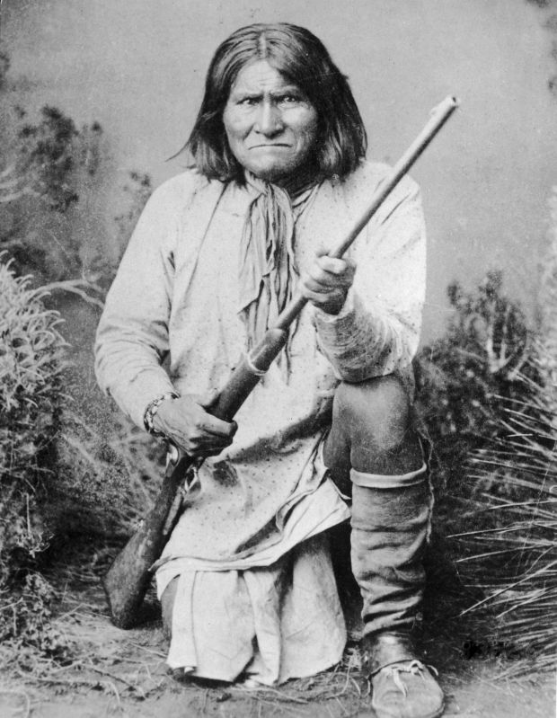
Geronimo (1827 – 1909)
Great Warrior and Apache leader from the Southwest
Father, husband, warrior, medicine man of Apache tribe who lived in the area of Arizona and New Mexico
Conducted raids on settlers in an effort to preserve Apache ways of life and protect their homeland
Buffalo - a staple of survival for Western American Indians, used for food, shelter, and clothing
- Even though Pres. Ulysses Grant proposed a "peace policy" in 1869, warfare targeted the destruction of American Indian Life, army campaigns and hunters reduced the buffalo to near extinction
Discovery Education “Conquest of the West – Geronimo and the Buffalo

Slide 15
Nez Perce & chief joseph
Who: Chief Joseph was born in Wallowa Valley (Oregon), Leader of the peaceful tribe, Nez Perce Birth name, In-mut-too-yah-lat-lat, means "Thunder Rolling Down the Mountain" in English
Where: northeastern Oregon, southeastern Washington, and parts of Idaho.
What:
Chief Joseph’s father negotiated treaties with the U.S. government
Boundaries for the Indians new reservation were agreed upon, although he denied agreeing to some of the terms
Gold was discovered on Indian land and their boundaries were not respected
Their land was drastically decreased to just a portion of land in Idaho. The Indians felt betrayed.
After much resistance by Chief Joseph, in 1877, the United States government began forcefully attempting to move the tribe to a reservation.
Retreat / Surrender:
Avoiding life on a reservation, they traveled 1,170 miles toward Canada, successfully fighting off and escaping the army for 4 months
Surrendering just before reaching Canada as his group of 800 faced starvation and peril
"I am tired. My heart is sick and sad. From where the sun now stands I will fight no more forever."

Slide 16
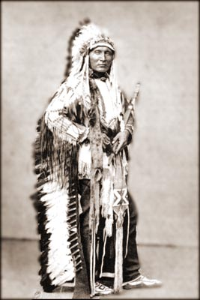
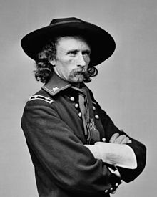
General Custer
Battle of Little Bighorn
Sitting Bull was a leader of the Sioux during the Indian Wars. Image courtesy Library of Congress
Crazy Horse

Slide 17
Battle of little bighorn 1876 Custer’s Last Stand
1854 – 1890 Sioux War series of conflicts between Plains Indians and the US Army
1875 Gold Rush in South Dakota (Black Hills)
causing miners to flood the area, invading the hunting grounds of the Sioux Indians
1876 – 77 Great Sioux Wars – US Army (protect miners) and fought Sioux
PEOPLE:
Colonel George Custer (7th Cavalry led his battalion in an attack on the Sioux at Little Bighorn
Crazy Horse & Sitting Bull – Sioux Leaders
EVENTS: VIDEO: (4:08) Battle of Little Bighorn
Sioux victory over Custer
Custer’s men outnumbered, Sioux great fighters, Custer died
Sioux left Little Bighorn, SD fearing the US army’s retaliation

Slide 18
Dawes act 1887
Tribal lands broken up by the federal government and divided into individual plots
Settlers (American Indians) would gain US citizenship status if they accepted individual plots to farm/settle
Goal: Assimilation into mainstream US society, Removing the Indian Culture/Identity from US society
Resulted in 90 million acres of tribal land being taken from American Indians and then sold to non-natives
Assimilation - Carlisle Boarding School established by the Bureau of Indian Affairs, it was meant to civilize the Indians and make them into the white definition of "American"

Slide 19
Wounded knee (Dec. 29, 1890) Wounded knee creek on lakota pine ridge indian reservation in South dakota
Attempts at assimilation by the federal government and conflicts due to encroachment of settlers led to wars and movements by tribal leaders to reassert Indian sovereignty
Ghost Dance –
a spiritual ceremony that evolved into a movement reflecting a desire for the return of tradition and preached nonviolence
inspired by a shaman (Wovoka - Paiute tribe in Nevada) who had a dream that that Creator would free the world of the white man and return the land back to the natives (along with their buffalo)
Ceremony, characterized by a dance and chanting, spread across the Great Plains and caused fear in white settlers
Sitting Bull helped the Ghost Dance spread to the Sioux people, who was killed 2 weeks prior by police officers who feared he might flee the reservation
EVENTS:
US Army demanded that Sioux surrender their weapons and end their ritual of the Ghost Dance
7th Cavalry opened fire on the Sioux while attempting to disarm them
Local Chief Big Foot was shot in his tent while recovering from pneumonia and others were shot down
300 Men, Women, Children were massacred as they tried to flee the reservation

